Slide 1
Lesson 3 It’s cold in Harbin.
第二课时
接力版 六年级下
八步实验小学 曾娟娟

Slide 2
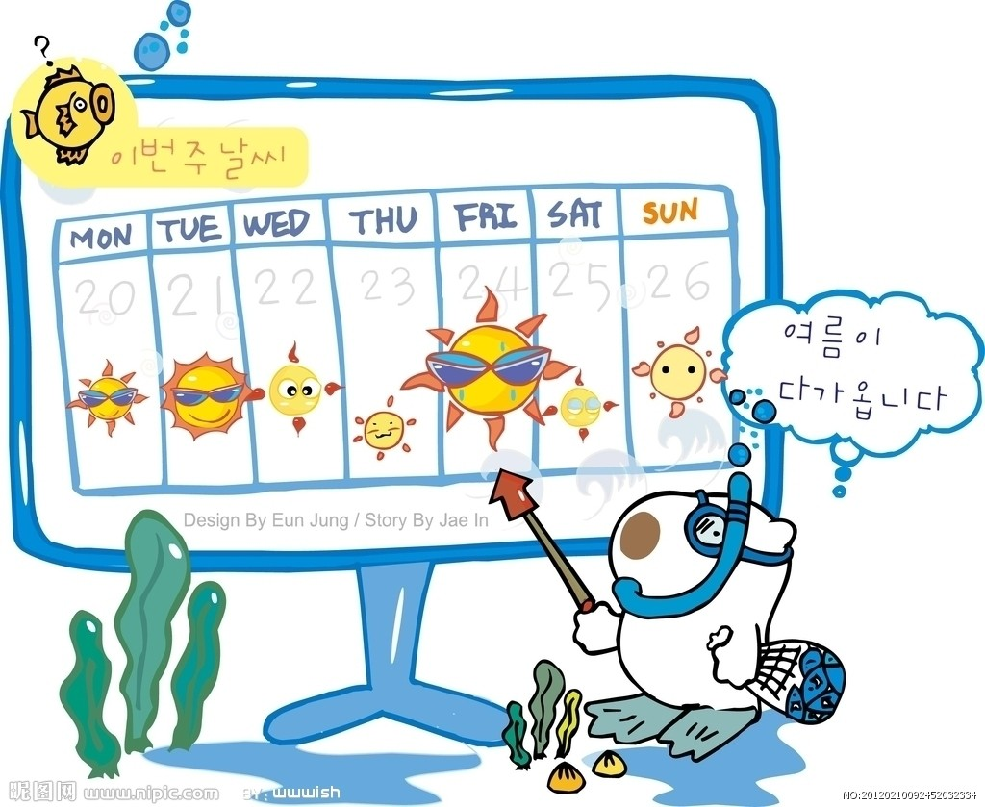
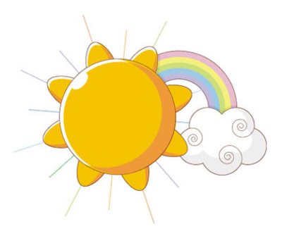
Let's chant
How is the weather?
How is the weather?
It’s a fine day.
How is the weather?
It’s a cloudy day.
How is the weather?
It’s raining.
How is the weather?
It’s snowing.

Slide 3
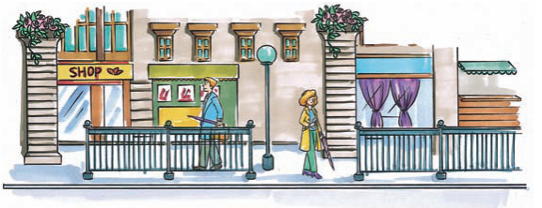
Enjoy reading
Can you guess where is it?
It is London.

Slide 4
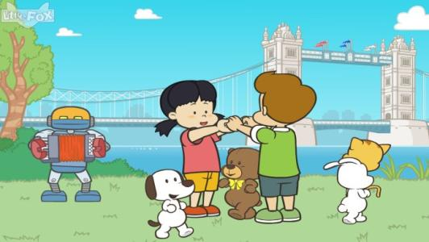
Enjoy reading
In London, it’s not very hot in
summer and not very cold in winter.
But there’s a lot of rain in summer there.

Slide 5
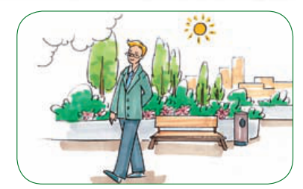
Enjoy reading
It is a sunny day. Mr Smith is walking in a park. He feels happy.

Slide 6
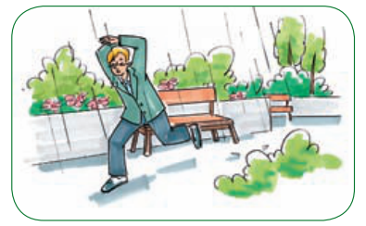
Enjoy reading
Suddenly, it begins to rain.
But he doesn’t bring an umbrella with him.
He feels cold.

Slide 7
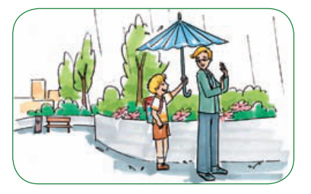
Enjoy reading
“Hi! We can share this umbrella.” A boy is holding an umbrella behind him. Mr Smith feels warm now. He
thanks the boy.

Slide 8
Let's answer
What is the weather like in London?
__________________________________________________________________________________
It’s not very hot in summer and not very cold in winter. There’s a lot of rain in summer there.
What do you think of the boy?
_______________________________________
He is kind, warm-hearted.

Slide 9
Look at the pictures and try to retell the story.
Let's Retell

Slide 10
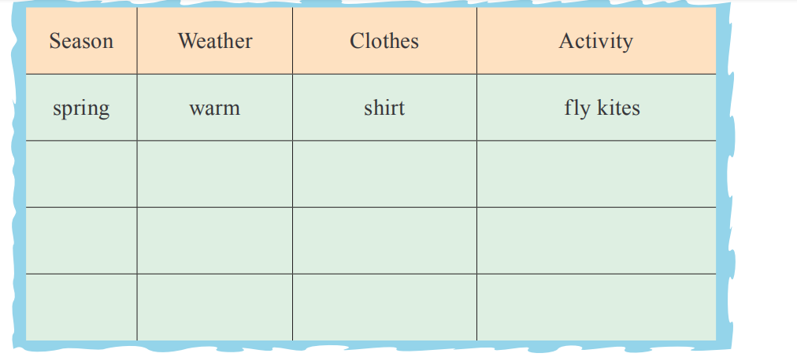
Do a survey
Talk with your partners and try to fill the blanks.

Slide 11
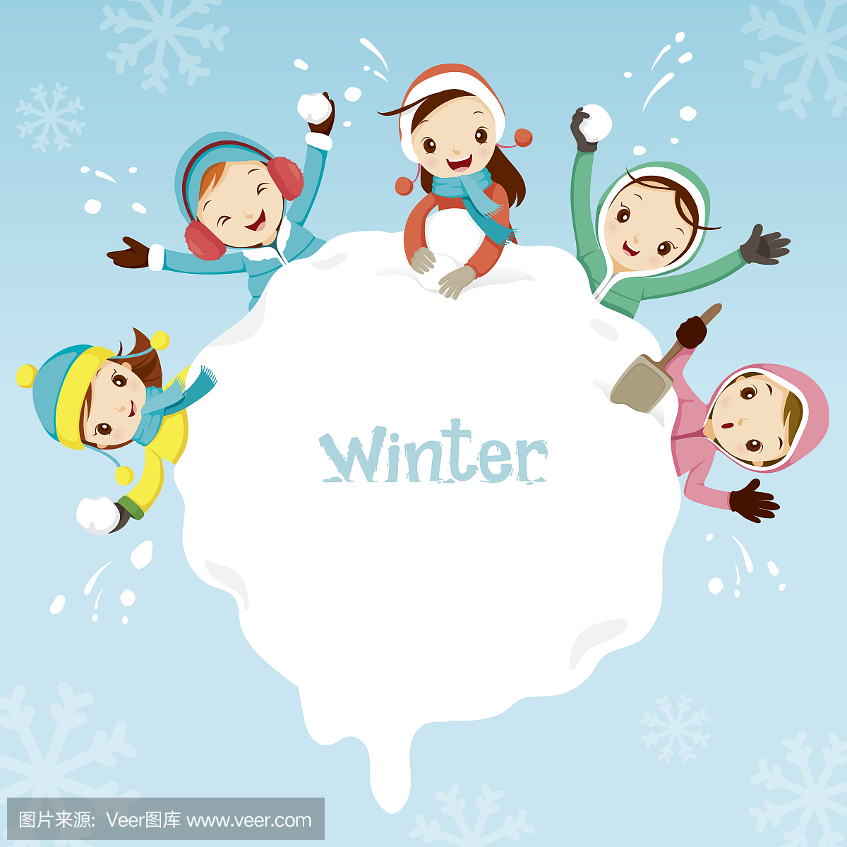
Look and say
In my hometown, it’s cold in winter.
I wear coat.
I often make a snowman with my friends.

Slide 12
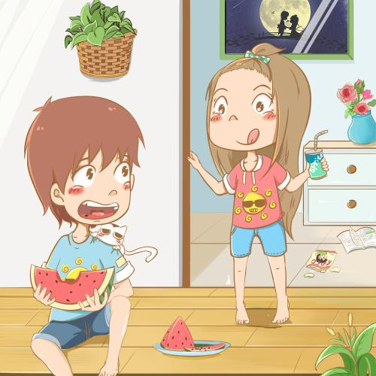
Look and say
In my hometown, it’s hot in summer.
I wear T-shirt and shorts.
I often eat watermelon.

Slide 13
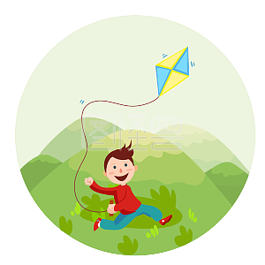
Look and say
In my hometown, it’s warm in spring.
I wear shirt.
I often fly kites.

Slide 14
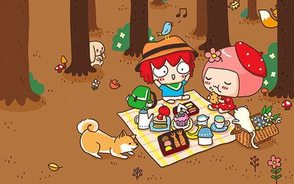
Look and say
In my hometown, it’s cool in autumn.
I wear shirt.
I often have a picnic with my friends.

Slide 15
Pronunciation
Listen to the Words
draw
dress
dr
[drɔ:]
[dres]
[dr]
drink
drive
[drɪŋk]
[draɪv]

Slide 16
Pronunciation
Listen to the Words
train
travel
tr
[treɪn]
[ˈtrævl]
[tr]
try
tree
[traɪ]
[tri:]

Slide 17
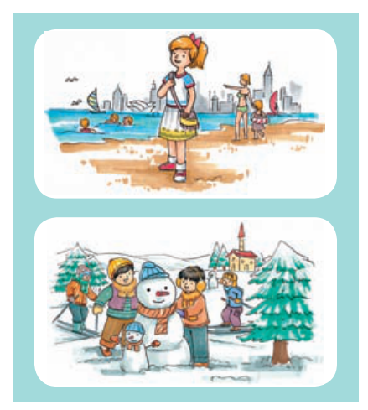
Fill in the blanks
In January, it is hot in Sydney and cold in Harbin.
Sally is in Sydney now. It’s hot there. She _________ a T-shirt. She often _________ in the sea.
Tom is in Harbin. It’s _________ there. He is wearing a coat. He _________ a snowman with his friend.
is wearing
swims
cold
makes

Slide 18
Homework
1. 背诵本课的单词、课文。
2. 总结Unit 3 知识点。
3.完成《Unit 3 Period 2》课后作业。

