Slide 1
Lesson 2 How can we do it?
第一课时
接力版 六年级下
八步实验小学 曾娟娟

Slide 2
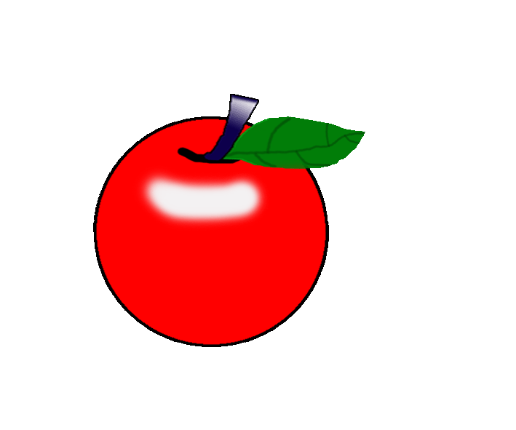
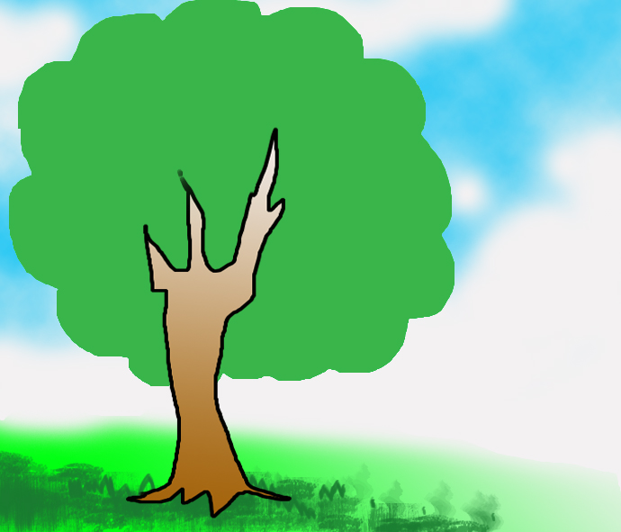
Can you pick apples?
catch
way
easy
study
circle
thing

Slide 3
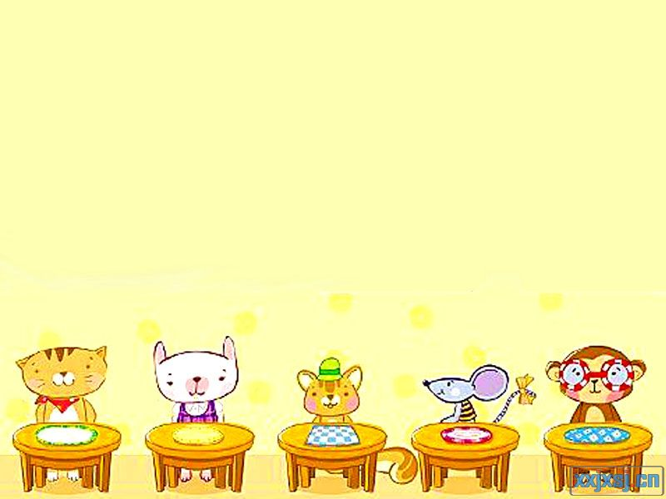
Lead in
What can you do at school?

Slide 4
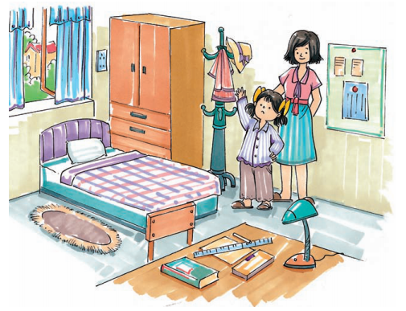
Look listen and answer
What does she want to do?
Ann wants to get the hat.

Slide 5
Listen and think
Ann wants to get the hat, but she’s too short.
How can Ann get the hat?
Ann can get the hat with a chair.

Slide 6
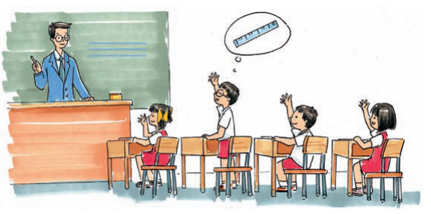
Look and guess
What are they doing?

Slide 7
Listen and repeat
Mr Liu: Boys and girls, how can we draw a line?
Peter: We can draw it with a ruler.
Mr Liu: Yes. But we don’t have a ruler. How can we do it?
Ann: Can we draw it with a book?
Mr Liu: Yes, we can.
John: We can draw it with a card.
Lingling: We can also draw it with a pencil-box.
Mr Liu: Great! We can draw a line with many things.
How many ways are there to draw a line?

Slide 8
Think and answer
1. How many ways are there to draw a line?
_____________________________________
2. What are these ways?
_____________________________________
_____________________________________
_____________________________________
_____________________________________
There are 4 ways to draw a line.
We can draw it with a ruler.
We can draw it with a book.
We can draw it with a card.
We can draw it with a pencil-box.

Slide 9
Role play
Show time
4人一组，分角色表演对话

Slide 10
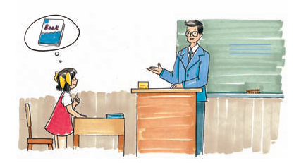
Look and say
A: How can we draw a line?
B: We can draw it with a ruler.
A: Can we draw it with a book?
B: Yes. We can also draw it with a card.

Slide 11
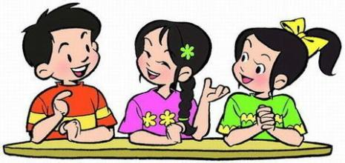
Let's talk
Can we draw a line with a notebook/bottle…?
No, we can't.
Yes, we can.

Slide 12
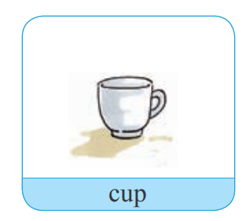
Practice
How can we draw a circle?
We can draw a circle with a cup.

Slide 13
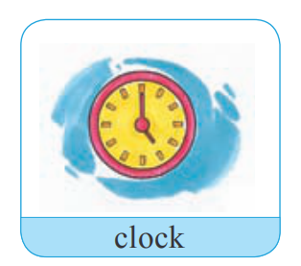
Practice
How can we draw a circle?
We can draw a circle with a clock.

Slide 14
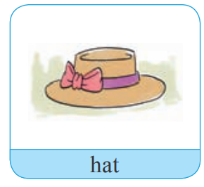
Practice
How can we draw a circle?
We can draw a circle with a hat.

Slide 15
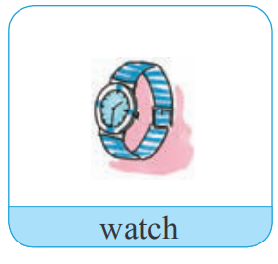
Practice
How can we draw a circle?
We can draw a circle with a watch.

Slide 16
Summary
How can we draw a circle?
我们可以怎么画一个圆？
We can draw a circle with a/an ...
我们可以用一个……。
Can we draw a circle with a/an ...?
我们可以用一个……画一个圆吗？

Slide 17
Homework
1. 背诵本课的生词。
2. 在会写的基础上正确朗读本课对话。
3.完成本课的课后作业。

