Slide 1
空白演示
Unit 1 He is wearing a blue T-shirt
第一课时
接力版 六年级下
在此输入您的封面副标题
八步实验小学 曾娟娟

Slide 2
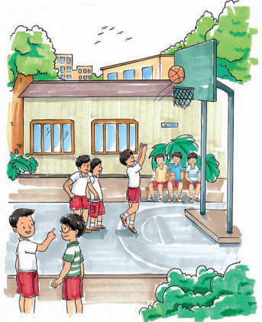
Look listen and answer
What are they doing?
Peter and Jack are looking for John, they are going to play basketball.

Slide 3
Listen and answer
What do we know about John?
He is tall and strong.
He is wearing a blue T-shirt. And he's holding a basketball.
He likes playing basketball.

Slide 4
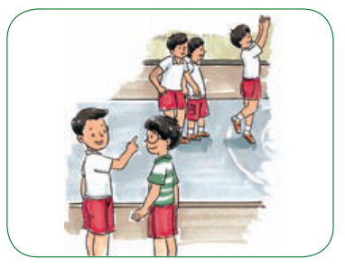
Listen and repeat
Jack: Look at that boy! Is it John?
Peter: Which one?
Jack: The tall and thin boy.
Peter: No. That is Tom. John is tall and strong.
Who is Tom?

Slide 5
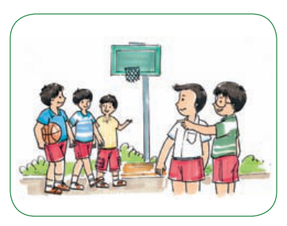
Is John wearing a blue and white T-shirt?
Listen and repeat
Peter: Look! John is over there. He's talking with his friends.
Jack: Is he wearing a blue and white T-shirt?
Peter: No. He is wearing a blue T-shirt. And he's holding a basketball.
Jack: Oh! He's cool!

Slide 6
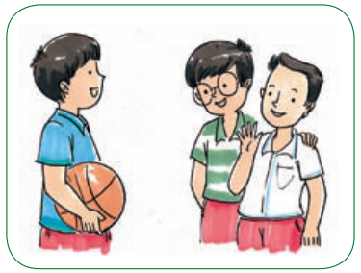
Listen and repeat
Peter: John, this is my cousin, Jack.
John: Nice to meet you, Jack.
Jack: Nice to meet you, too.
Peter: Jack likes playing basketball, too.
John: Great! Let's go and play.
What are they going to do then?
They are going to play basketball.

Slide 7
Practice
True or False
( ) 1. John is looking for Peter.
( ) 2. They see Tom at first.
( ) 3. John is strong and tall.
( ) 4. John is wearing a blue and white T-shirt.
( ) 5. Jack is John's cousin.
F
T
T
F
F

Slide 8
Practice
I can complete.
Peter and Jack ______________ John, they are going to ______________. Tom is ____________. John is ____________. John ________ with his friends. He ___________ a blue T-shirt and he's holding ____________. he likes playing ____________ too.
are looking for
play basketball
tall and thin
tall and strong
is talking
is wearing
a basketball
basketball

Slide 9
Role play
4人一组，分角色表演对话
请注意表情语音语调。

Slide 10
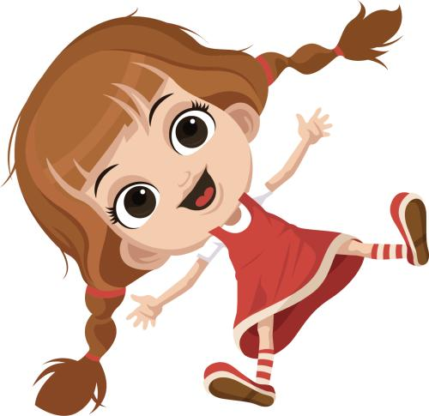
Practice
Yes, she is wearing a red dress.
Is she wearing a red dress?

Slide 11
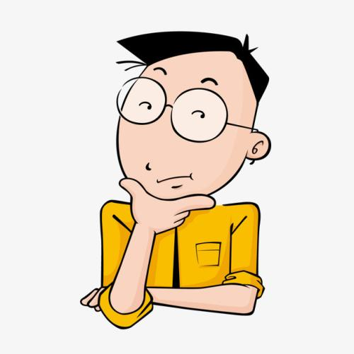
No, he is wearing a yellow shirt.
Is he wearing a green T-shirt?

Slide 12
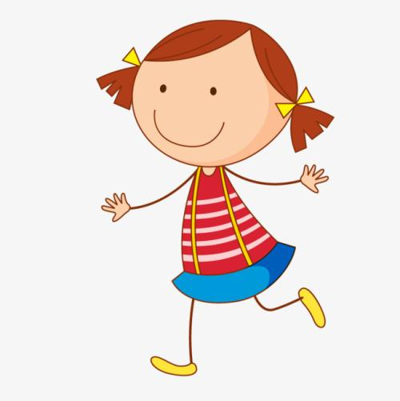
Practice
Is she wearing a red and black T-shirt?
No, she is wearing a red and white T-shirt.

Slide 13
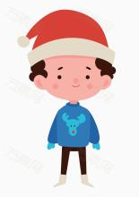
Practice
No, he is wearing a blue sweater.
Is he wearing a blue sweater?

Slide 14
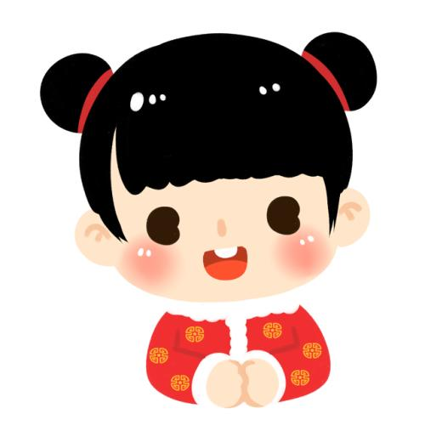
Practice
No, she is wearing a red coat.
Is she wearing a grey coat?

Slide 15
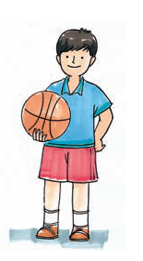
Look and say
体型：
John is tall and strong.
John
穿着：
He's wearing a blue T-shirt.
配饰：
He's holding a basketball.

Slide 16
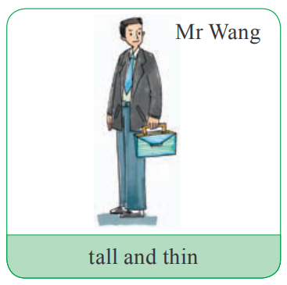
Look and practise
体型：
Mr Wang is tall and thin.
穿着：
He's wearing a black coat.
配饰：
He's holding a box.

Slide 17
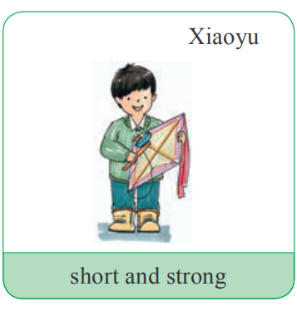
Look and practise
Xiaoyu
体型：
Xiaoyu is short and strong.
穿着：
He's wearing a green sweater.
配饰：
He's holding a kite.

Slide 18
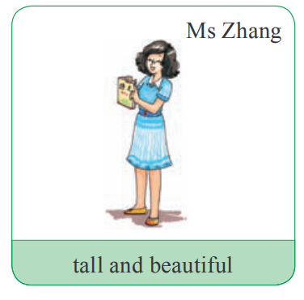
Look and practise
Ms Zhang
Ms Zhang is tall and beautiful.
She's wearing a blue dress.
She's holding a Chinese book.

Slide 19
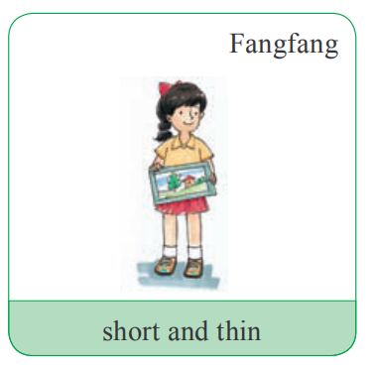
Look and practise
Fangfang is short and thin.
She's wearing a yellow T-shirt and a red skirt.
She's holding a picture.

Slide 20
Summary
He is tall and strong.
他又高又壮。
He is wearing a ...
他穿着……
He is holding a/an ...
他拿着一个……。

Slide 21
Homework
1. 背诵本课的生词。
2. 在会写的基础上正确朗读本课对话。
3.完成本课的课后作业。

