Slide 1
Lesson 1 He is wearing a blue T-shirt
The second period
接力版 六年级下
八步实验小学曾娟娟

Slide 2
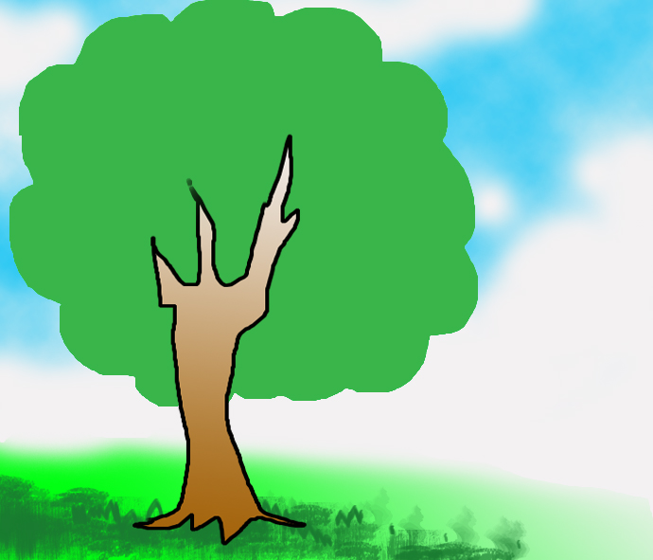
Review the words
T -shirt
cousin
hold
thin
which
tall
Ms

Slide 3
Practice
Review the essay
tall
John is a _______ and strong boy. He likes __________ basketball. Look! He __________ a blue T-shirt. And he is holding a ________ in his hand. Now, he is talking with Peter and Jack. They are going to ____ basketball. Is he cool?
playing
is wearing
basketball
play

Slide 4
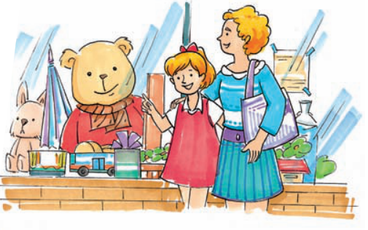
Enjoy reading
Where are they?
They are in the toy shop.

Slide 5
Let's read
New home
Yesterday, Sally saw a toy bear in the toy shop. “Mum, I like that bear. It’s wearing a beautiful red coat. Can I have it for my birthday?” asked Sally. “But your birthday is in October,” said mum. “Please! I like it very much,” said Sally.
Q:What does the toy bear look like?

Slide 6
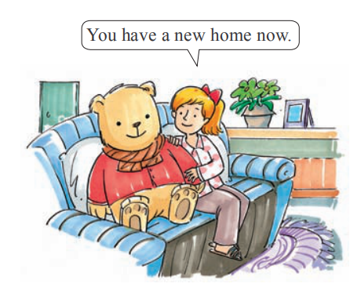
Let's read
You have a new home now.
Sally’s mother bought the toy bear for her. Sally was very happy. She played with the toy bear at home. “You have a new home now, dear! Are you happy?” Sally said to the toy bear.

Slide 7
Let's answer
What did Sally want?
______________________________
She wanted a toy bear.
What did Sally say to the toy bear?
_______________________________________
You have a new home now, dear! Are you happy?

Slide 8
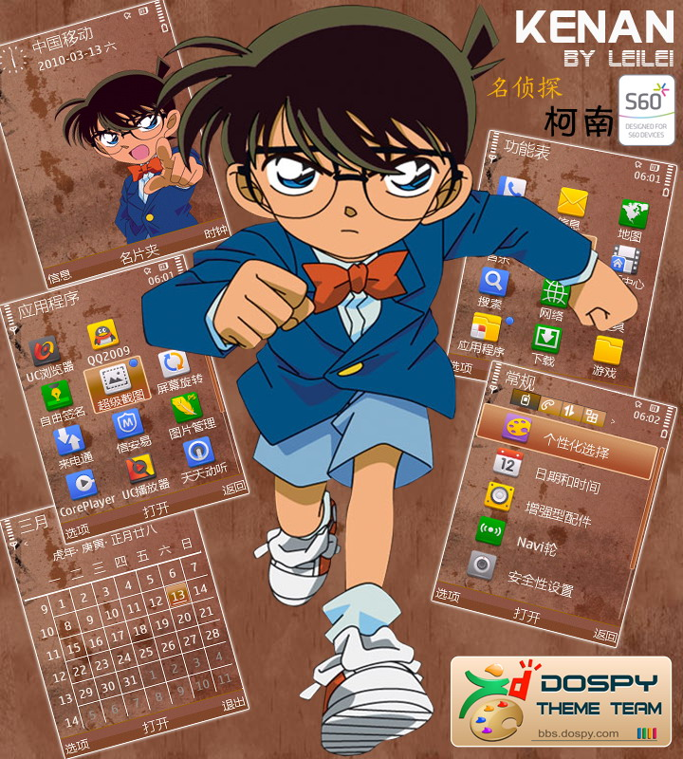
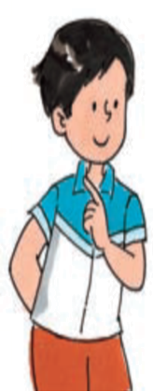
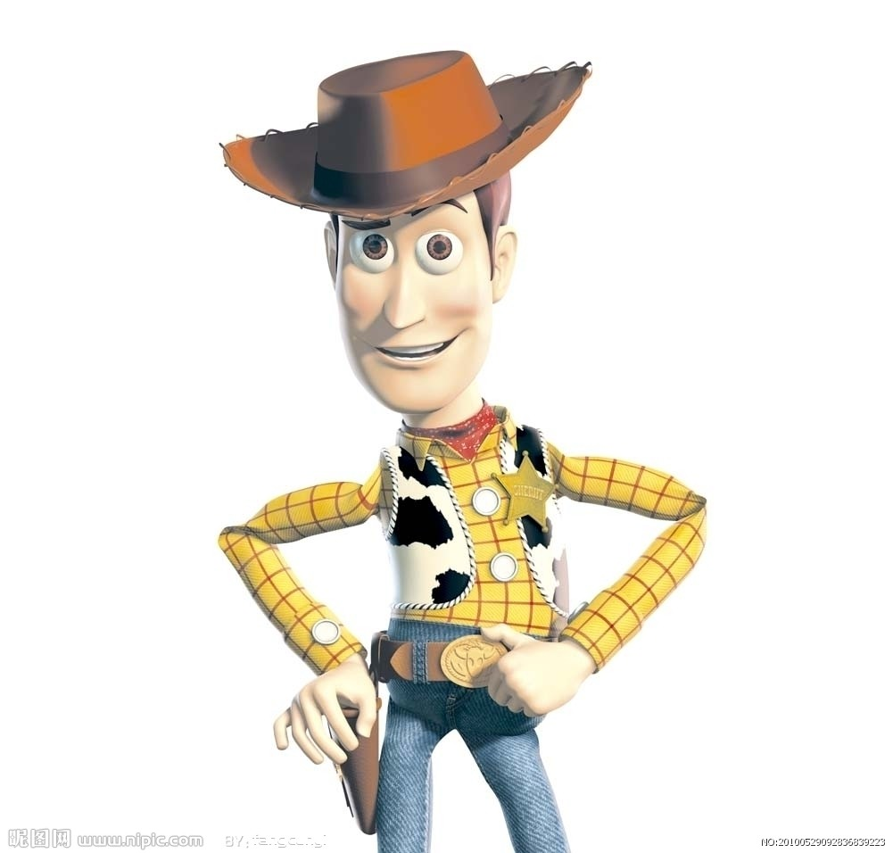
I can guess
Rules:
1.先观察这些人物的特征。
2.然后以提问的方式找出谈论的是谁。

Slide 9
I can guess
He is a boy.
Tom
Is he tall?
Yes, he is .
Is he fat?
No, he is not fat .
Is he wearing a blue and white T -shirt?
Yes, he is.

Slide 10
I can guess
He is a man .
Woody
Is he tall?
Yes,he is.
Is he fat?
No,he isn't.
Is he wearing a blue shirt?
No, he is wearing a yellow shirt.

Slide 11
I can guess
He is a boy.
Is he short?
Yes, he is short.
Is he thin?
Yes, he is thin.
Is he wearing a blue suit?
Yes, he is.

Slide 12
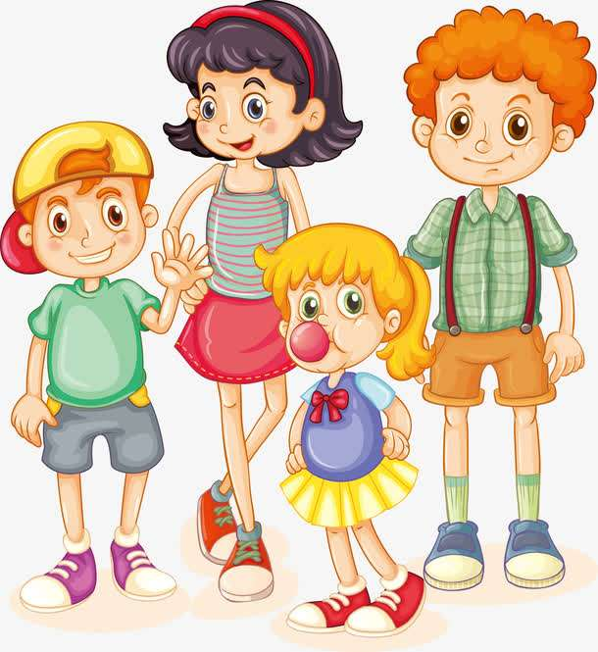
I can find
Who is she?
She is tall.
She is thin.
She is wearing a red skirt.
Her hair is black.

Slide 13
I can find
Who is he?
He is strong.
He is fat.
He is wearing a green T-shirt and a blue shorts.
His hair is orange.

Slide 14
Play a game
Said features, guess who in the description of the class.
说特征，猜猜在描述班里的谁。

Slide 15
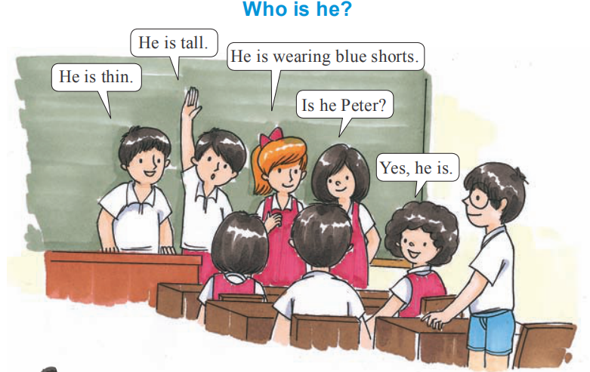
Who is he?
Play a game
.

Slide 16
Pronunciation
child
China
ch
[tʃaɪld]
['tʃaɪnə]
[tʃ]
lunch
much
[mʌtʃ]
[lʌntʃ]

Slide 17
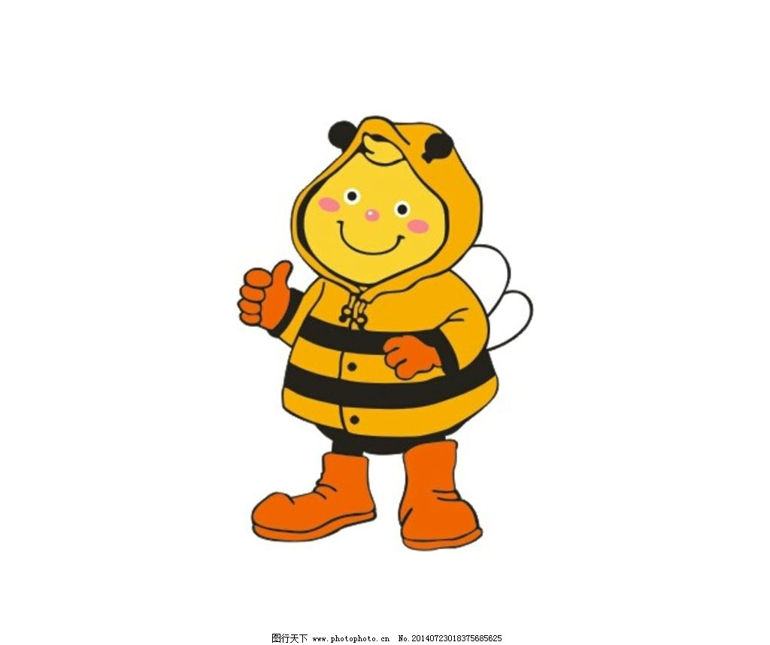
Pronunciation
Listen to the Words
shop
shirt
sh
[ʃɒp]
[ʃɜ:t]
[ʃ]
wash
fish
[wɒʃ]
[fɪʃ]

Slide 18
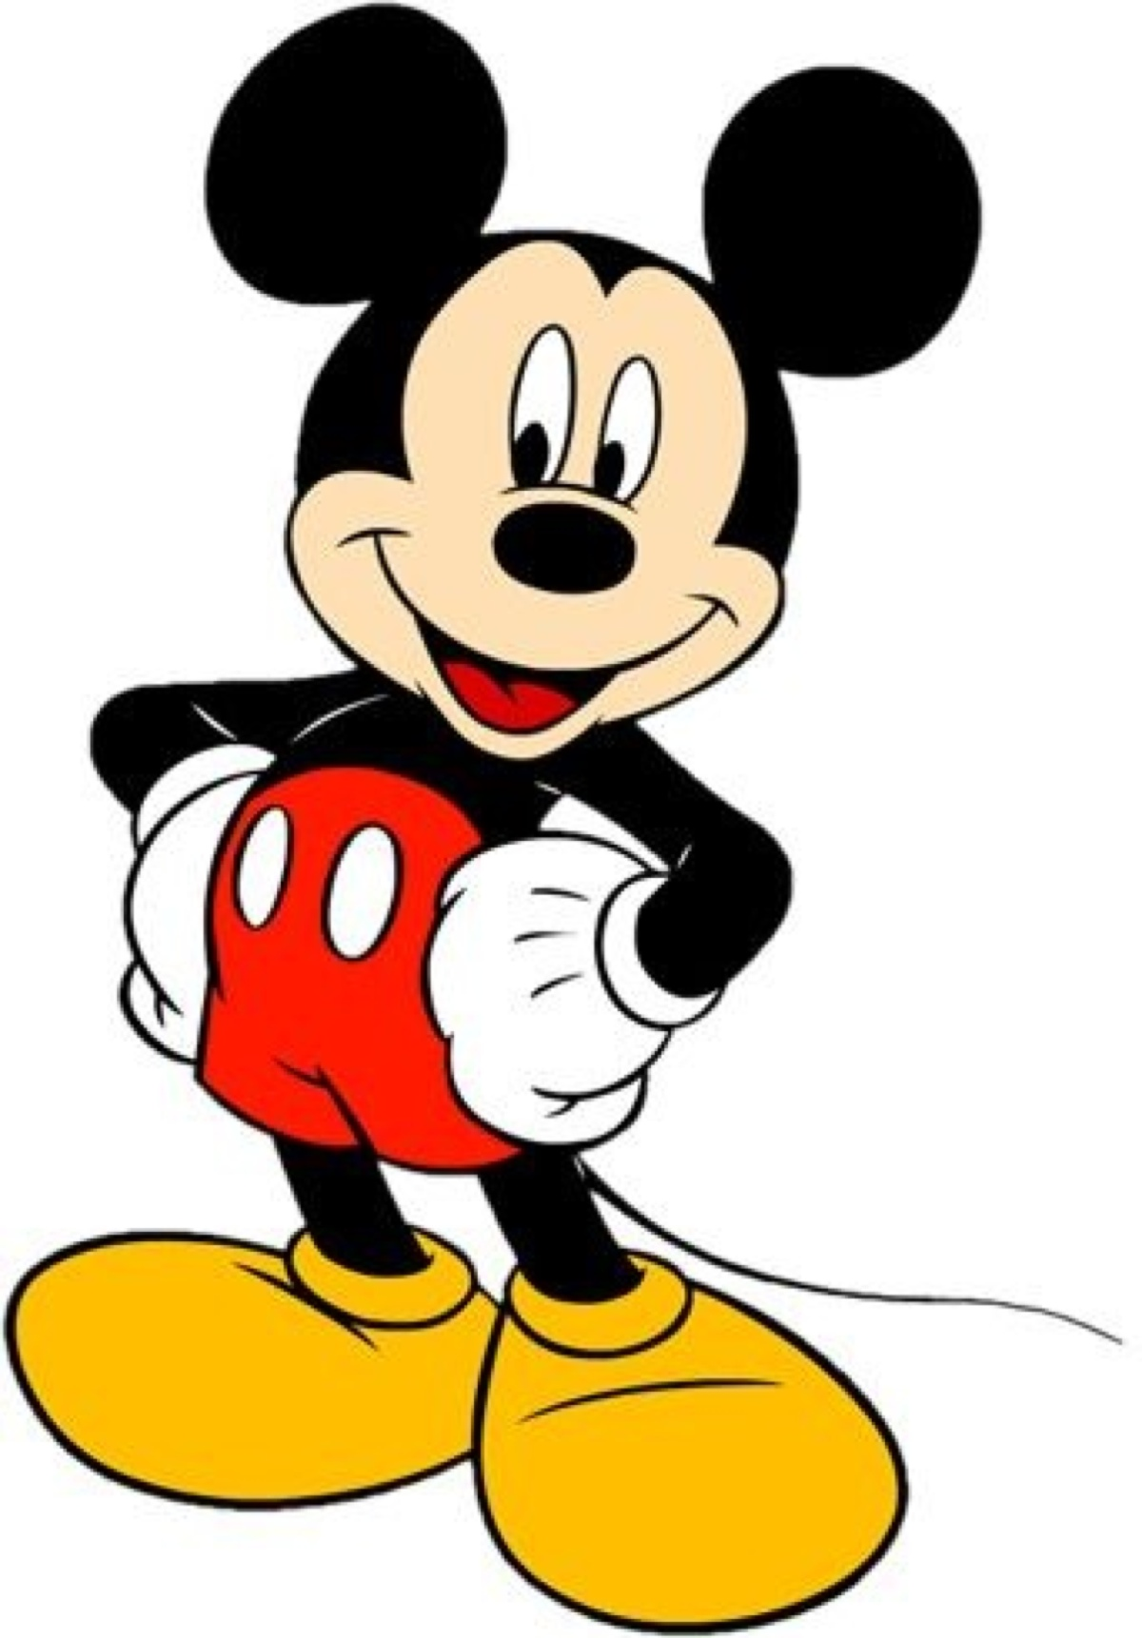
Homework
1. 背诵本课的单词、课文。
2.完成本课后作业。
3.预习Unit 2:
熟读Period 1的课文、单词。

