Slide 1
Lesson 8 It's time to say goodbye.
Period 2 Enjoy reading
新兴二路小学 林栩伊

Slide 3
Read it out
以下的动词以及过去式是本节课我们将会出现的，请同学们大声跟我读。
is
was
were
are
是
是
become
have
became
had
有
成为
feel
felt
help
helped
感觉
帮助

Slide 4
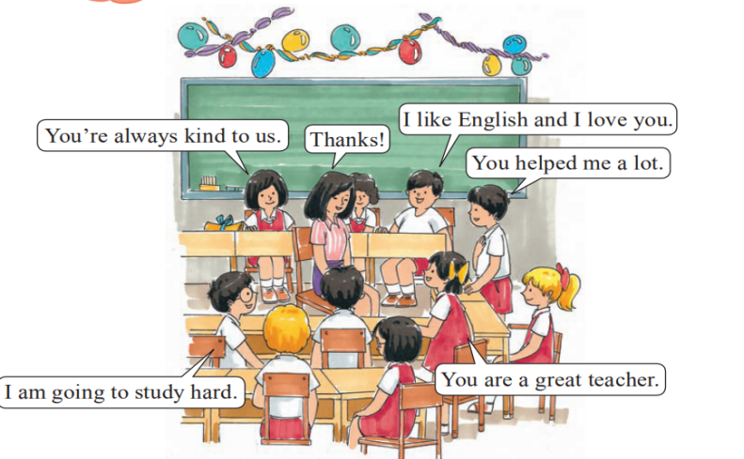
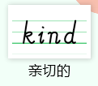
Listen and choose
听音选句子
They are having a farewell party. What are they talking about?
他们正在举行告别晚会， 他们在谈论什么呢？
Lingling
Kim
Peter
Miss Wang
Tom
Ann

Slide 5
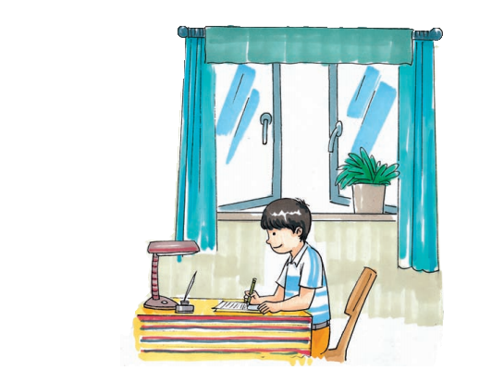
Look and say
What is John doing?
He is writing a letter.

Slide 6
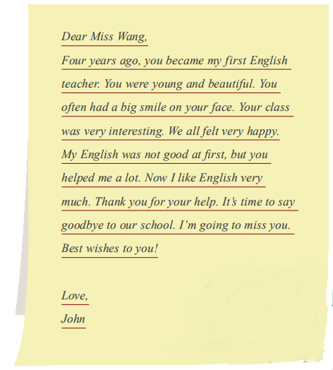
John's letter

Slide 7
Think and say
英文书信的格式:
1.称呼后面是逗号。
2.开头不用空格
3.落款在左下角。
Yours,
xxx
Sincerely,
xxx

Slide 8
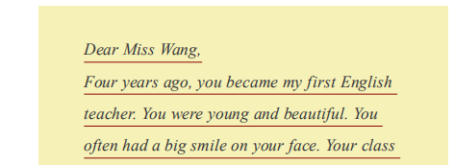
Listen and circle
听音圈出答案
Part 1
1. Who did John write to?
John写信给谁？
2. What does she teach?
她教什么科目的？
3. What was she like then?
她那时长什么样的？

Slide 9
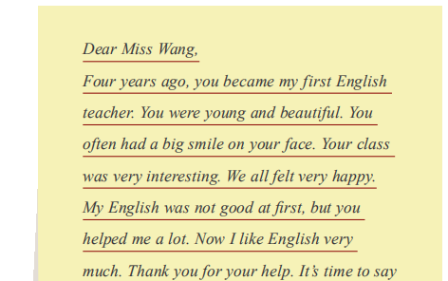
Read and judge
1分钟细心阅读
Part 2
读第二部分,判断以下句子正T误 F
T
( )1. Miss Wang's class was very interesting.
F
( )2. John's English was good at first.
T
( )3. Miss Wang helped John a lot.

Slide 10
Read and fill
读第三部分,填上空缺的单词
1.阅读第三部分，
2.用笔记本写下你的答案。
3.时间1分钟。
Part 3
1
2
3
Thank you for your help..
It's time to say goodbye..
结束语&
感谢祝福语
4
I'm going to miss you..
Best wishes to you!.

Slide 11
Listen and imitate

Slide 12
c
Fun to read aloud
It's time to say goodbye
Thank you for your help.
I'm going to miss you!
You helped me a lot
We all felt happy.
Your class was very interesting.
You were young and beautiful.
Best wishes to you!

Slide 13
Retell the letter
1.拿出笔记本写下你的答案。
2.时间1分钟。
复述这封信
Five years ago,Miss Wang John's first English teacher. She was and .She often a big smile on her face. Her class was very . They all very happy. John's English good at first,but Miss Wang him a lot. Now he like English very much.
was
beautiful
had
young
interesting
felt
was
not
helped

Slide 14
Think and write
你们也即将毕业了，将要你们的老师和学校说再见了，你们想跟老师说些什么呢？想一想，写一封信给你的老师。
提示：1.注意英文书信格式。
2.要有结束语以及感谢语。
3.可参考模仿John的信。

Slide 15
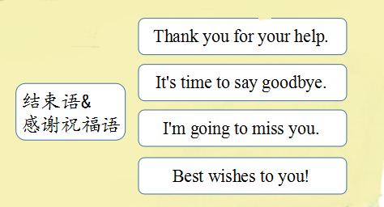
Summary
1.
2.

Slide 16
Homework
1. 朗读Enjoy reading三次。
2. 用英文给老师写一封信。

