Slide 1
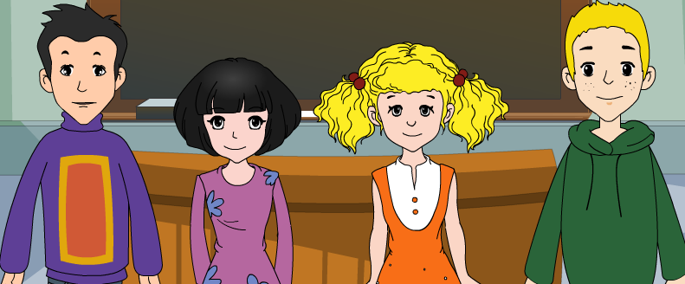
外研八年级（下） 授课教师 杨晔

Slide 2
Module
9
Friendship
Unit 2
I believe that the world is what you think it is.

Slide 3
Let's review
一、根据句意和汉语提示写单词。
explain
When he comes here. I'll ________ (解释)
to him myself.
2. What an awful way to ______ (对待) a friend like this!
3. He expects me to stay on here and I can hardly _______ (拒绝 ).
treat
refuse

Slide 4
4. My father is a _________ (耐心的）man.
5. We’ll go around the room, and each of you can __________ ( 介绍 ) yourself.
patient
introduce
二、翻译句子。
1. 我不后悔告诉她我的想法。 ___________________________________
2. 请把这个问题给我讲解一下。____________________________________
I don’t regret telling her my idea.
Please explain this problem to me.

Slide 5
Teaching aims
1. Teaching aims:
To understand the sequence of events and the behavior of characters
To be able to guess the meaning of new words from the context

Slide 6
2. Main contents:
Key vocabulary
lonely; silence, bright, treasure, day by day,
trust, include, circle, suggestion
Key structures
I did not know who she was.
I asked her why she smiled at me that day.
She said she could not remember.
Now I believe that the world is what you think it is.

Slide 7
Warming up

Slide 8
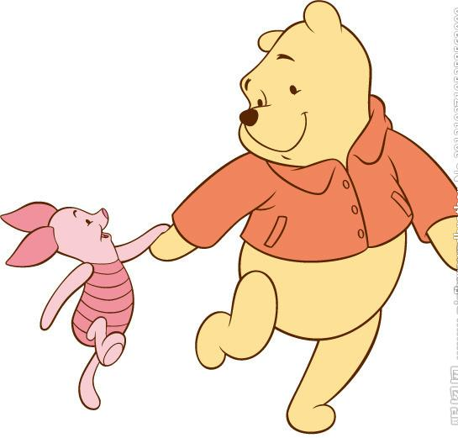
Think about it!
Do you think what a good
friend should be like?
Do you know any stories
about great friendship?

Slide 9
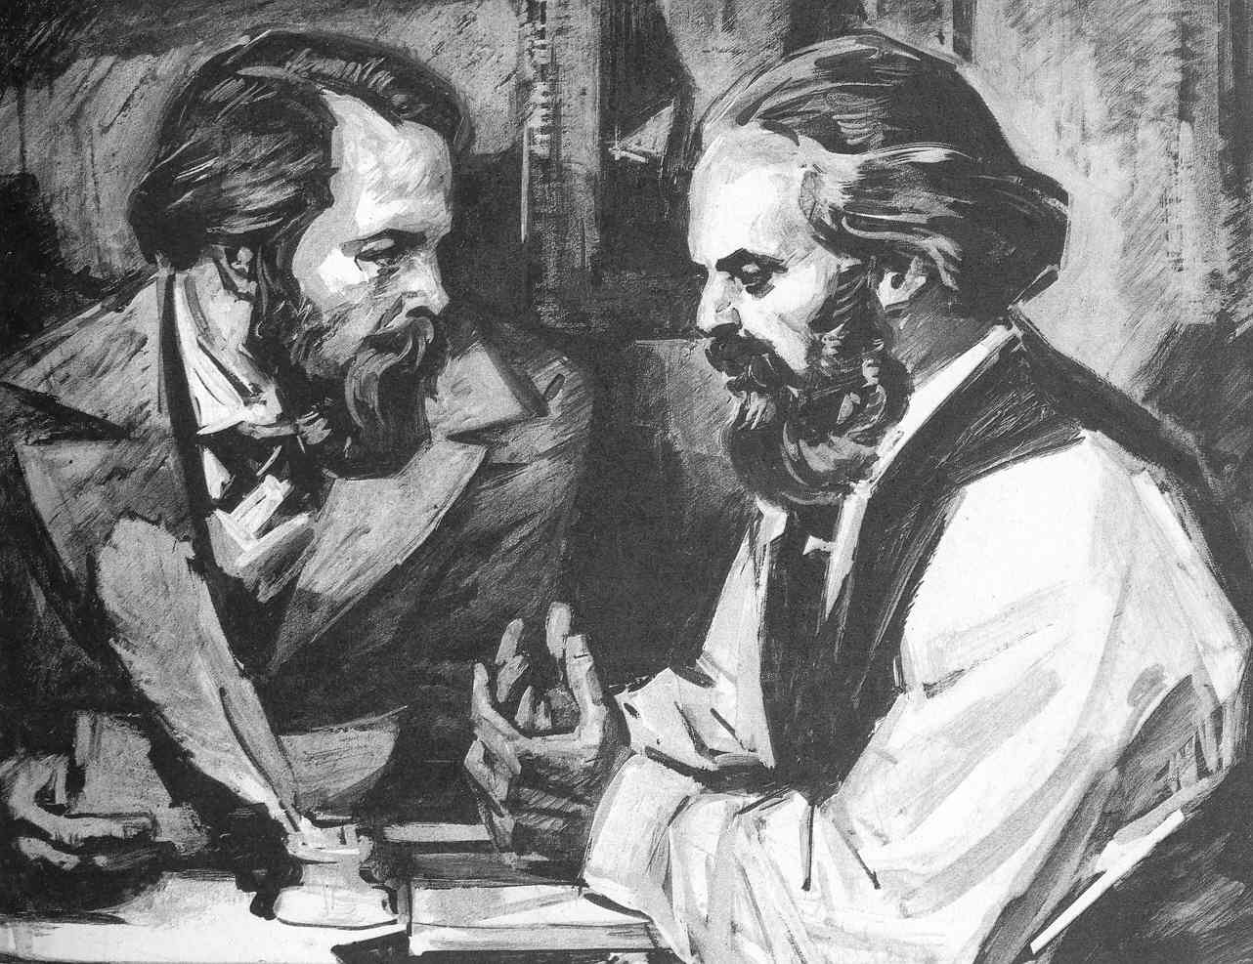
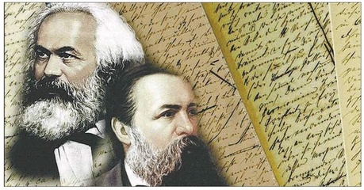
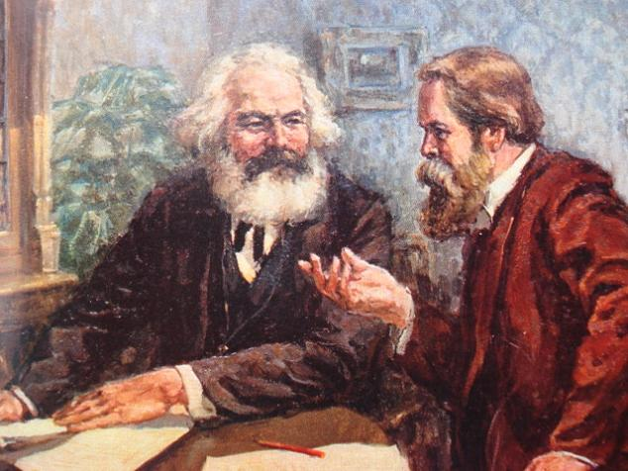
马克思和恩格斯
Marx and Engels

Slide 10
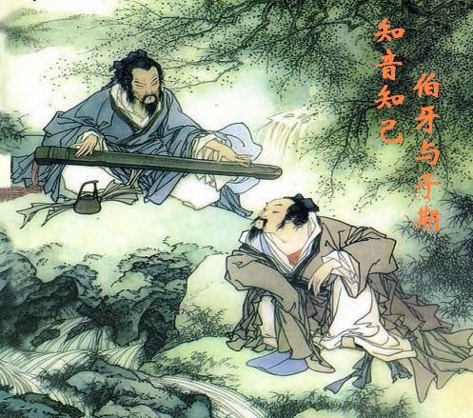
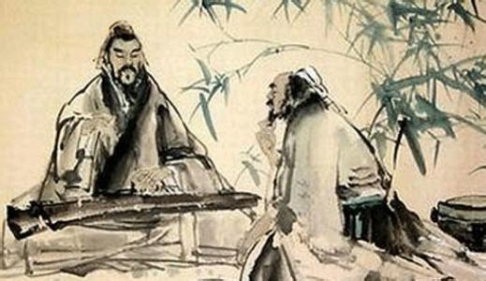
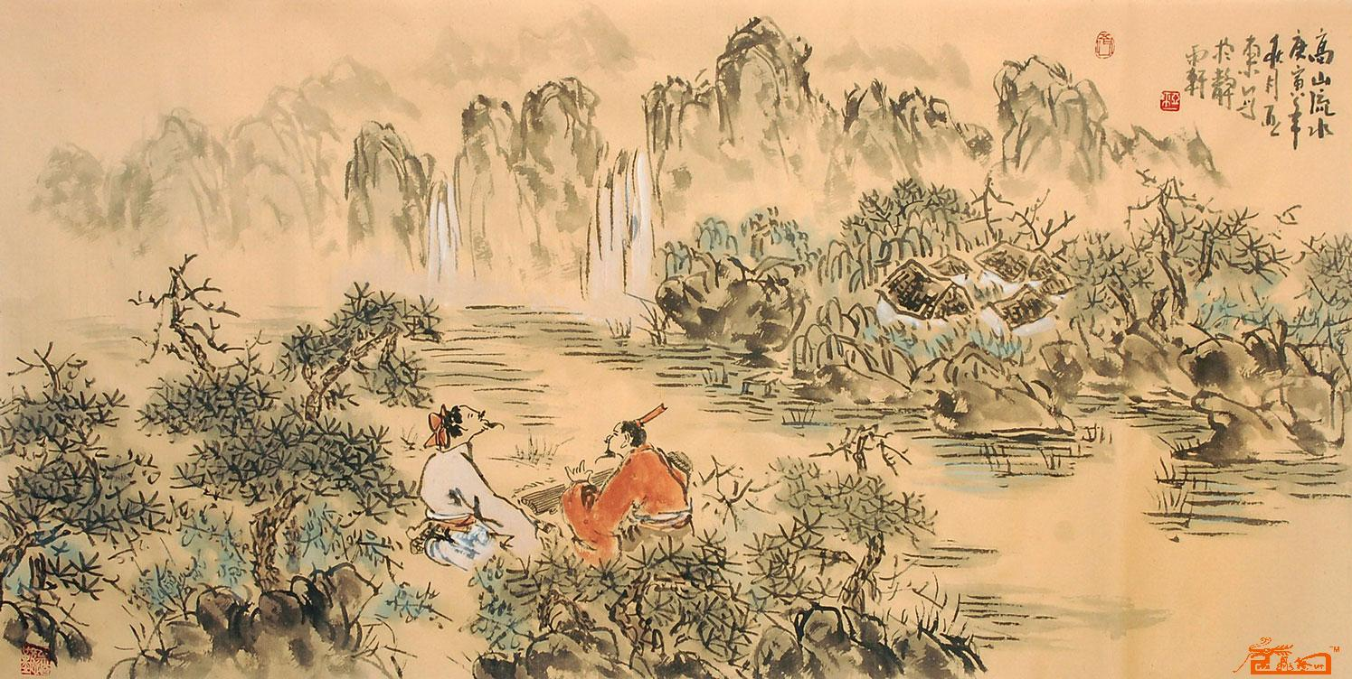
知音之交
Bosom friends
（伯牙子期）

Slide 11
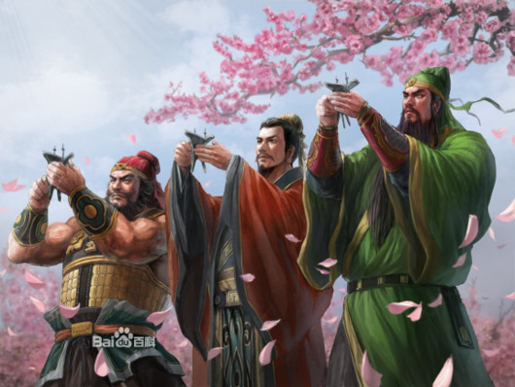
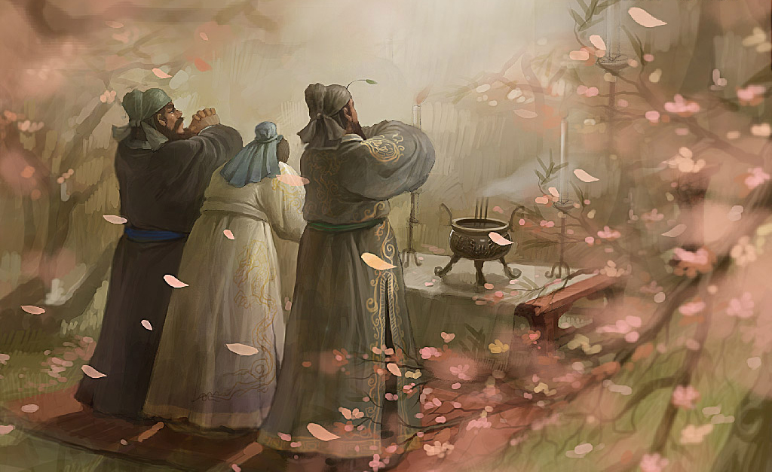
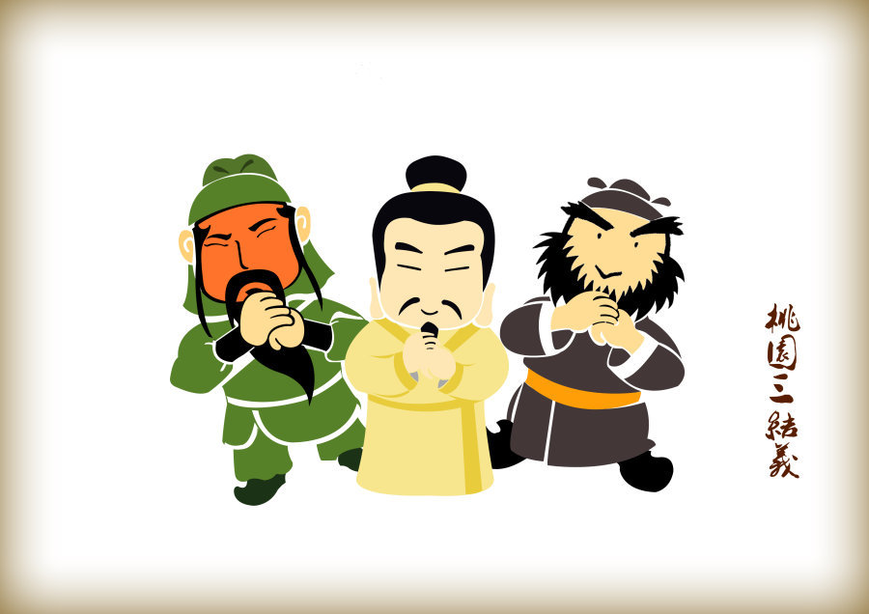
生死之交
Sworn brothers (刘备、关羽、张飞)

Slide 12
诗歌欣赏 A poem
Friendship/ is no/ common weed That/ grows along/ the way. It’s /highly cultivated And/ watered/ day by day.
友谊不是长在路边的寻常之草。
它是我们一天天悉心浇灌的珍宝。
Notes:
导入二

Slide 13
谚语proverb
A friend in need is a friend indeed.
A faithful friend is hard to find.
Make your enemy your friend.
A friend is a second self.
A good friend is my nearest relation.
A life without a friend is a life without a sun.

Slide 14
Reading and vocabulary

Slide 15
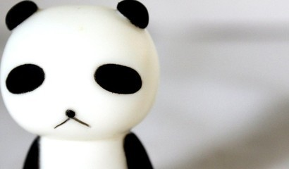
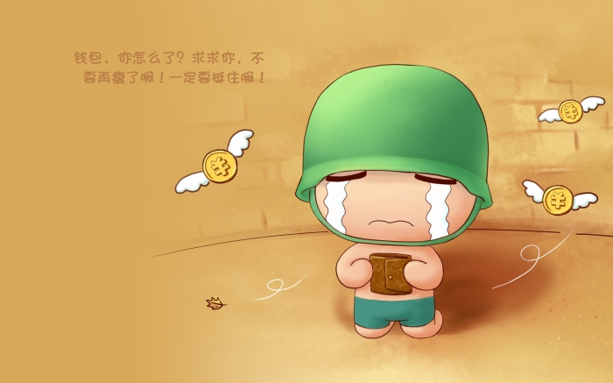
1. Work in pairs and answer the questions.
1. When was the last time you felt sad?
2. Who did you tell that you were sad?
3. What did you do to feel better?
4. How can you make other people feel happy?

Slide 16
Learning to learn
When you read a story, focus on the
five wh-questions:
Who is the main character?
What happens?
When does the main event or story
take place?
Where does it take place?
Why?

Slide 17
Watch and read
见视频Module 9 Unit 2 Activity 2

Slide 18
2. Read the passage and answer the questions.
A beautiful smile
By Zhang Bei
When I was thirteen years old, a girl gave me an important gift. It was a smile.
It was the early autumn of my first year at a new school. No one knew me. I was very lonely, and afraid to make friends with anyone.

Slide 19
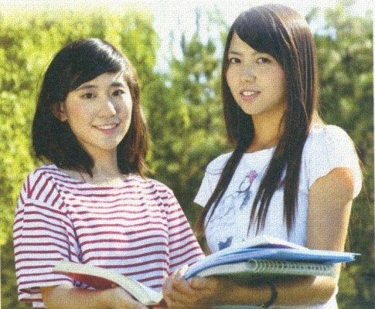
Every time I heard the other students talking and laughing, I felt even more lonely. I could not talk to anyone about my problem, and I did not want my parents to worry about me.
One day, my classmates were talking with their friends, but I sat in silence. At that moment, a girl entered the classroom. I did not know who she was.

Slide 20
She passed me and then turned back. She looked at me and, without a word, smiled.
Suddenly, I felt the touch of something bright and friendly. It made me feel happy, lively and warm. It was like a hidden treasure.
That smile changed my life. I started to talk with the other students. Day by day, I learnt to trust people, and they included me

Slide 21
in their circle of friends. The girl with the bright smile has become my best friend now, and we stick together like glue.
One day, I asked her why she smiled at me that day. She said she could not remember!
Now I believe that the world is what you think it is. If you think you are lonely, you might always be alone. My suggestion is: Smile at the world and it will smile back.

Slide 22
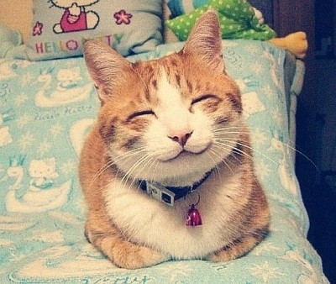
Now answer the questions.
1. Does the beginning of the passage
surprise you? Why?
2. How did the writer feel in the past?
Yes, it does. Because I don't think a smile
can be an important gift.
The writer felt very lonely.

Slide 23
3. How does the writer feel now?
4. What advice does she give?
She feels happy.
Smile at the world and it will smile back.

Slide 24
3. Complete these sentences.
At first
(1) ______ knew me. I felt (2) ____ ______ and was afraid to (3)_____
________with anyone.
Now
The girl has become my (6)__________.
I believe that the world is (7) _____
__________ it is.
Then one day
A girl looked at me and(4)______.
I felt (5)______，
lively and warm.
No one
very
best friend
smiled
lonely
happy
make
what
friends
you think
Facts
Opinion: Smile at the world
and (8) ________________.
it will smile back

Slide 25
4. Complete the sentences with the words
in the box.
circle glue silence stick
suggestion treasure trust
suggestion
My father made the ___________ that I
should find a hobby.
2. Even today, some people search for _________ under the sea.
3. You can ______ them to look after the house.
treasure
trust

Slide 26
4. You must make the stamp wet before you
_____ it to the letter.
5. Have you got any ______? I want to stick
these pieces of paper together.
6. John’s _______ of friends includes some
students from the UK.
7. I like the ________ in the countryside. The
city is too noisy for me!
stick
glue
circle
silence

Slide 27
Language points

Slide 28
1. No one knew me. 没有人认识我。
no one 没有人, 无人 (否定含义)
= nobody, 作主语时, 谓语用单数形式。
No one was in the room when I entered.
none 表示三者或三者以上中“没有任何人
或物”, 常与 of 短语连用。作主语时谓语
动词用单数或复数皆可, 但of 后为不可数
名词时, 谓语动词只能用单数。
They were all very tired, but none of them
would stop to take a rest.

Slide 29
2. I was very lonely, and afraid to make
friends with anyone.
我很孤独，害怕和任何人交朋友。
（1）be afraid of ... 意为“害怕……”，后接
名词、代词或动名词。
He was afraid of speaking in public.
他害怕在公共场合讲话。
（2）be afraid +that从句，意为“恐怕……”
I’m afraid that you will miss the train if
you don’t hurry up.
如果你不快点儿的话，恐怕你会错过火车。

Slide 30
（3）I’m afraid so. 恐怕如此。
I’m afraid not. 恐怕不行。
--I think we have to put off the sports meeting
because of the bad weather.
我认为我们不得不推迟运动会，因为天机太
糟糕了。
--I’m afraid so. 恐怕是这样。
--Can I go out to play football now?
我现在能出去踢足球吗？
--I’m afraid not. 恐怕不行。

Slide 31
3. Every time I heard the other students talking and laughing, I felt even more lonely.
每次我听到其他同学有说有笑时，我觉得自己更加孤单了。
（1） every time, 表示“每次”。在本句中相当于一个连词词组，引导时间状语从句，相当于each time。类似用法的短语还有the day, by the time, the moment等。例如：

Slide 32
Every time/Each time I met him, he wore a blue shirt.
每次遇到他时，他都穿着一件蓝色的衬衫。
（2） hear sb doing sth 听见某人正在做某事
hear sb do sth 听见某人做了某事
-- Do you often hear Wei Hua read
English in his room?
你经常听到魏华在他房间里读英语？
-- Listen! Now we can hear him reading
English in his room.
听！他现在就正在房间里读英语。

Slide 33
（3）even意为“甚至”，用于修饰比较级。比较级还可以用much, a lot, a little, a bit
等词(组)修饰，表示不同程度。
He is much stronger than I.
他比我强壮的多。
It is even colder today than yesterday.
今天比昨天冷。

Slide 34
4. silence n. 寂静；无声
... but I sat in silence.
但是我静静地坐着。
silence是不可数名词。in silence意为“安
静地，沉默地”；keep in silence意为“保
持沉默”。silence的形容词形式是silent。
keep silent = keep in silence 保持沉默
He reads the book in silence.
他安静地看书。
They heard the story out in silence.
他们静静地听完故事.

Slide 35
5. Suddenly, I felt the touch of something
bright and friendly.突然，我感到被一种欢快
而又友好的东西所 触动。
bright表示“快乐的，活泼的，开朗的；明亮的”，形容词,修饰不定代词something 要后置。
例如：
The boy was so bright and lively.
这个男孩活泼开朗，充满活力。
The bright lights arrested the boy's attention.
明亮的灯光吸引了孩子的注意力。

Slide 36
6. Day by day, I learnt to trust people, and they
include me in their circle of friends.
渐渐地，我学会了信任他人，他们也让我加
入了他们的朋友圈。
1) day by day, 表示“一天天地，渐渐地”。
如：It is getting warmer day by day.
2) trust表示“信任，相信”。如：
n. A good marriage is based on trust.
v. If you break your word, he will never trust
you again.

Slide 37
3) include…in… 表示“包括，把……列
为……的一部分”。例如：
Please include me in the list.
请把我列入名单中.
4) circle of friends 意为“朋友圈，交际圈”
Geoffrey has a large circle of friends and is
very popular at parties.
杰弗里交际很广,在社交聚会上深受欢迎.

Slide 38
7. And we stick together like glue.
我们像胶水一样整天黏在一起。
stick表示“粘，粘贴”。如：
What's wrong with this stamp? It won't stick.
这邮票怎么回事？它粘不上去。
We just stuck the poster to the wall.
我们把海报贴在墙上了。

Slide 39
8. Now I believe that the world is what you
think it is.
现在我相信世界就是你认为的样子。
(你认为世界是怎样的, 它就是怎样的)
本结构比较复杂, 主句是 I believe;
that the world is what you think it is 是
believe的宾语从句;
what you think it is 是宾语从句中的表语从
句, 意为“你认为的那个样子”。

Slide 40
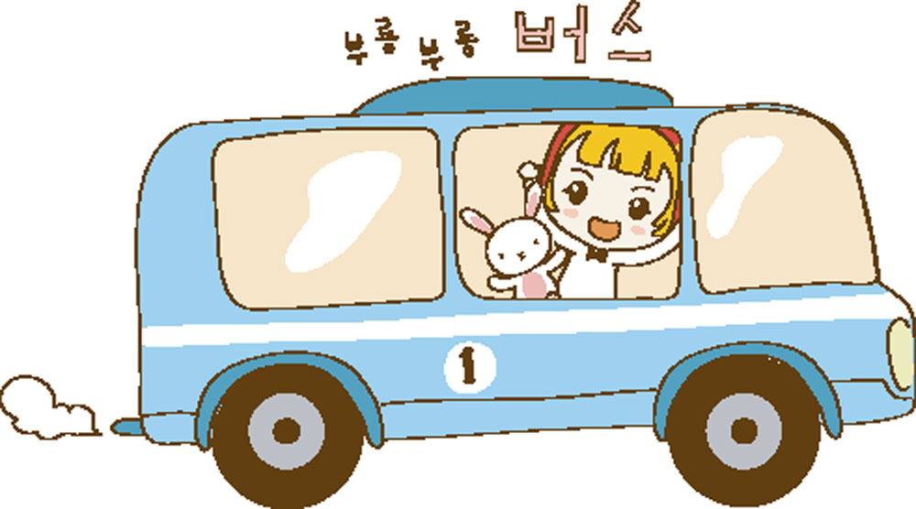
9. My suggestion is: smile at the world and it
will smile back. 我的建议是：笑着面对世界
吧，它也会报你以微笑。
（1） suggestion是可数名词，意为“建议”；其同义词是advice，为不可数名词。“一条建议”
可以表达为“a suggestion”或“a piece of
advice”。它的动词形式为suggest。

Slide 41
[拓展]
suggestion的动词形式是suggest。其常见用法：suggest doing sth.建议做某事；
suggest that sb. (should) do sth. 建议某人做某事。例如：
I suggest doing exercise every day.
我建议每天做运动。
2) smile at 对……微笑
If a man doesn't smile at you, just smile at him.
如果一个人没有对你微笑, 就向他微笑吧.

Slide 42
Watch and read
见视频Module 9 Unit 2 Activity 2

Slide 43
Writing

Slide 44
5. Read the passage again. Find paragraphs
that describe the following stages.
What happened and when.
Where she was and how she felt.
Why she felt that way.
What happened one day.
What happened suddenly.
What happened after this.
What happened later.
What she thinks now.
— Para 1
— Para 2
— Para 3
— Para 4
— Para 5
— Para 6
— Para 7
— Para 8

Slide 45
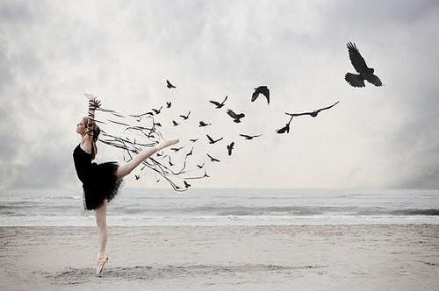
6. Write a passage about someone or something that changed your life. Use the stages in Activity 5 to help you.

Slide 46
Possible answer
Mum and Dad walked in with a big box. They put it down on the floor and said "Happy Birthday", and then your nose came over the side and I saw you for the first time.
I was ten and we had moved to a new town. It was quite a nice town, but I didn't know anyone and the places in the town did not feel familiar. I stayed indoors a lot. I told

Slide 47
people I liked being alone. I did not do any exercise. I became quite lazy.
But then you came along—my dear friend and pet, Spot. From the moment you came out of your box and I saw you, my new dog, white with black spots, a cute face and a tail that never stopped moving, my life changed.
I became noisy again and we were always going out for walks and runs in the park.

Slide 48
Before you came into my life, I did not make friends because I often sat at home alone. But when people saw me going out every day
with my lovely dog, they started smiling and saying hello to me. The whole town seemed to be my friend.
Thank you, Spot — you have brought me many new friends, but don't worry, you'll always be my favourite!

Slide 49
Focus on
Words:
silence bright treasure trust glue include circle stick suggestion
Phrases:
in silence day by day smile at
circle of friends every time
Patterns:
I didn’t know who she was.
I asked her why she smiled at me that day.
She said she could not remember.

Slide 50
Exercise

Slide 51
一、单项选择题。
____ I read the novel, I felt the touch of something.
A. Every time B. Everytime
C. Every times D. Everytimes
2. The boy felt _____ when he stayed at
home alone.
A. alone B. lonely C. happily
A
B

Slide 52
3. The news shops near our school are increasing ________.
A. day by day B. day after day
C. the other day D. some day
4. She suggested ______ early so that we could catch the first train.
A. to get up B. getting up
C. get up D. to getting up
A
B

Slide 53
5. None of them talked. They finished their
meal in _____.
A. silence B. order C. place D. public
6. It rained heavily this morning, but _____ of
my classmates were late for school.
A. neither B. none
C. all D. no one
A
B

Slide 54
Homework
Write a passage about friendship between you and one of your friends.

Slide 55
桂林市桂电中学
2020.8.25录制

