Slide 1


外研版新标准
七年级上册
Module 1
My Classmates
Unit 2
I'm Wang Lingling and I'm thirteen years old

Slide 2

Words and expressions
everyone
capital
friend
but
city
big
small
first
last
all
pron. 大家；每人
n. 首都；省会
n. 朋友
conj. 但是，然而
n. 城市
adj. 大的
adj. 小的
adj. 第一的
adj. 最后的, 最末的
pron. 每个，全体

Slide 3
Reading
Put the sentences in the correct order.
Nice to meet you too. Where are you
from？
b) Hello, my name is ... What’s your name?
c) I’m from ... too.
d) Nice to meet you... My name is ...
e) I’m from...
B - D - A - E - C

Slide 4





A: What’s the capital of China?
B: Beijing is the capital of China./
The capital of China is Beijing.
America
Washington D.C.
England
London
France
Paris
Germany
Berlin
Japan
Tokyo

Slide 5






Shanghai
a very big city in China
a small city in England
Guessing
Cambridge

Slide 6
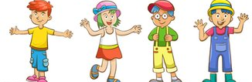
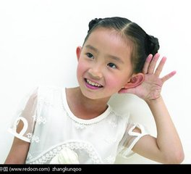


1. Listen and take some notes.
What’s his/her name?
Wang Hui
Daming
Lingling
Tony
How old is he/ she?
12
13
13
Where is he/she from?
Beijing
Beijing
Shanghai
Cambridge

Slide 7


2. Read the passage , then check T or F.
1.Henry is Daming’s English name.
2.Lingling’s English name is Lucy.
3.Wang Hui and Lingling are classmates now.
4.Tony is from England.
5.Cambridge is the capital of England.
F
David
T
F
but he is not in my class
T
F
a small city
And correct the mistakes! .

Slide 8
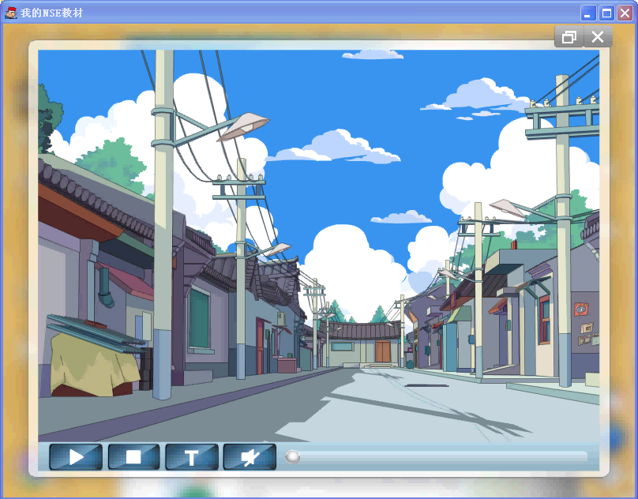

Slide 9

3. Read and complete the passage.
capital city friend first last
Smith is Tony’s _____ name, and Tony is his _____ name. He’s from Cambridge, a small _____ in England. In Tony’s class, Daming and Lingling are from Beijing, the ________ of China. Wang Hui is Lingling’s _______. He’s from the big city of Shanghai.
last
first
city
capital
friend

Slide 10

everyone, English name, twelve, from, capital, Lingling, Lucy, friend, BJ too
Daming
thirteen, Wang Hui, not in,His, Henry, He’s , Shanghai, a very big city
Lingling
Cambridge, a small city, first name, last name, thirteen,
Tony
Ending!
4. Retelling

Slide 11

Tony Smith
first name
last name
given name
family name
Li Daming
last name
first name
Guide to language use
family name
given name

Slide 12


Bill Gates
first name
last name
given name
family name
赵丽颖
Zhao Liying
last name
first name
Guide to language use
family name
given name

Slide 13

Hello, everyone! Allow me to introduce myself to you.
Name
My name is ……
Nationality
国籍
I’m from …… I’m ……
I’m …… years old.
Age
Job and class
I’m …… Class…Grade…
Friend
…… is my friend.
It's nice to meet you all.

Slide 14

Write sentence about yourself.
1. My name’s…
2. I’m …
3. I’m from…
4. I’m … years old.
5. I’m in Class …
My name is Li Ming and I’m from China. I’m Chinese and I’m fourteen years old. I’m in Class One, Grade Seven.

Slide 15
Quiz
I. Join the sentences with “and”.
He is from China. He’s Chinese.
2. Miss Li isn’t American. She isn’t a student.
3. She’s a teacher. She is English.
4. I can play football. He can play basketball.
He is from China and he’s Chinese.
Miss Li isn’t American and she isn’t a student.
She’s a teacher and she is English.
I can play football and he can play basketball.

Slide 16
II. Choose the best answers.
( ) 1. This_____Mike. _____is a new student.
A. am, He B. is, He C. are, She
( ) 2. I am .
A. China B. English C. England
( ) 3. We new here.
A. all B. all are C. are all
B
B
C

Slide 17
( ) 4. I am Class One.
A. in B. at C. on
( ) 5. __________? I am from China.
A. What’s your name
B. How old are you
C. Where are you from
A
C

Slide 18
III. Choose the right word from the box to complete the dialogues.
he, she, I, we, you, it, they
1. —How old are you? —____ am 12.
2. —Where are Betty and Tom from?
—______are from Australia.
3. —Who is the girl? — _____is Lily.
4. _____are all new students in this school.
5. What’s that? ______ is a dog.
I
They
She
We
It

Slide 19
IV. 根据汉语意思完成下列句子, 每空一词。
1. 伦敦是英国的首都。
London is the ______ __ England.
2. 简是我的名字。
Jane is my _____ _____.
3. 那个男孩不在我班。
That boy ____ __ my class.
4. 你的姓是什么？
What is your ___ _____?
5. 遇到你非常高兴，杰克。
___ nice __ meet you, Jack.
capital of
given name
isn’t in
last name
It’s to

Slide 20
Self-introduction
（自我介绍）
My name is…
I’m a student.
I’m from …
I’m … years old.
I’m in Class … , Grade …
My friend is ... / … is my friend.

Slide 21

Good bye!
授课教师
桂林市桂电中学 杨晔

