Slide 1
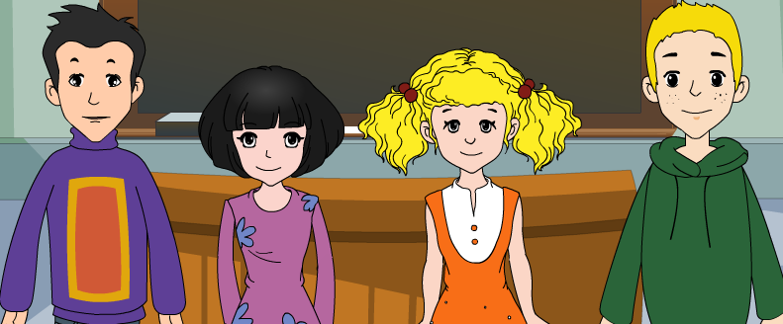
外研八年级（下） 授课教师 杨晔

Slide 2
Module
10
On the radio
Unit 1
I hope that you can join us one day.

Slide 3
Teaching aims
1. Teaching aims:
To be able to give advice and warnings,
and get specific information from the conversation
To be able to talk about radio programmes

Slide 4
2. Main contents:
Key vocabulary
director, show, around, show sb. around,
on air, avoid, national, international, interview
Key structures
And we should avoid making any noise in
the background!
Remember what I said: we need to keep
quiet if the red light is on.
I think you need to speak English really well.

Slide 5
Warming-up

Slide 6
What kind of radio programs do you like?
I like listening to…
entertainment
娱乐
news
culture
文化
sports

Slide 7
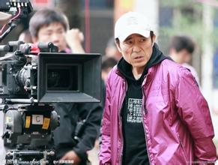
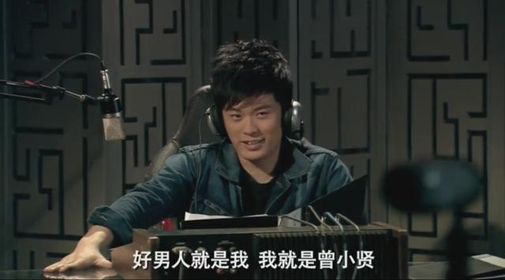
New words
director 导演
radio presenter 电台主持人
studio 录音室
is on air 直播

Slide 8
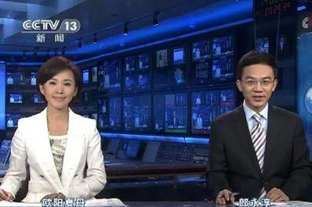
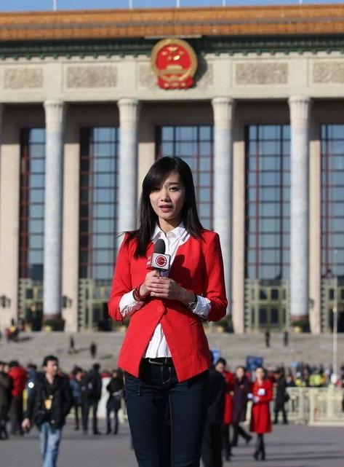
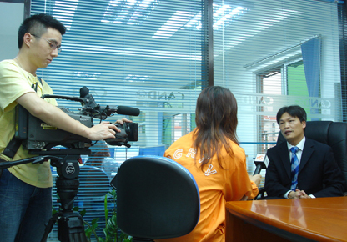
newsreader
reporter 记者
the latest news 最近的新闻
report the news
播报新闻
do an interview 做采访

Slide 9
Listening and vocabulary

Slide 10
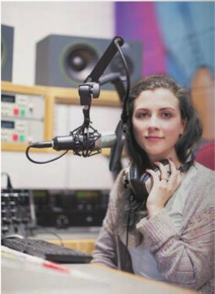
Listen and check (√ ) the types of news you hear.
culture
government
sports
weather
√
√

Slide 11
2. Listen again and complete the
sentences.
1. Zhang Li reads ________________________
____________________ on Radio Beijing.
2. The president of Russia will stay in China
for __________.
3. The match is between ______ and _________.
the latest news from China
and around the world
three days
China England

Slide 12
Tapescript
Zhang Li: Good afternoon. It's three o'clock,
and you're listening to Radio Beijing,
with the latest news from China and
around the world. I'm Zhang Li. The
president of Russia arrived in Beijing
today for a three-day visit to China...
Now for sports, and we're going over
to Wang Lin for the latest report on

Slide 13
the football match between China
and England. Wang Lin, can you
tell us what the score is?
Wang Lin: Yes, at the moment, the score is
China 2, England 1. China is
winning, but there is still half
an hour to go. Back to you,
Zhang Li!
Zhang Li: Thank you. We are looking
forward to the result.

Slide 14
Watch and read
Everyday English
_{• Come this way.}
_{• It gets crazy in here…}
_{• That’s great news!}
见视频Module 10 Unit 1 Activity 3

Slide 15
Listen and answer.
Where are Lingling and Tony?
They are at Radio Beijing.
2. What are they doing?
They are visiting the radio station.
3. Who is Chen Huan?
He is the news director at Radio Beijing.
4. What is the news while they are at the radio station?
Germany has won the football match,2-1
against England.

Slide 16
Now complete the notes.
1. When the red light is on, it means
____________.
2. We collect _________________________
________________ and write reports in
the newsroom.
3. You should _______________________
if you want to be a presenter.
4. This is also where we _____________
with the big sports stars.
we’re on air
the latest national and
international news
speak English really well
do interviews

Slide 17
4. Complete the sentences with the words
in the box.
avoid background international
interviews national
1. Newspapers and television programmes
often have ___________ with famous people.
2. More and more _____________ students are
coming to China to learn Chinese.
interviews
international

Slide 18
3. Every country has its own ________
hero — a person who did something very
important for the country and its people.
4. Try to _______ drinking too much tea or
coffee, or you will not be able to sleep well.
5. Could you speak a little bit louder，please?
It is very noisy in the ____________.
national
avoid
background

Slide 19
Language points

Slide 20
I’m the news director at Radio Beijing.
我是北京广播电台新闻部的主任。
director “导演，主管，经理”。是名词。
动词为direct, 意 为“指导，导演，管理”。
We went back and reported our findings to
director.
我们回去把调查的结果向经理汇报了。
The film was directed by Howard Hawks.
该影片是由霍华德·霍克斯导演的。

Slide 21
2. Now, come this way.
没关系，现在请走这边。
come this way 这边走
Come this way , if you please.
如果您愿意，请这边走。
Please come this way. We'll go in by that door.
请这边走，我们从那扇门进去。
Practise
请从这里的入口进入博物馆。
Please come this way into the museum.

Slide 22
3. Thank you for showing us around.
谢谢您带我们参观。
show sb. around + 地点, “带某人参观，给某
人做向导”。e.g.
Shall I show you around the factory?
我带你去参观工厂, 好吗?
thank you for doing sth
= thanks for doing sth.
感谢某人做某事
e.g. Thank you for helping me.
= Thanks for helping me.

Slide 23
4. When it’s on, it means we’re on air.
当它（红灯）亮时，我们正在广播。
on air, “（广播或电视）播出，正在广播”。
例如：
We will be on air in about five minutes.
我们将在大约五分钟后开始广播。
The radio station is on air from 6.00 a.m.
这个电台早晨6点开播.

Slide 24
5. And we should avoid making any noise
in the background!
要避免背景中的任何杂音。
avoid“避免，防止”
avoid + doing sth. “避免做某事”
e.g.
Please try to avoid making the same
mistake next time.
下次请尽量避免犯同样的错误。

Slide 25
6. It gets crazy in here just before the programme
begins.
在节目开始前，这里都要忙疯了。
It gets crazy… …变得疯狂
It really gets crazy around Thanksgiving and Christmas and Easter.
在感恩节，圣诞节以及复活节时事情就会变得疯狂有趣。
Practise
考试前，教室里忙疯了。
It gets crazy in classroom before the test comes.

Slide 26
So keep studying, and I hope that you can
join us one day.
所以继续学习吧，我希望有朝一日你能加入
我们。
keep (on) doing sth. 表示“坚持做某事”。
例如：
Keep climbing until you get to the top of the
mountain.
继续攀登，直到你到达山顶。

Slide 27
8. And it is where we do interviews with the
big sports stars.
“where we do interviews with the big sports
stars” 是一个由where引导的表语从句。
interview 采访，访谈”。是可数名词。
do an interview with sb. “采访某人”
give an interview to… “接受……的采访”
I want to do an interview with the headmaster next month.
我想下个月采访校长。

Slide 28
9. We need to keep quiet if the red light is on.
红灯亮的时候我们需要保持安静。
keep quiet 保持安静
We should keep quiet in the class.
我们应在课堂上保持安静。
Practise
请在开会时保持安静并关闭你的手机。
Please keep quiet in the meeting and turn off your phone.

Slide 29
10. That’s great news! 那是好消息！
That’s great news. “真是好消息”，较口语的说法，表达看到好消息的喜悦之情。
That’s great news for developers.
对于开发人员，这是个特棒的消息。
Practise
这是一个超级好消息因为思考积极面能够改变生活！
That’s great news because thinking positively changes lives!

Slide 30
11. It’s awful news! 这是坏消息！
It’s awful news. 非正式的说法，相对应的表达是“It’s great news!”。
It’s awful news for me.
对我来说是个坏消息。
Practise
他不能接受这个坏消息。
It’s awful news for him to accept.

Slide 31
Object Clause:
. 我认为你需要把英语说得相当漂亮。
3. 所以，坚持学习吧，我希望有一天你能加入到我们当中来。
4. 记住我所说过的话: 如果红灯亮着，我们就需要保持安静。
5. 最后，我们刚刚得到消息称德国以2比1战胜了英格兰，赢得了这场足球比赛。
I think you need to speak English really well.
So keep studying, and I hope that you can join us one day.
Remember what I said: we need to keep quiet if the red light is on.
Finally, we’ve just heard that Germany has won the football match, 2-1 against England.

Slide 32
Pronunciation and speaking

Slide 33
5. Read and predict how the speaker is likely to pronounce the .
1. the red light 2. the interview
3. the programme 4. the football match
5. the end 6. the reports
7. the sports news
/ðə/ —— 1，3，4，6，7
/ði:/ —— 2，5
Now listen and check.

Slide 34
分析: 英语中the有两种读音：一是在以辅音音素开头的单词前读作/ðə/ ,如the day, the key; 二是在以元音音素开头的单词前读作/ði:/ ，如 the hour, the inside.

Slide 35
Watch and read
Everyday English
_{• Come this way.}
_{• It gets crazy in here…}
_{• That’s great news!}
见视频Module 10 Unit 1 Activity 3

Slide 36
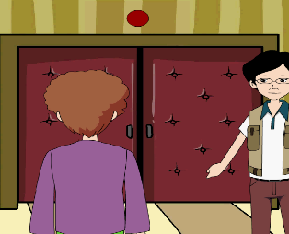
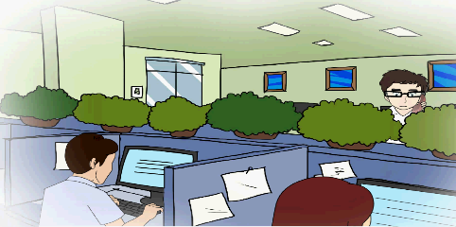
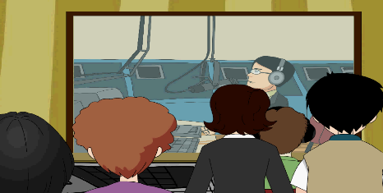
4.Roleplay

Slide 37
7. Work in pairs. Ask and answer questions
about the radio.
1. What do you like listening to?
2. What do you not like listening to?
3. What programme did you listen to the last
time you turned on the radio?
4. What do you need to do if you want to be a
presenter?
Now work with other pairs. Find out who
has the same answers.

Slide 38
For example:
A: What do you like listening to?
B: I like listening to my father’s record
collection.
A: Why?
B: Because the music is very different
from modern music.
A: What’s it like?
B: The songs tell stories.
A B

Slide 39
Focus on
Words:
director show around avoid background national international interview
Phrases:
show sb. around on air
Patterns:
Come this way.
It gets crazy in here…
That’s great news!

Slide 40
Exercise

Slide 41
一、单项选择题。
He is the famous ______ of Harry Potter.
A. direct B. director C. act D. reporter
2. The radio is _____, and we can hear the news now.
A. in air B. on air C. to air D. by air
3. No matter how hard it is, we’ll keep
____until we make it.
A. failed B. failing C. tried D. trying
B
B
D

Slide 42
4. We should _______ eating too much meat in our daily life.
A. speak B. show C. hear D. avoid
5. — Could I do an ______ with you tomorrow?
— Yes, of course.
A. interview B. interviews
C. director D. directors
6. We must keep listening to English programmes _______ the radio.
A. in B. of C. for D. on
D
A
D

Slide 43
二、根据句意和汉语提示写单词。
1. He is a famous _________ (导演).
2. I want to be a __________ (主持人) in the
future.
3. There will be an _____________ ( 国际的)
meeting next week.
4. He has a strong political ___________(背景).
5. He has an ____________ (访谈) next
Thursday for a job.
director
presenter
international
background
interview

Slide 44
桂林市桂电中学
2020.8.26录制

