Slide 1
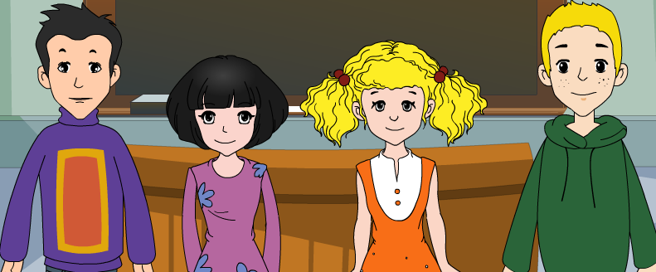
外研版新标准
授课教师：杨晔
八年级下册

Slide 2
Module
3
Journey to space
Unit 2
We have not found life on any other planets yet.

Slide 3
Teaching aims
1. Teaching aims:
To be able to summarize a passage
To be able to describe a picture using the present perfect.

Slide 4
2. Main contents:
Key vocabulary
group, light, impossible, take, out,
communicate
Key structures
However, we have not found life on any other planets yet.
Scientists have also discovered many other galaxies in the universe.

Slide 5
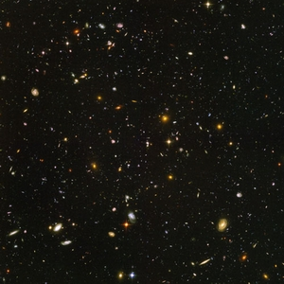
Universe is full of
mysteries(神秘）. Let's
explore it！

Slide 6
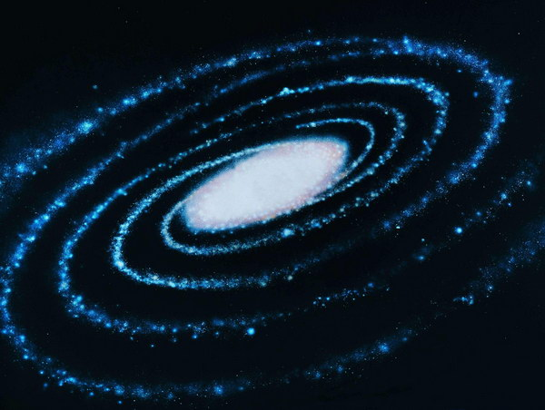
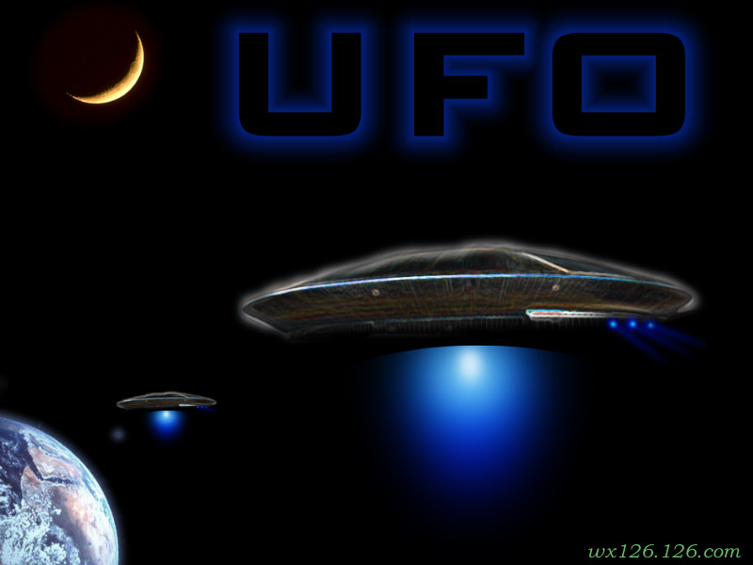
Warming up
1. How many planets are there in our
solar system?
2. Is there any life on other planets?

Slide 7
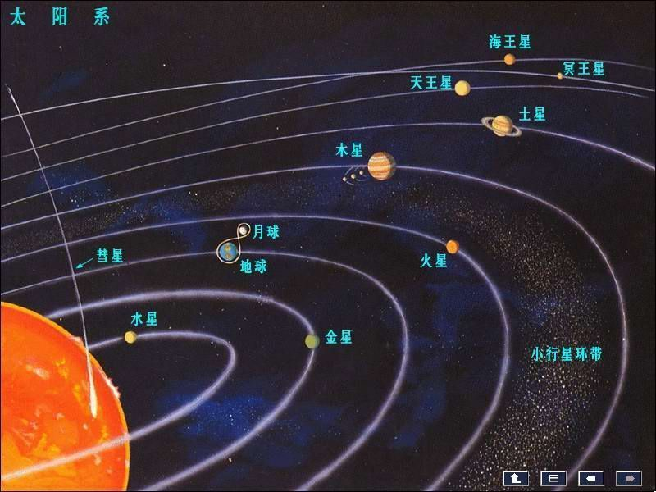
Put the words and expressions in the box in order: small – large.
galaxy, planet, solar system,
star, universe
3
2
1
3
4
5
1. planet 2. star 3. solar system
4. galaxy 5. universe

Slide 8
天体系统的层次
河外星系
总星系
其他恒星系
银河系
其他行星—卫星系
太阳系
月球
地月系
地球

Slide 9
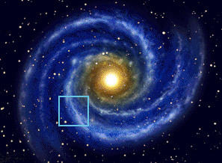
The Milky Way Galaxy
银 河 系
银河系主体部分的直径约为10万光年
银河系有太阳这样的恒星2000多亿颗

Slide 10
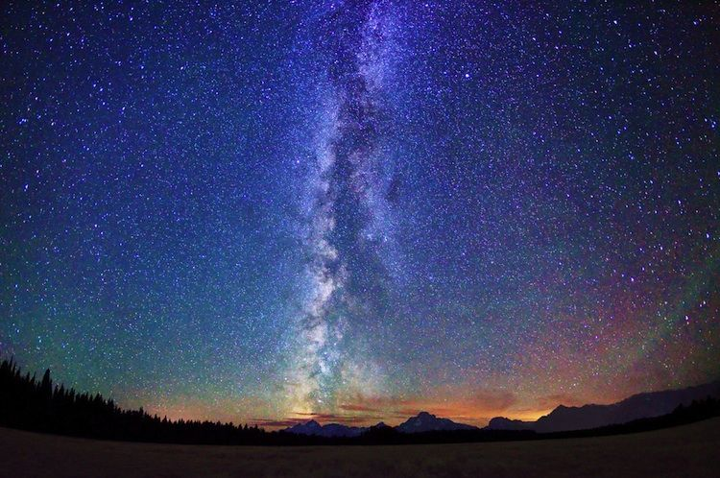
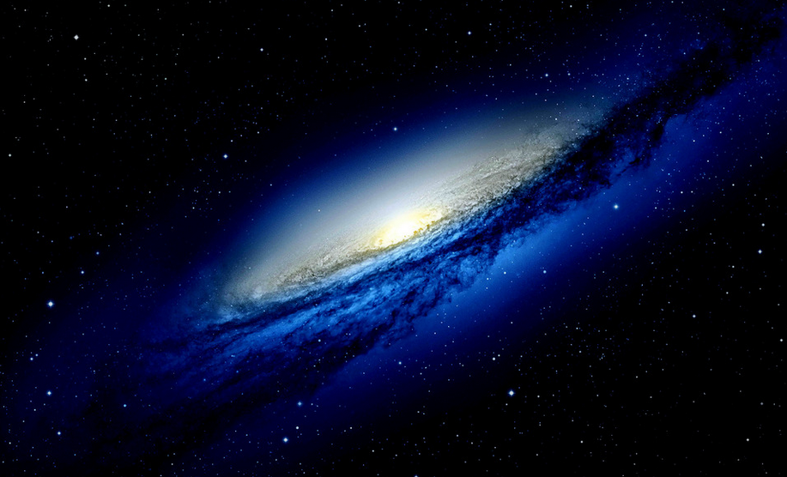
The Milky Way Galaxy

Slide 11
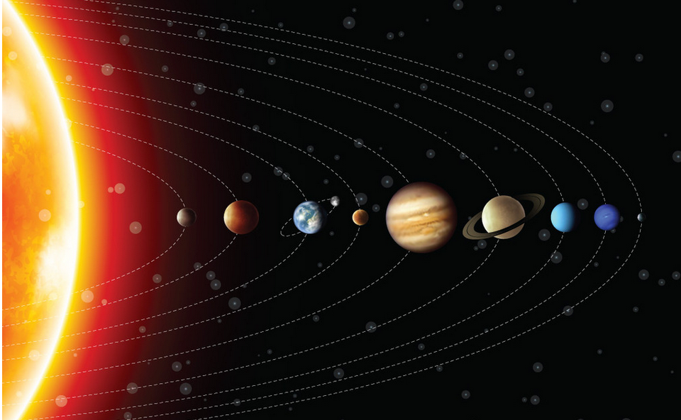
The solar system

Slide 12
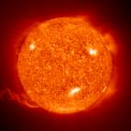
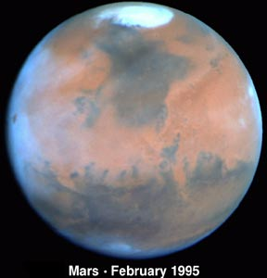
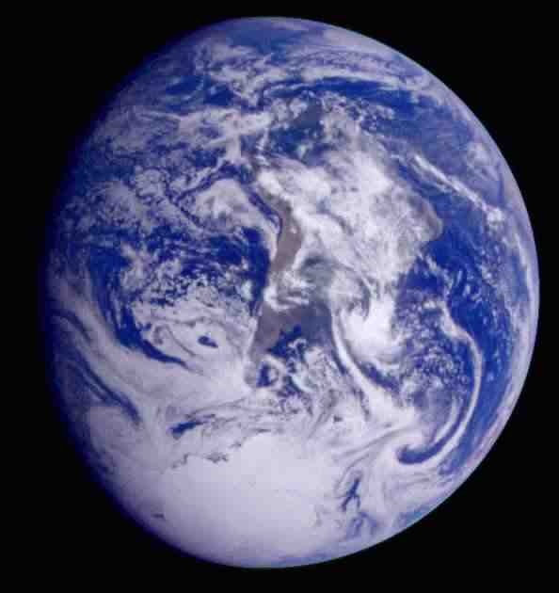
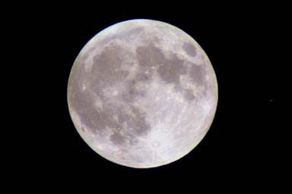
the sun
Mars 火星
the Earth
the moon

Slide 13
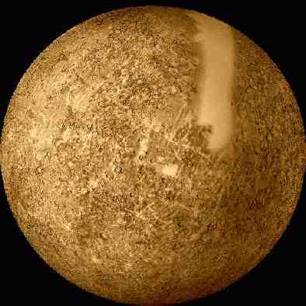
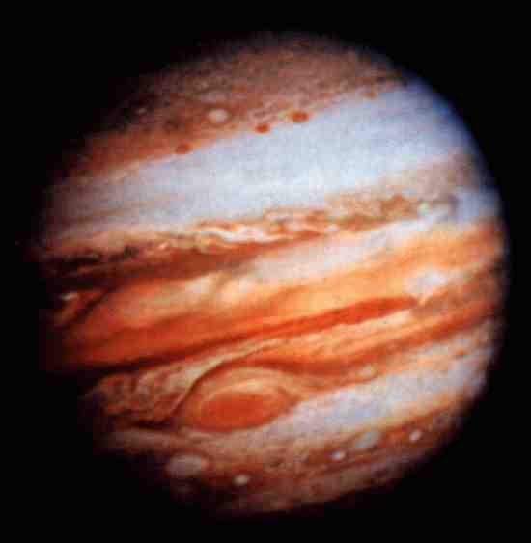
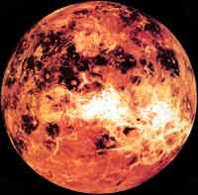
Mercury 水星
Jupiter 木星
Venus 金星
Saturn 土星

Slide 14
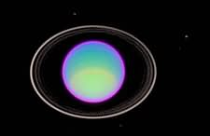
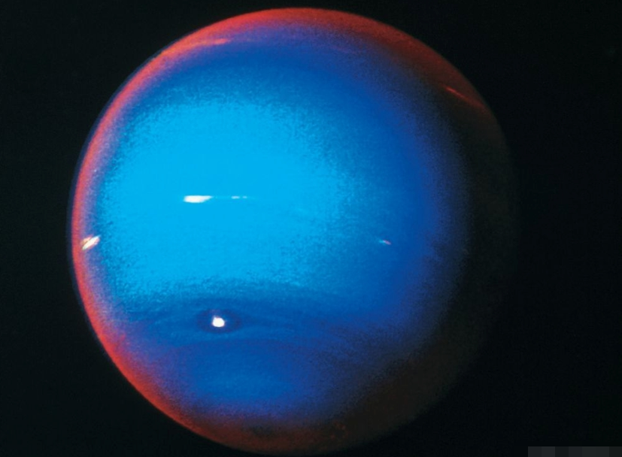
Neptune 海王星
Uranus 天王星

Slide 15
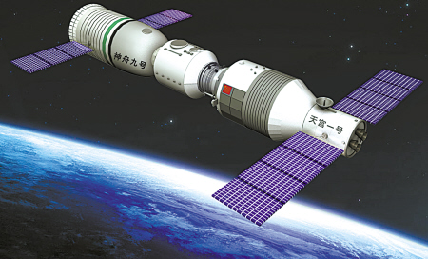
Reading and vocabulary
1. Work in pairs. Look at the picture and
talk about what you know about
Chinese spaceships.
Shenzhou-9 is a manned spaceship.

Slide 16
Learning to learn
When you read a passage with a title and pictures, think about the words you may find in the passage, and the questions you may want to ask before you start to read.

Slide 17
Watch and learn
见视频Module 3 Unit 2 Activity 2

Slide 18
2. Read the passage and choose the
best title for it.
Anyone out there?
Life on the earth
3. The sun and other stars
4. The stars at night
1. Anyone out there?
________________________________
Scientists think that there has been life on the earth for hundreds of millions of years. However, we have not found life on any other planets yet.

Slide 19
sent spaceships to travel outside the solar system. However, no spaceship has travelled far enough to reach other stars in our Galaxy.
Scientists have always asked the questions: with so many stars in the universe, are we alone, or is there life out there in space? Have there been visitors to the earth from other planets? Why has no one communicated with us? We do no know the answers... yet.

Slide 20
3. Check (√) the true sentences.
1. The earth is a star. □
2. The sun is a star. □
3. There is more than one galaxy in the
universe. □
4. The light from the stars in other galaxies
has travelled for a long time to reach us. □
5. Scientists have received many messages
from space. □
6. Spaceships have visited most of the
universe. □
√
√
√
No one has communicated with us.

Slide 21
4. Complete the passage with the words
and expression in the box.
communicate environment none
solar system universe
Is there life on other planets? There are seven other planets in our (1) ___________ ,
but (2) _____ of them has a(n) (3)___________ like that of the earth. Spaceships from the
solar system
none
environment

Slide 22
earth have done surveys of the other planets, but they have not found any life there. Why has no one from other planets tried to (4) _____________ with us? It is true that
scientists have not discovered life on other planets in the (5) _________ yet, but some scientists believe that they will find it some day.
communicate
universe

Slide 23
Watch and read
见视频Module 3 Unit 2 Activity 2

Slide 24
5. Phrases
1.数以亿计的 hundreds of millions of
2.数以百万计的 millions of
3.绕着....转 go around
4.拍照 take photos
5.....的一小部分 a small part of...
6.在宇宙中 in the universe
7.在太空中 in space
8.与....交流 communicate with...
9.空间站 space station
10.寻找 look for
11.以...命名 be named after

Slide 25
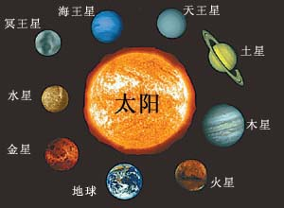
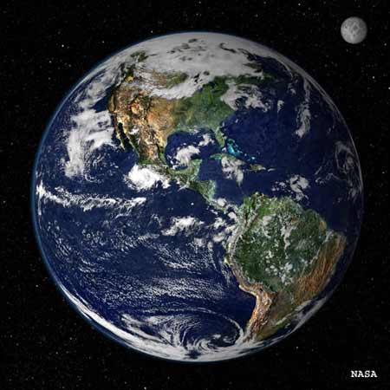
Anyone out there?
1
2
3
A.a planet
1. Anyone out there?
B.solar system
4
5
C.the Galaxy\ the Milky way
D.a star
太阳
E.universe

Slide 26
Language points
1. Scientists think that there has been life on
the earth for hundreds of millions of years.
科学家认为地球上的生命已存在了数亿年。
hundreds of millions of 数亿……
We paid hundreds of millions of dollars in
taxes.
我们交纳了数亿美元的税金。

Slide 27
数词在表示模糊数目的短语中用复数形式，且后面要加上of。
hundreds of 数以百计的
thousands of 数以千计的
millions of 数以百万计的
billions of 数以亿计的, 数十亿的
百、千、百万、十亿如果和具体数字连用，百、千、百万、十亿须用单数形式。如：
six hundred two thousand
nine million seven billion

Slide 28
即学即练
1. It is said that the disease has killed more than________ people worldwide.
A. two hundreds B. two hundreds’
C. two hundred’s D. two hundred
2. ______ Chinese are looking for ways to learn English well.
A. Thousand B. Thousands
C. Thousand of D. Thousands of
D
D

Slide 29
2. The earth is a planet and it goes around the sun. Seven other planets also go around the sun.
地球是颗行星，它围绕着太阳转。此外还有七颗行星也围绕着太阳转。
1) 七颗行星指的是：水星（Mercury)、金星 (Venus)、火星(Mars)、木星 (Jupiter)、土星（Saturn)、天王星 (Uranus)和海王星(Neptune)。

Slide 30
2) go around: 绕着……运转
The Earth goes around the Sun.
地球绕着太阳转。
Let's go around the town, not through it.
我们绕过这城镇吧，不要穿过去了。

Slide 31
3) other/the other/others/another
这几个相类似的词容易弄混淆，其实意思大相径庭。
other其它的（人或物）, 后面经常跟可数名词复数形式；
We haven’t found life on other planets yet.
我们还没有在其它的星球上发现生命。（其他的星球不可能只有一个）

Slide 32
the other（两者中的）另一个,后面不可能跟复数形式；
He has two daughters. One is a teacher, the
other is a doctor.
他有两个女儿，一个是老师，另一个是医
生。
（有且只有两个，两者中的另一个）
others其它的人或物（已经包括在内）, 后面不能跟名词，本身就含有名词的含义；

Slide 33
Some people came by car, others came on
foot.
有些人是坐汽车来的，其他人是走着来的。（others后面不能再加名词）
another（三者以上中的，或不知道数量的）另一个, 后面也不可跟复数形式。
Would you like another cup of tea?
你要再来有一杯茶吗？
（泛指再来一杯）

Slide 34
4) also adv. 也，同样；而且（不与否定式动词连用）
She speaks French and German and also a
little Russian.
她会说法语、德语，还会说一点儿俄语。
He is young and good-looking, and also
very rich.
他又年轻又帅气，而且还很富有。
I teach five days a week and I also teach
evening classes.
我每星期教五天，而且还教晚上的课。

Slide 35
比较：also/too/as well
also, too, as well都指句中有关词语与前面提到的事物相结合或相一致，这三个词语的雅俗程度和在句中的位置有所不同。
also含较庄重色彩，通常用于主要动词之前（但若主要动词为be，则放于其后）

Slide 36
I’ve met Jane and I’ve also met her mother.
我已见到简，我也见到了她的母亲。
She was rich, and she was also selfish.
她很富，她也很自私。
too和as well比较通俗，通常用于从句的句尾。
I’ve read the book and I’ve seen the film as
well/too.
我看过这本书，也看过这部电影。

Slide 37
3. None of them has an environment like that
of the earth…
没有一颗行星拥有与地球一样的环境……
none 表示（三个以上）一个也没有。意为“没有一个人/东西”，none作主语时，谓语的单复数形式要根据实际情况来定。如：
None of them has been to Beijing.
他们中没有一个人到过北京。（none指代可
数名词， 强调单一性，谓语用单数形式）

Slide 38
None of them were aware of the danger.
他们都没有意识到危险。（none指代可数
名词，强调整体性，谓语用复数形式）
None of the money is his.
这些钱没有他的份儿。（none指代不可数
名词，谓语动词用单数形式）

Slide 39
4. ... and our solar system is a small part of a much larger group of stars and planets, called the Galaxy or the Milky Way.
……我们的太阳系只是一个由恒星和行星组成的星系的一小部分，这个星系比太阳系大得多，称作银河系或银河。
这里的the Galaxy专指“银河系”，也可以 称作the Milky Way。而galaxy则泛指“星系”。例如：
Scientists have discovered a distant galaxy.
科学家发现了一个遥远的星系。

Slide 40
本句中called the Galaxy or the Milky Way为过去分词短语做定语，修饰a much larger group of stars and planets。
类似的例子还有：
They have a two-year-old son called Mike.
他们有一个两岁的儿子叫迈克。

Slide 41
5. However, no spaceship has travelled far
enough to reach other stars in our Galaxy.
然而，还没有任何航天器能到达银河系
里的其他恒星。
形容词/副词 + enough to do表示“到达……程度，会发生某结果”。
He is old enough to go to school.
他到上学的年龄了。
He got up early enough to catch the first bus.
他起得很早，赶上了首班车。

Slide 42
6. ... with so many stars in the universe, are
we alone, or is there life out there in space?
……宇宙中有这么多星球，我们是孤独的
吗，抑或太空中还有其他生命存在呢？
这里with so many stars in the universe是介 词短语，在句中作状语。
with + 名词 + 介词短语,在句中做状语，表示伴随情况。
With so many things to do, we have no time
to play.
要做的事情这么多，我们都没时间玩了。

Slide 43
alone adj.孤单的, 孤独的。作形容词时不作定语只作表语, 也可作副词。意思是“独自地”。
I don’t like going out alone after dark.
我不喜欢天黑后独自外出。
比较：alone/lonely
alone表示独自一人；lonely表示心灵上的孤单。
Although I’m alone, I don’t feel lonely.
虽然我独自一人，但是我不感到孤单。

Slide 44
Exercises
1. In the world ___ people like watching TV.
A. millions of B. two millions
C. two million of D. two million of
2. Basketball is such a popular game in the
world that ____ people play it for fun and
exercise.
A. million of B. millions of
C. millions D. two millions of
A
B

Slide 45
3. ___ girls took part in the Super Girl Competition, but only a few of them succeeded.
A. One million of B. Millions of
C. Two millions D. Two million of
4. Every year ____ people in this country lose their jobs.
A. many millions B. millions of
C. millions D. two millions
B
B

Slide 46
5. The spaceship ______ will go around the earth in 2005 will be called Shenzhou Ⅶ.
A. which B. who C. whom D. what
6. After playing football for more than half an hour, the students took _____ rest.
A. a few minute’s B. a few minutes’
C. a little minute’s D. a little
A
B

Slide 47
7. —How heavily it rained this early morning!
—Yes. But ________ of the students in our class was late for school.
A. some B. none C. all D. neither
8. I tried several jackets on, but ____ of
them looked good.
A. both B. either C. none D. neither
B
C

Slide 48
根据汉语提示完成英语翻译。
1. 地球是行星，它围绕太阳运转。
The Earth is a planet and it
_____________ the Sun.
2. 为什么不把书带回来？
____________________ the book?
3. 没有一个学生去过英国。
_______ the students __________
England.
goes around
Why not bring back
None of
has been to

Slide 49
4. 完成今天的作业不容易。
_______________ today’s homework.
5. 我刚读过有关火星的书。
I ____________ books _____ Mars.
6. 从其他星系到我们这里要花费很多年。
It _____ many years _______ us
from other galaxies.
It’s hard to finish
have just read about
takes to reach

Slide 50
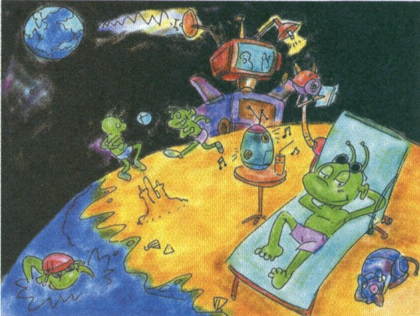
Writing
6. Look at the picture from a science story
for children and answer the questions.

Slide 51
What have the scientists just received?
(a message from one of our spaceships)
They have just received a message from one of
our spaceships.
Where has the spaceship landed? (Mars)
2. What has the spaceship discovered? (people on Mars)
The spaceship has landed on Mars.
The spaceship has discovered people on Mars.

Slide 52
3. Why have the people on Mars not sent us a
message? (do not know how to)
4. Why have the people on Mars not visited us
on the earth? (do not know how to)
Because they do not know how to sent a
message to us.
Because they do not know how to get to the earth.

Slide 53
6. Write a passage to describe the picture.
Use your answers to the questions in
Activity 5 to help you.
We have just received a message from our spaceship to Mars …

Slide 54
Possible answer
We have just received a message from our spaceship to Mars. Our spaceship has discovered aliens there. They have never sent us a message because they don't know how to communicate with us. They have not visited the earth because they don't know how to fly to our planet, and they prefer life on Mars. They seem very happy on their planet. They have used parts from the other spaceships from the earth to make TVs, radios, etc. We hope they don't do the same with this one!

Slide 55
桂林市桂电中学录制
2020.8.18

