Slide 1
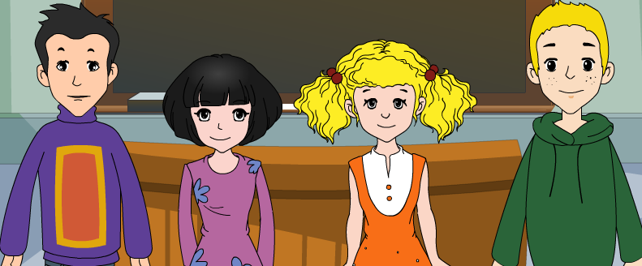
外研版新标准
授课教师：杨晔
八年级下册

Slide 2
Module
4
Seeing the doctor
Unit 2
We have played football for a year now.

Slide 3
Teaching aims
1. Teaching aims:
To be able to understand passages about health routines
To write about healthy living with the hints provided by pictures

Slide 4
2. Main contents:
Key vocabulary
well, heart, active, pet, member, take part
(in sth.), then, daily, weak
Key structures
I have had him for three months now and
I feel really healthy.
Since then, it has become part of my life.

Slide 5
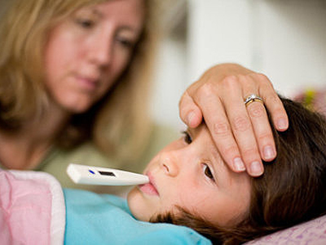
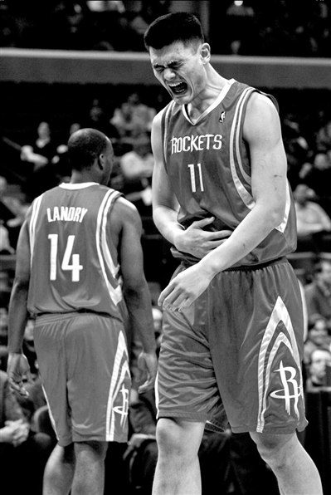
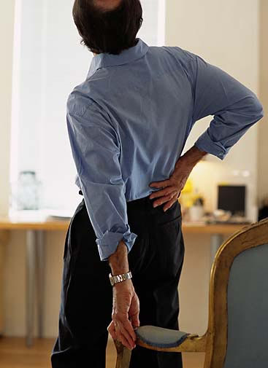
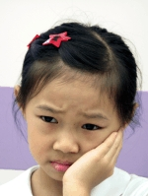
Ask and answer
A: What’s the matter with…? B: He/She…

Slide 6
Make sentences: give advice
She should drink a lot of water and
take a good rest.

Slide 7
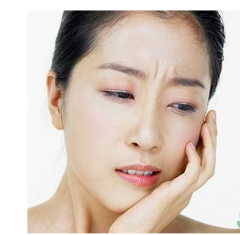
She needs to see a dentist.

Slide 8
He'd better lie down and rest.

Slide 9
He must see a doctor.

Slide 10
Pair work: Make dialogues
Problems
have a cold
get tired
be stressed out
have a toothache
have a sore throat
have a headache
Give advice
take some medicine
sleep
have a good rest
see a dentist
drink hot water
see a doctor

Slide 11
What are good ways to have a healthy living?
For example:
having a balanced diet
taking exercise regularly

Slide 12
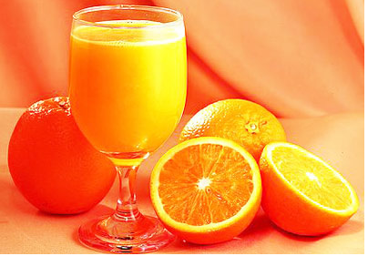
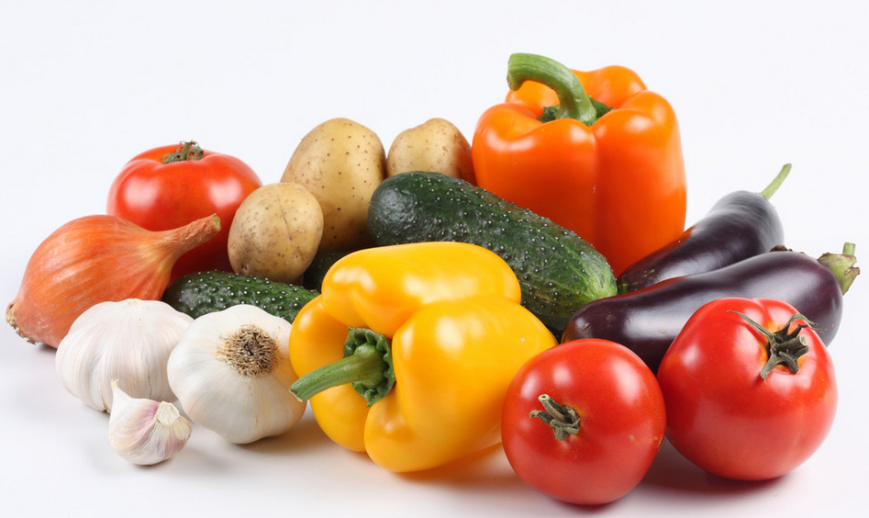
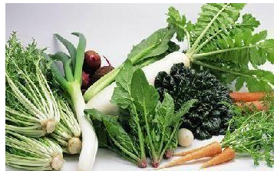
eating more fruit and vegetables.

Slide 13
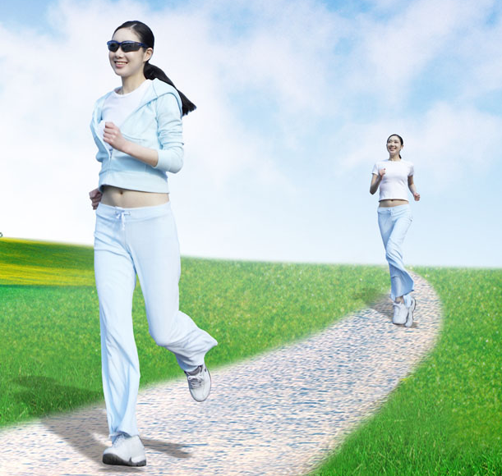
running

Slide 14
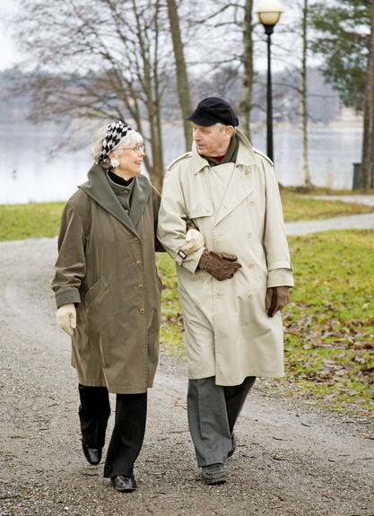
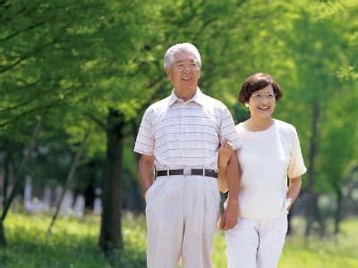
taking a walk

Slide 15
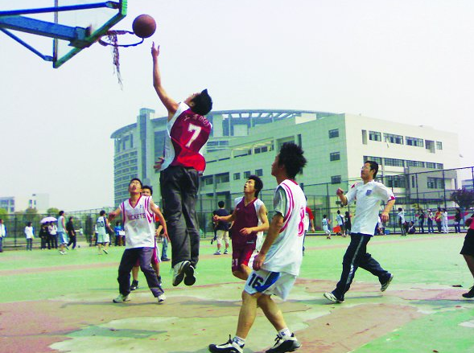
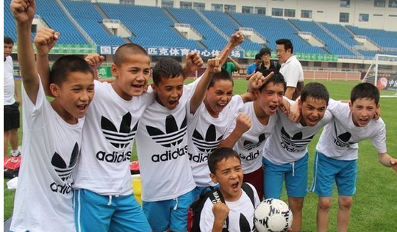
playing ball games

Slide 16
Reading and vocabulary
1. Describe the activities in the pictures.
Which ones are healthy?
Pictures b, c, d, e are healthy.

Slide 17
Healthy or unhealthy?
Jogging，playing football, riding a bike and walking the dog is healthy while eating too much junk food is unhealthy.

Slide 18
Learning to learn
When you write your advice, you can use you..., you should/should not... and sentences like Do…or Do not...

Slide 19
2. Watch and match
Do daily exercise by riding a bike to work. Picture d
Anna
Wang Wei
Thomas
Richard
B. Keep fit by playing football.
Picture c
C. Try to go for a run, but not enjoy it. Picture b
D. Get exercise by walking the dog. Picture e

Slide 20
3. Complete the notes.
Anna
1. She was not feeling very ______.
2. She needed more ________.
3. She got a pet _____ from her parents and
she takes him for a _____ every day.
Wang Wei
4. She was the _____ member of the football
team.
5. She has played football with the team for a
_____ and all the members feel very ___.
well
exercise
dog
walk
first
year
fit

Slide 21
Thomas
6. He went to work on the ____________ for
several years.
7. He bought a _____ in January.
8. He arrives at work with a _____on his face.
Richard
9. He started running a _____ ago.
10. He does not ______ running.
11. He thinks he is perhaps too ______to go
for a run.
underground
bike
smile
week
enjoy
weak

Slide 22
4. Complete the sentences with the
words in the box.
active awful condition daily member Perhaps
Tom runs six miles every morning, so he
is in very good _________ .
2. Jill is a very ______ girl and plays lots
of sports.
condition
active

Slide 23
3. I had a very bad headache yesterday, and I
felt ______ .
4. Ben is a(n) _________ of the school football
team.
5. You do not look very well. _________ you
should see a doctor.
6. I saw your grandfather taking his ______
walk this morning.
awful
member
Perhaps
daily

Slide 24
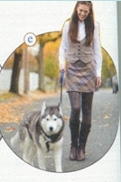
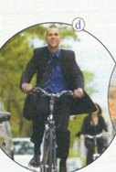
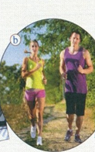
4. My friends and I have to do sports
for healthy living.
Anna:
Thomas:
Wang Wei:
Richard:

Slide 25
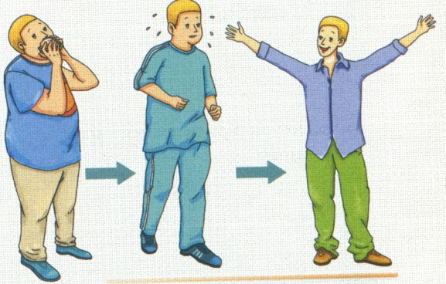
Writing
5. Work in pairs. Look at the pictures of
Colin. Write notes and explain:
what the problem was
what suggestions the
doctor gave him
what happened next
how Colin feels now

Slide 26
Now write four sentences to describe what happened.
Possible answers
I didn't feel very well, I was too heavy and I
ate too much fast food.
My doctor said I should get some exercise
and eat healthy food.
I went exercising.
Now I feel very well and happy.

Slide 27
6. Write a passage about healthy living.
Use the sentences you wrote in
Activity 5 to help you.
Possible answer
I didn't feel very well last summer, and I was too heavy. My doctor said I ate too much fast food. She said I should get some exercise, eat different food and drink a lot of water.

Slide 28
I started to go exercising with two friends. At first I didn't like it, because it was tiring. My friends said, "Don't stop! You can do it!" I didn't give up. Later I began to enjoy exercising and now I feel very well and happy. My life is very different now!

Slide 29
Language points
1. Now I get exercise by taking him for a walk every day.
现在我每天都通过遛狗来锻炼身体。
by doing sth.表示“通过某种方式”。例如：
You can do your shopping at home by using the Internet.
通过上网你就可以在家里购物了。
take the dog for a walk = walk the dog 遛狗

Slide 30
2. She is in excellent condition too.
她的身体状况也很好。
in excellent condition或 in condition 表示“ 康状况很好”。例如：
Do exercise every day and you will be back
in condition soon.
每天锻炼身体，你很快就会恢复健康 的。
out of condition则指“健康状况不佳”。例如：
The horse is still out of condition after a
serious illness. 这匹马生了一场大病，目前
健康状况 仍然不佳。

Slide 31
3. Perhaps I am too weak to do any exercise.
也许我太虚弱不能做任何运动。
too…to… 表否定含义，表示“太……而不能”
My brother is too young to go to school.
我弟弟年龄太小，不能上学。
We walk too slowly to get there on time.
我们走得太慢，不能按时到达那儿。

Slide 32
“never/not too …to…”这一结构意思是 “不太……所以能……”。双重否定表示肯定意义。
Never too old to learn.
活到老学到老。
It’s never too late to stop smoking.
戒烟何时都不算晚。
You cannot be too careful to do your
homework.
你做作业越仔细越好
(=无论怎样仔细也不为过)。

Slide 33
Exercises
一、单项选择题。
1. How long ______ you____ your best friend?
A. do; know B. did; know
C. will: know D. have; known
2. I _______ ill since last night.
A. have been B. was
C. am D. have gone
D
A

Slide 34
3. You should _______ your temperature.
A. take B. have C. make D. do
4. The old man is too old ______ a car.
A. drives B. has driven
C. driving D. to drive
5. Could you give me ________ ?
A. advices B. some advice
C. an advice D. some pieces of advices
A
D
D

Slide 35
二、根据句意和汉语提示写单词。
1. Have you found your _____ (宠物)？
2. John is a _______ (成员) of the basketball
club.
3. My father had a_________ (头痛) yesterday.
4. _______ ( 自……以来) then, we have
known each other.
5. The doctor took her ____________ (体温）
and found that she had a fever.
pet
member
headache
Since
temperature

Slide 36
三、根据中文提示完成句子。
1. 他最近没有去看电影。
He ______ _____a film recently.
2. 跑步已经成为我生活的一部分。
Running ____ _______ _____ of my life.
3. 我每天锻炼，身体状况非常好。
I take exercise every day and now I am
___ _________ _________.
hasn't seen
has become part
in excellent condition

Slide 37
4.琳达在这所大学学习五个月了。
Linda ___ _______ at this university for
five months.
5.这个小男孩儿玩了很长时间的电脑游戏。
This little boy ____ ________ computer
games for a long time.
has studied
has played

Slide 38
Homework
Do you know how to keep healthy?
Talk about with your classmates and put the healthy living styles into practice.

Slide 39
桂林市桂电中学录制
2020.8.19

