Slide 1


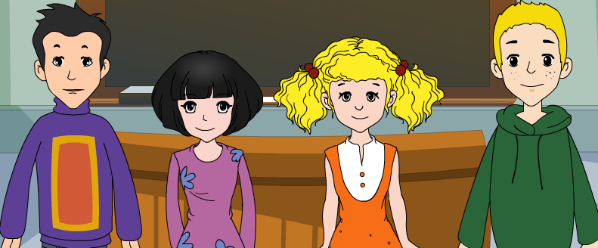
外研八年级（下） 授课教师 杨晔

Slide 2
Module
7
Summer in Los Angeles
Unit 1
Please write to me and send me some photos!

Slide 3

Teaching aims
1. Teaching aims:
To understand conversations about holiday trips and future plans
To get specific information from a conversation on a person’s trip
To talk about an imaginary trip to LA

Slide 4
2. Main contents:
Key vocabulary
list, make a list, crazy, at the end of, shorts,
trousers, sunglasses, total, passport
Key structures
Well, it sounds crazy, but I don’t know what to take
When are you leaving and how long are you going to stay there?
Shorts are good, or you can wear light trousers

Slide 5

Warming up

Slide 6

Think about it!
How do you spend your summer holidays?
Have you ever been in any summer courses or summer camps in a foreign country?

Slide 7

summer camp

Slide 8
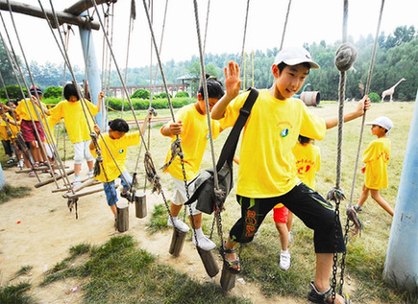
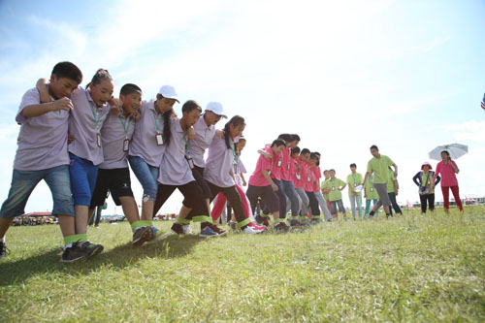
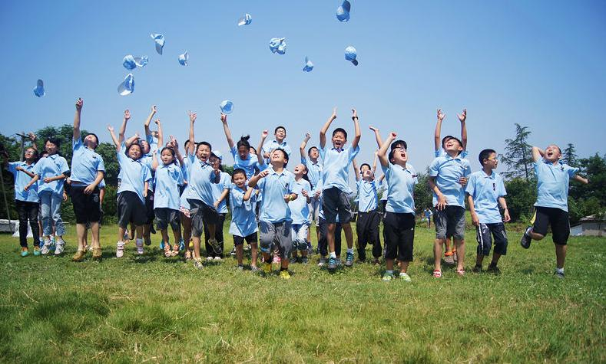
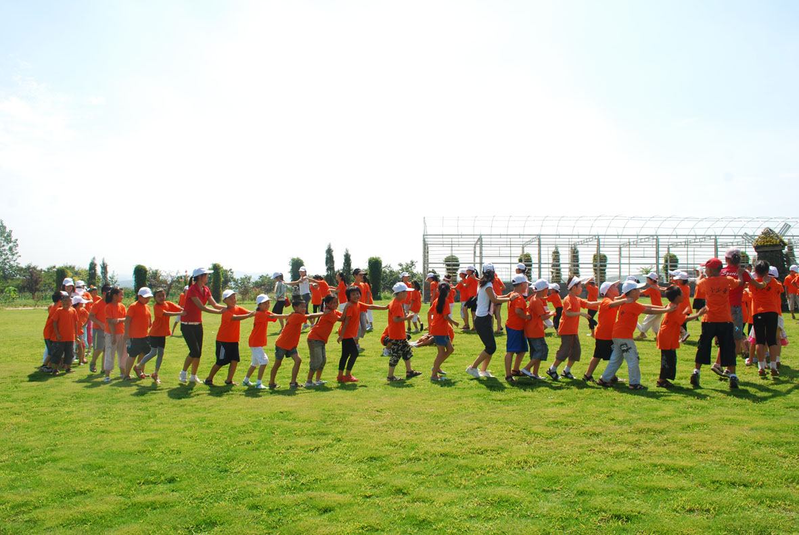
do some activities

Slide 9
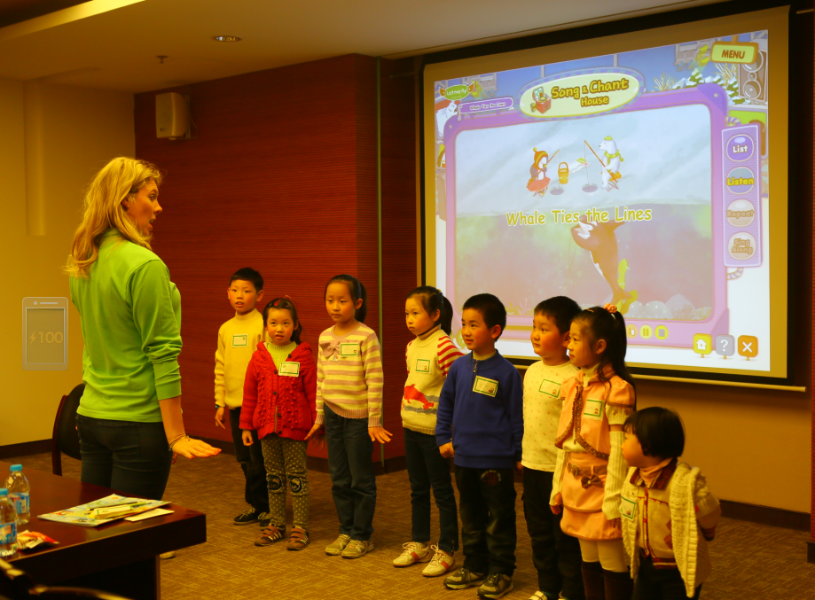
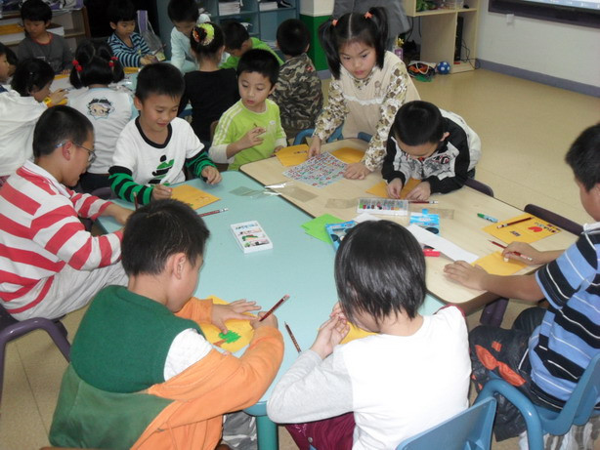
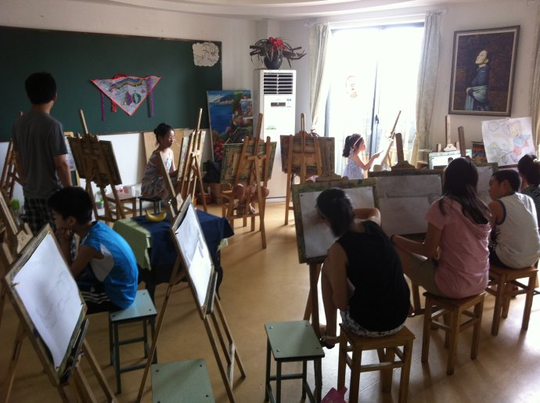
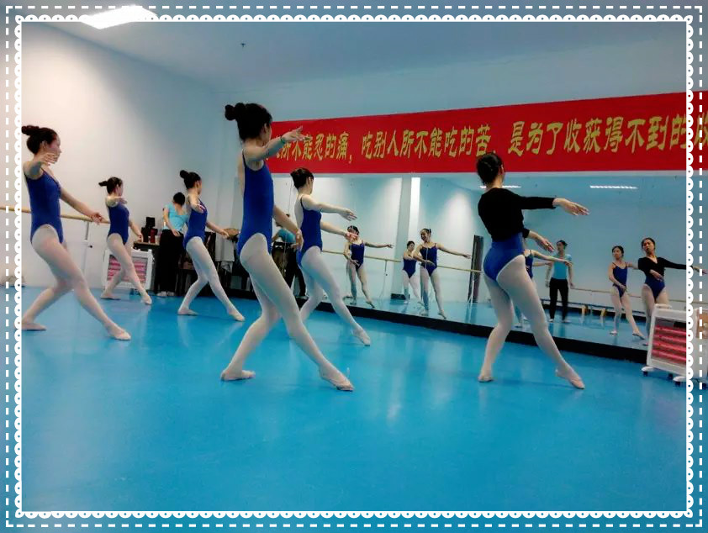
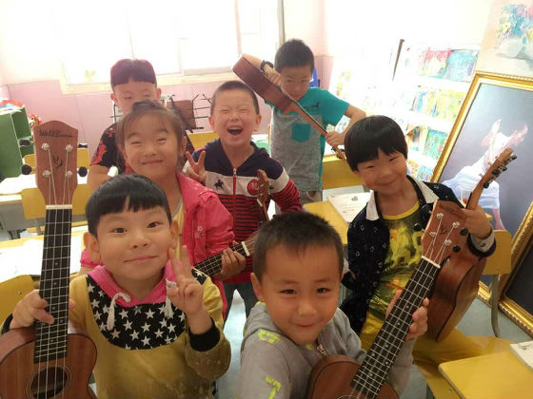
Summer Courses

Slide 10
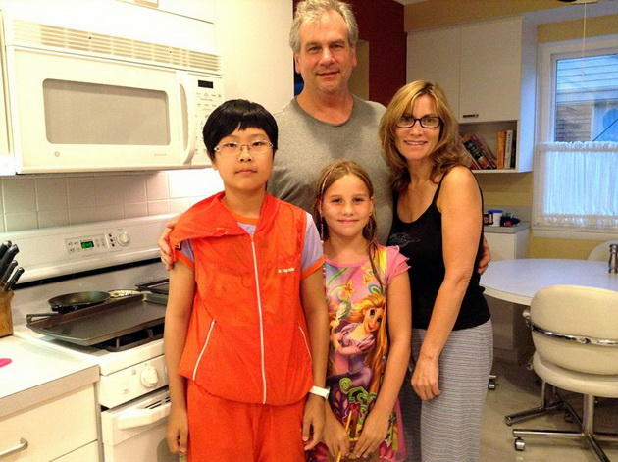
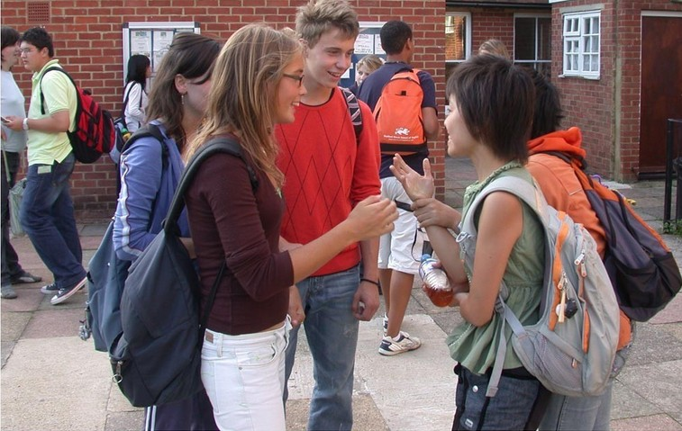
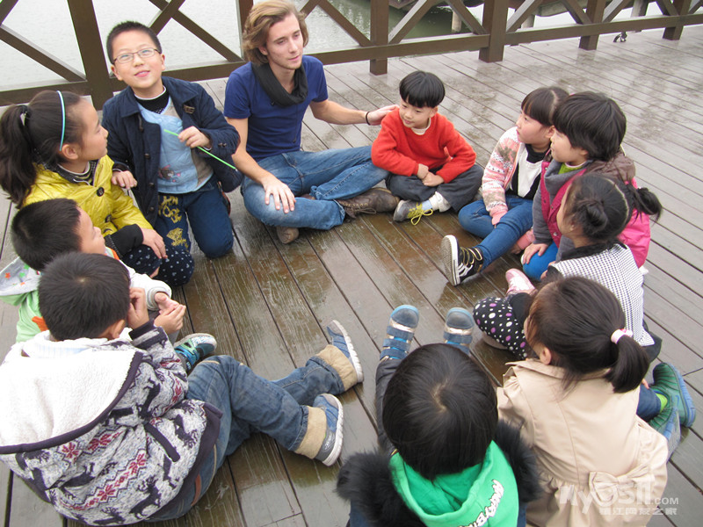
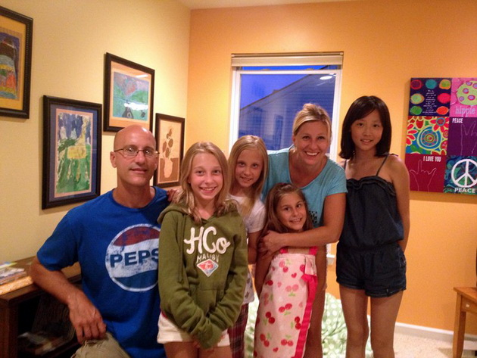
stay with American families

Slide 11
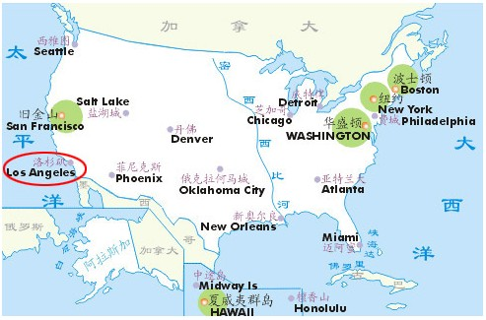
LA ?
How much do you know about
LA is short for Los Angeles.
Los Angeles is the second largest city in the US. It is located on the west coast of America. In Spanish, Los Angeles means “angel” (天使), so Americans call it “the City of Angel”.

Slide 12
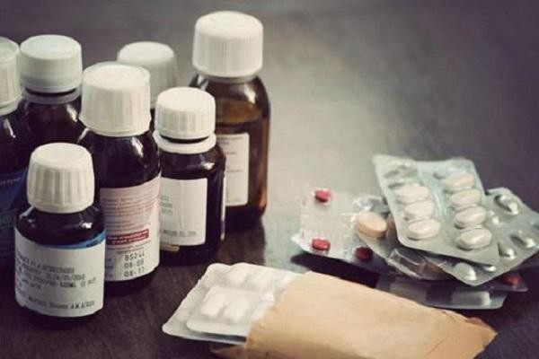
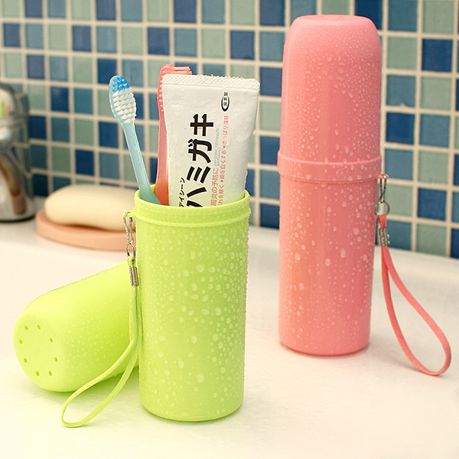
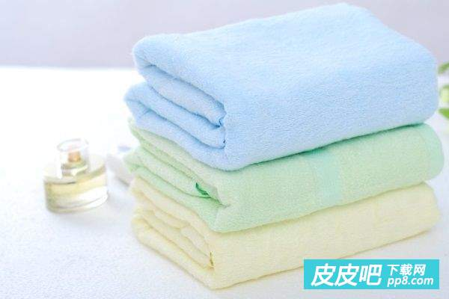
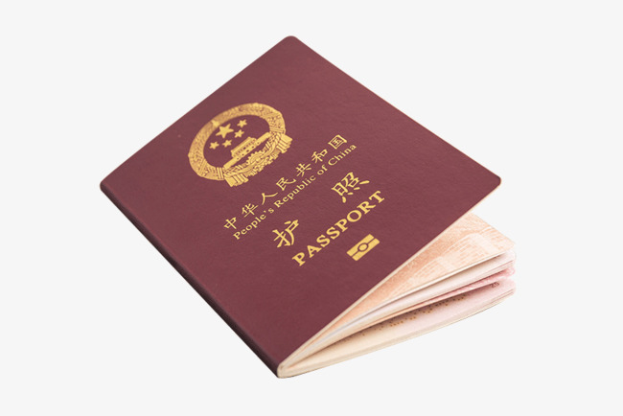
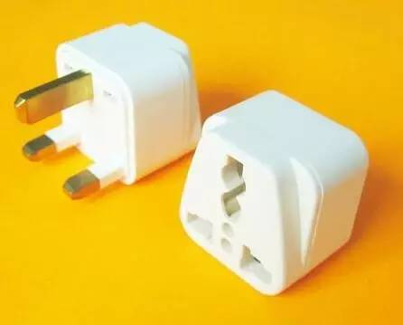

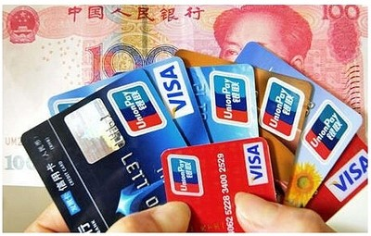
What should we take?
Trip to LA?
medicine
toiletries
['tɔɪlətrɪz]
towels
passport
credit card
conversion plug
luggage
['lʌɡɪdʒ]

Slide 13
Listening and vocabulary

Slide 14


Listen and complete the notes.
Where Daming and Lingling are going:____________________
What they are going to do:_________
___________________________
3. How long they will stay: ____________
____________________
4. How many students there are in the group: ___________________________
They are going to LA.
They are
going to do an English course.
They’ll stay
for about four weeks.
They are going in a group of 20.

Slide 15

Tapescript
Darning: Have you heard the news?
Betty: What news?
Darning: Lingling and I are doing an English
course in LA this summer!
Betty: Oh, really? That's great! How long
will you stay in LA?
Darning: About four weeks. It's a good chance
to practise my English.

Slide 16
Betty: It sure is! But it's also quite expensive
to stay in America for four weeks.
Darning: We are going in a group of 20, and
we'll all stay with different families,
so it won't cost so much.
Betty: That's good to hear. I hope you have
a great time!

Slide 17

Watch and read
Everyday English
• Can you help me?
• How can I help?.
• Well, it sounds crazy, but…
• By the way, …
见视频Module 7 Unit 1 Activity 2

Slide 18
Now check (√) the things Betty suggests Lingling take .
1. dollars
2. shorts
3. jeans
4. T-shirts
5. pens
6. a dictionary
7. passport
8. sunglasses
9. notebooks
√
√
√
√
√
√

Slide 19
3. Find sentences in the conversation which suggest that...
Can you help me?
Ling ling wants help.
2. Betty is glad to offer help.
3. Lingling asks for more help.
4. Betty tells Lingling to remember something important.
How can I help?
What else?
Oh, by the way, don’t forget to take your passport.

Slide 20
4. Complete the passage with the words in the box.
crazy list passport shorts
total trousers weigh weight
When you are planning a trip, make a (1) ______ of things to take. Do not go (2) _______ and take too many clothes. For warm countries you can keep cool with (3) ________ and some
list
crazy
shorts

Slide 21
light (4) _________. If you travel by plane, your bag cannot (5)_______ too much. For some flights, twenty kilos may be the (6)_____ you can take. To make sure, ask the travel company for help. Remember to check the (7)_______ of your bag. And finally, the most important thing: do not forget to take your
(8) __________!
trousers
weigh
total
weight
passport

Slide 22
Pronunciation and speaking

Slide 23
5. Listen and underline the words the speaker stresses.
1. What clothes should I take to LA?
2. I haven't got any sunglasses. I'll buy a pair
there.
3. Many things are more expensive in America.
Now listen again and repeat.

Slide 24
Watch and read
Everyday English
• Can you help me?
• How can I help?.
• Well, it sounds crazy, but…
• By the way, …
见视频Module 7 Unit 1 Activity 2

Slide 25
6. Work in pairs. Talk about Lingling’s
plans and Betty’s advice.
Lingling is preparing for her trip to LA. She always likes to get things ready earlier. But she doesn't know what to do, she asks Betty for help.
notebooks ,pens, a dictionary , at the end of July, four weeks, shorts, light trousers, sunny and hot, sunglasses, more expensive, 200 dollars, mustn't weight too much, the total weight, passport

Slide 26
Summary
prepare for
get things ready
make a list of
at the end of
pay for
by the way
have a great time
write to sb.
为…做准备
把事情准备好
列一个…的目录（清单）
在…的结尾
支付
顺便说一句
玩得高兴
写信给（某人）

Slide 27

5. Summer holiday is coming. You are making a travel plan to...
A: XXX, what are you doing?
B: I’m preparing for my trip to…
A: That’s a beautiful place. I have been there twice.
B: Really? Could you give me some advice? I don’t know what to do.
A: ...
When..... How long......
weight\ weigh
I don’t know what to do....
Anything else?
passport\ dictionary\shorts...

Slide 28

Language points
Lingling and I are doing an English course
in LA this summer!
今年夏天玲玲和我将要在洛杉矶学习英语课程。
本句是一个现在进行时表达将来含义的句子。有些动词如 go, come, leave等，可以用现在进行时表将来。
例如：
I’m going. 我要走了。
When are you leaving for Beijing?
你打算什么时候离开去北京？

Slide 29
2. Shorts are good, or you can wear light
trousers.
短裤就行，或者穿薄裤子也可以。
本句中的light可以解释为thin and not warm, 指“衣服薄的，不暖和的”。
例如：
She just take a light sweater and went out.
她只拿了一件薄毛衣就出去了。

Slide 30
3. If you've already paid for the air tickets
and for homestay. it should be OK.
如果你己经付过机票钱和家庭寄宿费了， 那就应该够了。
pay for 表示“支付……的费用，为……付 款”。

Slide 31
例如：
My father paid for my driving lessons.
我爸爸支付了我学车的费用。
homestay指吃住在当地人家里，实际体验 当地人的生活。

Slide 32
4. Is 200 dollars enough?
200美元够吗？
表示金钱、时间、重量或路程的名词做主语时，我们通常把它看成一个整体概念，即使它形式上是复数的，谓语动词也应该用单数形式。
例如：
Three months has passed since you left.
自从你离开已经过去三个月了。
Ten kilometres is not so far.
10公里不算远。

Slide 33
5. Oh, by the way, don't forget to take your
passport.
噢，顺便说一下，别忘了带你的护照。
by the way的意思是“顺便说一下，附带说一下”，用于转入与刚才说的主题无关的事。

Slide 34
例如：
By the way, why not drop in for a drink this evening?
顺便说一句，今晚来我家喝一杯怎么样？
By the way, have you seen my glasses anywhere?
顺便问问，你在什么地方见过我的 眼镜吗？

Slide 35

Exercise
一、单项选择题。
1. — What do you think of this skirt?
— It’s beautiful and it fits us well, _____ I
like it very much.
A. since B. so C. but D. or
2. — Have you got some water to drink?
— Here you are. There___ still some in the
bottle.
A. are B. were C. is D. was
B
C

Slide 36
3. _____ there many American friends in the
school last Friday?
A. Is B. Was C. Are D. Were
4. There ____ a great many accidents last year.
A. were B. are C. is D. was
5. —How many children ____ in the picture?
—Three.
A. has there B. is there
C. have there D. are there
D
A
D

Slide 37
二、根据句意和汉语或首字母提示写单词。
If you want to go abroad, you should have
a p___________.
2. If you go to the beach, wear a pair of
s_________. It is good for your eyes.
3. Her _______(重量) has increased to 120 pounds.
assport
unglasses
weight

Slide 38
Homework
Learn the new words and expressions in this unit.
Talk about the advantages and disadvantages of summer courses.

Slide 39


桂林市桂电中学
2020.8.20录制

