Slide 1
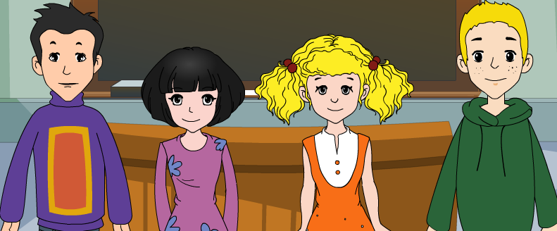
外研八年级（下） 授课教师 杨晔

Slide 2
Module
6
Hobbies
Unit 1
Do you collect anything?

Slide 3
Teaching aims
1. Teaching aims:
To understand the conversation on hobbies
To get specific information from the conversation about hobbies
To be able to ask each people about their hobbies

Slide 4
2. Main contents:
Key vocabulary
stamp, shelf, have a look, as, coin, pound,
dollar, valuable, with, value, just
Key structures
—Sorry, it’s a bit of a mess.
—You’ve got…
—People often give me fans…

Slide 5
Think about it!
A: What do you like doing when you
are free?
B: I like singing.
A: So your hobby is singing.

Slide 6
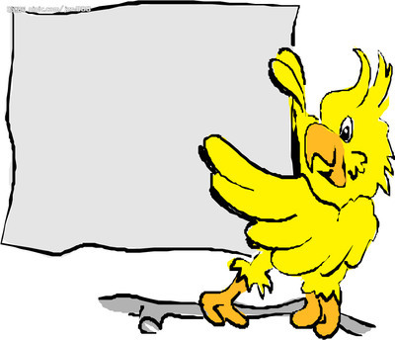
Different people have different hobbies！
爱好；兴趣

Slide 7
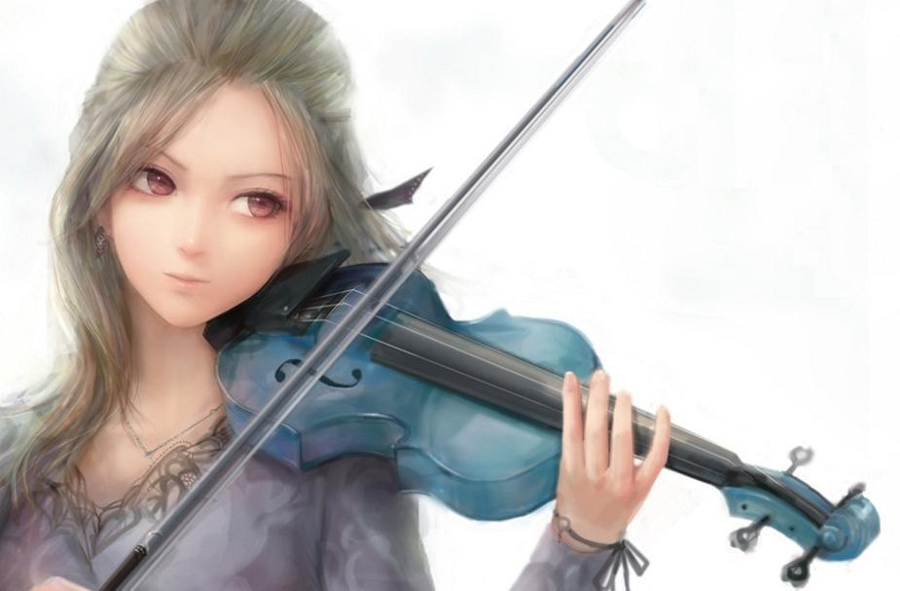
What other hobbies do people usually have?
mountain biking
playing the violin
sailing

Slide 8
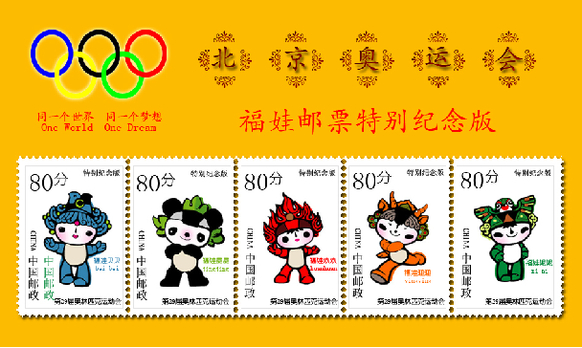
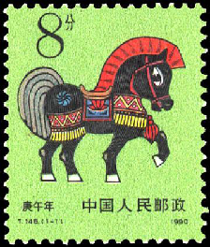
Look and say
My brother's hobby is collecting stamps.
Yes. And I have a large collection of stamps.

Slide 9
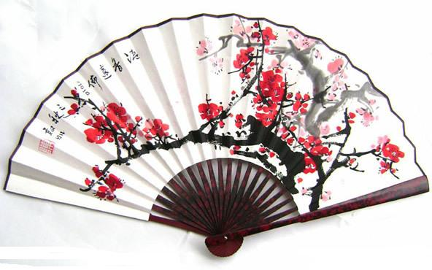
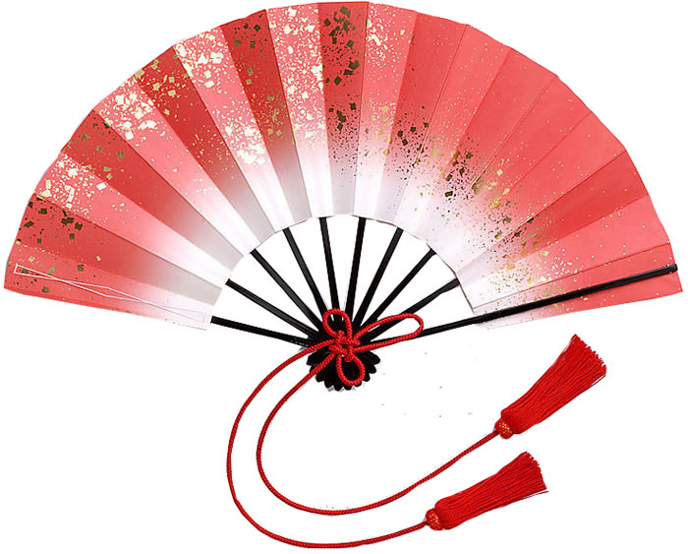
Let’s look at the pictures and say the name of the collection.
fans
It is a colletion of fans.

Slide 10
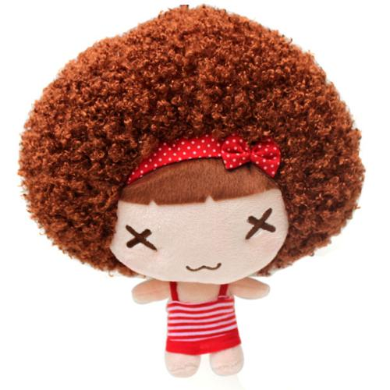
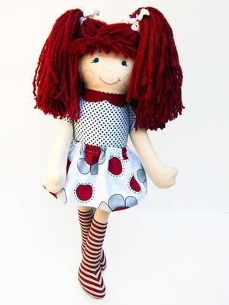
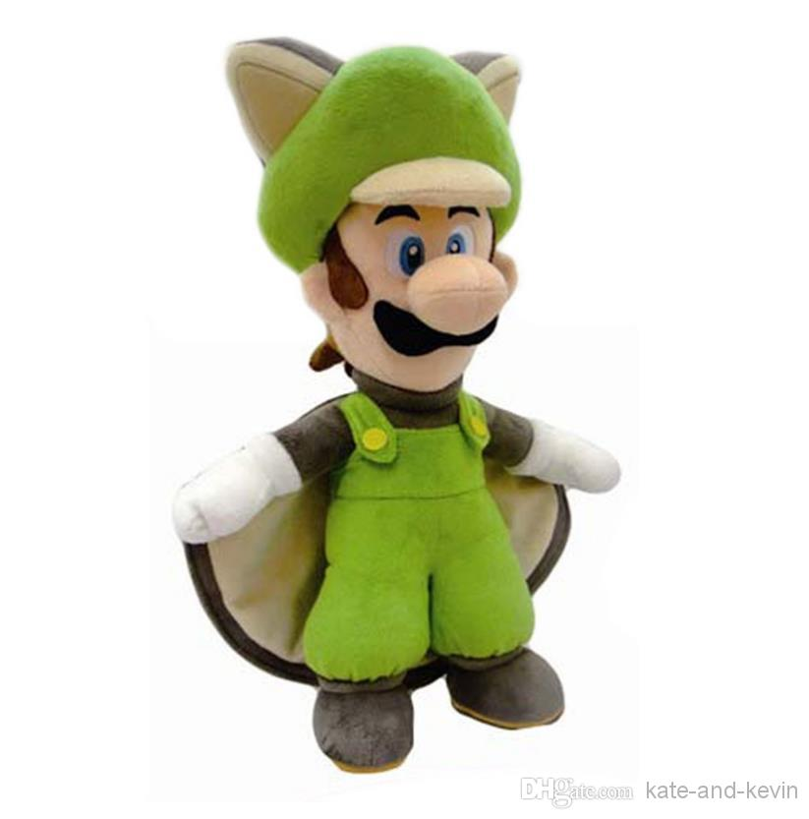
dolls

Slide 11
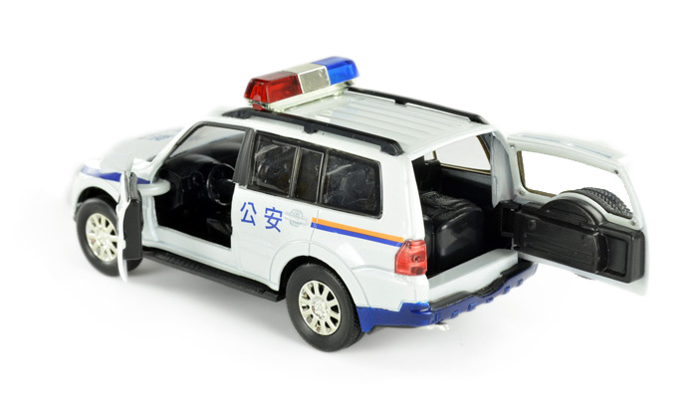
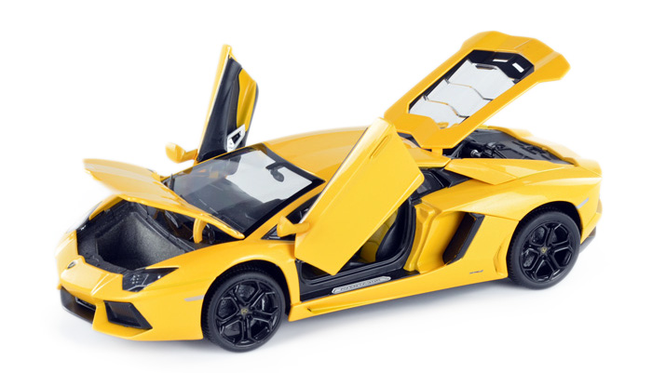
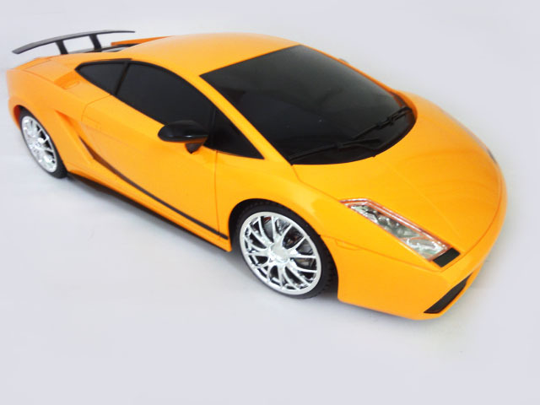
model cars

Slide 12
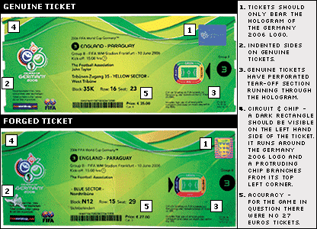
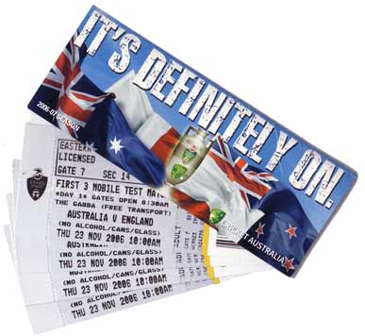
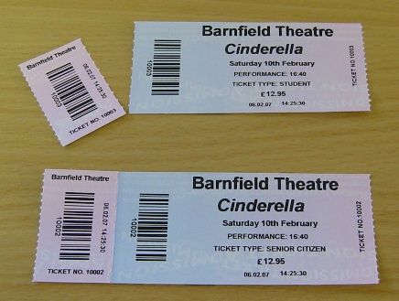
tickets

Slide 13
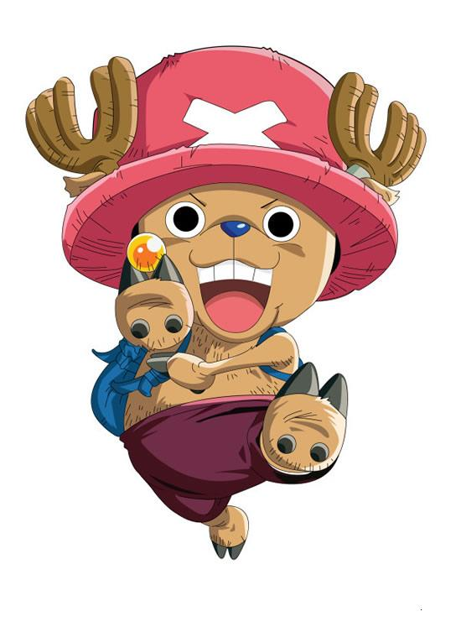
I collect stamps because it is interesting and takes up the least space. But it’s a
bit expensive. What about you?
Do you collect anything?
What do you collect?
Why do you collect them?

Slide 14
Listening and vocabulary

Slide 15
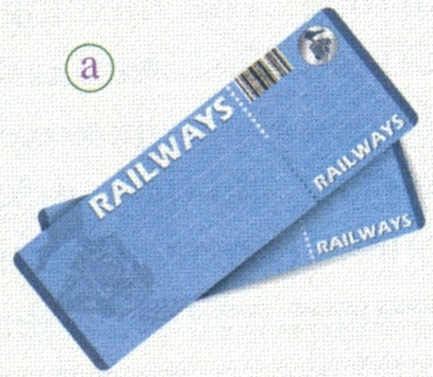
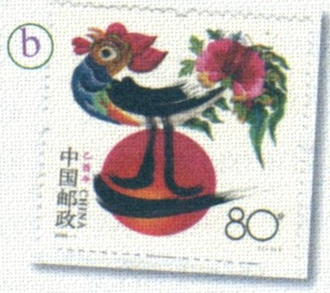
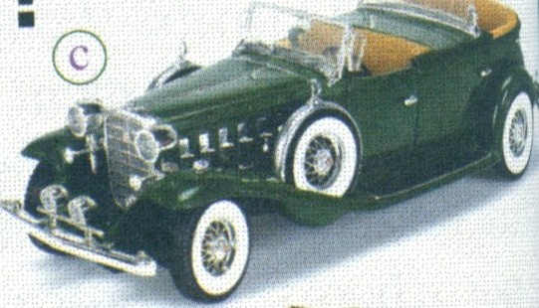
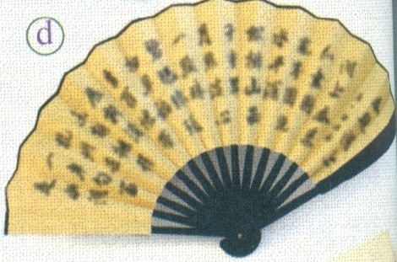
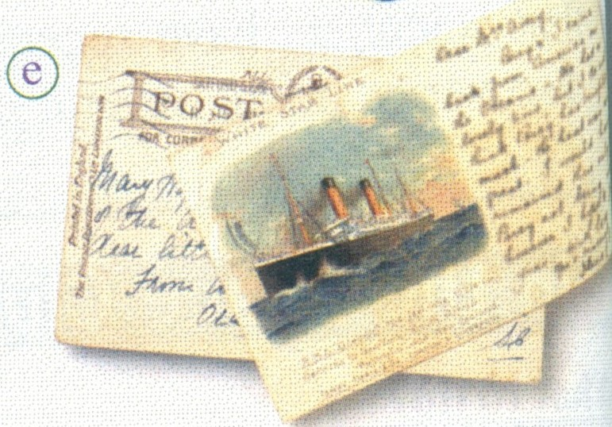
Listen and find out who collects the things in the pictures.
Tony
Tony’s dad
Tony’s mum
√
√
√
√
√
√

Slide 16
2. Answer the questions. Use the words
and expression in the box to help you.
collect fan postcard stamp
ticket tidy up toy
What does Tony’s mum want him to do ?
She wants him to tidy up his room.

Slide 17
2. Which hobby does Tony think is expensive?
3. Which hobby do you think takes up
the most space?
Tony thinks stamp-collecting is expensive.
(Possible answer) I think collecting toy cars takes up the most space.

Slide 18
Tapescript
Tony's mum: Tony, can you tidy up your room,
please?
Tony: OK, Mum. I'll do it right away.
Tony's mum: You need to find a place to put all
those toy cars.
Tony: That's not easy. I've got so many
toy cars now!
Tony's mum: Yes, you have! You know, your
dad collected cars too when he
was your age. He also collected
stamps.

Slide 19
Tony: Well, stamps are too expensive
for me. But I've collected a lot of
tickets. Did you collect anything
when you were young, Mum?
Tony's mum: Yes, I collected postcards and
fans — you know, Chinese fans.
Tony: I see.

Slide 20
Watch and learn
Everyday English
• Sorry, it’s a bit of a mess.
• let me have a look.
• Can I see them?
• Right!
见视频Module 6 Unit 1 Activity 3

Slide 21
Now complete the notes.
Lingling’s hobby: _________________
Betty’s hobbies:
____________________________________
Tony’s hobby:
______________________________
collecting fans
collecting coins and notes; collecting stamps
collecting bus and train tickets

Slide 22
4. Complete the passage with the correct form of the words in the box.
coin dollar pound remember shelf somewhere
Many people collect things, like postcards and toys. They like to put them (1) __________ special to look at. Lingling collects fans and keeps them on a (2) _______ in her bedroom.
Betty collects (3) _______ and notes, such as
somewhere
shelf
coins

Slide 23
British (4)________ and US (5) ________
She also collects stamps from all over the world. Tony collects tickets, but Betty thinks that you cannot do anything with old tickets. Lingling thinks that people also enjoy collecting things to (6) __________ something important in their lives.
pounds
dollars
remember

Slide 24
Pronunciation and speaking

Slide 25
5. Listen and notice the intonation.
1. Let me have a look.
2. Do you collect anything?
3. Yes, I collect coins and notes.
4. Can I see them?
Now listen again and repeat.

Slide 26
Watch and read
Everyday English
• Sorry, it’s a bit of a mess.
• let me have a look.
• Can I see them?
• Right!
见视频Module 6 Unit 1 Activity 3

Slide 27
Role-play
1. Read the dialogue aloud for a
few minutes by yourself;
2. Role play in groups;
3. Role play in front of the class
We’ll see which group does the best.

Slide 28
6. Work in pairs. Ask and answer about
your hobbies.
1. What is your hobby?
2. Why do you enjoy your hobby?
3. When did you start doing it?
4. How often do you …?
5. Where do you …?

Slide 29
Let’s ask and answer.

Slide 30
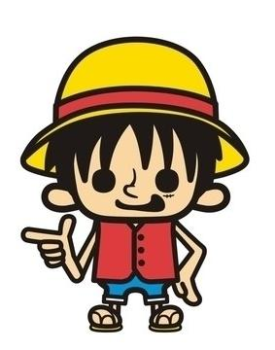
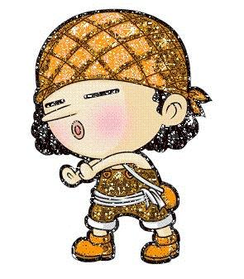
A
A: What’s your hobby, Eric?
B: My hobby is reading books.
A: When did you start doing it?
B
B: I started doing it when I was seven years old.
A: How often do you read books?
B: I read books every day when I am free.

Slide 31
A: Where do you read books?
B: I read books everywhere, in the classroom,
bedroom, library and park and so on.
A: Why do you enjoy your hobby?
B: I think reading can make me happy and
know a lot about the world.
A: Do you want to change your hobby when
you grow up?
B: I don’t think so. Reading is important and
relaxing.

Slide 32
6. Work in pairs. Ask and answer about
your hobbies.
1. What is your hobby?
2. Why do you enjoy your hobby?
3. When did you start doing it?
4. How often do you …?
5. Where do you …?

Slide 33
Language points

Slide 34
Language points
Tony’s mum want him to tidy up his room.
I’ll tidy up the table and chairs.
tidy up = clean up 收拾好, 整理好
Please tidy up these newspapers.
When are you going to tidy your room up?
2. Which hobby do you think takes up the
most space?
take up: 占用
These documents take up too much space.

Slide 35
例：
Daming , your bedroom looks . Will you please ? A. tidy ; tidy it B. tidy ; tidy it up C. untidy ; tidy up it D. untidy ; tidy it up
D
解析:系动词look后跟形容词作表语,排除B ; 根据句意应为untidy, 排除A; tidy up 跟代动词作宾语时,代词必须位于词组中间.

Slide 36
3. Did you collect anything when you were young, Mum?
collect v. bring or get sth together 收集
collection n. 收藏品, 收集物
collector n. 收藏家
e.g.
Linda likes collecting dolls.
David has a collection of tickets.
Mr. Wang is a book collector.

Slide 37
例：
— How long you stamps? — For many years. I have a wonderful
collection. A. have ; collected B. have ; had C. have ; bought D. have ; collecting
A
解析: collection提示问句意为”集邮”,排除B, C; collect 构成完成时态用过去分词collected , 排除D.

Slide 38
4. Sorry it’s a bit of mess.
不好意思，（家里）有点乱。
mess n. 脏乱；凌乱 (此处是不可数名词)
They spent the whole morning tidying up the
mess after the party.
The heavy rain made a great mess of the garden.
a bit: a little 有点 (既可修饰形容词/
副词的原级, 也可修饰比较级)
not a bit=not at all, not a little=very
a bit of adj. 一点(修饰不可数名词)

Slide 39
5. … I collect coins and notes, you know, like
British pounds and US dollars.
我收集硬币和纸币，你知道，比如英镑和美元。
notes 在这里表示“纸币”，为复数形式，其单数形式为note。例如：
Have you read the book One million Pound
Note by Mark Twain?
你读过马克吐温的《百万英镑》吗？
Where did the five-pound note come from?

Slide 40
notes 还可以表示“记录，笔记”，一般只用复数形式，固定搭配: take notes
例如：
Some students don't like to take notes.
一些学生不爱作笔记。
Do you usually take notes in class with a pen or a pencil?
你在课堂上记笔记通常用钢笔还是铅笔？

Slide 41
6. My hobby doesn’t cost as much as yours…
我的爱好不像你们的爱好那么费钱…
cost much 意思是“花很多钱”，如：
We can take a taxi. That doesn’t cost much.
我们可以打车去，花不了多少钱。
Most hotels cost much more in high season.
旺季的时候大多数酒店收费很高。

Slide 42
7. People usually collect things just to remember
something important in their lives.
人们收藏东西常常只是想纪念生活中重要的事 情。
当形容词或else修饰复合不定代词something, everything，everyone等时，形容词或 else必须放在复合不定代词的后面。如：

Slide 43
Xiaoming, I have something important to tell you.
小明，我有重要的事情要告诉你。
We need one more helper. Can you find anyone else?
我们还需要一个助手，你能再找一个吗？

Slide 44
即学即练
1. The fisherman saw _____ in the net.
A. some strange thing B. something strange
C. some thing strange D. strange something
2. There is ______ with my computer. It doesn’t work.
A. nothing wrong B. anything wrong
C. wrong something D. something wrong
B
D

Slide 45
Exercise
一、单项选择题。
D
1. The plane will ________from Beijing Capital Airport and land in London.
A. take up B. take out
C. take away D. take off
2. Tom owns ____ larger collection of _____ books than any other student in our class.
A. the;/ B. a;/
C. a; the D./；the
B

Slide 46
3. I like koala bears because they are kind of interesting. (词语释义) ______
A. very B. a few
C. a bit D. too
4. This photo often makes me _____ of my teachers in the primary school.
A. think B. to think
C. thinks D. thinking
C
A

Slide 47
C
5. The woman made her son ____ finally after she told him some jokes.
A. laughed B. to laugh
C. laugh D. laughing
6. -- I always listen to the teacher _______ in
class. -- It's very clever of you to do that. A. free B. freely
C. careful D. carefully
D

Slide 48
C
7. I heard somebody playing _____ .
A. piano B. a piano C. the piano D. pianos
8. —Ben, would you like to play football with
us? — ____, but I have to wash the dishes first.
A. No, I can’t B. I don’t want to
C. Yes, please D. I’d like to
D

Slide 49
B
9. Look! There’s ______ football under the teacher’s desk. Let’s play ____ football, OK?
A. / , / B. a, /
C. a , the D. a, a
10. We waited ages for a taxi. We gave up ______and walked home.
A. at the beginning B. in the end
C. at first D. at least
B

Slide 50
二、根据句意和汉语或首字母提示写单词。
1. Every ______ (硬币）has two sides.
2. My friend sent me a __________(值钱的）
gift yesterday.
3. He showed no _________ (兴趣) in the
world around him.
4. You can buy a s______ in the post office.
5. Before you begin to make a speech, you
should c_______ your ideas.
coin
valuable
interest
tamp
ollect

Slide 51
Homework
Learn the new words and expressions in this module.
Talk about your hobby and ask about others’ hobbies.

Slide 52
桂林市桂电中学
2020.8.20录制

