Slide 1
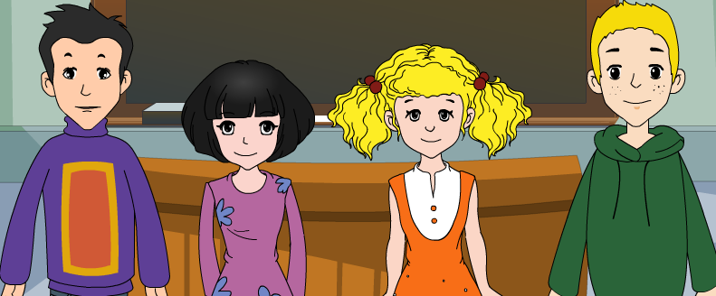
外研版新标准
七年级上册
Module 4
Healthy food
Unit 2
Is your food and drink healthy?

Slide 2
Words and expressions

Slide 3
Words and expressions
delicious
/bit /
/'taiəd /
/su:p /
/ri'membə/
/stei /
/'brekfəst /
/lʌntʃ /
/'dinə /
/'helθi/ adj.
/,ʌn'helθi/
/helθ/ n.
/di'liʃəs /
/bred /
/'hæmbə:ɡə /
/kri:m/
/'nu:dl /
/'ʃuɡə /
/tʃi:z/
/'evri /
/tu:θ /
bit
bread
有点儿
a bit
hamburger
tired
cream
soup
noodle
remember
sugar
stay
cheese
长胖
get fat
every
breakfast
tooth
lunch
dinner
（pl：teeth / ti:θ /）
healthy
be good for
对……有好处
unhealthy
be bad for
对……不宜
health

Slide 4
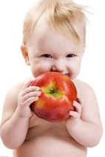
An apple a day
keeps a doctor away.
/ im p tnt /
'
ɔ:
It’s important
for us to remember:
have healthy
food and drink.
Eat well, stay healthy, and don’t get fat!

Slide 5
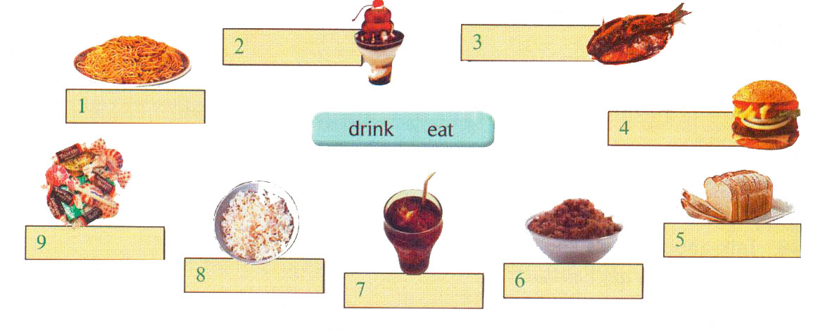
1. Label the pictures with the words
and expression from the box.
2. ice cream
3. fish
1. noodles
4. hamburger
9. candies
5. bread
8. rice
6. sugar
7. cola

Slide 6
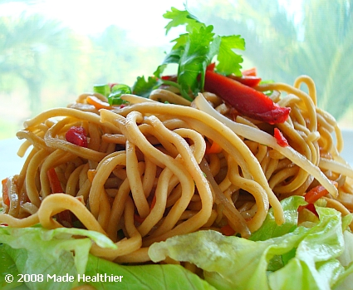
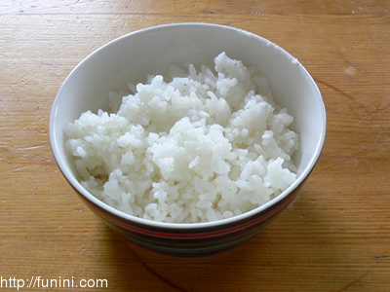
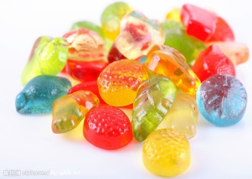
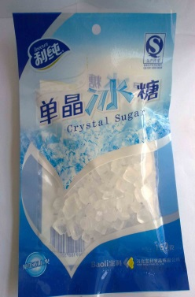
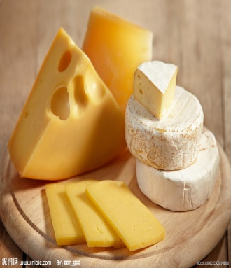
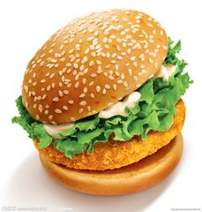
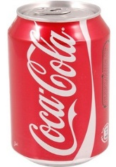
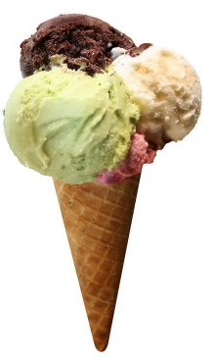
noodles
rice
bread
fish
healthy
candies
ice cream
hamburgers
unhealthy
cola
Sugar?
cheese

Slide 7
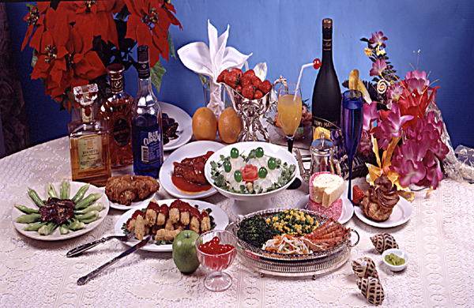
2. Free talk
What's your favourite food and drink?
Is it healthy food and drink?
Noodles are my favorite food and I think they are very healthy.
Cola is my favorite drink but too much cola is unhealthy.

Slide 8
P22
Read and complete the table
Healthy food and drink | Unhealthy food and drink
meat, carrots, eggs,
sweet potatoes,
milk, cheese, fish,
chicken soup,
noodles, rice, juice,
water, tea, vegetables
ice cream, hamburgers
cola, candy,

Slide 9
Summary
Complete the passage.
delicious, fat, important, lots of,
meal, remember, stay, sweet, tooth--teeth
A healthy breakfast is _________ in the morning and it’s my favourite ______. There are _______ fruit and vegetables for lunch at school, but there isn’t any cola or candy. Candy and cola are ______ food and drink and they are bad for your ______. At home, my grandma’s dinners are _________ and we aren’t ______. ____________ ! Eat well and stay _________.
important
meal
lots of
sweet
teeth
delicious
fat
Remember
healthy

Slide 10
Enjoy watching and retell.
It’s important to remember: …
* 1. Eat…or…, not… *2. Have a good…
* 3. Drink… and…, not… *4. … 5. 6.

Slide 11
My diet!(我的饮食）
Every morning, I have a good breakfast because it can help me stay healthy. I eat the right food for breakfast: eggs, noodles or bread and I drink milk. They are healthy food and drink and they are good for me. I usually have rice, a little meat and a lot of
vegetables for lunch. For dinner, I only have yogurt and fruit, because I am on diet（节食）. My favourite snack is chocolate, but too much chocolate is bad for me.I think my diet is healthy, and I know it’s important to remember: eat well, stay healthy and don’t get fat!

Slide 12
A healthy diet(饮食）
Nowadays(目前） many students do not have a healthy diet and they are not very strong. Here is my advice（建议） on how to keep a healthy diet.
Firstly, __________________
Secondly, ______________________
Thirdly, ________________________
All in all (总而言之），it is very important to remember _____________________.
1. 每日三餐，早餐一定要吃。
2. 每天摄入一定量的米饭，肉类，蔬菜，水果等。
3. 少喝饮料多喝果汁和牛奶。

Slide 14
Good bye!
授课教师
桂林市桂电中学 杨晔

