Slide 1
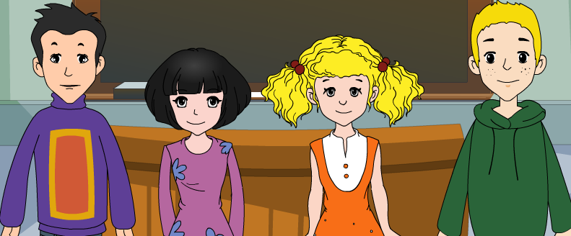
外研版新标准
七年级上册
Module 2
My family
Unit 2
These are my parents.

Slide 2
Words and expressions

Slide 3
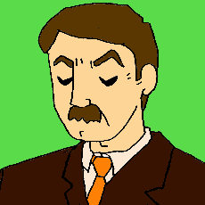
When you see a man or a woman,
What jobs can you think of ?
manager
actor
teacher
bus driver
policeman
?

Slide 4
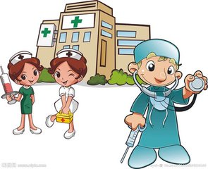
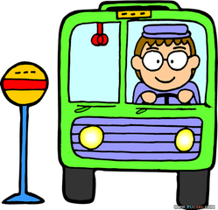
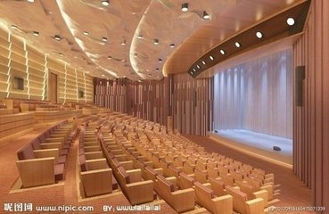
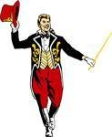
hospital
/'hɔspitl /
/bʌs/ /'steiʃən /
bus station
nurses
/'draivə /
driver
/nə:s /
doctor
theatre
/'θiətə /
actor
manager
/'mænidʒə
1.What and where

Slide 5
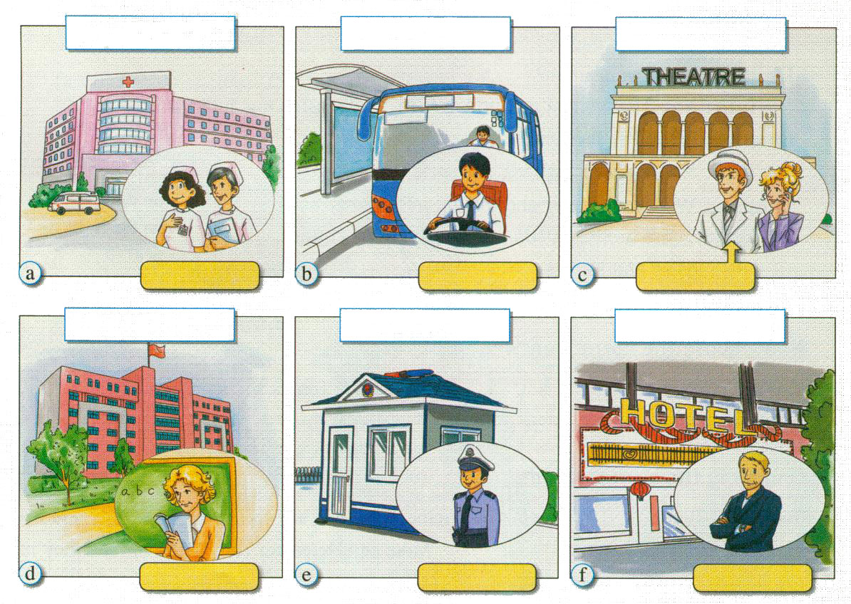
hospital
bus station
theatre
nurses
bus driver
actor
school
police station
hotel
English teacher
policeman
hotel manager

Slide 6
P 10 3. Read the passage and write the letters of the pictures in Activity 1.
1 These are Betty's parents. _______
2 These are Lingling's mother and Daming's mother. ___________
3 This is Tony's father. ___________
4 This is Tony's mother. __________
5 This is Daming's father. _________
6 This is Lingling's father. __________
c
a
f
d
e
b

Slide 7
Complete the table.
 | Betty |  | Daming
Father | actor | theatre
Mother |  |  | nurse
police station
policeman
manager
theatre
hospital
 | Tony |  | Lingling
Father
Mother
manager hotel
driver bus station
teacher school
nurse hospital
A: What does Betty’s father do? B: He is an actor.
A: Where does he work? B: He works at a theatre.

Slide 8
Watch and read

Slide 9
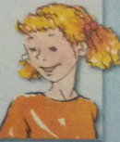
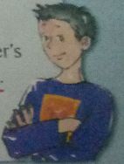
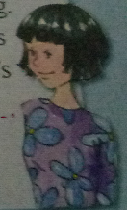
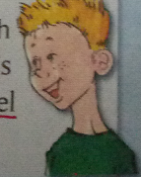
6. Retelling
I have made many friends in my new school. Now let me introduce them to you. This is ….
Li Daming
Chinese
father's job
policeman
nurse
Betty King
American
actor
the manager of
Wang Lingling
Chinese
nurse
hospital
bus driver
Tony Smith
English teacher
hotel manager

Slide 10
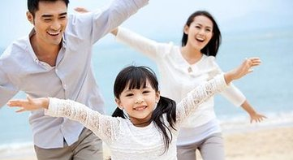
8. Writing
My family
1. Put Module 1 and Module 2 together to
introduce your family.
Members:
Job and place:
Hobby:
........
And other information.

Slide 11
5. Look at this sentence.
My name is Tony Smith and I’m English.
capital letter
full stop
提示: 英语句子的首字母; 姓名的首字母; 第一人称I以及国家名称的首字母都需要大写。英语中句号用实心小圆点表示。

Slide 12
My family
I love my family, because I have a happy family. My father is an officer and he works in the government. He is tall with a pair of black glasses. His hobby is playing table tennis .My mother is a housewife. She is very kind and nice. I love my parents very much! I am an eleven-year-old schoolboy, I am in Guidian Middle School. Playing volleyball is my favourite sport . There is a little baby in my home, she is my sister. She is so lovely that everyone likes her. I’m very happy to live with my parents together!

Slide 13
Good bye!
授课教师
桂林市桂电中学 杨晔

