Slide 1
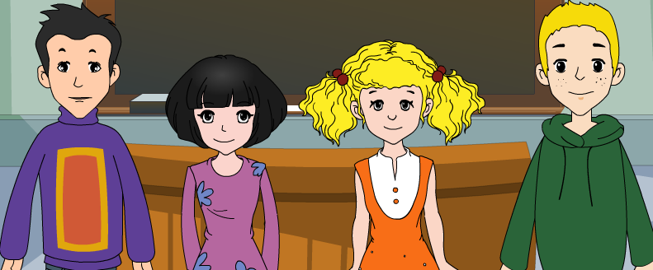
外研版新标准
七年级上册
Module 3
My School
Unit 1
There are thirty studnts in my class

Slide 2
/'twenti/
/'θə:ti/
/'fɔ:ti/
/'fifti/
/'siksti/
/'sevənti/
/'eiti/
/'nainti/
twenty 20
Numbers
thirty 30
forty 40
fifty 50
sixty 60
seventy 70
eighty 80
ninety 90
Notes:
是否取消此张？

Slide 3
/'fə:nitʃə/
/'piktʃə/
/'fju:tʃə/
/'teli,viʒən/
furniture 家具
picture 图片
future 将来
television 电视
/wə:ld/
world 世界
New
Words
/kəm'pju:tə/
computer

Slide 4
√

Slide 5
Listen again and complete the table.
Class | Number of students | Pictures | Type of map
Linda’s class
Daming’s class
There are some pictures.
A map of
England
30
There aren’t any pictures
A map of
the world
40
Notes:
如果大部分学生已经在第二部分的记笔记中记下了表格中的信息，则无需进入第二遍听力。

Slide 6
Watch & Read in role

Slide 7
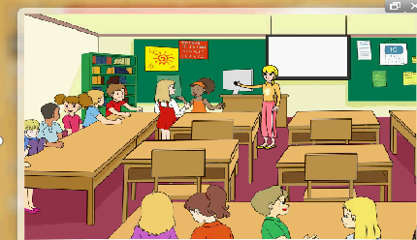
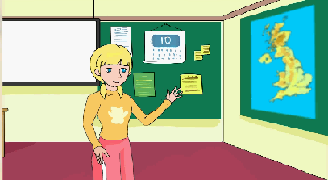
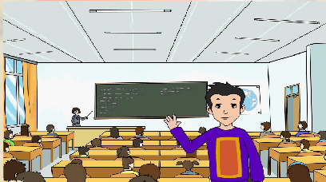
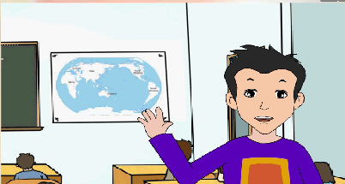
Talk about Daming's and Linda's classrooms.
big thirty computer pictures England
forty computer pictures the world

Slide 8
Complete the sentences
big
1. Linda’s classroom in England is _____. There are _______ students in her class.
thirty
2. In Daming’s class in Beijing, there are ______ students, _________ girls and _________ boys.
forty
twenty
twenty
computer
3. In Linda’s classroom, there is a __________ on the teacher’s desk. There are some _________ at the front of the classroom and a _______ of __________ on the wall.
pictures
map
England
4. In Daming’s classroom, there is a map of the _______ on the wall.
world

Slide 9
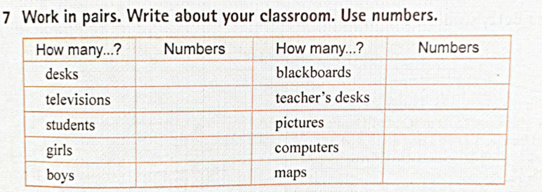
e.g
A: How many desks are there in your classroom?
B: There are fifth-two desks.
A: Are there computers in your classroom?
B: Yes, there is one on the teacher's desk.

Slide 11
Good bye!
授课教师
桂林市桂电中学 杨晔

