Slide 1
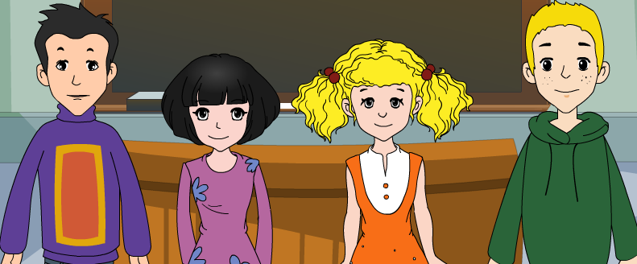
外研八年级（下） 授课教师 杨晔

Slide 2
Module
9
Friendship
Unit 1
Could I ask if you’ve mentioned this to her?

Slide 3
Teaching aims
1. Teaching aims:
To be able to talk about a personal experience with friends
To be able to understand sentences with object clauses.

Slide 4
2. Main contents:
Key vocabulary
separate, explain, mention, refuse, treat,
herself, whether, lonely, regret, patient,
introduce, encourage, join in
Key structures
Tell me when the problem started.
So could you explain what happened then?
Can you tell me how she’s different?
Could I ask if you’ve mentioned this to her?
Do you know why she treats you like that?

Slide 5
Guessing Game:
introduce
refuse
explain
separate
regret

Slide 6
Warming up

Slide 7
Think about it!
Do you have any friend?
Who is your best friend?
Where is your best friend from?
What does he / she like?
Do you often make a telephone call with
your friend?
…

Slide 8
What a good friend should be like?
I think that a good
friend should be…
Brain storming

Slide 9
I think that a good friend
should be clever.
kind | interesting | helpful
happy | beautiful | funny
polite |  | strong
bright | clever | able
nice | honest | humorous
good friend

Slide 10
Can you list some expressions we use when we call somebody?
1. May I speak to Mary?
2. Is that Jim speaking?
3. This is Linda speaking.
4. Hold the line, please.
5. May I ask who is calling?
6. Can I take a message?
Notes:
导入一

Slide 11
7. Would you like to leave a message?
8. I’ll call back later.
9. I’m sorry, but he isn’t in right now.
10. Sorry, but I have to hang up now.
11. Your line was busy just now.

Slide 12
Listening and vocabulary

Slide 13
Listen and choose the correct answer.
Lingling wants to speak
to Betty / Mrs King.
2. Betty is in / out.
3. Betty’s friend / Mrs King’s friend works on the Friendship Helpline.

Slide 14
2. Number the sentences in the order
you hear them.
a: I’m sorry, she’s not in at the moment.
b: Is that Mrs King?
c: Could I speak to betty, please?
d: May I have the number?
e: Can I take a message?
f: Thanks so much.
2
3
1
5
4
6
Now listen again and check.

Slide 15
Tapescript
Mrs King: Hello!
Lingling: Hello! Could I speak to Betty, please?
Mrs King: I'm sorry, she's not in at the moment.
Lingling: Is that Mrs King?
Mrs King: Yes, this is Betty's mother. Is it
important? Can I take a message?
Lingling: Yes, please. This is Lingling, Betty’s
classmate. I have a problem with my
best friend and I need her help.
Mrs King: Oh, I'm sorry to hear that, Lingling.

Slide 16
But Betty is visiting her grandmother.
She won't be back until tomorrow.
Maybe you can try calling my friend,
Jane. She works on the Friendship
Helpline at school.
Lingling: Thanks so much, Mrs King. May I
have the number?
Mrs King: You can call her on 58590808.
Lingling: Thank you, Mrs King.
Mrs King: You're welcome, Lingling. I hope my
friend can help you.

Slide 17
Listen and answer
1.What’s Lingling’s problem?
Lingling’s friend doesn’t want her to see her other friends.
2. What advice does the helpline give to Lingling?
Try to find out whether she feels lonely without you.
Be patient with her and explain to her that she can make friends with your other friends too.
Try to introduce her to them.
Do you have any other advice?

Slide 18
Now Check (√) the true sentences.
1. Lingling called to ask for advice about
her schoolwork.
2. Lingling and her best friend are now in
the same school.
3. Lingling is happy to see her best friend
at the same school.
4. Lingling is having a hard time in the new
school.
5. Lingling gets help from the helpline.
×
√
√
×
√

Slide 19
4. Complete the passage with the correct
form of the words in the box.
encourage herself introduce lonely
patient regret separate treat
When you get (1)__________ from a friend, it may create problems for your friendship. She may not want you to see your other friends. If this is the case, she
separated

Slide 20
probably (2)_______ you like that because she does not feel sure of (3)_________. Try to find out whether she feels (4)_______ without you. It is natural to feel like that. She probably (5)_______ hurting you. Be (6) _______with her, (7)__________ her to your other friends and (8)___________her to join in more.
treats
herself
lonely
regrets
patient
introduce
encourage

Slide 21
Please pay attention to how the Helpline asked Lingling about her problem:
when started
→ what happened
→ how she is different
→ why she treats you like that → give some suggestions

Slide 22
4. Think and find out the other way to ask the questions
When did the problem start?
2. What happened then?
3. How is she different?
4. Have you mentioned this to her?
5. Why does she treat you like that?
Tell me
when the problem started.
Could you explain
what happened then?
Can you tell me
how she is different?
Could I ask
if you have mentioned this to her?
Do you know
why she treats you like that?

Slide 23
Practise
1.你能解释那时发生了什么吗？
Could you explain what happened then?
2.你能告诉我她怎么不一样？
Can you tell me how she is different?
3.我可否问一下你是否向她提及这件事吗？
Could I ask if you have mentioned this to her?
4.你知道她为什么那样对你吗？
Do you know why she treats you like that?
5.我不知道她是谁。
I didn’t know who she was.
6.我问她为什么那天她对我微笑。
I asked her why she smiled at me that day.
宾语从句三要素: 引导词、语序、时态

Slide 24
Proverbs
A friend in need is a friend indeed.
患难见真情.
Friends are like wine; the older, the better.
朋友象酒,越久越淳.
A life without a friend is a life without sunshine.
没有朋友的生活就像没有阳光的生活.

Slide 25
Language points

Slide 26
1. separate v. 使分开；分隔
adj. 分开的；单独的
We got separated when we went to different
schools last term, but we stayed in touch.
上学期我们去了不同的学校就分开了，但是
我们仍然保持联系。
They have been separated for six years.
他们已经分开6年了。

Slide 27
1. separate 作动词，常见短语是“get separated”
意为“分开”，例如：
We got separated when we were young.
我们小时候就分开了。
stay in touch = keep in touch 保持联系
Don’t forget to stay/keep in touch .
别忘了保持联系。
get separated是短暂性动词短语，不能与时间
段连用；其延续性动词短语是“be separated” ,
可以与时间段连用。

Slide 28
2. explain v. 解释；说明
Could you explain what happened then?
你能解释一下后来发生了什么事吗？
She explained the reason to me carefully.
她认真地向我解释了原因。
Can you explain to us how to use
the computer?
你能向我们解释一下怎样使用这台电吗？

Slide 29
【探究】
（1）explain sth. to sb. 向某人解释/ 说明某事
[不能说explain sb. sth. ]
（2）explain +that/ how/ why 从句，意为“(向
某人) 解释/ 说明……”。
（3）explain (to sb.) + 疑问词 + 动词不定式。

Slide 30
3. Could I ask if you've mentioned this to her?
我能问一下你跟她说过这事吗？
（1）该句为主从复合句，其中if引导的是宾语
从句。在此句中，if表示“是否”。
（2）mention sth. to sb. 意为“向某人说起某事”。
例如：
I mentioned this idea to my mum, and she
seemed to like it.
我把这个想法跟妈妈说了，她好像挺喜欢的。

Slide 31
4. refuse v. 拒绝
She refused to listen.
她拒绝听。
I don’t think he will refuse me.
我认为他不会拒绝我。
refuse是动词，意为“拒绝；回绝”。常
见搭配：refuse sb./ sth. 拒绝某人/ 某
事；refuse to do sth.拒绝做某事。

Slide 32
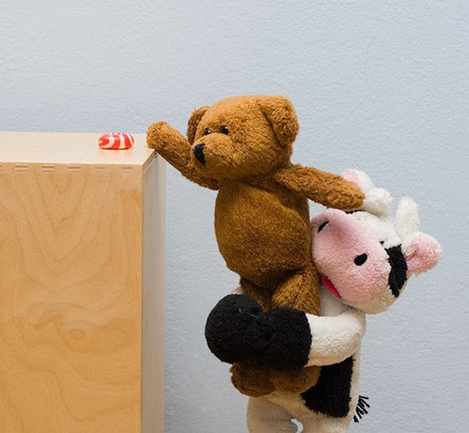
5. …do you know why she treats you like that?
…你知道她为什么那样对你吗？
treat sb. like that 表示“向那样对待某人”。
He treated me like that when I was in trouble.
当我遇到麻烦时，他那样对我。

Slide 33
6. Maybe she doesn't feel very sure of herself in
her new school.
也许是她在新校园里对自己不太自信的缘故。
feel/be sure of oneself 表示“有自信心，满怀
信心”。例如：
To succeed in something, you must be sure of
yourself. 要想获得成功, 你必须有自信心。
herself 表示“她自己”。是反身代词。
She can look after herself. 她可以照顾她自己。

Slide 34
7. Try to find out whether she feels lonely
without you.
设法弄清楚没有你在身边她是否感到孤独。
whether 作连词，表示“是否”，用于便是
迟疑或对某事不确定，常与“or not”连用，
构成“whether... or not”结构。该句中相当
于 if。
He asked me whether she was coming.
他问我她是否来。
feel lonely 表示“感到孤独”。

Slide 35
【辨析】
（1）lonely为形容词，意为“孤独的”，表示主观上感到孤独、寂寞，有较浓的感情色彩，在句中作表语或定语。作定语时，意为“荒凉的，偏僻的”，多修饰表示地点的名词。常见短语：feel lonely感到孤独；a lonely island 一座孤岛。
（2）alone用作形容词，意为“单独的”，只作表语，不能作定语，侧重说明客观上独自一人，没有同伴，没有感情色彩。
He is alone in the house. 他独自有人在屋里。

Slide 36
8. regret v. 懊悔；遗憾
I’m sure she regrets hurting you.
我肯定，她后悔伤害了你。
regret doing sth. 表示“后悔做了某事（已做）”。
regret to do sth. 对要做的事感到遗憾(未做) 。
regret to say / tell / inform ... 遗憾地说（告诉等）
I now regret leaving school so young.
我现在后悔当初那么年轻就辍了学。
I regret to say you failed in the exam.
我遗憾地说你考试不及格。

Slide 37
9. So be patient with her and explain to her
that she can make friends with your other
friends too.
所以对她要有耐心，向她解释她也能和你的
其他朋友交朋友。
be patient with表示“对……有耐心”。
Ms Wang is always patient with her students.
王老师对她的学生总是很有耐心。

Slide 38
make friends with sb. 表示“与某人交朋友”。
I am glad to make friends with you.
我很高兴能和你交朋友。
be patient to do sth. 意为“有耐心做某事”。
He is patient to teach his students English.
他有耐心教他的学生英语。
patient 的名词形式为patience, 意为“耐心”。
patient作为名词时，表示“病人”。

Slide 39
10. introduce v. 介绍；引见
Try to introduce her to them.
尽量把她介绍给你的朋友。
introduce … to sb. 表示“向某人介绍…”。
introduce oneself to 自我介绍
Let me introduce my friend to you.
让我向你介绍我的朋友。
Let me introduce myself to you.
让我向您做个自我介绍。

Slide 40
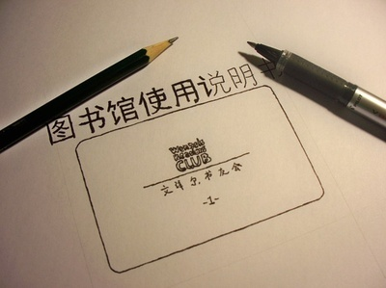
【拓展】
introduction n. 介绍，
说明(事情的内容或性质)
instruction n. 说明书；
指令(针对具体的操作步骤)
Follow the instructions on the packet carefully.
仔细按照包装上的说明操作。

Slide 41
I’ll encourage her to join in more.
我会鼓励她多加入到我们中来。
encourage sb. to do sth. 表示“鼓励某人去做
某事”。例如：
My teacher always encourage us to speak
English aloud in class.
我们老师总是鼓励我们在课堂上大声说英语。
join in 表示“加入，参加”。指参加某项活动。
Would you like to join in the party tonight?
你来参加今晚的派对吗？

Slide 42
Pronunciation and speaking

Slide 43
5. Listen and underline the words
the speaker stresses.
1. Don’t tell me who she is.
2. Tell me when the problem started.
3. Can you tell me how she’s different?
4. Maybe she doesn’t feel very sure of herself
in her new school.
5. I’ll encourage her to join in more.
Now listen again and repeat.

Slide 44
Watch and read
Everyday English
• Who is calling, please?
• This is …speaking.
见视频Module 9 Unit 1 Activity 3

Slide 45
Do you have any problems with friendship?
I’m shy and I haven’t had many friends.
My friend wants to copy my homework.
I had a big fight with my best friend and we don’t talk to each other now.

Slide 46
6. Work in pairs. Talk about your problems
with friendship.
Student A: You call the helpline to ask for
advice on your problems:
I’m shy and I haven’t had many friends.
I had a big fight with my best friend and we
don’t talk to each other now.
I have to go to a new school, but I don’t want
to leave my friends.

Slide 47
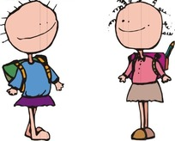
Student B: You work on the helpline.
Listen to Student A’s problems
and try to help.
— This is... on the helpline. How can I help you?
— This is... speaking. I have a problem…

Slide 48
Focus on
Words:
separate explain mention herself whether lonely regret patient introduce
Phrases:
join in encourage sb. to do refuse to do
Patterns:
Tell me when the problem started.
So could you explain what happened then?
Do you know why she treats you like that?

Slide 49
Exercise
一、单项选择题。
The good friends got ____ when they went to different colleges.
A. part B. separate C. separated
2. Don’t refuse ___ to others' advice. They may be very helpful.
A. to listen B. listen C. listening
C
A

Slide 50
3. My father often ______ the importance of study to me.
A. mention B. mentions
C. mentioned D. mentioning
4. When others don’t understand, you should be patient _____ them.
A. to B. at C. with D. for
B
C

Slide 51
5. Kate's family moved to a new place. She
often stays _____ at home and sometimes
she feels ______ without friends now.
A. alone; alone B. alone ; lonely
C. lonely; lonely D. lonely: alone
6. —Who's calling, please?
— ______ Lingling speaking.
A. I am B. She is
C. This is D. That is
B
C

Slide 52
7. — Is that Betty speaking?
— Sorry, She’s out. May I ____?
A. take a message B. leave a message
C. give a message D. write a message
8. ____ your help, I can’t make so much
progress.
A. With B. Under C. Below D. Without
A
D

Slide 53
9. He regretted ______ his father yesterday.
A. having not seen B. seeing not
C. not to see D. not seeing
10. I regret ______ that we have no news for you.
A. to say B. saying
C. to have said D. having said
D
A

Slide 54
Words
treat （对待） regret （后悔） introduce （介绍） mention （提到） separate （分开） explain（解释） refuse （拒绝） encourage
The mothers try to ________ the fighting children.
He _________ the meaning of this word to the students with some examples.
The girl often _________ the boy’s name before her parents.
I am going to Beijing on business, so I have to _______ his invitation.
Teachers should not _______ their students coldly.
I _______ leaving my little sister alone in the house.
Allow me to _________ a friend to you.
He ____________ me and told me not to give up.
separate
explained
mentions
refuse
treat
regret
introduce
encouraged

Slide 55
三、翻译句子。
1. 我不后悔告诉她我的想法。 ___________________________________
2. 请把这个问题给我讲解一下。 ___________________________________
3. 他们一起唱圣诞歌。
______________________________________
4. 我不知道我是否能来。
___________________________________
I don’t regret telling her my idea.
Please explain this problem to me.
They all joined in singing the Christmas songs.
I don’t know whether I’ll be able to come.

Slide 56
Homework
Learn the new word and expressions in this module.
Talk about what a friend should be like.

Slide 57
桂林市桂电中学
2020.8.25录制

