Slide 1
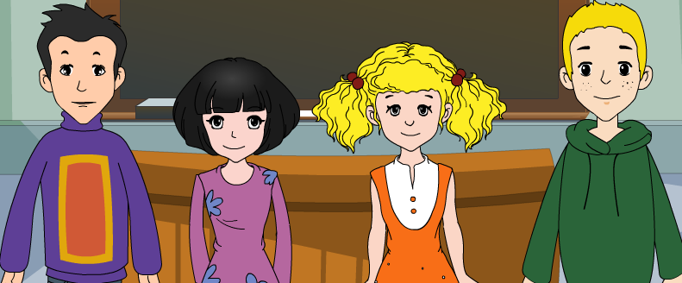
外研八年级（下） 授课教师 杨晔

Slide 2
Module
10
On the radio
Unit 2
It seemed that they were speaking to me in person.

Slide 3
Let's review
一、 完成下列英语句子。
1. 她有礼貌地带我们参观她家。
She was kind enough to ______ ___
________her home.
2. 我最喜欢的节目正在直播。
My favorite programme is ____ _____.
show us
around
on air

Slide 4
3. 他们把电影院当成聊天的场所了，不知道
在电影院要保持安静吗？
They thought cinema is a chatting place,
don’t they know to ______ ______ (保持安静)
in cinema?
4. 你应该独立完成作业，而不应该去抄他人的作业。
Do the homework by yourself; avoid _________others.
keep quiet
copying

Slide 5
Teaching aims
1. Teaching aims:
To understand the sequence of events and behaviour of characters
To be able to describe important events in the past and give background information

Slide 6
2. Main contents:
Key vocabulary
seem, listener, in person, article, studio
Key structures
It seemed that they were speaking not to
lots of listeners but to me in person.
…, and hoped someone might be listening.

Slide 7
Warming-up

Slide 8
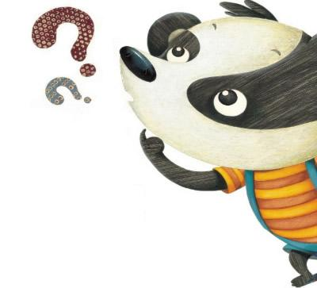
Do you know any broadcasting corporations in the world?

Slide 9
世界著名广播公司
美国之音(Voice of America)

Slide 10
1. 美国之音(Voice of America)
VOA是美国政府的无线电广播机构，也是美国对外宣传的主要工具之一。VOA每天用38种语言向世界各地播放新闻、音乐和其他节目。VOA节目中有“标准英语”(Standard English)和“特别英语”(Special English)。“标准英语”广播的语速快、句子长、词汇量大，适合中级以上英语水平的人；“特别英语”广播语音清晰、语速慢，适合初级英语水平的人。.

Slide 11
英国广播公司
(British Broadcasting Corporation)

Slide 12
2. 英国广播公司
(British Broadcasting Corporation)
BBC是提供广播、电视服务的非商业性公立组织，BBC最早是作为私人企业成立的，1922年2月14日开始广播，1927年改组为英国广播公司，1936年11月成为世界上第一个正式播送电视节目的电视广播公司。

Slide 13
Look at the picture and say what you can see.
a radio presenter
an earphone
a glass wall
a microphone
in a radio studio 录音室

Slide 14
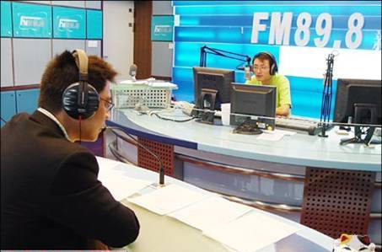
a radio manager 电台经理

Slide 15
Book time

Slide 16
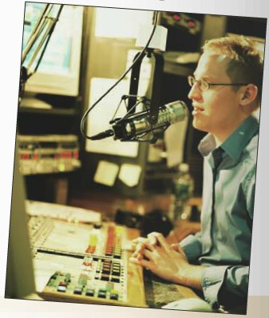
1. Look at the photo and say what it shows.
It probably shows that a newsreader or a presenter is on air.

Slide 17
1. Read to the passage and decide where
you are likely to see the photo.
a) In a book about the history of radio.
b) In the life story of a famous radio presenter.
c) In a book on how radio works.

Slide 18
Learning to learn
When you read a story, it is important to understand the order in which different events happen. You may find it useful to draw a timeline and write notes about each event.

Slide 19
Read again then fill the table with notes.
Time | What happened
He was four
He was nine
As he grew older
He was fifteen
Sat close to the radio, listening to his favorite programmes.
Asked for part-time jobs in small radio.
Learnt about Internet radio
Try to work on the it.
Do a sound check. / Get his first real job.

Slide 20
3. Complete the sentences.
The writer met _______________ in a
radio station.
2. The manager asked why he wanted a job ________.
3. At the age of four, the writer __________
_________________________, listening to his favourite programmes.
a radio manager
in radio
sat close to
the radio in the living room

Slide 21
4. At the age of nine，he asked for part-time jobs in __________________.
5. As he grew older，he learnt about ________ _______.
6. This was how the writer’s _______________ _______ began.
small radio stations
Internet
radio
first real job in
radio

Slide 22
4. Complete the passage with the correct form
of the words and expressions in the box.
article at the age of listener purpose seem studio
Peter (1) ______ to be very happy with his new job. He works in the (2) ______ of a local radio station. He is lucky that (3) ___________ only twenty he is doing something he loves and has a real (4) _________ . Every morning
seems
studio
at the age of
purpose

Slide 23
when he starts work, he does a sound check and then he looks for interesting newspaper (5) ________ to talk about on the show. The (6) _________can phone in to talk to Peter or they can send emails to ask him to play their favourite songs. At the end of the show, he closes down all the equipment and goes home.
articles
listeners

Slide 24
Phrases
电台经理
向下看某人
紧挨着
看起来像
亲自
要求，寻找
兼职, 临时工作
了解
目的是做某事
对...调查研究
radio manager
look down at sb.
sit close to
It seems\seemed that
in person \ by oneself
ask for
part-time job
learn about
the purpose is to do sth.
do research for\on sth.

Slide 25
Language points

Slide 26
The radio manager looked down at me.
电台经理低头看着我。
look down 向下看
look down at sb. 向下看着某人
相反词组: look up at sb.
Xi Jinping looked down at the little girl
and asked her name.
习近平低头看着小女孩问她的名字。

Slide 27
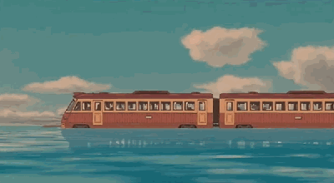
And you want a job in radio?
你想在电台找份工作？
陈述句用升调就变成了问句, 这种问句
称为陈述疑问句。朗读时句尾应该读升调。
例如：
The train is in already?
火车已经进站了？
He hasn’t got my letter?
他还没有收到我的信?

Slide 28
3. Shouldn’t you be at school?
难道你不用上学吗？
这是一个否定疑问句, 表示惊讶。
这种句式还可以表示责难和赞赏。如：
Why are you driving so fast? Don’t you
know the traffic regulations?
你为什么开那么快？难道你不懂交通规则
吗？（表示责难）
Aren’t these pictures lovely?
这些照片难道不可爱吗？（表示赞赏）

Slide 29
4. I still remember, when I was about four years old, I sat close to the radio in the living room, listening to my favourite programmes and to the voices of my favourite presenters.
我仍然记得在我四岁的时候，我紧挨着客 厅里的收音机坐着，听我最喜欢的节目和 最喜欢的主持人的声音。
1) remember doing sth. “记得做过某事”
remember to do sth. “记着去做某事”

Slide 30
2) close to 临近，靠近
sit close to sth 坐在…的旁边
close在这里是形容词, 意思是“离得近,
距离短”, 它还有“关上”的意思, 如:
The tables were close to the wall.
桌子靠墙放着。
Slowly he closed the book.
他慢慢地合上了书。

Slide 31
3) listening to my favourite programmes, and
to the voices of my favourite presenters.
在句中作状语, 表示伴随情况。
4) my favourite programmes 和 the voices of
my favourite presenters 并列作listening to
的宾语, and 后面省略了listening。

Slide 32
5. It seemed that they were speaking not to lots
of listeners but to me in person.
我感觉他们好像不是在和广大听众说话，而是
在亲自和我说。
It seems that + 从句 表示“看起来似乎……”;
seem 后面可接形容词, 不定式, 从句。
He seems very happy to get the book.
It seems that no one knew the news.
in person 亲自, 当面
I will go to the meeting in person.
我将亲自赴会。
You can ask him in person. 你可以当面问他。

Slide 33
6. At the age of nine, I asked for part-time jobs
in small radio stations.
九岁的时候，我去小电台找过兼职工作。
at the age of 在……岁的时候
She learnt to play the piano at the age of five.
ask for jobs 求职
ask for 1) 要求得到
2) 寻找, 要求见某人
He never asks for help.
There is a girl at the gate, asking for Miss Li.
ask sb. for sth. 向某人要求某物
Mary asked her dad for a new bike.

Slide 34
7. One day, I learn about Internet radio.
有一天我听说了网络电台。
learn about 听说 如：
I’m very keen to learn about the town’s
history.
8. I did this by looking out of the window.
我根据观察窗外的情况得到。
look out of the window 向窗外看
by doing sth. 通过做某事
I learned English by reading magazines.
我通过读杂志学习英语。

Slide 35
9. The purpose is to check the sound level.
目的是检查音质水平。
the purpose is to do sth. “目的是做某事”
例如：
The purpose is to get the main idea of the
article.
目的是为了了解文章大意。

Slide 36
Let the words fly
~forward to
期待；盼望
~ down on
~after
轻视；
瞧不起
照顾；照看
look
~ back
~ahead
回忆；回顾
向前看

Slide 37
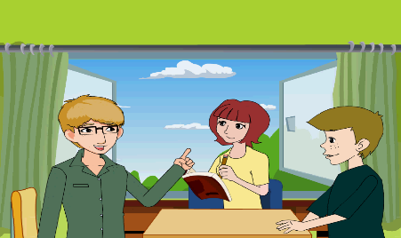
Look! This is my cousin Peter. He is a
famous radio presenter in Radio Beijing.
When he
was ____
he sat…in…, listening…and to…
It seemed that…not to…but to…
4
radio times
At the age of ____
asked for…in…
9
As he
_________
…grew. One day… Once a week…
…played…,talked…,hoped…
Soon…, and then… They…
grew older
When he
was ____
did …check, got his first…
15
This was how his first real job in radio began.

Slide 38
Writing

Slide 39
5. Look at the sentences from the passage.
“How old are you?” The radio manager looked down at me. “Fifteen,’’ I said. “And you want a job in radio? Shouldn’t you be at school?”, he asked. | describing an important event in the past
I have always loved the radio. I still remember, when I was four years old, I sat close to the radio in the living room, listening to my favourite programmes and to the voices of my favourite presenters. | giving background information

Slide 40
Now find sentences in the passage in Activity 2 which show:
important events in the past
background information
Once a week, I played my favorite music from my father's computer...and hoped someone might be listening. | describing an important event in the past
As I grow older, my interest in radio grew. One day I learnt about Internet radio. | giving background information

Slide 41
Now find sentences in the passage in Activity 2 which show:
important events in the past
background information
“Ok,come with me,”... “Ok, that's great！” the man behind the glass said. | describing an important event in the past
This was how my first real job in radio began. | giving background information

Slide 42
6. Write a passage describing an important event in the past and giving background information.
I first appeared on TV at the age of thirteen. A television presenter stopped me in the street, and started to interview me...

Slide 43
Focus on
Words:
seem listener article studio purpose part-time
Phrases:
in person close to ask for do research on…
Patterns:
It seemed that they were speaking not to
lots of listeners but to me in person.
2. …, and hoped someone might be listening.

Slide 44
Exercise

Slide 45
一、单项选择题。
It seemed _____ they went to go skiing
together.
A. if B. whether C. that D. what
2. You can go to talk with Mr. Smith ___ in the English corner.
A. in person B. in radio
C. in people D. in studio
C
A

Slide 46
3. At the ____ of twelve, he went to the junior high school.
A. question B. sound C. job D. age
4. The purpose is ____ to my favorite music.
A. listen B. listens
C. to listen D. listening
D
C

Slide 47
5. I don't remember ____ the book yesterday.
A. where I put B. where did I put
C. where will I put D. where l will put
6. —I don’t know _____.
— Because he has to look after his mother.
A. why he is leaving
B. why is he leaving
C. whether he is leaving
D. whether is he leaving
A
A

Slide 48
7. --Do you know ____ this afternoon?
--I'm not sure, but I'll tell you as soon as
she ____.
A. how will Betty arrive; starts
B. how Betty will arrive; will start
C. what time will Betty arrive; will start
D. what time Betty will arrive; starts
D

Slide 49
8. As a middle school student, we should start thinking about ____ for our country in the future.
A. what we did B. what did we do
C. what we can do D. what can we do
9. —I wonder ____ at 8:00 last night?
—I was watching NBA.
A. what were you doing B. what did you
C. what you were doing D. what are you doing
C
C

Slide 50
10.----Could you tell me ________?
----At the end of July.
A. how often he heard from his pen pal
B. how soon he will be here
C. that he went on vacation
D. when you will start your vacation
D

Slide 51
二、根据单词首字母或中文提示完成句子。
1. I think i____________ calls are very expensive.
2. The ________(目的) of this exercise is to
increase your strength.
3. He s_____ to know everything.
4. At the a___ of five, he began to play the
piano.
5. When the red light is on, we’re on a___.
nternational
purpose
eems
ge
ir

Slide 52
三、根据中文提示完成句子。
1. 我想知道他多大了。
I want to know _____ _____ ____ ____.
2. 你能告诉我飞机何时起飞吗？
Could you tell me ______ the plane _____ ____.
3. 你知道为什么玛丽昨天没有去上学吗？
Do you know _____ Mary _______ ___ to school yesterday?
4. 能告诉我你叫什么名字吗?
Could you tell me _____ ______ ______ ___?
how old he is
when takes off
why didn’t go
what your name is

Slide 53
桂林市桂电中学
2020.8.26录制

