Slide 1
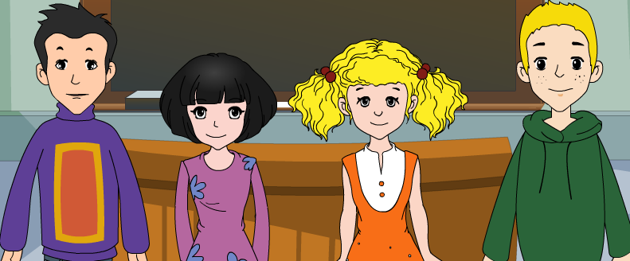
外研版新标准
七年级上册
Module 2
My family
Unit 1
Is this your mum?

Slide 2
Phonetic symbols
[i:] | green | he | teacher
[i] | busy | family | Betty
[ɪ] | big | live | English
[e] | bed | desk | friend
[æ] | bad | cat | thanks

Slide 3
Words and expressions

Slide 4
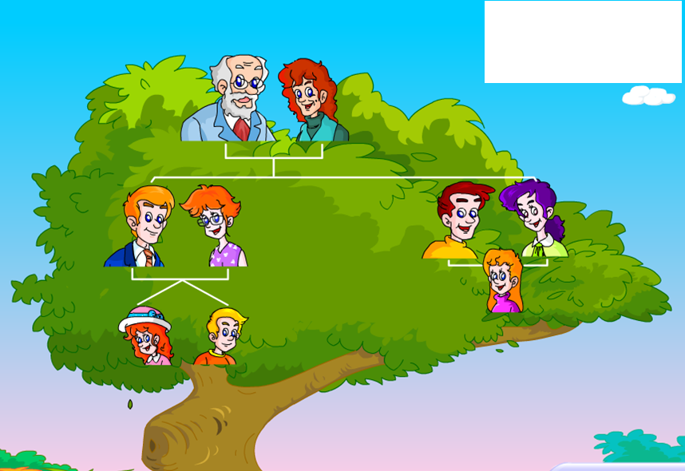
grandparents
grandfather
grandmother
Family Tree
wife
家谱
husband
parents
What a big family!
uncle
aunt
father
mother
Tony
Daughter（6y）
Son（8y）
cousin
A photo of Tony's family
sister
brother
younger sister
elder brother

Slide 5
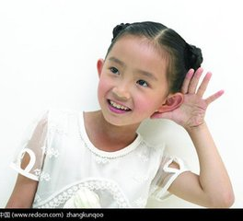
Who are they ?
1. Linda
A. Tony’s uncle
2. Liz
B. Tony’s cousins
3. Paul
4. Mike
C. Tony’s sister
5. Helen
D. Tony’s aunt
1. Listen and match

Slide 6
Who are they ?
1. Linda
A. Tony’s uncle
2. Liz
B. Tony’s cousins
3. Paul
4. Mike
C. Tony’s sister
5. Helen
D. Tony’s aunt
1. Listen and match

Slide 7
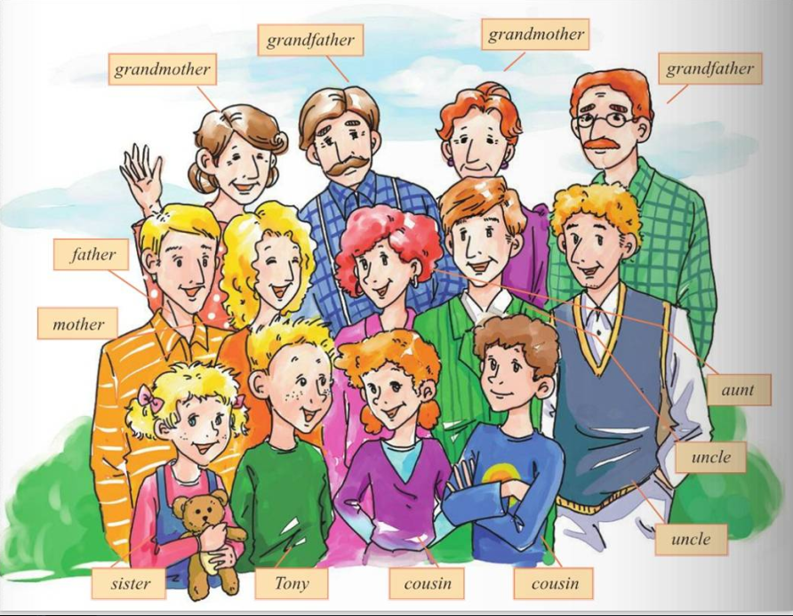

Slide 8
Read and answer the questions.
1. Are Tony’s dad’s parents on the left ?
2. Where is Tony's aunt, Liz?
3. Where are Mike and Helen?

Slide 9
Read and answer the questions.
1. Are Tony’s dad’s parents on the left ?
2. Where is Tony's aunt, Liz?
3. Where are Mike and Helen?
No, they aren’t.
They’re on the right.
She is next to his mother.
They are in front of Paul.

Slide 10
Watch , read and repeat!
Notes:
, that-those

Slide 11
Useful sentences
1. 多么大的一个家庭啊！
What a big family!
2. 我的外祖父和外祖母在我妈妈的左边，我的爷爷奶奶在我爸爸的左边。
My mum's parents are on the left, and my dad's parents are on the right.
3. 在他旁边的那个女人是我爸爸的姐姐(妹妹)，我的姑姑Liz.
The woman next to her is my dad's sister, my aunt Liz.
4. ——在保罗前面的那个男孩和女孩分别是谁？
——那是保罗的儿子和女儿，我的表哥(弟)迈克和表姐(妹)海伦。
——Who are the boy and the girl in front of Paul?
——Those are Paul's son and daughter, my cousins, Mike and Helen.
Notes:
, that-those

Slide 12
L: ... your family?
T: Yes, ....
L: What....! ....sister?
T: Yes, .... ... . Linda.
L: ... grandparents?
T: Yes, .... .My mum’s parents ...., and my dad’s parents ...
L: I see.....?
I love recting
T: That's my dad.
L: ... your mum?
T: Yes. The woman ..., my aunt Liz.
L: ... her husband?
T: No, ... , my uncle Paul.
L: ... the boy and the girl ...Paul?
T:......., my cousins, Mike and Helen.

Slide 14
Summary
on the left, on the right, in front of, next to
cousin, brother, aunt, big
big
Tony has a _____ family. In the photo,
his father’s parents are_____________and
his mother’s parents are ___________.
Mike and Helen are Tony’s _______ and
they are ____________ Paul. Paul is
Liz’s _______. Liz is his ______ and
she is ________ my mum.
on the right
on the left
cousins
in front of
brother
aunt
next to

Slide 15
Introduce your family
How many people are there in your family? Who are they?
How old are they?
What are their jobs?
Family Tree
Show Time

Slide 16
Dictation: Words and expressions

Slide 17
FAMILY=
Father and mother, I love you.
FAMILY
What does "family" mean ?

Slide 18
Good bye!
授课教师
桂林市桂电中学 杨晔

