Slide 1
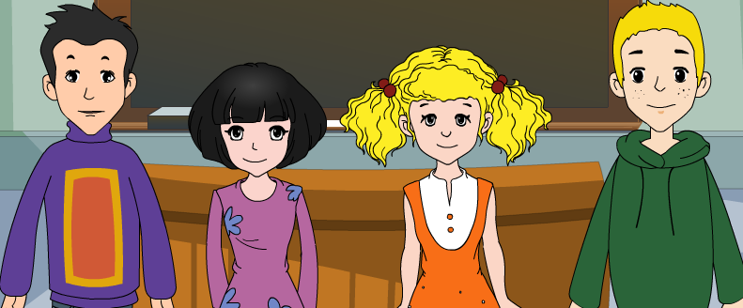
外研版新标准
七年级上册
Module 4
Healthy food
Unit 1
We've got lots of apples.

Slide 2
/'helθi /
/fu:d /
/driŋk /
/mi:t/
/'vedʒitəbl /
/'tʃɔkəlit /
/bi:n /
/bi:f /
/'tʃikən /
healthy
food
drink
meat
vegetable
chocolate
bean
beef
chicken
/s / drinks / t / tea
/ z / apples /d/ food
/’kærət /
/'kɔfi/
/ti:/
/dʒu:s /
/pə'teitəu /
/tə'mɑ:təu /
/hæv /
/kaind /
carrot
coffee
tea
juice
potato
tomato
have
kind
Words and expressions

Slide 3
Words and expressions

Slide 4
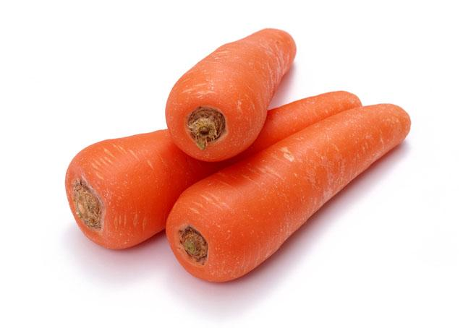
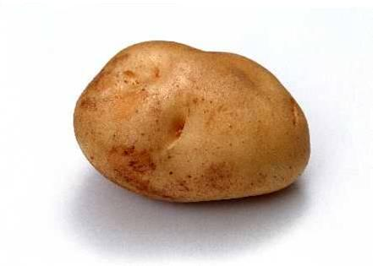
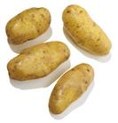
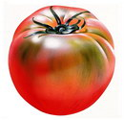
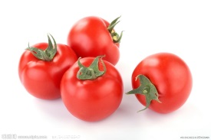
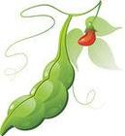
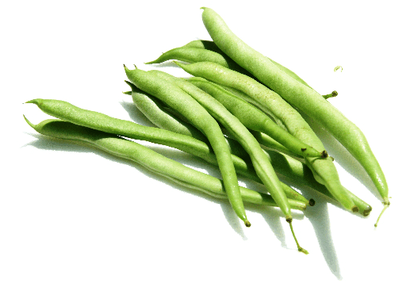
What’s this in English?
What are these?
It’s …
They are…
a carrot
carrots
a potato
potatoes
a tomato
tomatoes
a bean
beans
1. Talk about the pictures
vegetables

Slide 5
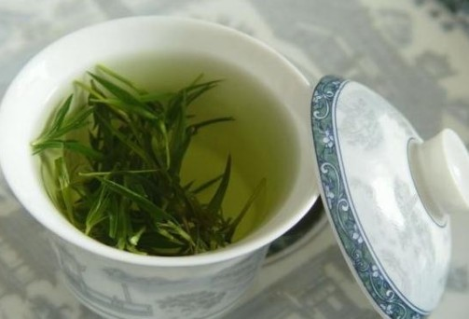
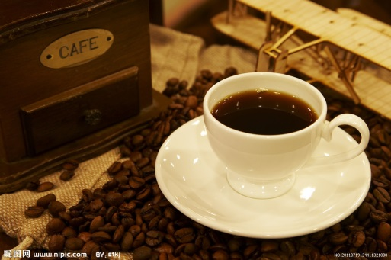
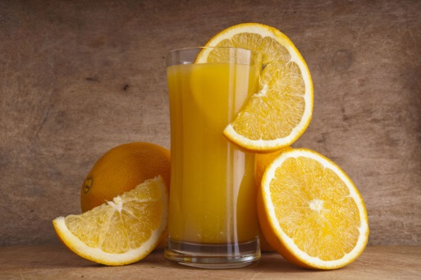
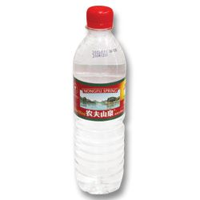
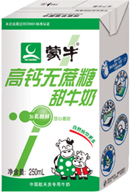
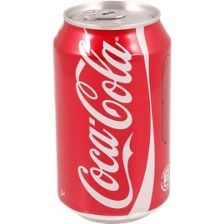
a cup of tea
a cup of coffee
a glass of juice
a bottle of water
a box of milk
a tin of cola
What can you see?
drink

Slide 6
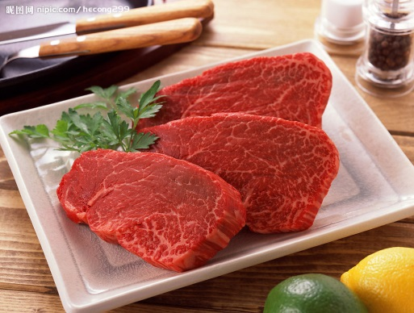
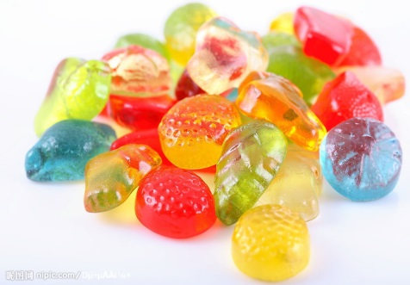
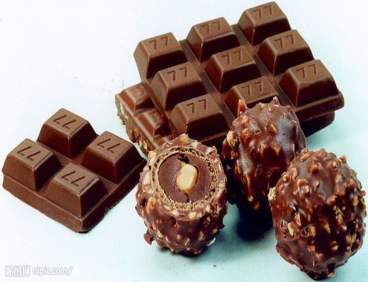
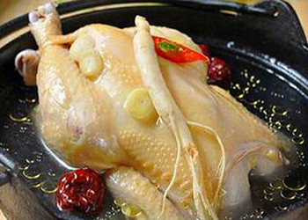
sweets
chocolate
candies
beef
chicken
meat
candy
How to say it in English?

Slide 7
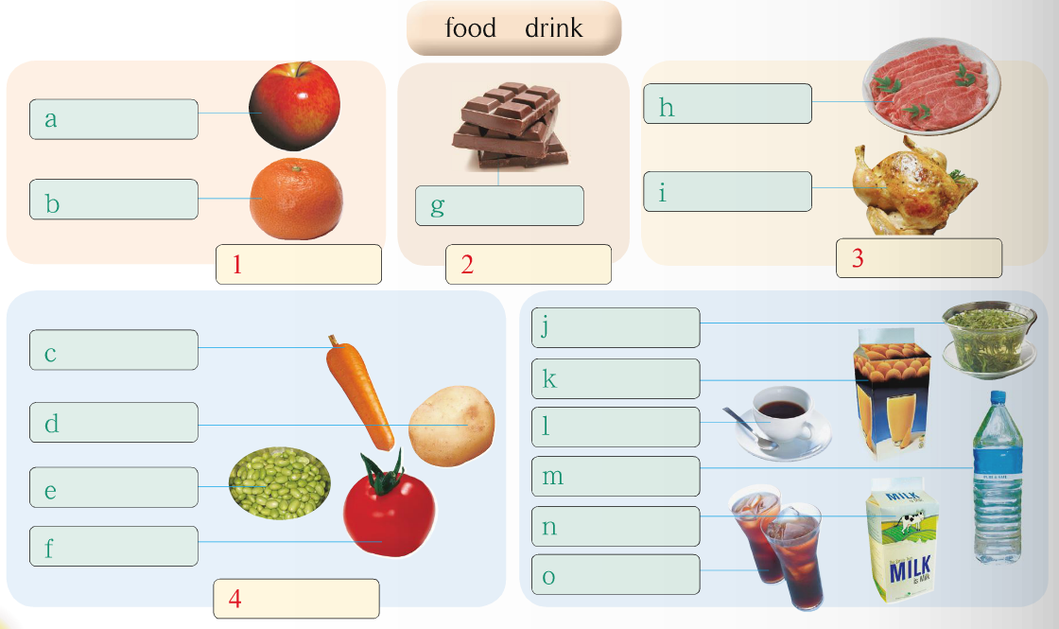
Label the food in the pictures with the words from the box.
candy
fruit
meat
vegetables
drink
√

Slide 8
apple(s)
beef
orange(s)
chocolate
chicken
fruit
candy
meat
carrot(s)
tea
juice
potato (es)
water
beans
milk
tomato(es)
vegetables
cola
coffee
drink

Slide 9
2. Listen and check the food and drink
Betty and her mother have got
P20
apples juice
beans milk
beef oranges
carrots potatoes
chicken tea
coffee tomatoes
cola water
√
x
x
x
x
√
x
x
√
√
√
√
x
x
They have got some ….
They haven’t got any ….

Slide 10
Now listen again, then complete the table
Things Tony’s family has got at home
Things Tony’s family hasn’t got at home
P21
meat
chicken
Food
chocolate
apples
oranges
orange juice
Drink
coffee
cola
tea
---Has Tony got any…?
---Yes, he has./ No, he hasn’t.

Slide 11
Watch and read!

Slide 12
Dad: Tony, let’s go shopping for food and drink. Now, we haven’t got any meat. Let’s get some chicken.
Tony: Ok. Have we got any chocolate?
Dad: Yes, we have. Too much chocolate isn’t good for you. Let’s get some fruit.
Tony: What kind of fruit? Apples?
Dad: No, we’ve got lots of apples. We haven’t got any oranges, so let’s get some.
Tony: How about some orange juice?
Dad: Yes, good idea! And coffee. Let’s get some for your mum. She hasn’t got any coffee.
Tony: All right, some coffee for Mum, and some cola for me. I haven’t got any cola.
Dad: No cola! Cola is bad for you! How about some tea?
Tony: Oh, too bad!
4. Recite!.

Slide 13
What's in your fridge?
Drill-1
You have got
1 three bananas
2
3
...
You haven't got
1 chicken
2
3
...
A: Have you got any bananas?
B: Yes, I have. I've got three bananas.
A: Have you got any chicken?
B: No, I haven't.

Slide 14
What's in your friend's fridge?
Drill-2
He has got
1 an apple
2
3
...
He hasn't got
1 cola
2
3
...
A: Has he got any apples?
B: Yes, he has. He's got only one apple.
A: Has he got any cola?
B: No, he hasn't.

Slide 15
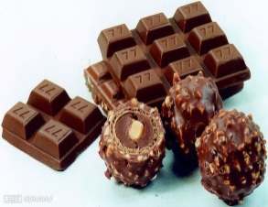
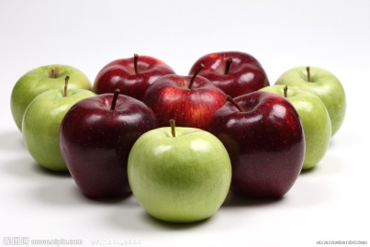
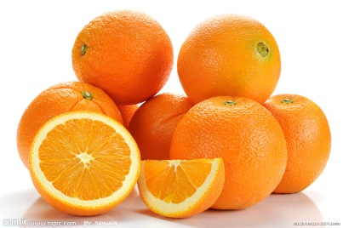
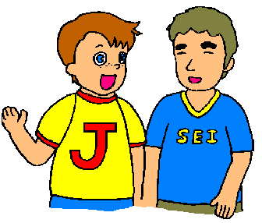
×
×
√
√
×
√
√
Make a dialogue!
Dad: It’s mum’s birthday tomorrow. Let’s make a big dinner for her.
You: Good idea! Let’s go shopping for food and drink.
Dad: You check the fridge and I make a shopping list.
Have we got any…?
…(至少四样东西）
Dad: OK! Let’s go to the supermarket and give mum a big surprise.

Slide 16
Good bye!
授课教师
桂林市桂电中学 杨晔

