Slide 1
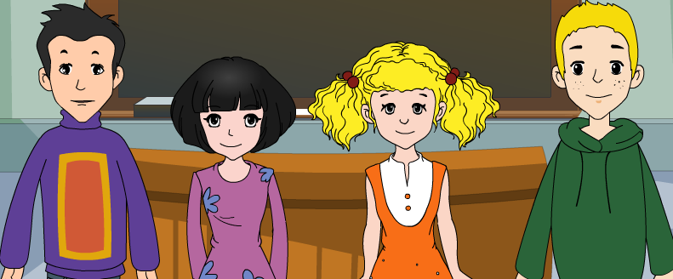
外研版新标准
七年级上册
Module 3
My school
Unit 2
The library is on the left of the playground

Slide 2
building
dining hall
gate
library
/'bildiŋ/
/dainiŋ/ /hɔ:l/
/ɡeit/
/'laibrəri/
office
playground
science lab
/'ɔfis/
/'pleiɡraund/
/'saiəns/ /læb/
Words

Slide 3
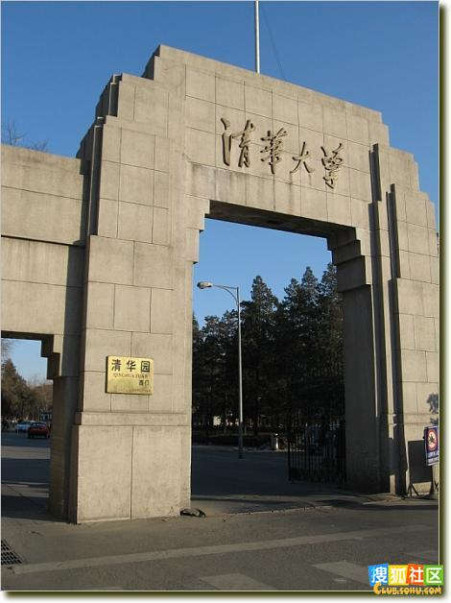
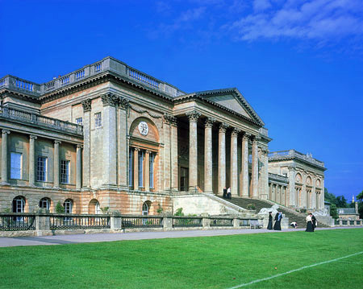
building /'bildiŋ/
gate /ɡeit/

Slide 4
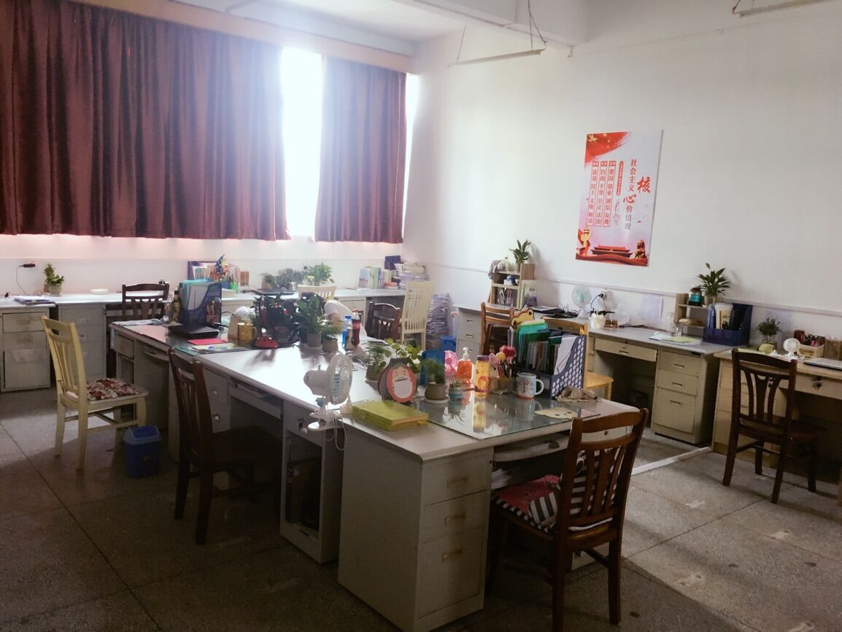
library
/'laibrəri/
books; newspapers; magazines
office
/'ɔfis/

Slide 5
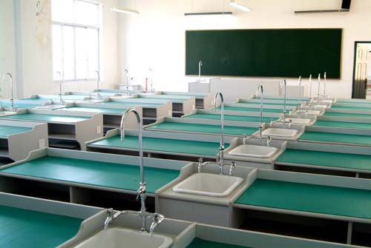
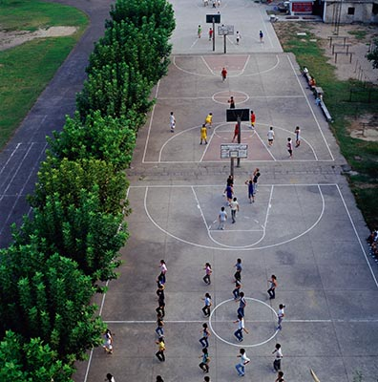
science lab
/'saiəns/ /læb/
playground
/'pleiɡraund/

Slide 6
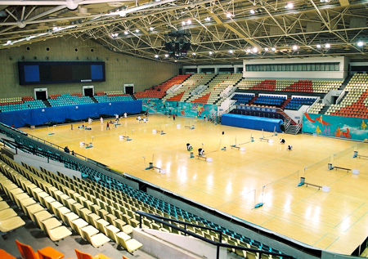
sports hall
gym /dʒim/

Slide 7
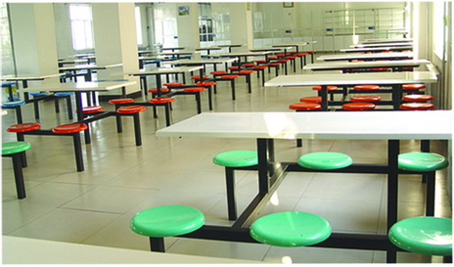
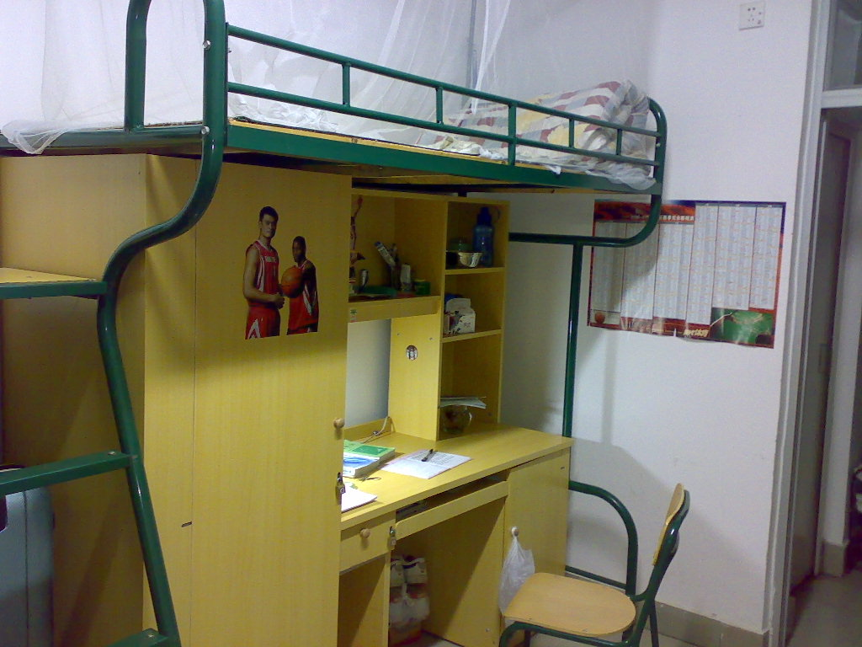
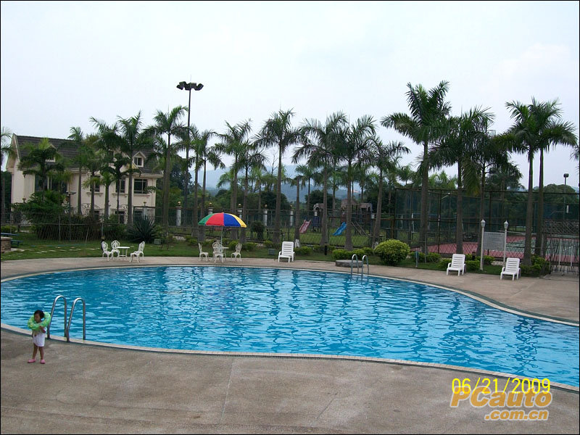
dining hall
/dainiŋ/ /hɔ:l/
dormitory
/'dɔ:mitəri/
swimming pool
/pu:l/

Slide 8
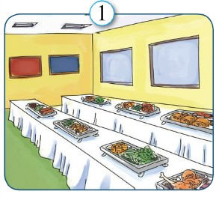
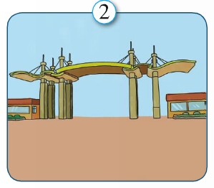
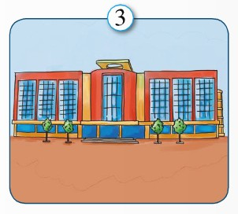
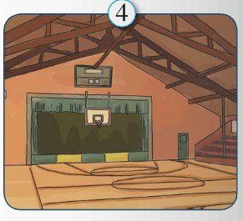
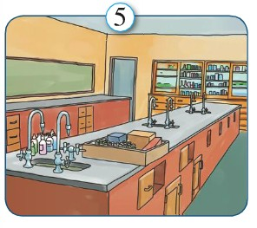
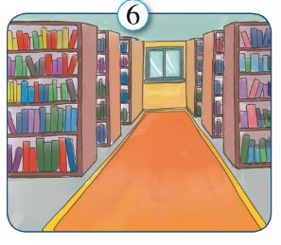
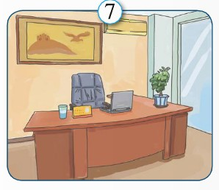
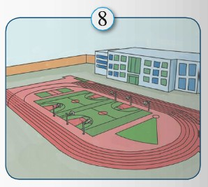
1. Label the pictures with the words and expressions from the box. P.16 Ex1
dining hall
gate
building
sports hall
science lab
library
office
playground

Slide 9
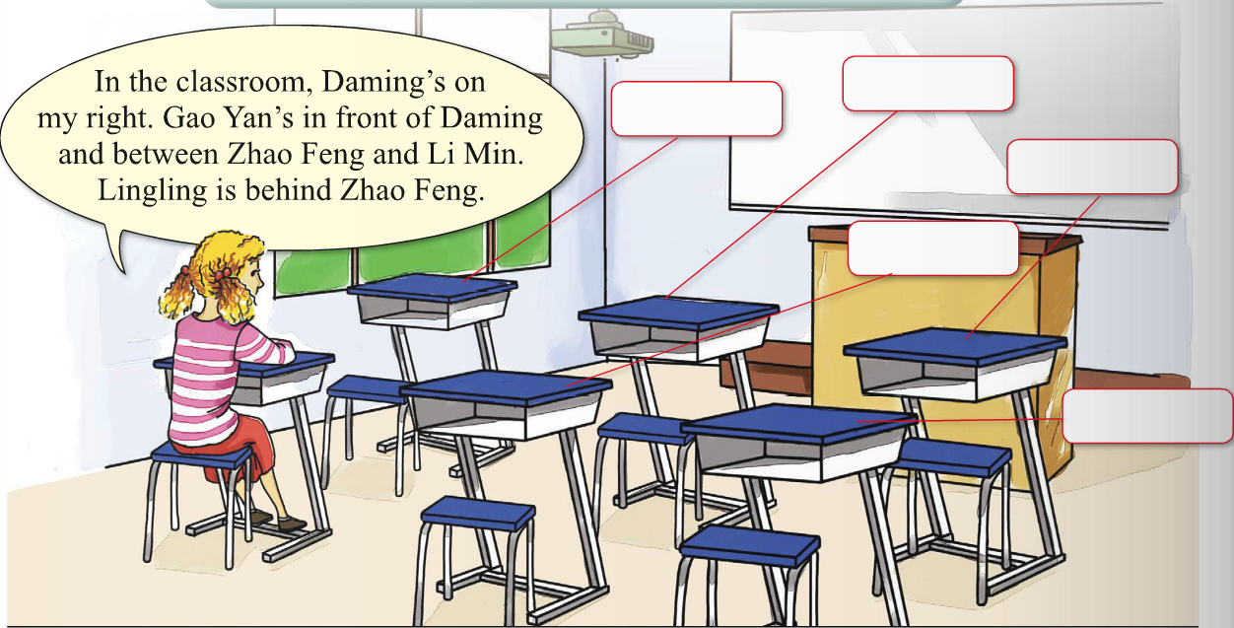
2. Read Betty’s words, and write her classmates’ names on their desks. P16
behind, between, in front of, on the right
Gao Yan
Li Min
Zhao Feng
Daming
Lingling

Slide 10
3. Free talk
Describe（描述） your position.
behind, between...and.., in front of,
on the right, on the left, next to,...
eg: In the classroom, Li Xiaohui is on my right...
Notes:
“Just now we talked about our classroom, but today Daming and Linda are talking about their classroom. Please take a piece of paper and write down some notes as much as you can”

Slide 11
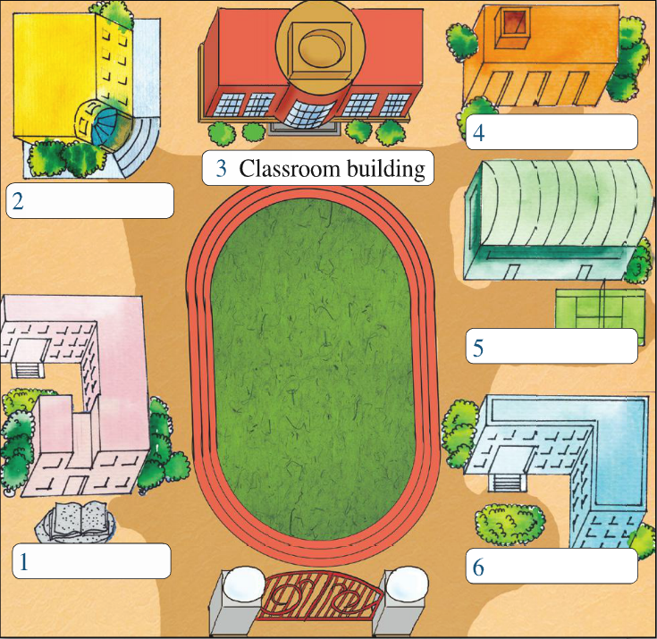
Read and mark P17
Dining hall
School offices
Sports hall
Library
Science
building

Slide 12
P17
Read and answer the questions.
1.How many buildings are there in the school?
2.What’s on the right of the library?
3.What’s in the library?
4.How many classrooms are there in the classroom building?
5.Where are the computer rooms and science labs?
There are six buildings in the school.
There is the big playground.
There are many books, maps and computers in it.
There are twenty-four. ...with twenty-four..
They are in the science building.

Slide 13
7. Watch and read aloud.

Slide 14
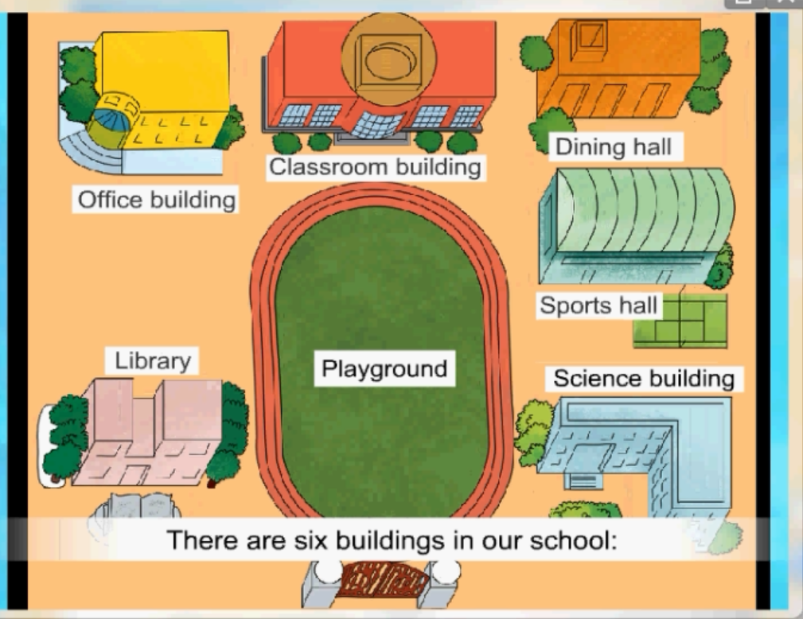
Introduce the school
between…and…
on the right
behind, on the left
in front of
in the middle of
on the left, near
A: Where is the library?
B: It's near the school gate, on the left of the playground.

Slide 15
boys’ dormitory
girls’ dormitory
basketball field
This is a map of our school. There are seven buildings in our school: ...
… behind, between..and , in front of, on the right, on the left, next to(三句话)…
What a wonderful school!
Introduce your school

Slide 16
大楼，建筑物 building
食堂，餐厅 dining hall
大门 gate
图书馆 library
/'bildiŋ/
/dainiŋ/ /hɔ:l/
/ɡeit/
/'laibrəri/
办公室office
操场 playground
实验室 science lab
/'ɔfis/
/'pleiɡraund/
/'saiəns/ /læb/
Dictation

Slide 17
Position 方位
在……后面
在……和……中间
在……前方
在……左面
在……右面
behind
between
in front of
on the left of
on the right of

Slide 18
Good bye!
授课教师
桂林市桂电中学 杨晔

