Slide 1


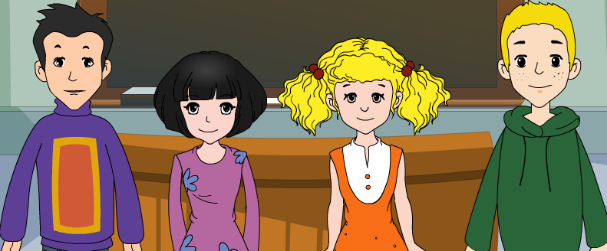
外研八年级（下） 授课教师 杨晔

Slide 2
Module
8
Time off
Unit 2
We thought somebody was moving about.

Slide 3

Let's review!
一、翻译下列词组
1. 听说 ________________________
2. 在市中心 ____________________
3. 占去(时间或空间) ____________
4. 指明；指出 __________________
5. 去游泳 ______________________
hear about
in the city centre
take up
point out
go swimming

Slide 4
Let's review!
二、根据句意及首字母提示补全单词
1. We’ll go to Dalian this weekend to enjoy the s________.
2. Thy boy was too t______ and he drank two glasses of water fast.
3. At the t____ of the mountain, we saw the beautiful sunrise.
4. Please speak more slowly. We can h_______ follow you.
ights
hirsty
op
ardly

Slide 5

All of you did a good job!
Let’s go on!

Slide 6
Teaching aims
1. Teaching aims:
To understand specific information in the reading material
To understand the sequence of events
To be able to write a passage, using clues

Slide 7
2. Main contents:
Key vocabulary
Square, kilometre, human, wake, wake sb. up,
somebody, about, path, pull
Key structures
We thought somebody was moving about.
Lingling’s uncle said it was an animal.
…,and found it was just a hungry monkey looking for food.

Slide 8



Travel broadens the mind.
旅游开阔眼界。
Read ten thousand books, travel ten thousand miles.
读万卷书,行万里路。
To be a civilized tourist

Slide 9

Warming up

Slide 10

Think about it!
What do you know about Zhangjiajie?
Have you ever been there ? Or do you want to go there to take some time off?

Slide 11
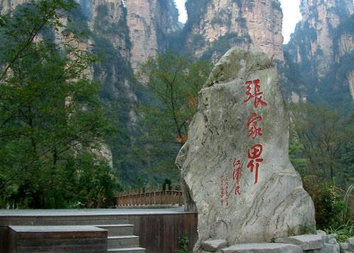

Slide 12
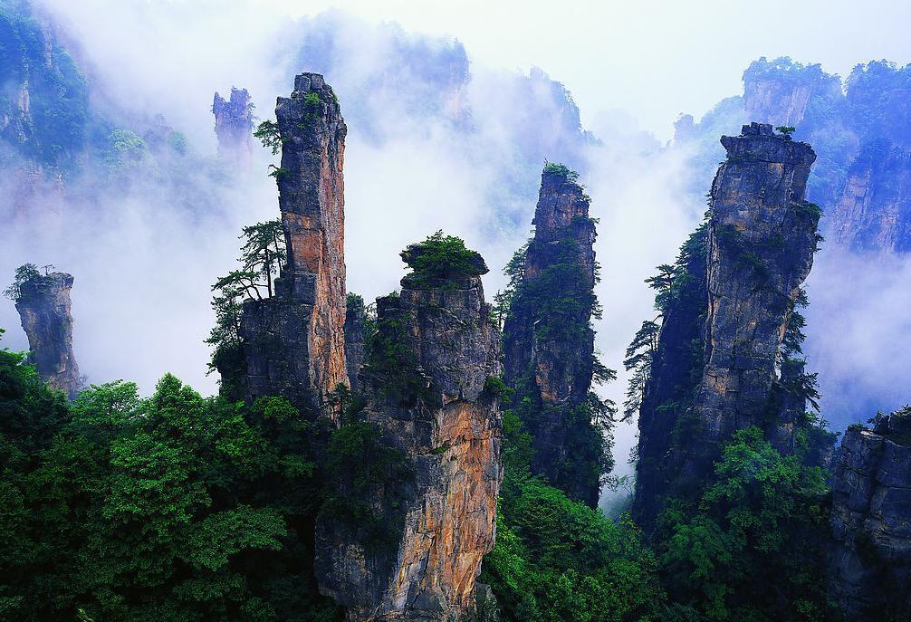
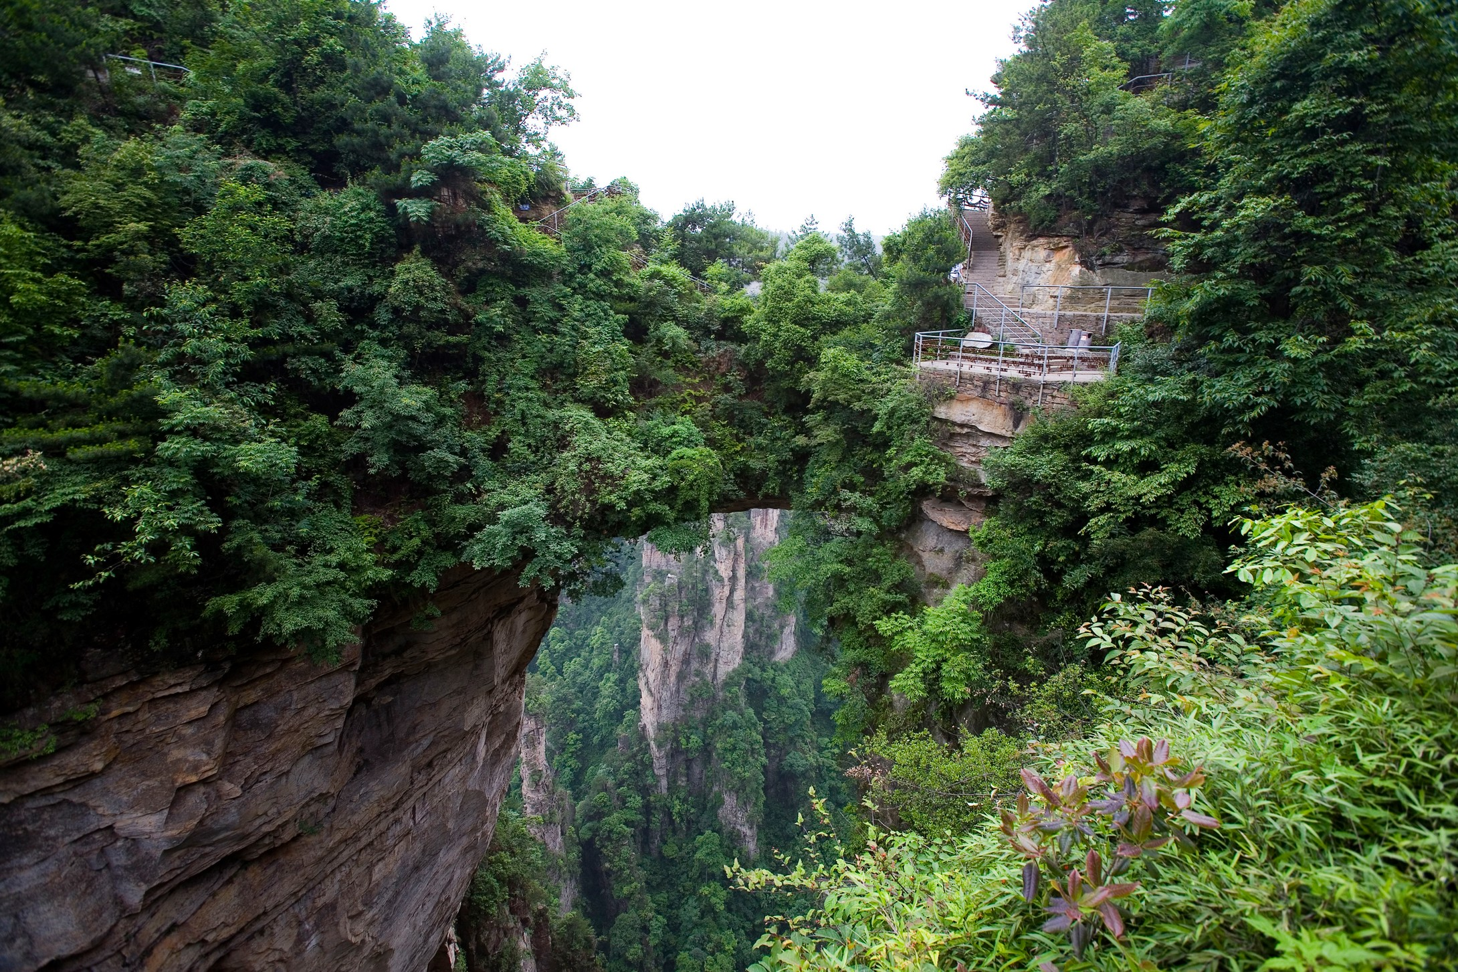
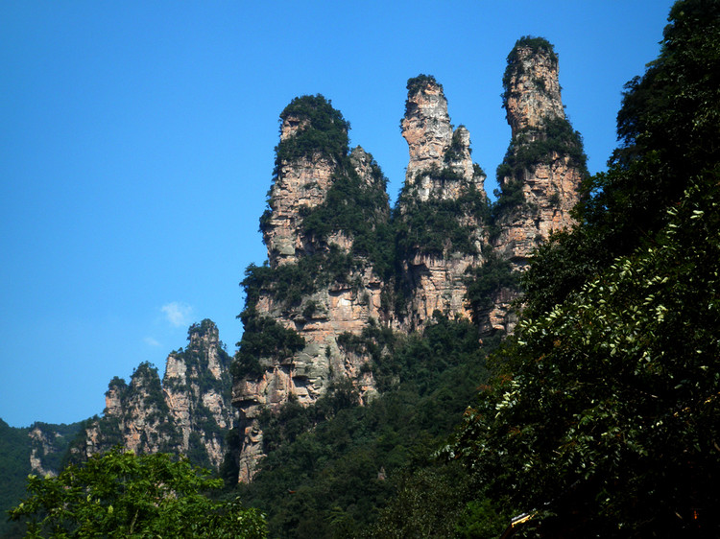
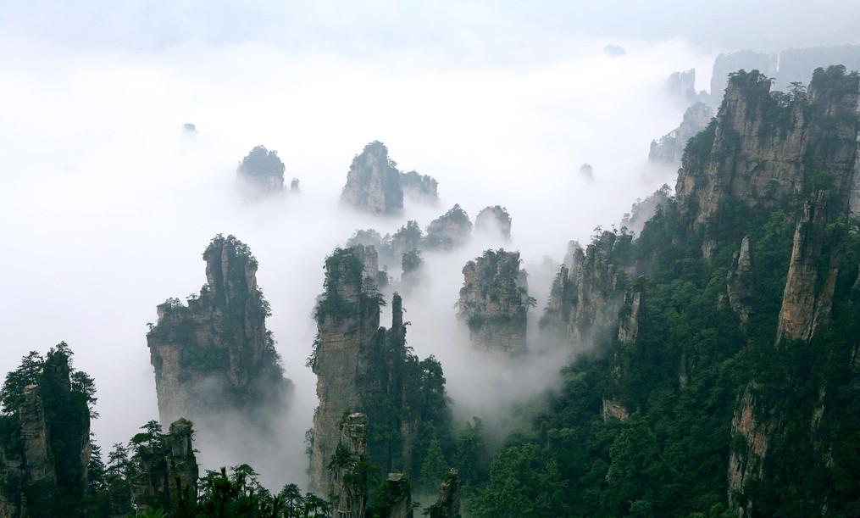
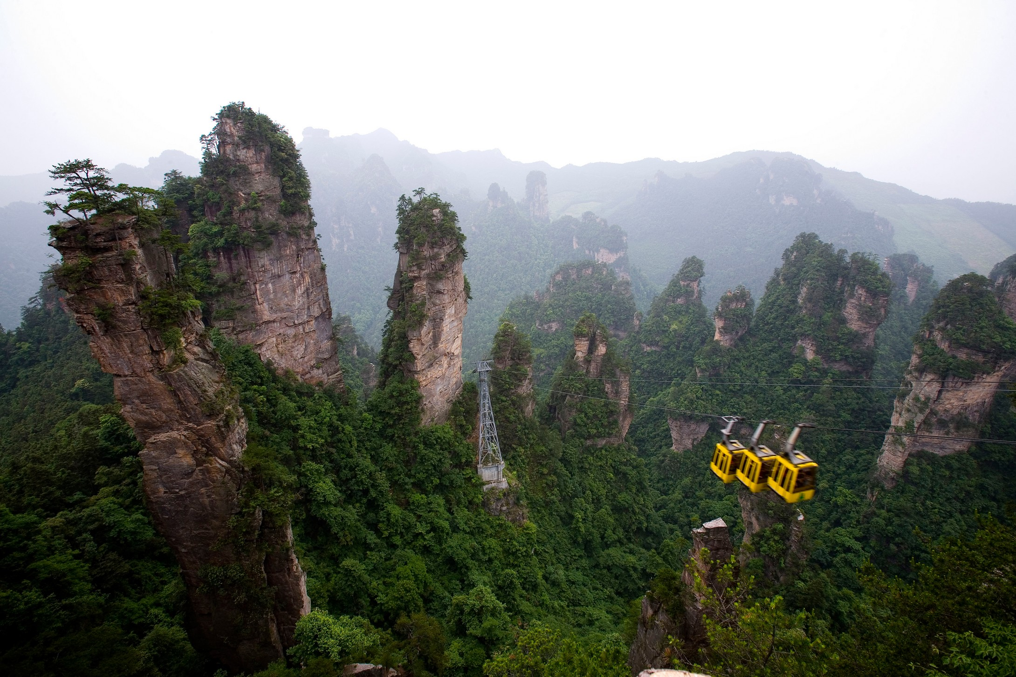
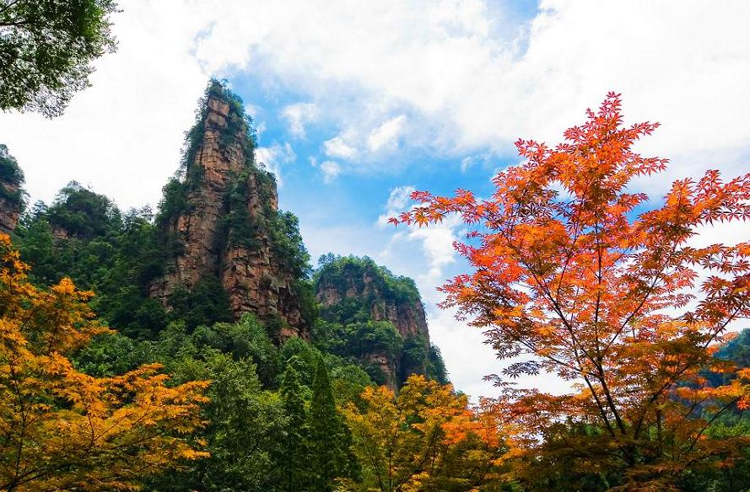

Slide 13
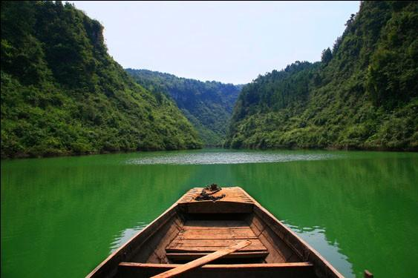
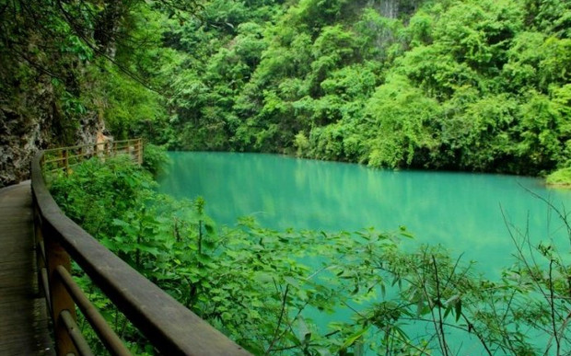
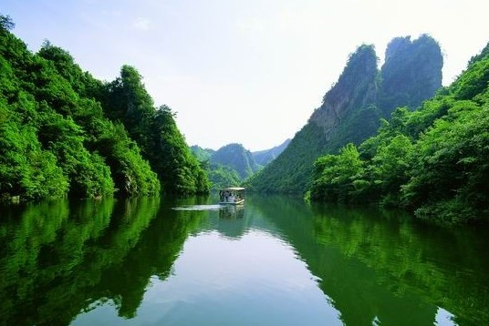
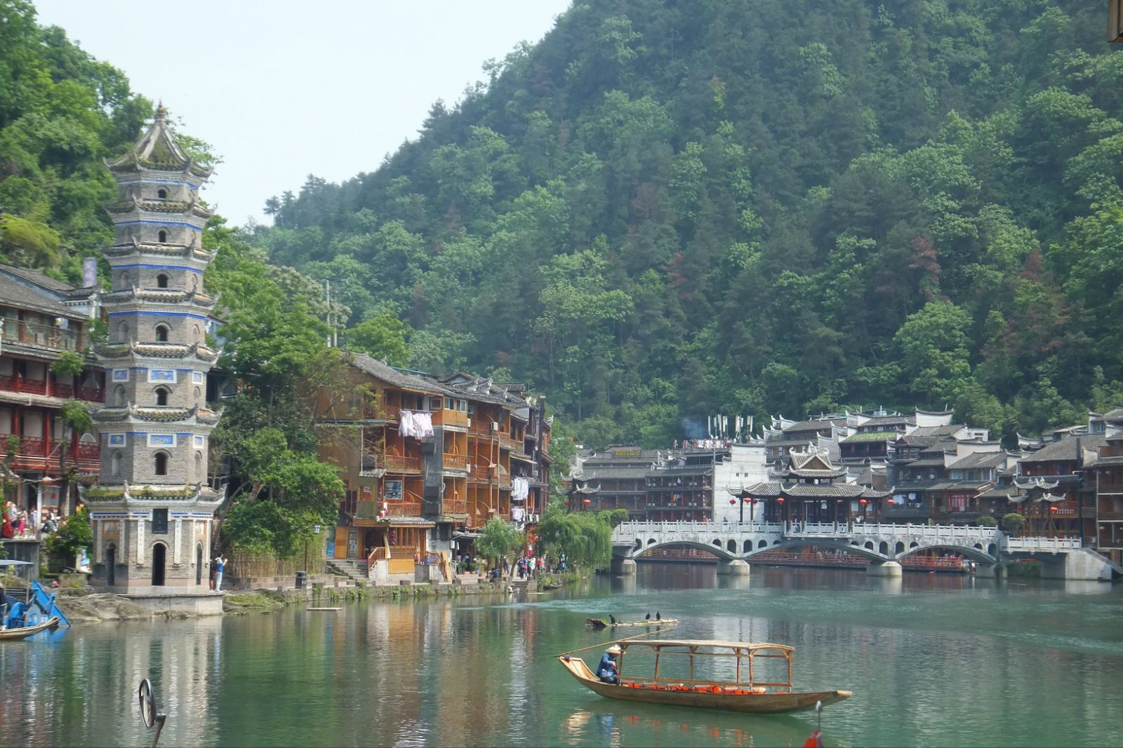
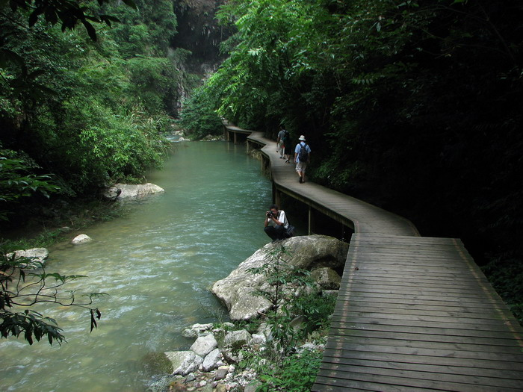

Slide 14
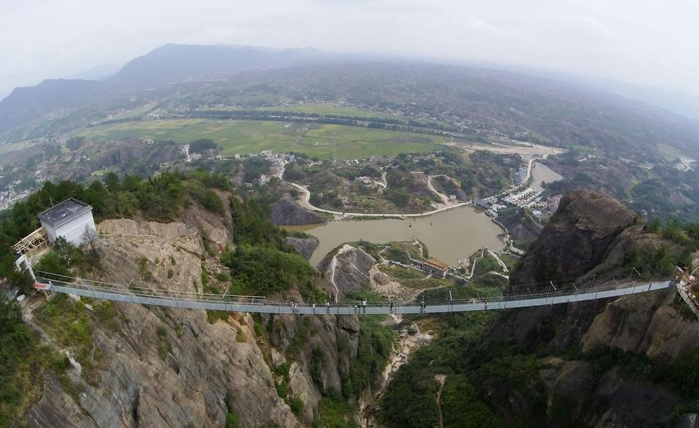
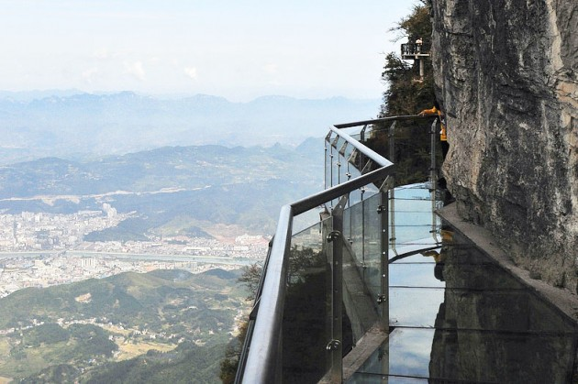
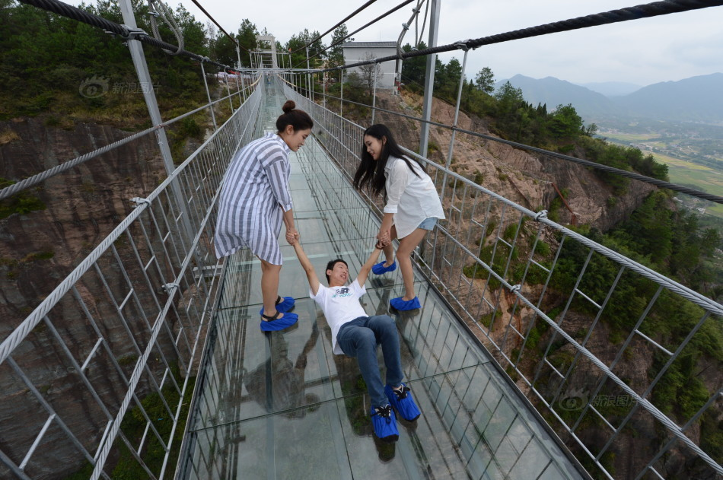

Slide 15
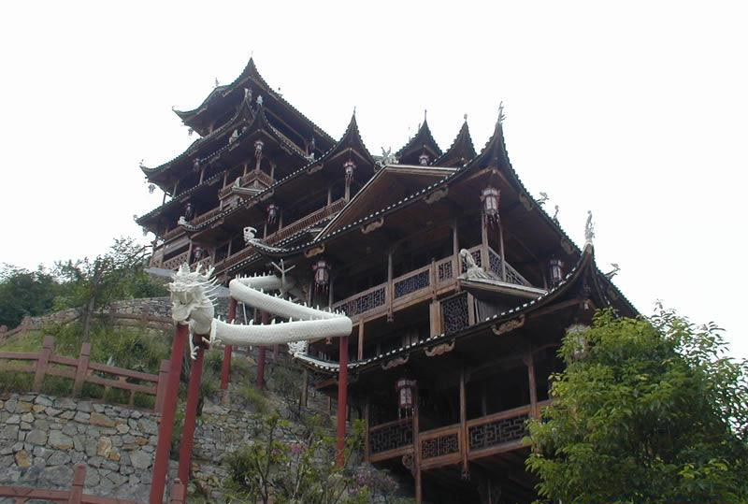
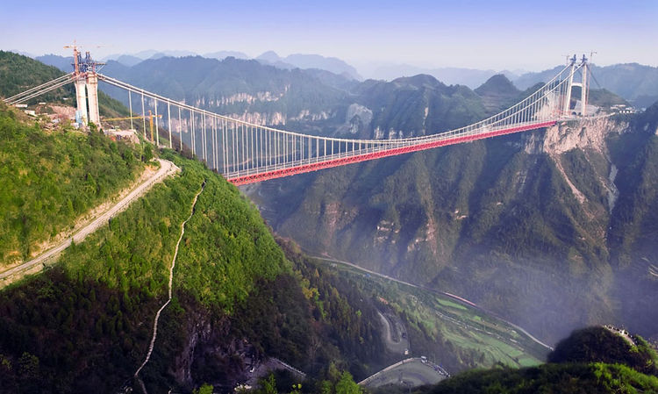
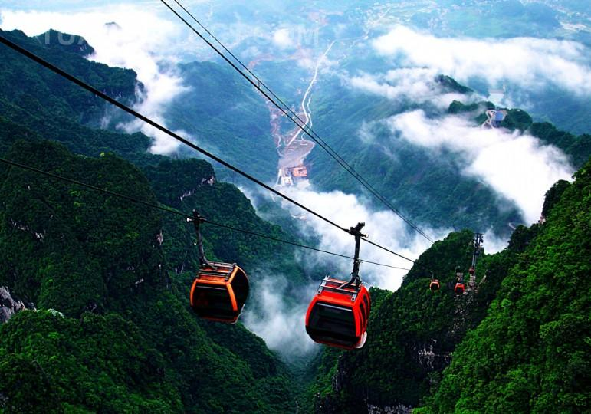
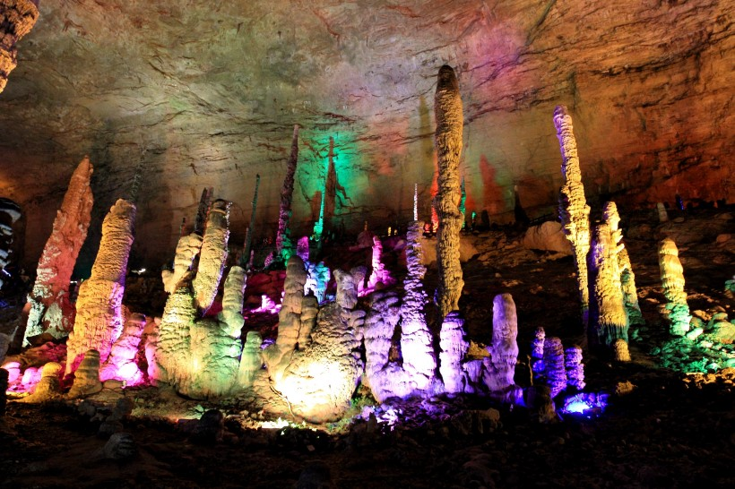

Slide 16
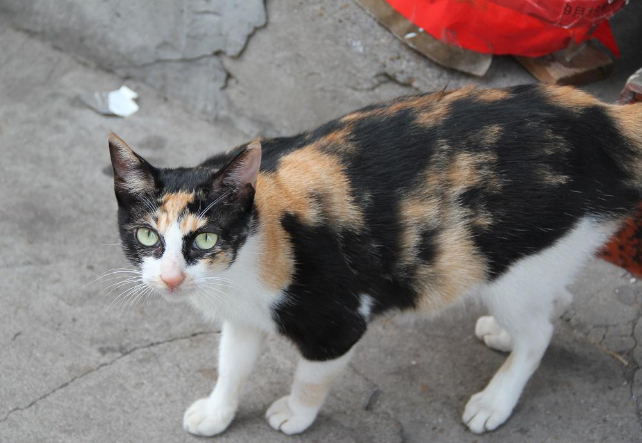
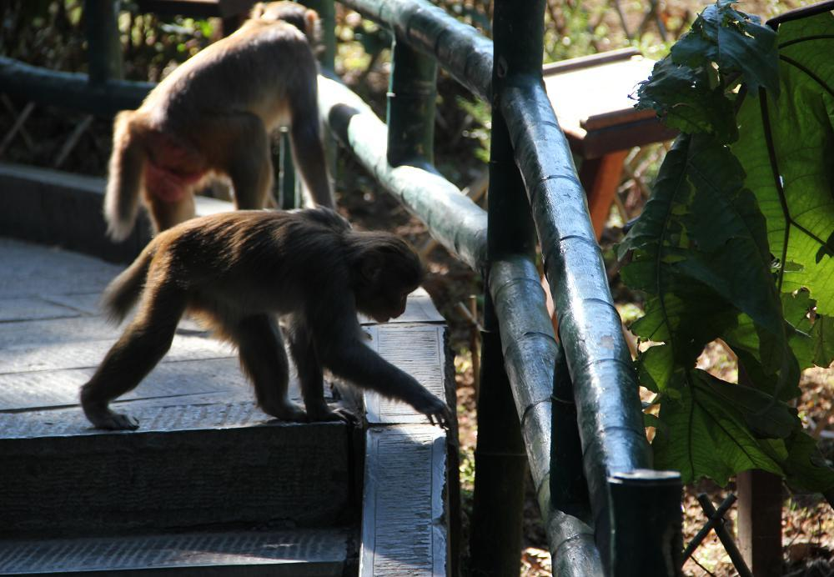
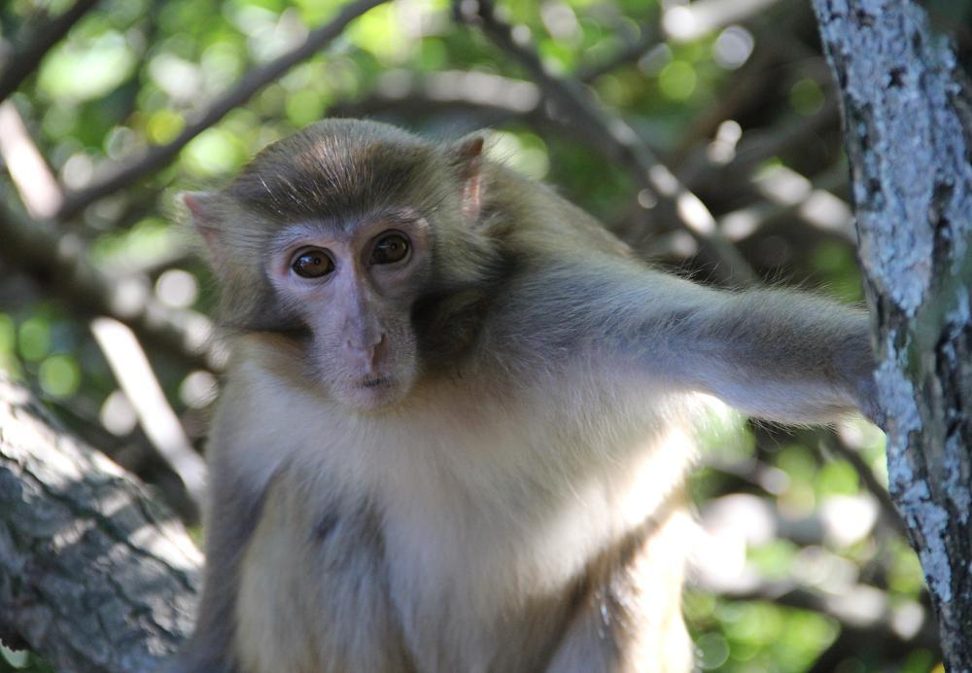
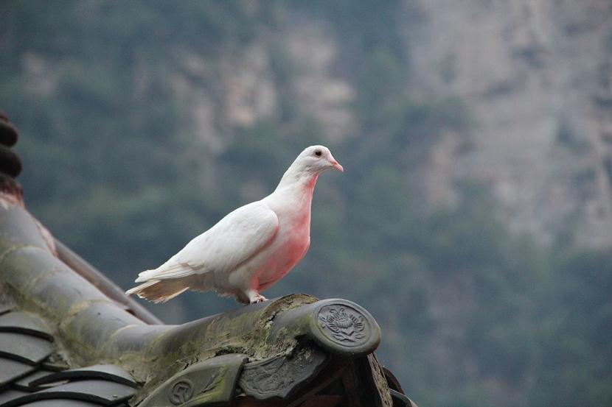

Slide 17
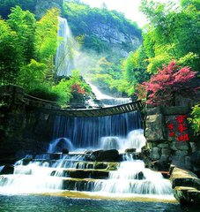
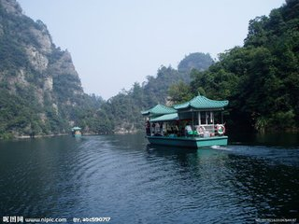
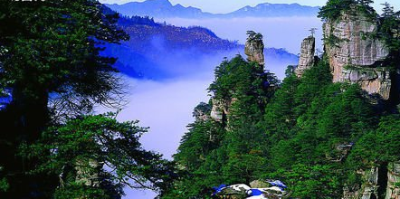
It’s a magic land of …
waterfalls
rivers
mountains
rocks
forests

Slide 18
Reading and vocabulary

Slide 19

1. Look at the photo and write down words
that can best describe it.
stone, tall, dangerous,
beautiful, strange,
various (多样的),
different, great,
charming (迷人的)
attractive (吸引人的)
…

Slide 20
2. The main idea of each paragraph.
Descriptions of Zhangjiajie
A special experience at night
The story of their climbing on Mount Tianzi
Where to go tomorrow
Para 2
Para 3
Para 4
Para 5

Slide 21

2. Work in pairs. What do you know about
Zhangjiajie? Can you answer the questions?
1. Where is it?
2. How large is it?
3. What is there to see?
4. Where can you stay?
5. What animals can you see?
6. What’s the most famous thing to see?

Slide 22

Learning to learn
Read and find out how Betty starts and finishes her email to her mum and dad. Next time when you write your email, you can start and finish the email in the same way.

Slide 23

Watch and read
见视频Module 8 Unit 2 Activity 3

Slide 24


3. Read the email and check your answers to Activity 2.
FROM:
Betty
TO:
Mum and dad
SUBJECT:
Wonderful time in Zhangjiajie
Dear Mum and Dad,
I promised to write, so...
We’re staying with Lingling’s uncle in Hunan

Slide 25
Province, and I’m having a wonderful time here in Zhangjiajie. It’s a magic land of mountains, forests and rivers. It's very large, about 480 square kilometres. It’s famous for the strange shape of its tall rocks. Some of them look like humans while others look like wild animals.
Last night we camped by a small lake. During
the night, we heard a noise! It woke everybody

Slide 26
up. We thought somebody was moving about. Lingling's uncle said it was an animal. We came out without making any noise, and found it was just a hungry monkey looking for food.
This morning, we climbed Mount Tianzi! From the top we hoped to see the lakes and forests. But it was a pity that it was cloudy. We could only see the mountain tops above the clouds.

Slide 27
Then we walked down the path, along a river, past trees and other plants and back to the camp. I pulled a leaf off a plant, but Lingling’s uncle said that it was wrong to pull leaves off plants and that we should protect everything here. I was very sorry.
Tomorrow we’re going to Dongting Lake, the second largest freshwater lake in China. We’ll
to back home next week! Wish you were here!
Love,
Betty

Slide 28

Now answer to the questions in Activity 2.
Where is it?
2. How large is it?
4. Where can you stay?
It’s in Hunan Province.
It’s about 480 square kilometres.
You can stay in camps or hotels.

Slide 29
5. What animals can you see?
6. What’s the most famous thing to see?
You can see monkeys.
The tall, strangely shaped rocks are the most famous thing to see.

Slide 30

4. Number the sentences in the correct order.
a) Betty pulled a leaf off a plant.
b) The noise woke everybody up.
c) They climbed Mount Tianzi.
d) A monkey made some noise.
e) They camped by a small lake.
f) Lingling’s uncle said that people should
protect everything in Zhangjiajie.
5
3
4
2
1
6

Slide 31
5. Complete the sentences with the correct form of the words in the box.
human kilometre path shape wish
1. Are there rocks in _______ or animal_______
in your home town?
2. How many __________ is Zhangjiajie from your home town?
3. Is it safer to walk along a ______ or climb over rocks?
4. Where do you ______ you were right now?
human
shapes
kilometres
path
wish

Slide 32

7. Summary
1.平方千米
2.外形
3.人形岩石
4.唤醒某人
5.摘下
6.答应做某事
7.一片有着…的神奇的土地
8.四周走动
9.沿着小路走
10.第二大淡水湖
1. square kilometre
2. shape
3. rocks in human shape
4. wake sb. up
5. pull off
6. promise to do sth
7. a magic land of…
8. move about
9. walk down/along the path
the second largest
10. freshwater lake
Notes:
M xz.<vdkflklfgrrpore0

Slide 33
Betty with Lingling and her uncle is having a wonderful time in Zhangjiajie. ..
Where ?
How large ?
Zhangjiajie:
What is it like?
Famous for…
A special experience at night
Where did they camp ?
What did they hear?
What was that?
The story of climbing Mount Tianzi
What did they hope to see from the top?
What did they only see?
Is it right to pull leaves off plants? What should we do?
Where to go tomorrow
When to be back home

Slide 34

6. Work in pairs. Ask and answer the questions in Activity 5.
1. Are there rocks in human or animal shape in your home town?
2. How many kilometres is Zhangjiajie from your home town?
3. Is it safer to walk along a path or climb over rocks?
4. Where do you wish you were right now?

Slide 35
Writing

Slide 36
7. Read the information about Zhangjiajie.
How large is it? | about 480 square kilometres
Where is it? | about 400 kilometres from Changsha
What can you see? | Mountains, rivers, forest, many kinds of plants and animals
What’s special? | strange shape of tall rocks, beautiful sights
Where can you sleep? | hotels or camps

Slide 37

Now decide which is more personal, Betty’s email or the information in this table.
8. Choose the most important or interesting
facts about Zhangjiajie and write a passage
about it.
Zhangjiajie is about 480 square kilometres.
It is about 400 kilometres from…

Slide 38
Possible answer
Zhangjiajie is about 480 square kilometres. It is about 400 kilometres from Changsha. Everyone loves its many unusual mountains, rivers and forests. There are a lot of different plants and animals too. Zhangjiajie is popular with people because of the shapes of its tall rocks, and its beautiful sights. Visitors can stay in hotels or tents in the park.

Slide 39
Language points

Slide 40

1. wake (woke-woken) v. 唤醒；醒来
It woke everybody up.
它把大家都被吵醒了。
wake常与副词up连用，构成动副词结构短语wake up，意为“使……醒来；叫醒”。当宾语时代词时，须放在wake和up中间；当宾语是名词时，放在up的前面或后面均可。wake up 的反义词组是fall asleep，意为“睡着，入睡”。

Slide 41
wake的形容词形式为awake。常用于be动词后作表语。
例如：
It was twelve o’clock, but he was still awake.
十二点了，可她还是睡不着。

Slide 42
2. I promised to write, so...
我答应要写信(给你们)，所以……
promise to do sth. 意为“答应做某事；承诺做某事”。promise也可接双宾语，即promise sb. sth. = promise sth. to sb.，意为“答应给某人某事；许诺某人某事”。
My father promised me a computer.
=My father promised a computer to me.
我爸爸答应给我买一台电脑。

Slide 43
3. pull v. (用手)拉，牵，扯
I pulled a leaf off a plant.
我从一株植物上扯了一片叶子。
pull后接名词或代词作宾语。其反义词是 push（推）。例如：
You push and I’ll pull. 你推，我就拉。
pull ... off... 把……从……上摘下来
pull together 同心协力
pull ... out of… 从……拖出……

Slide 44
4. We thought somebody was moving about.
我们认为有人在四处走动。
move about 意为“走来走去；四处走动”。
与move有关的短语：
move in 搬进来
Our new neighbors moved in yesterday.
我们的新邻居昨天搬进来了。
move out 搬出去；迁走
We should move out before painting the room.
我们应该在粉刷房间之前搬出去。

Slide 45
5. Wish you were here!
真希望你们也在这里啊！
本句中wish后面的宾语从句使用了虚拟语气。
wish一般用来表示“不能实现或没有把握实现的愿望”，所以其宾语从句使用虚拟语气，翻译成汉语时，意为“要是……就好了；但愿……”
（1）wish作为名词时，意为“愿望，希望”，为可数名词。例如：
His wish came true. 他的愿望实现了。

Slide 46
（2）wish作动词时，意为“希望；祝愿”，常见用法如下：
①wish sb. +名词 祝某人……
②wish to do sth. 希望做某事
③wish sb. to do sth. 希望某人做某事
例如：
She wishes me to win the chess match.
我希望我赢得国际象棋比赛。

Slide 47
活学活用

Slide 48

一、单项选择题。
1. —Mum, what’s for breakfast?
— Shh！Your dad slept late last night.
Don’t _______.
A. wake up her B. wake him up
C. wake up him D. wake her up
2. You mustn’t ______ the leaves off, or you
may hurt the plant.
A. pull B. touch C. leave D. press
B
B

Slide 49
3. He promised _______ his old friend during
his stay in Tianjin.
A. see B. seeing C. saw D. to see
4. — What are you going to do when you
grow up?
— A singer, but my parents wish me
_____a teacher.
A. am B. to be C. will be D. be
D
B

Slide 50
二、选择适当的介词、副词填空。
along about off
1. Before you go to a place to spend your
holiday, you should know _______ the
weather first.
2. Walk ________ the street and take the
right turn at the first corner.
3. I'm too tired. Shall I have some time ____?
I want to relax a little bit.
about
along
off

Slide 51
Homework
Write a passage about a place of interest you know or you have been to.
Search for some information about Zhangjiajie.

Slide 52


桂林市桂电中学
2020.8.20录制

