Slide 1


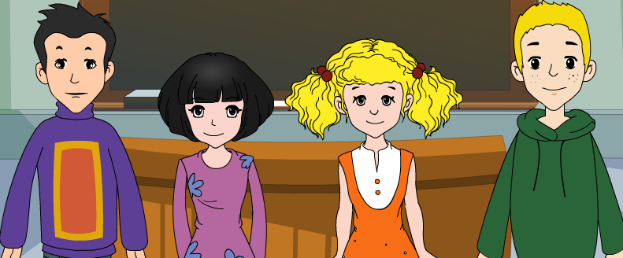
外研八年级（下） 授课教师 杨晔

Slide 2
Module
8
Time off
Unit 1
I can hardly believe we’re in the city centre.

Slide 3

Teaching aims
1. Teaching aims:
To get the main ideas of the listening material and the conversation
To understand the object clause with that in context
To be able to introduce a place of interest in your home town

Slide 4
2. Main contents:
Key vocabulary
hardly, take up; point out; at the top of;
waste
Key structures
I can hardly believe we’re in the city centre.
I don’t think they allow people to swim in
the lake.
I hope it will be cooler up here.

Slide 5

Warming up

Slide 6

Think about it!
Do you like to travel? Where do you want to go?
Do you know some world famous tourist attractions?

Slide 7

let's guess
Look at each picture (symbol building) and
say out the name of the city in two seconds.

Slide 8
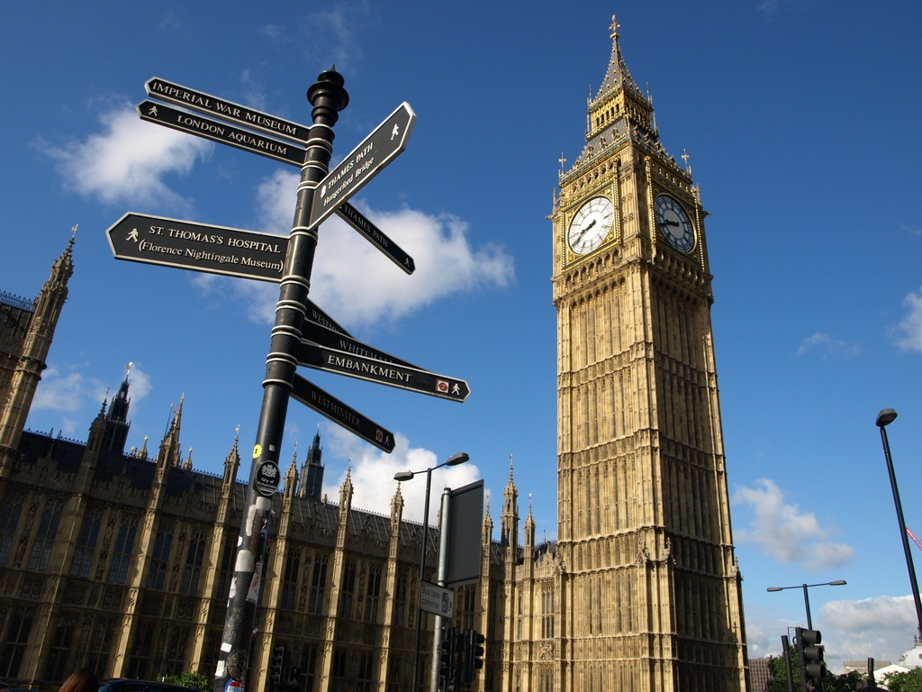
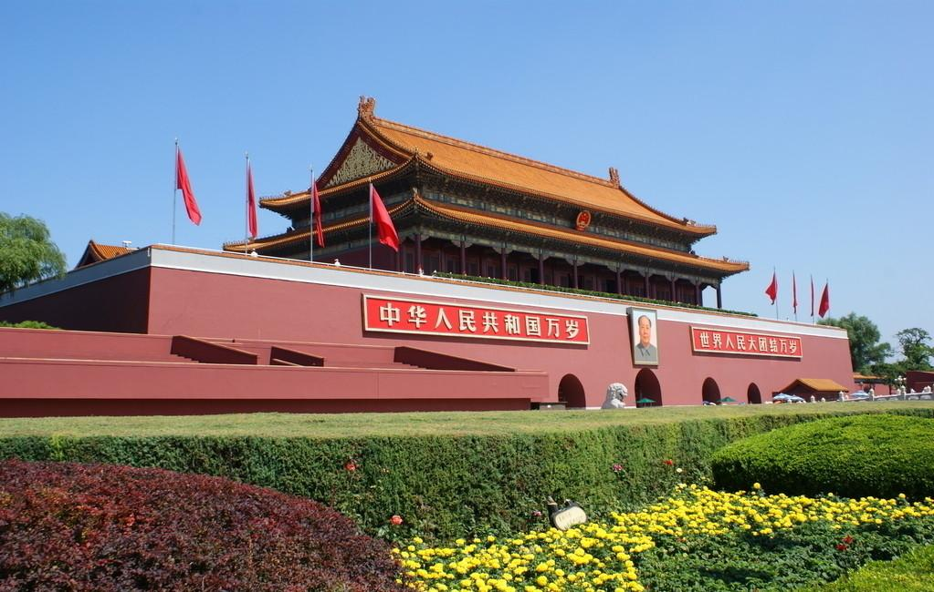
Big Ben
London
Tiananmen Square
Beijing

Slide 9
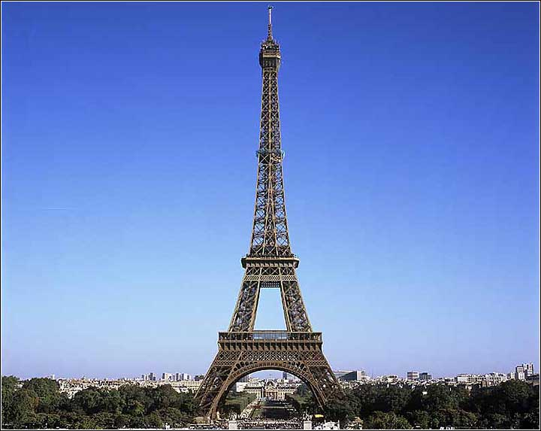
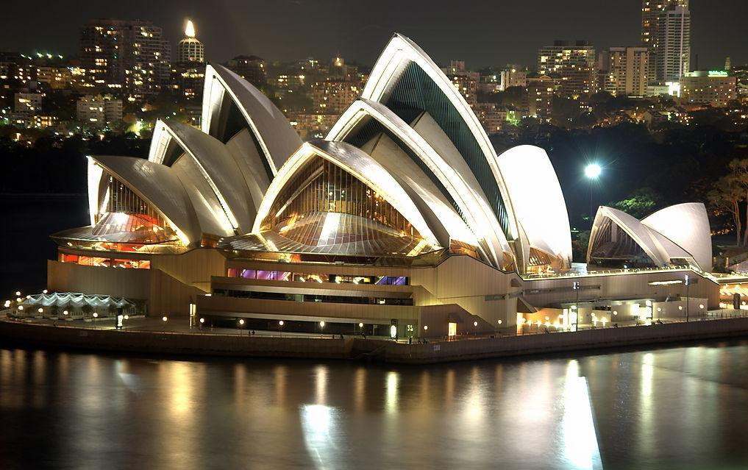
Eiffel Tower
Paris
Opera House
Sydney

Slide 10
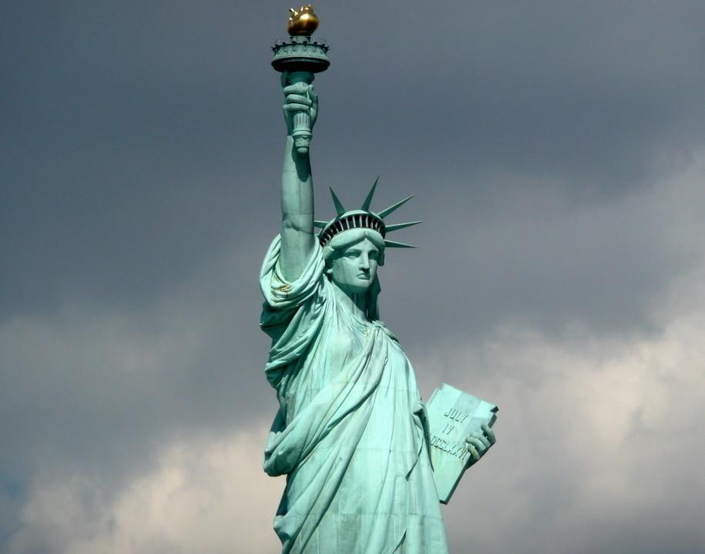
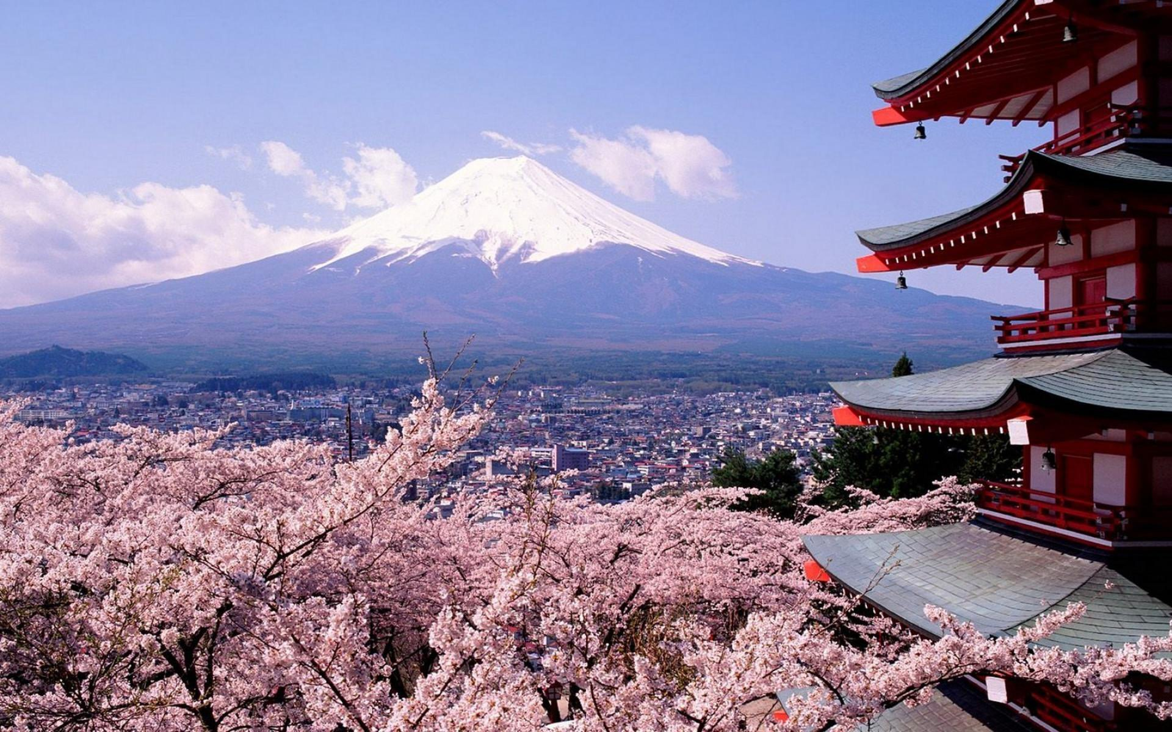
the Statue of Liberty
New York
Fuji Mountain
Japan

Slide 11
Listening and vocabulary

Slide 12
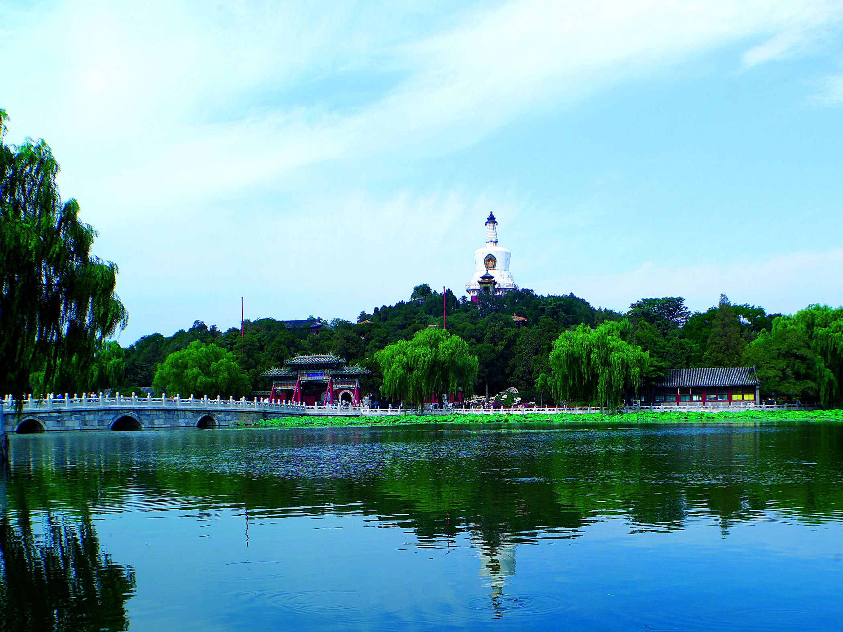
Welcome to Beihai Park

Slide 13
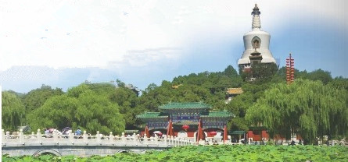
1. Look at the photo and listen. What is the conversation about?
The conversation is about going to Beihai Park.

Slide 14
2. Listen again and choose the correct answer.
Tony has / hasn't heard about Beihai Park.
2. Tony guesses that the park is very popular / not very popular.
3. Lingling suggests that they spend the day there / Darning and Betty come too.
4. Lingling thinks / doesn't think the park will be busy.

Slide 15


Tapescript
Tony: I've heard that Beihai Park is very
beautiful.
Lingling: Yes, it is. Shall we go for a walk there?
Tony: That's a great idea. Maybe Daming
and Betty will come too.
Lingling: Let's tell them that we're going to

Slide 16
spend the day there.
Tony: I guess it's a very popular place.
Will there be lots of people there?
Lingling: Well, lots of people go there, but
it's a big park, so I don't think it'll
be very busy.
Tony: I hope not.

Slide 17

Watch and read
Everyday English
• Here we are.
• Wow!
• I can hardly believe…
• That’s too bad.
• Come on!
见视频Module 8 Unit 1 Activity 3

Slide 18
3. Listen to the conversation and answer the questions.
1.Where are Lingling, Tony and Daming?
2.How does Tony feel about the park?
They’re in Beihai Park.
It’s so quiet. He can even hear the birds singing.
3. What is Beihai Park famous for?
This park is famous for its lake, bridges and the ancient buildings on the hill.
4. Does Daming want to climb the hill? Why?
No. Because he is so tired and the weather is so hot.
5. Where will they have their picnic?
At the top of the hill.

Slide 19
Now complete the sentences about Beihai Park.
Beihai Park is so______ that you can even
hear the birds singing.
2. The park is famous for its_____, bridges and the ancient buildings on the hill.
3. The lake takes up ________ of the park area.
4. You can point out the ______ of Beijing
from the top of hill.
5. They do not allow people to swim _________.
quiet
lake
over half
sights
in the lake

Slide 20
仿句造句
1. 教室里太安静了以至于我们甚至以为教室里没有人。
The classroom is so quiet that we even think there is nobody in.
2. 桂林以其青山绿水和古老的建筑物而闻名于世。
Guilin is world famous for its green hills, clear water and the ancient buildings.
3. 操场占据了半个校园的面积。
The playground takes up half of the school area.
4. 从叠彩山顶上，你可以俯瞰桂林市的风景。
You can point out the sights of Guilin from the top of Diecai Hill.
5. 老师禁止学生带手机进入校园。
Teachers do not allow students to bring their mobiles into schools.

Slide 21
4. Read the sentences and answer the questions.
hardly sights thirsty waste
1. “I can hardly believe we’re in the city centre.”
Does Tony know they are in the city centre or
not?
Tony doesn't think they are in the city centre.

Slide 22
2. “Then I can point out the sights of Beijing
for you.”
Does Lingling want them to look at something
or listen to something?
3. “I’m so hungry and thirsty.”
Does Daming want something to drink?
Lingling wants them to look at something.
Yes, he does.

Slide 23
4. “Let’s not waste any more time.”
Does Tony think they arc spending their
time well or badly?
Tony thinks they are spending their time badly.

Slide 24
Pronunciation and speaking

Slide 25
5. Listen and notice how the speaker pronounces the words.
1. It’s so quiet here that I can even hear the
birds singing.
2. Let’s walk along the lake, cross the bridge
and climb up the hill.
3. I don’t want to climb.
Now listen again and repeat.

Slide 26
6. Work in pairs. Talk about a place of
interest in your home town..
Student A: You’re a visitor from another
country.
Student B: You’re introducing a place of
interest in your home town to
student A. You can talk about:
where it is
where it is ●what is special about it
any other information you know about it
how big it is
how old it is

Slide 27

Use these expressions:
I guess (that)…
I know (that)…
I think (that)…
I’m sure (that)…
I can’t believe (that)…

Slide 28
Language points

Slide 29

1. time off
time off “休假，放假” , 是名词短语。
例如：
You work too hard. You should take some
time off.
你太辛苦了，应该休息一段时间。
Her boss gave her time off.
她的老板准了她的假。

Slide 30

2. hardly adv. 几乎不；几乎没
I can hardly believe we’re in the city centre.
我几乎不敢相信我们是在市中心。
hardly 是一个含有否定意义的副词，常用于be动词、情态动词或助动词之后，行为动词之前。它用于反义疑问句时，其附加疑问句要用肯定形式。

Slide 31
hard即可用作形容词，也可用作副词。用作形容词时，意为“坚固的；困难的；硬的”；用作副词时，意为“努力地；辛苦地；猛烈的”。
例如：
They lived a hard life twenty years ago.
二十年前，他们过着艰苦的生活。(形容词)
It’s raining so hard outside.(副词)
外面雨下得很大。

Slide 32
3. It’s so quiet that I can even hear the birds
singing!
这里如此安静，我甚至可以听到鸟儿在唱歌。
so…that…意思是“如此……以至于……”,可以引导结果状语从句，so后面跟形容词或副词的原级，that后接从句。例如：
It’s so hot that I can’t sleep.
天如此热，我无法睡觉。

Slide 33
hear sb. doing sth. 意为“听见某人正在做某事”，doing表示动作正在进行。
I heard the girl playing the piano at this time yesterday.昨天这个时候我听见那个女孩正在弹钢琴。
hear sb. do sth. 意为“听见某人做某事”， do
表示动作已经完成，即动作的全过程结束了或动作经常发生。
I often hear the girl play the piano in the next room.我常常听见那个女孩在隔壁房间弹钢琴。

Slide 34
4. The lake takes up over half of the park area.
湖占据了这个公园一半多的面积。
Reading takes up most of my time.
阅读占用了我大部分时间。
take up既可以指时间上的“占去”，也可以指空间上的“占去”。take up 还有“开始从事；开始做；接受”等意思。例如：
They’ve taken up golf.
他们学起了打高尔夫球了。

Slide 35

away
back
down
photos
part in
off
out
搭配
解除；消除
退回；收回
拆掉；写下
take
拍照
参加
起飞；脱掉
带……出去；切除

Slide 36
5. Let's walk along the lake, cross the bridge
and climb up the hill.
咱们沿湖散步，过桥去爬山吧。
walk along 沿着…走
Walk along the road and turn right at the traffic lights.
沿着这条路走,在交通灯处向右转。
climb up 爬上；攀登
If I climb up a tree, I can see farther.
如果我爬到树上的话，我就能看得更远一些了。

Slide 37
6. point out 指出；指明
I can point out the sights of Beijing for you.
然后我可以为你们指出北京的景点。
例如：
If you see that boy, please point him out for me.
如果你看到那个男孩，请把他指给我看。
Did Ms Du point out where you were wrong?
杜老师有没有指出你什么地方错了？

Slide 38
point out 的宾语可以使名词、代词或that从句。代词作其宾语时，要放在point和out之间。
point to/at 意为“指向；指着”（to强调远距离， at强调近距离）。
He pointed to the south.他指向南方。
Don’t point at people with a finger.
不要用手指指人。

Slide 39
7. I'm sure it'll be fantastic to see the city from
the top.
我想从山顶上俯瞰北京一定很棒。
fantastic = wonderful 极好(妙)的;了不起的
She's a fantastic dancer. 她的舞跳得非常好。
What a fantastic goal! 这球进得多漂亮!

Slide 40
8. I don't think they allow people to swim in
the lake.
我认为他们不允许人们在湖里游泳。
allow sb. to do sth. （ sb. 不可以省略）
允许某人做某事 = allow doing sth.
His parents won’t allow him to stay out late.
他的父母不会允许他在外待得很晚。
They allowed smoking in this room only.
他们只允许在这间屋子里抽烟。

Slide 41
活学活用

Slide 42
一、单项选择题。
C
I could ____ hear what you said just now. Could you please say it again?
A. sometimes B. always
C. hardly D. clearly
2. He tried to _____ the danger of driving alone for me.
A. point at B. point out
C. point on D. point to
B

Slide 43
3. —What are you going to do during the summer vacation?
—I’m going to ____ a new hobby like swimming or dancing.
A. take off B. take up
C. take after D. take in
4. We don't allow people _____ in the cinema.
A. smoke B. smoked
C. smoking D. to smoke
B
·
D

Slide 44
二、根据句意和首字母提示写单词。
1. I like the beautiful s_____ of this city.
2. He is very t______ and he needs some
water now.
3. I can h_____ understand what he said
because he speaks English too quickly.
4. They walked around the lake and c____
the small bridge.
ights
hirsty
ardly
ross

Slide 45

Homework
Learn the new words and expressions in this module.
Describe a park around your home or school.

Slide 46


桂林市桂电中学
2020.8.20录制

