Slide 1
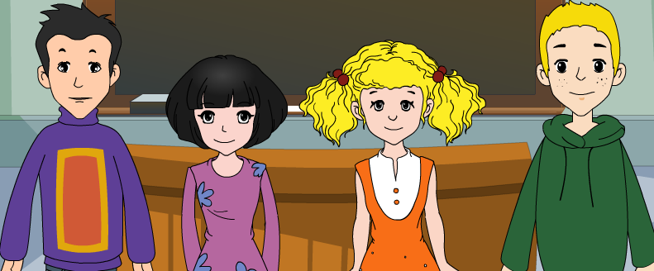
外研八年级（下） 授课教师 杨晔

Slide 2
Module
5
Cartoons
Unit 1
It’s time to watch a cartoon.

Slide 3
Teaching aims
1. Teaching aims:
To be able to understand conversations about cartoon characters and identify specific information
To be able to talk about one’s favourite cartoon character(s)

Slide 4
2. Main contents:
Key vocabulary
cartoon, handsome, smart, fight, cool, hero,
humorous, can’t help doing sth., laugh
Key structures
We’ve finished our homework.
It’s time to watch a cartoon.

Slide 5
Think about it!
Do you like cartoons? What’s your
favourite cartoon character?
• Can you talk with others about
cartoons?

Slide 6
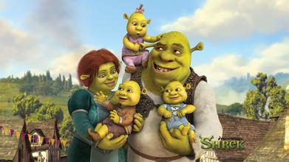
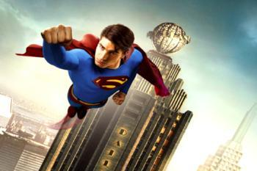
Can you list some popular cartoon characters?
Shrek 史瑞克
Superman 超人
Notes:
导入一

Slide 7
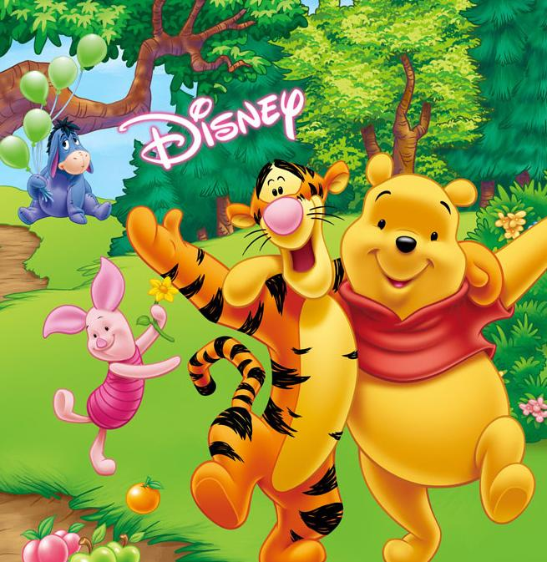
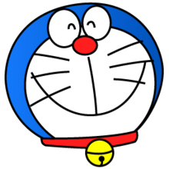
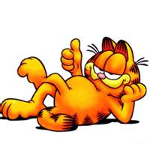
Doraemon
叮当猫
Winnie the Pooh
维尼熊
Garfield 加菲猫

Slide 8
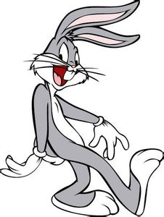
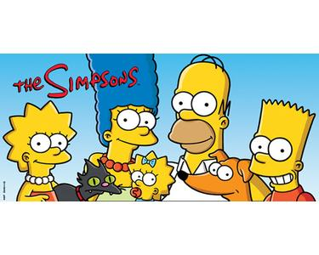
Bugs Bunny 兔八哥
The Simpsons
辛普森一家

Slide 9
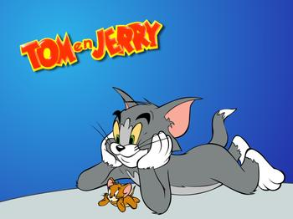
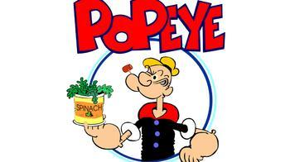
Tom and Jerry
猫和老鼠
Popeye
大力水手

Slide 10
卡通人物
cartoon characters

Slide 11
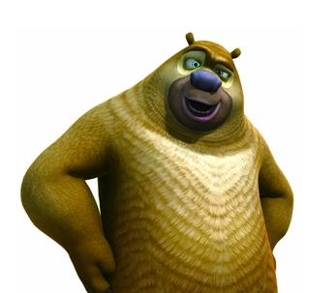
Do you know any other cartoon characters?
Let’s learn more together!

Slide 12
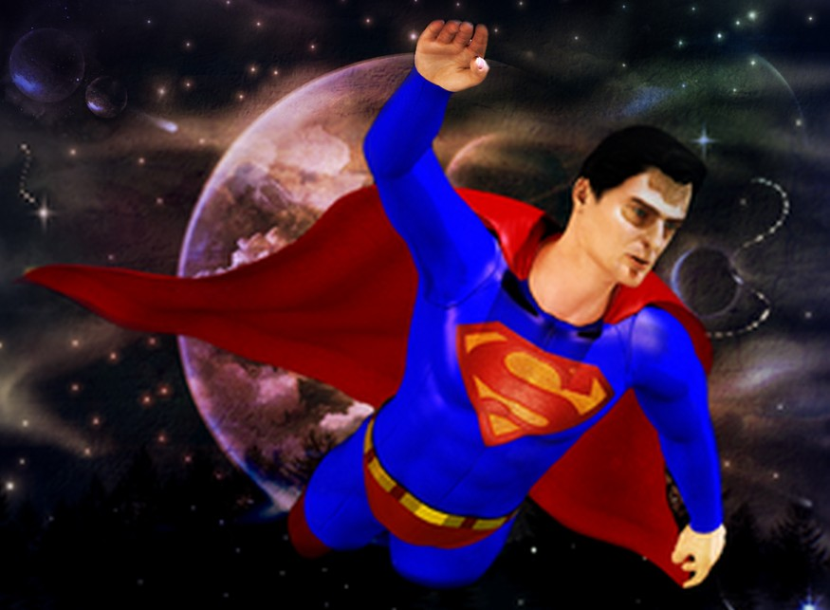
Superman

Slide 13
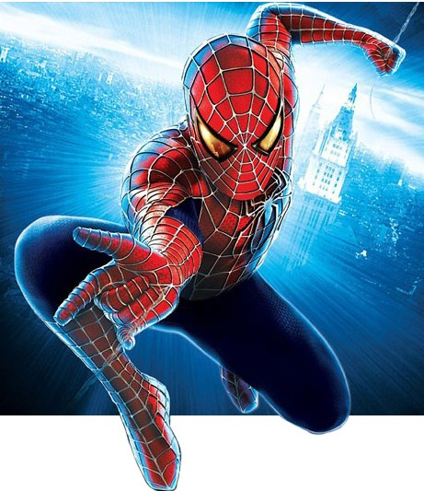
Spiderman

Slide 14
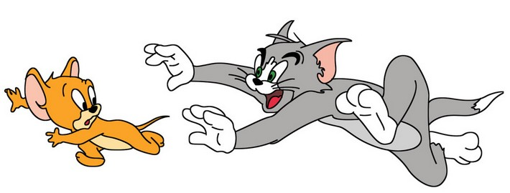
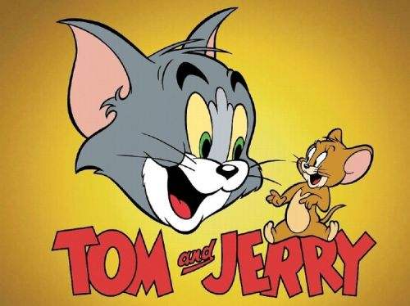

Slide 15
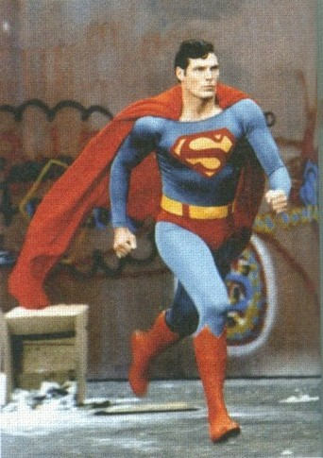
Listening and vocabulary
Answer the questions.
What kind of cartoons do you like?
Do cartoons always end in a happy way?
What cartoons do you think are funny?

Slide 16
2. Listen and find out Betty's and Tony's answers to the questions in Activity 1.
brave cartoon cute funny handsome smart
1. What kind of cartoons do you like?
Betty likes exciting cartoons; Tony likes funny cartoons.

Slide 17
2. Do cartoons always end in a happy way?
3. What cartoons do you think are funny?
Betty and Tony say cartoons always have
happy endings.
Tony thinks Tom and Jerry are funny.
Now work in pairs and check. Do they like the same cartoons as you?

Slide 18
Tapescript
Tony: What kind of cartoons do you like,
Betty?
Betty: My favourite cartoon is Superman.
It's great!
Tony: Why do you like it so much?
Betty: The stories are so exciting! Superman
is brave... and he's very handsome too.

Slide 19
Tony: I don't like it much, myself. The
stories always have happy endings.
Betty: Yes, but all cartoons have happy
endings.
Tony: I guess you're right. I like watching
Tom and Jerry. It's funny!
Betty: Yes, and Jerry is smart and cute!

Slide 20
Watch and read
Everyday English
_{• It’s time to… …}
_{• That’s cool.}
_{• I don’t think we agree.}
见视频Module 5 Unit 1 Activity 3

Slide 21
Now answer the questions.
What does Tony think about Spiderman?
2. Why does Daming think Superman is better?
It is more modern and Spiderman is cool.
Superman is stronger than Spiderman. He can fly through the sky and fight bad people and he is a real hero.

Slide 22
3. Why do they both like Tom and Jerry?
4. What lesson can Tony learn from Tom and Jerry?
It’s humorous and Tom and Jerry are very funny.
He can learn a lot about people and life from them — although they fight a lot, they love, help and protect each other too.

Slide 23
4. Complete the passage with the correct form of the words in the box.
cartoon fight hero humorous laugh lesson
Children and adults all over the world love (1)_________. Some, like Tom and Jerry, are (2)__________, and people enjoy (3)_________ at the funny stories in them. Others, like Superman and Spiderman, are about (4)_____ .
They (5)______ bad people to protect the world. These cartoons are not just stories — they also teach (6)_______about good and bad.
cartoons
humorous
laughing
heroes
fight
lessons

Slide 24
Pronunciation and speaking
6. Listen and underline the words the speaker stresses.
1. That's a real hero!
2. I don't think we agree.
3. They fight a lot, but they really love each other. 4. I think there’s a lesson there!
Now listen again and repeat.

Slide 25
英语句子一般由多个单词构成，这些单词的重读(stress) 一般遵循以下规律：
名词、形容词、数词、动词、副词、代词和表达强烈思想感情的感叹词需要重读；人称代词、连词、冠词、介词、以及少数系动词和助动词等主要起语法作用的单词一般不重读（当然有少数例外）。

Slide 26
Watch and read
Everyday English
_{• It’s time to… …}
_{• That’s cool.}
_{• I don’t think we agree.}
见视频Module 5 Unit 1 Activity 3

Slide 27
Role-play
1. Read the dialogue aloud for a
few minutes by yourself;
2. Role play in groups;
3. Role play in front of the class
We’ll see which group does the best.

Slide 28
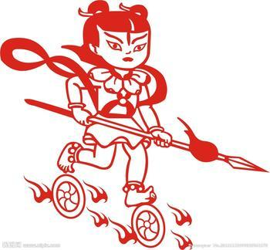
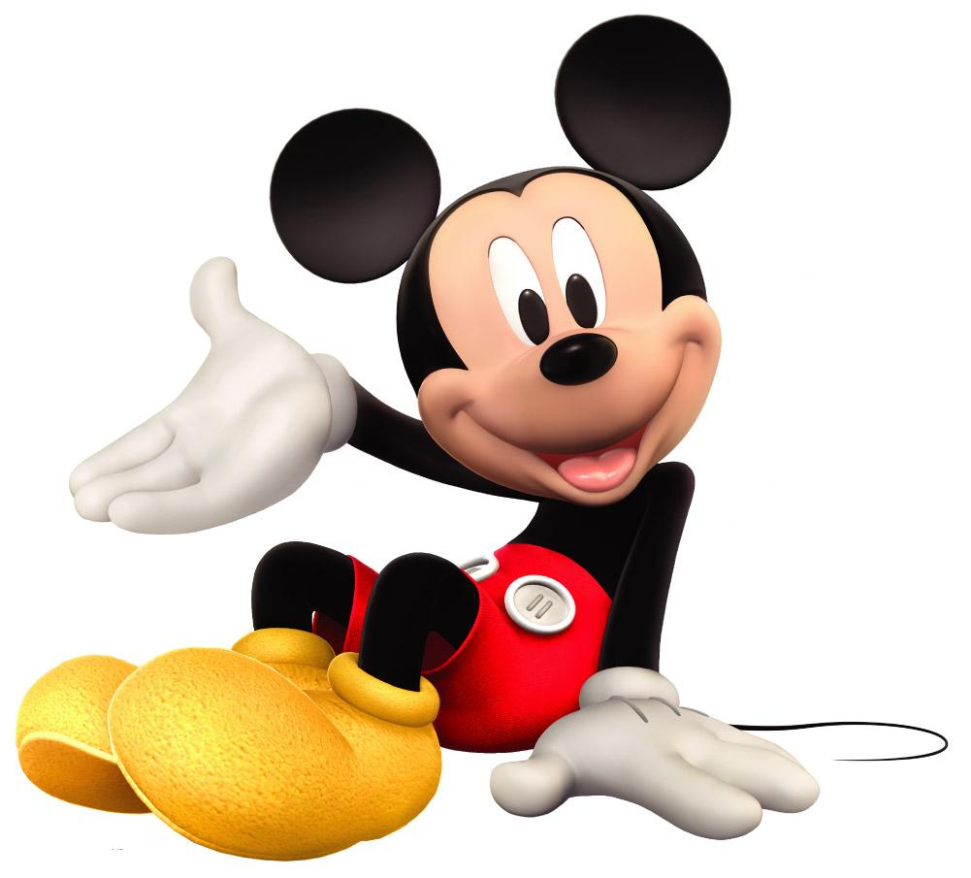
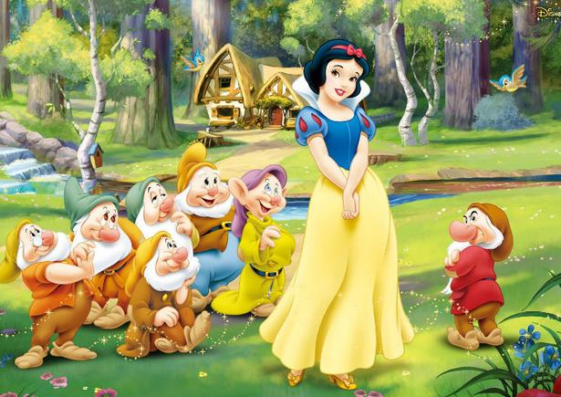
5. Work in pairs. Describe your favourite cartoon character or the characters below. Use the words in the box in Activity 2 to help you.
☺ Nezha
☺ Mickey Mouse
☺ Pleasant goat
☺ Snow White

Slide 29
Example:
— I think Nezha is brave. And he can fly.
— Yes, I think so too. / No, I think he is very naughty. And he brings his family a lot of trouble.
Please describe what characters do or can do, and what they are like.

Slide 30
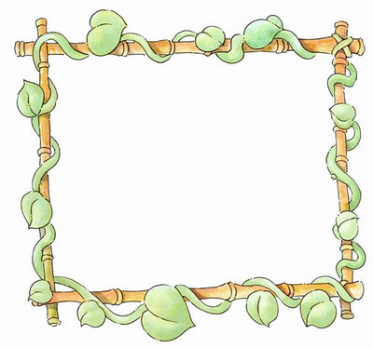
smart friendly intelligent
clever fun
brave cool
Nezha

Slide 31
Mickey Mouse
beautiful smart friendly cute
lovely clever intelligent

Slide 32
beautiful smart friendly cute
fun interesting lovely clever
Pleasant Goat

Slide 33
beautiful smart friendly cute
fun shy interesting
lovely clever
Snow White

Slide 34
7. Work in pairs. Ask and answer the
questions.
1. What cartoons do you like reading or
watching on TV?
2. When do you read or watch them?
3. Which one do you like best? Why?
—What cartoons do you like reading?
—I like reading...

Slide 35
【课文解析】Language points
1. It’s time to watch a cartoon.
该看卡通片了。
It is/was time to do sth.
到了做某事的时间了。
Practise
到了上床睡觉的时间了。
It’s time to go to bed.
到了吃晚饭的时间了。
It’s time to have supper.

Slide 36
2. He keeps fighting bad people.
他一直在和坏人做斗争。
He kept on repeating these words over and over.
他一遍又一遍重复这几句话。
keep (on) doing something 是一个固定搭配，表示“反复做，继续做某事”

Slide 37
3. I can’t help laughing when I watch them!
看的时候我总忍不住要笑。
can’t help doing sth.表示“忍不住做某事”。例如：
I couldn’t help thinking about the past.
我禁不住想起了过去。
She couldn’t help crying.
她禁不住哭了起来。

Slide 38
4. The cute mouse always beats the cat!
这只机灵的老鼠总能打败那只猫。
beat表示“打败，胜过”之意，后接的宾语多是某运动员或球队。beat还可以表示“敲打，（心脏等）跳动”。如：
Do you think the Stars will beat the Bulls?
你认为明星队能打败公牛队吗？
His heart is still beating.
他的心脏还在跳动。

Slide 39
课后回顾
本课时主要短语和句型
keep doing sth.
can’t help doing sth.
It’s time to…
I don’t think we agree.
We’ve finished our homework.
Why don’t we…?
反复做；继续做……
忍不住做……
到了做……的时间了
我们不同意
我们做完家庭作业了
我们为什么不……

Slide 40
Spelling bee
Now 2 minuets to test your spelling.
1. English-Chinese
humorous cartoon hero lesson handsome sky smart
2. Chinese-English
与……战斗，战争 忍不住做某事
笑，发笑 时髦的，酷的
When finished, exchange your papers to see who does the best.

Slide 41
Exercise
一、单项选择题
1. Miss Lee _____ to Pairs once.
A. goes B. went C. has gone D. has been
2. —Who works______ ，Mike or Jim?
—Mike.
A. hard B. harder
C. hardest D. the hardest
D
B

Slide 42
3. Alice’s Adventures in Wonderland is one of ______ stories.
A. famous B. more famous
C. most famous D. the most famous
4. We ____ each other for seven years.
A. have known B. know
C. knew D. will know
D
A

Slide 43
5. It’s not right to keep her ____ so long.
A. waits B. wait
C. to wait D. waiting
6. Superman keeps ____ bad people.
A. fights B. fight
C. to fight D. fighting
D
D

Slide 44
二、根据句意和汉语提示写单词。
1. He is so __________ (幽默的）that he
always makes people laugh.
2. Soldiers should _________ (保护) their
country.
3. They _______(与……战斗）bad people.
4. He is a ____________(英俊的) young man.
5. A ______ (勇敢的)fireman saved the woman.
humorous
protect
fight
handsome
brave

Slide 45
二、根据句意和汉语提示写单词。
1. 快点! 该去学校了。
_________________________________
2. 空气正在变得比几年前洁净得多。______________________________________________________________
3. 我们为什么不用刀子呢？ _________________________________
Hurry up! It’s time to go to school.
The air is getting much cleaner than a few years ago.
Why don’t we use the knives?

Slide 46
4. 我们总认为他还活着。
__________________________________
5. 如果人们继续砍伐森林（cut down the forest），他们将没有地方居住。
____________________________________________________________________
We can’t help thinking he’s still alive.
If people keep cutting down the forest, they will have nowhere to live.

Slide 47
Homework
Learn the new words and expressions in this module.
Write a short paragraph about your partner’s favourite cartoon character.

Slide 48
桂林市桂电中学
2020.8.20录制

