Slide 1
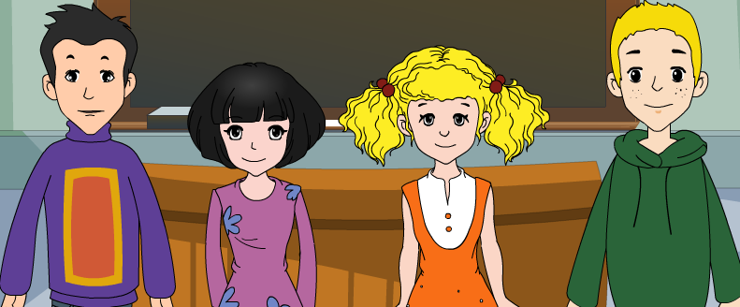
外研八年级（下） 授课教师 杨晔

Slide 2
Module
6
Hobbies
Unit 2
Hobbies can make you grow as a person.

Slide 3
Teaching aims
1. Teaching aims:
To understand the passage about hobbies
To be able to talk about different hobbies
To be able to write about hobbies with the target language

Slide 4
2. Main contents:
Key vocabulary
person, interest, skill, activity, sailing,
come out, result, as a result, pleasure, success
Key structures
Many students have hobbies, such as…
As well as…
Many young people love his book, and as a result…

Slide 5
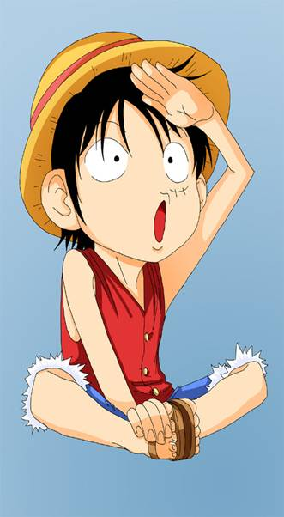
Let's review!
Ⅰ.英汉互译，完成下表。
扇子 |  | 使整齐 | 看一看
 | stamp |  |  | pound
邮票
英镑
fan
tidy up
have a look
美元 |  |  | 有价值的
 | just | must |  | hobby
只是：仅仅
肯定
爱好
dollar
valuable

Slide 6
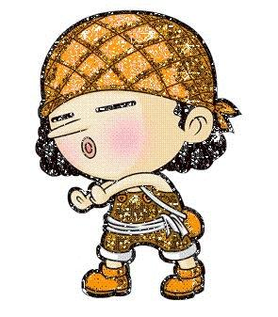
Ⅱ.完成下列对话。
A: ____________________, Eric?
B: My hobby is reading books.
A: _________________________?
B: I started doing it when I was
seven years old.
A: _________________________?
B: I read books every day when I
am free.
What’s your hobby
When did you start doing it
How often do you read books

Slide 7
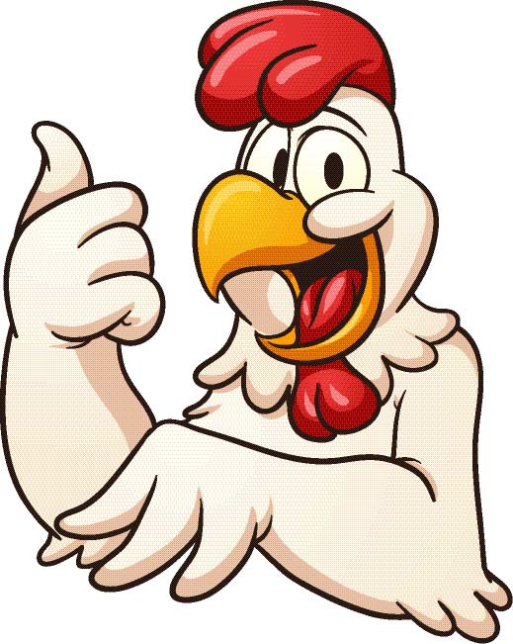
All of you did a good job!
Let’s go on!

Slide 8
Reading and vocabulary

Slide 9
1. Work in pairs. Talk about your hobbies. Use the words and expressions in the box to help you.
climbing dancing growing vegetables looking after animals playing volleyball painting singing writing
active dangerous healthy interesting relaxing

Slide 10
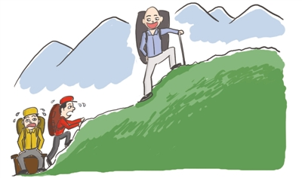
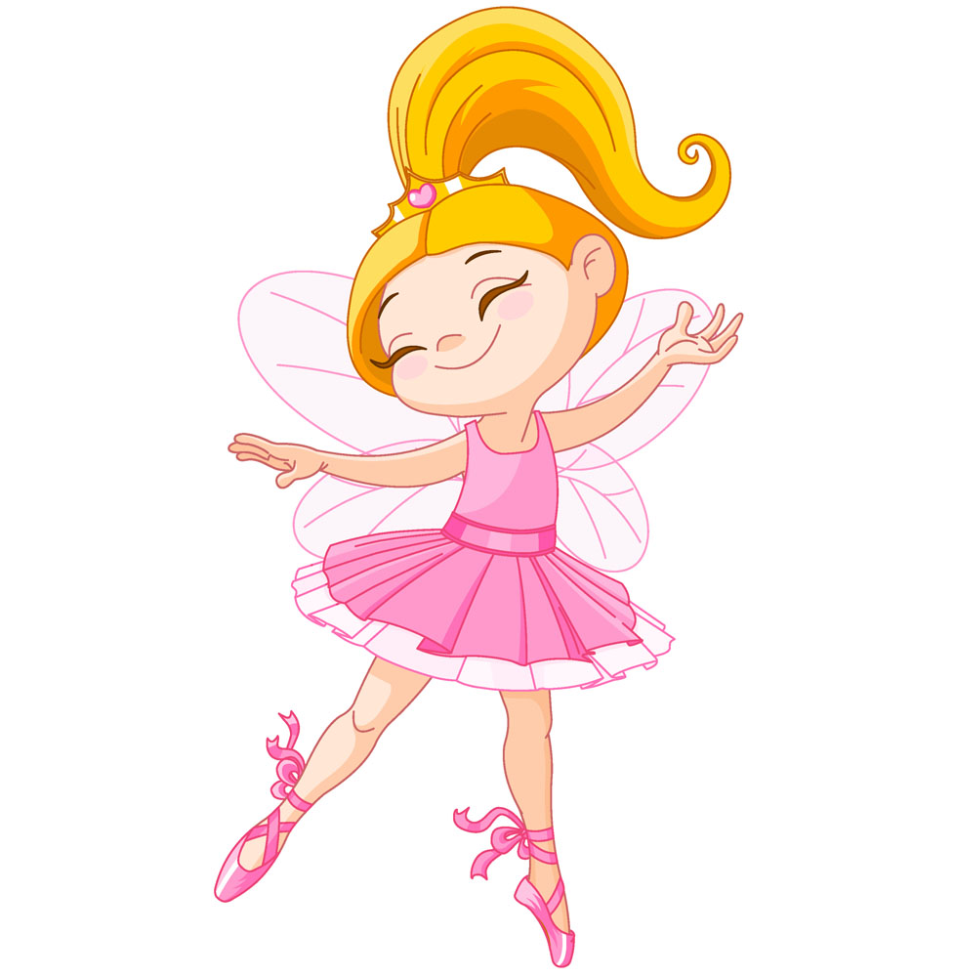
climbing
I don’t like climbing because
I am not a professional climber.
职业的，专业的
dancing
People like dancing because it’s relaxing.

Slide 11
1. Work in pairs. Talk about your hobbies. Use the words and expressions in the box to help you.
climbing dancing growing vegetables looking after animals playing volleyball painting singing writing
active dangerous healthy interesting relaxing

Slide 12
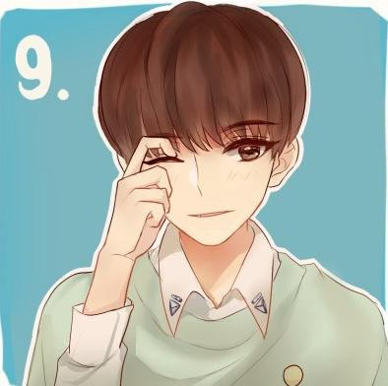
Find a hobby to help you improve your English.
If you like football, follow an English team.
If your hobby is watching films, try to watch English films.
Learning to learn

Slide 13
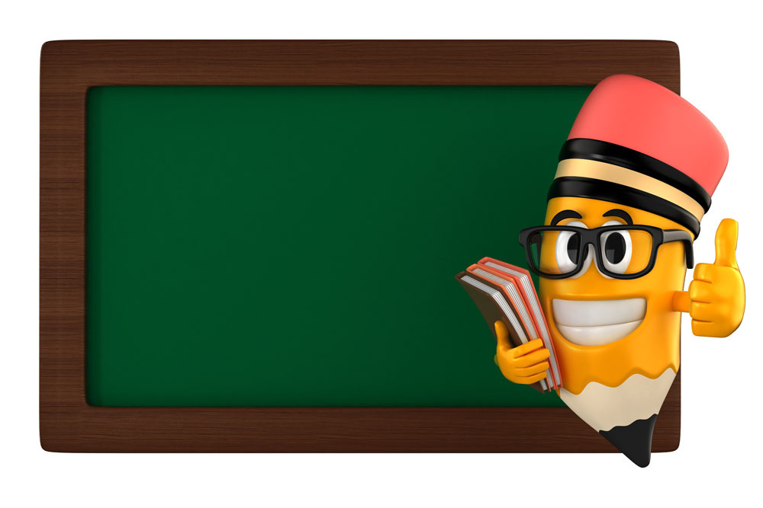
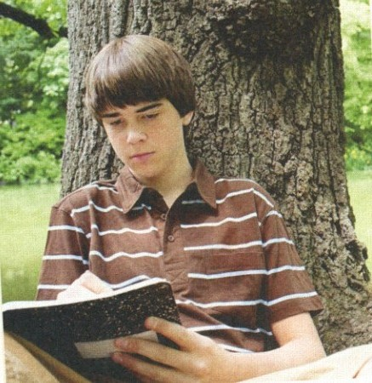
Watch and learn
David’s hobbies

Slide 14
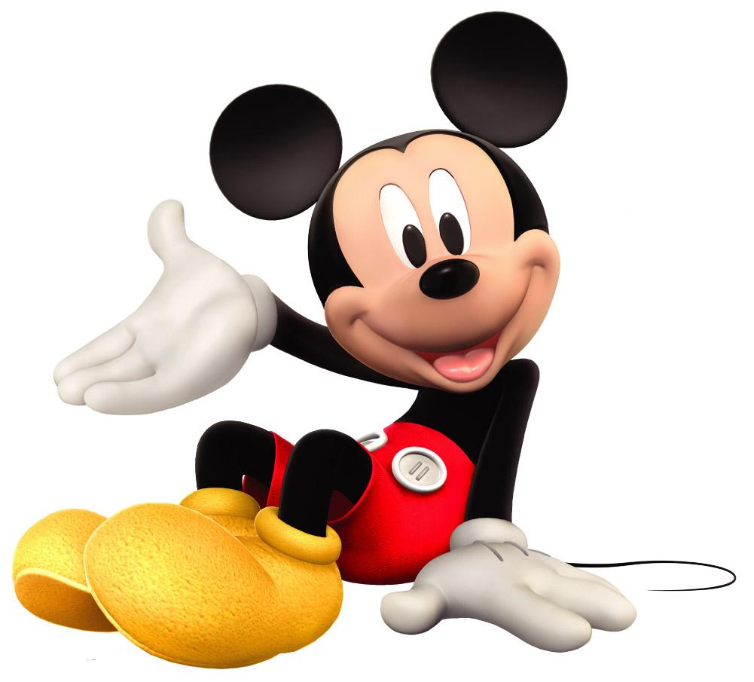
Now answer the questions.

Slide 15
1. What advantages can hobbies bring to
young people?
2. What hobbies does David have?
Hobbies can make you grow as a person, develop your interests and help you learn new skills.
David likes writing, playing volleyball and many other things.

Slide 16
3. When did David become a successful writer?
4. Will David’s new books be successful?
After his story about the life of a sixteen-year-old boy came out as a book in 2012.
Maybe yes. The passage doesn't say it.

Slide 17
4. Complete the sentences with the correct form of the words in the box.
activity pleasure result skill success
1. What _________ do you enjoy doing?
2. What new ______ have you learnt through
your hobbies?
3. Has any of your hobbies brought you _______
and _______?
4. Have you made new friends as a(n) ______
of your hobby?
activities
skills
pleasure
success
result

Slide 18
Watch and read
David’s hobbies

Slide 19
David’s hobbies
What is David's favorite hobby?
When did he start doing it?
What has his hobby brought him?
Does he have other hobbies?

Slide 20
5. Work in pairs. Ask and answer the questions in Activity 4.
1. What activities do you enjoy doing?
2. What new skills have you learnt through
your hobbies?
3. Has any of your hobbies brought you pleasure
and success?
4. Have you made new friends as a(n) result
of your hobby?

Slide 21
Language points
1. Many students have hobbies, such as
reading…and looking after animals.
such as 表示“比如, 例如”, 用于列举
前面概述过的事物。
The shop is selling many things, such as
school things, food and toys.
look after (+ sb / sth)
= take care of 照顾; 照看
His parents were out, so he had to look after his little sister at home.

Slide 22
2. Hobbies can make you grow as a person,
develop your interests and help you learn
new skills. 爱好可以促使你成长，培养你
的兴趣，并帮助你学习新的技能。
make sb do sth
make sb + adj.
make sb + n.
His jokes made us all laugh.
他的笑话把我们都逗笑了。
Listening to music can make me happy.
听音乐可以使我快乐。
We make him our monitor.
我们选他当班长。

Slide 23
make you grow as a person: 使你健全成长
as prep. 介词 这里表示“作为”。
He began to teach in that school as a math
teacher in 2000.
develop your interests 培养你的兴趣
develop 表示“发展，形成，成长，提高”。
This course can help you develop your speaking skills.
Tom has developed into a strong leader.

Slide 24
help sb (to) do sth 帮助某人做某事
help sb with sth 在某方面帮助某人
I help him cook the meal.
我帮他做饭。
I help him with his English.
我帮他补习英语。

Slide 25
3. During the summer of 2010, he spent
four weeks at a summer camp.
I spend some of my free time playing
volleyball for my school team.
during 在……时间内, 在……期间
Some shops open at night during the
Christmas.
on sth
spend money / time
(in) doing sth
在某物
某人花时间 / 金钱
做某事

Slide 26
I spent 10 years on the book.
I spent 10 years writing the book.
我花了10 年时间在(写)这本书上。
spend; take; pay; cost 都表示“花费”,
区别是：
sb spend + some time / money + on / (in)
doing sth
It takes / took sb + some time + to do sth.
sb pay + some money + for sth
sth cost (sb) + some money

Slide 27
4. As well as the usual activities, …
as well as 表示“也, 还, 除……以外还有;
而且”, 是并列连词, 用来连接并列成分。
连接并列主语时, 谓语动词与前一主语
保持一致。
The girl is lively as well as healthy.
We all want to visit Beijing as well as
Shanghai.
He as well as his friends likes playing
football.

Slide 28
as well as 与 not only …, but also…的区别
A as well as B
强调A, “不但B, 而且A”
not only A but also B
强调B, “不但A, 而且B”
e.g.
The teacher as well as the students is
coming to see you.
Not only the teacher but also the students
are coming to see you.

Slide 29
5. David wrote a story about the life of a
sixteen-year-old boy, and it came out…
come out 本句中表示“出书”, 还可以表
示“出现; (秘密等)传出; 结果是”等。
When will your new book come out?
你的新书什么时候出版？
At last the truth came out.
真相终于大白了。
The answer to the question came out wrong.
这道题的答案结果是错的。

Slide 30
6. Many young people love his book, and as a
result, David has become a successful
young writer.
as a result 意为“结果”, 表示后面的句子
所表达的前面的句子所表达的构成因果
关系, 前面是因，后面是果 。如：
He works hard, as a result, he got a good
mark in the exam.

Slide 31
7. He is also interested in many other things.
他对许多其他东西也很感兴趣。
be interested in + n. /v.-ing 对……感兴趣
Women are always interested in fashions.
女人总对时装很感兴趣
I was interested in dancing.
我曾经对跳舞很感兴趣。

Slide 32
8. Maybe I’ll write about my volleyball team in the future.
maybe 与 may be的区别
maybe是副词, 意思是“也许、大概”，
在句中作状语, 相当于perhaps, 常位于
句首。
在 may be 中, may 是情态动词, be 是动
词原形, 两者构成完整的谓语形式, 与主
语形成系表结构, 意为“可能是”。 如：
Maybe he is a student.
He may be a student.

Slide 33
Exercise
一、单项选择题。
1 .Which hobby do you think _____ the least
time?
A. takes up B. clears up
C. stands up D. grows up
2. —Do you collect ______ , Kate?
—Yes. I collect stamps.
A. the car B. anything
C. everything D. nothing
A
B

Slide 34
3. There is _______ in today’s newspaper.
You should read it.
important something
B. important nothing
C. nothing important
D. something important
4. Mr Green wrote a book. It ____last month.
A. took out B. turned out
C. came out D. went out
D
C

Slide 35
5. Since then, the young man ______ another
bad habit.
A. has developed B. developed
C. will develop D. develops
6. — _____ do you fly kites with your brother?
— Once a month if it is fine.
How long B. How many
C. How often D. How far
A
C

Slide 36
7. —How did you become interested in
growing flowers?
—Well my mother first made me _____
about it seriously.
A. think B. thinking
C. thinks D. to think
8. Uncle Bill enjoyed _____ the violin when
he was young.
A. to play B. playing
C. play D. plays
A
B

Slide 37
9. Your grandma as well as your parents_____ coming to see you next weekend.
A. be B. is
C. are D. am
10.Not only Bob but also I _____ good at _________interesting stories.
A. are; speaking B. am; saying
C. is; talking D. am; telling
B
D

Slide 38
二、根据句意和汉语或首字母提示写单词。
1.Which ________ (活动) do you like better,
camping or swimming?
2.Watching sports gave him great _________
(愉悦).
3. He is a very nice p______ to work with.
4. Workers are learning a new s______.
5. It takes hard work to achieve s_______.
activity
pleasure
erson
kill
uccess

Slide 39
Writing

Slide 40
6. Look at the following sentences.
As well as the usual activities...
... such as sailing and climbing...
... as a result, David has become a successful young writer.
Now rewrite the following sentences using as well as , such as or as a result.

Slide 41
Some hobbies, for example, reading and painting, are very relaxing.
2. David likes writing. He also likes playing volleyball.
3. Many young people love David’s book, and so his hobby has brought him success.
Some hobbies, such as reading and painting, are very relaxing.
David likes writing as well as playing volleyball.
Many young people love David’s book, and as a result, his hobby has brought him success.

Slide 42
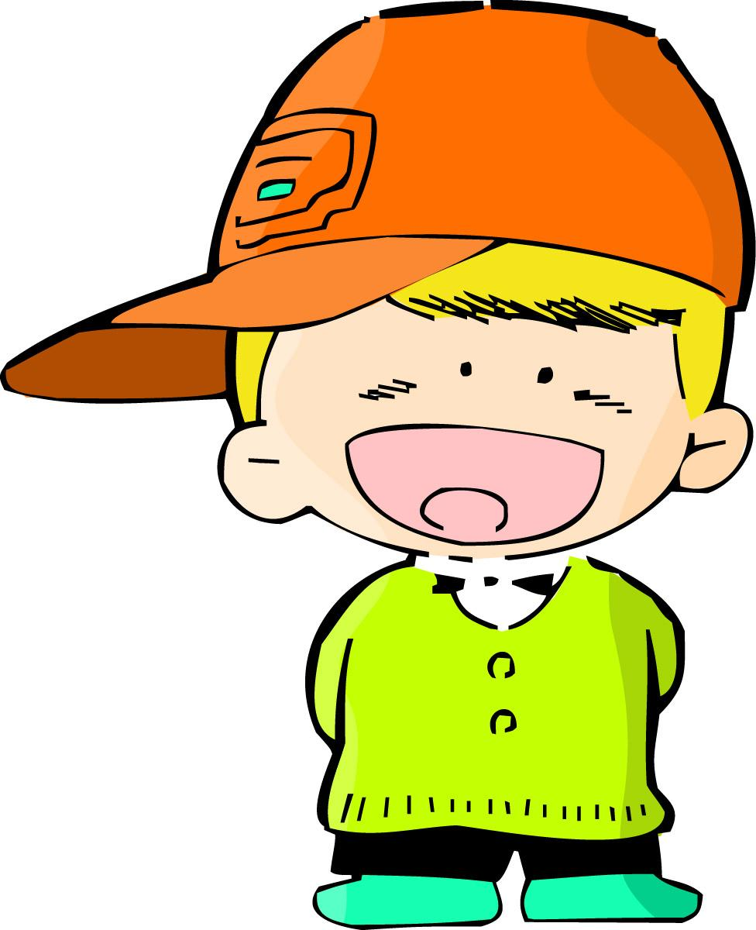
7. Work in pairs. Find out about your partner's hobby and make notes.
Ask your classmates about their hobbies:
What's your hobby?
My hobby is …

Slide 43
When did you start doing it?
I started in…
Why do you enjoy your hobby?
Because it’s…

Slide 44
You can make notes like this:
Name | Hobbies | When | Reason
Li Kai | play music swimming reading | at five | pleasure enjoyment relaxed

Slide 45
Now write a short passage called My classmate's hobby. Use as well as, such as or as a result. Use the following example to help you.
Li Kai is my classmate. He has many hobbies, such as playing music, swimming and reading. But playing music is his favorite hobby. He can play the piano as well as the violin. He started to play music when he was five. He says music has brought him pleasure and enjoyment and always makes him relaxed. He works hard on it. As a result, he has become a young musician in our school.

Slide 46
桂林市桂电中学
2020.8.20录制

