Slide 1

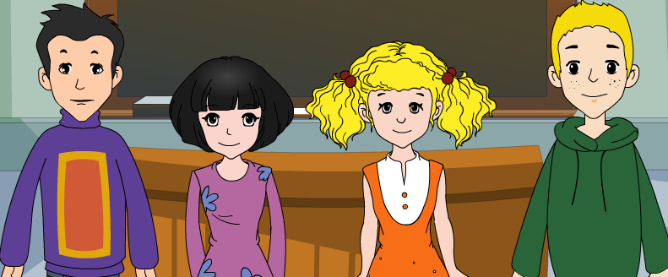
外研版新标准
七年级上册
Module 1
My Classmates
Unit 1
Nice to meet you.

Slide 2
Let's sing !

Slide 3

Words and expressions
Chinese
from
where
how old
year
America
England
China
n. 中国人；汉语
prep. 从……来
adv. 在哪里，去哪里
几岁
n. 年龄；年
n. 美国；美洲
n. 英格兰
n. 中国

Slide 4
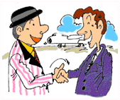
Warming up
Please introduce yourself by answering the questions.
A: What’s your name?
B: My name is_______.
A: Where are you from?
B: I'm from_______.
A: How old are you?
B: I'm _______ (years old).
A: Which class are you in?
B: I'm in Class_____ Grade ____.
A: Nice to meet you.
B: Nice to meet you too.

Slide 5

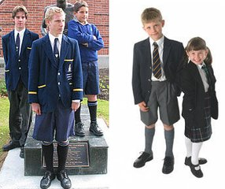
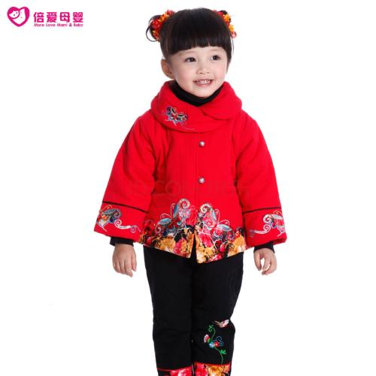
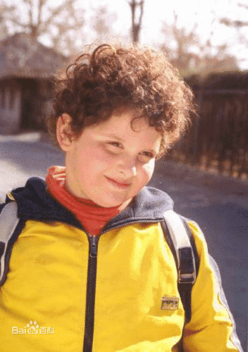
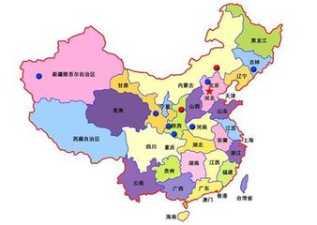
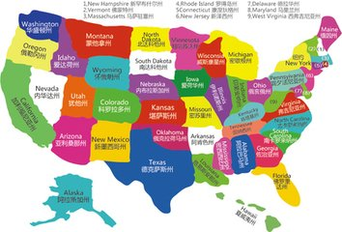
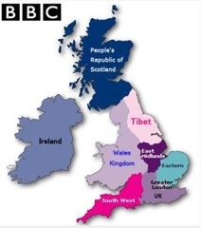
2. Work in pairs
A:What nationality is/ are _______?
B: _______ is / are _______.
OR: ____ is/comes/come from________.
English
Chinese
American
America
China
The Uk

Slide 6


Listening and vocabulary
Listen and check the number of speakers.
1
2
3

Slide 7
Listen again and check the words you hear.
class friend
hello name
teacher too

Slide 8


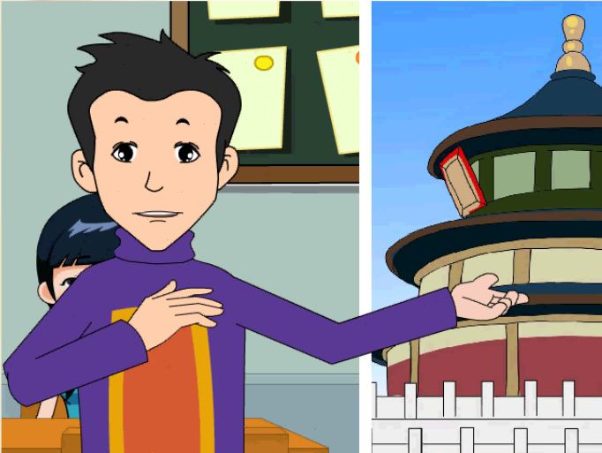

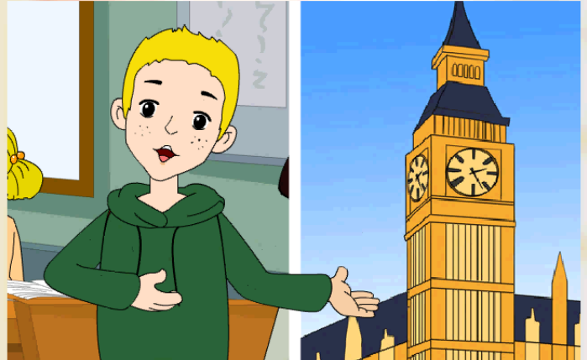
Who are they? Where are they from?
Ms Li
Lingling
Daming
Betty
Tony
Betty Daming Lingling Ms Li Tony

Slide 9
Listen and read.
Everyday English
Hello!
Nice to meet you.
Nice to meet you,too.
Thanks.
Hi!

Slide 10

Now check the true sentences.
Ms Li is from Wuhan.
Lingling is twelve years old.
Daming is thirteen years old.
Tony is not in Class 4.
Betty is from America.

Slide 11
Work in pairs. Choose the correct answer.
1. Is Daming from Beijing?
2. Is Lingling from Beijing?
3. Is Tony from America？
4. Is Betty English?
5. Are you from China?
/ No, he isn’t.
/ No, she isn’t.
Yes, he is. /
Yes, she is./
/ No, I’m not.
Yes, he is.
Yes, she is.
No, he isn’t.
No, she isn’t.
Yes, I am.

Slide 12




Pronunciation
Chinese meet teacher
Betty Tony
English is
friend twelve
thanks

Slide 13
Listen and read.
Everyday English
Hello!
Nice to meet you.
Nice to meet you,too.
Thanks.
Hi!

Slide 14
Talk about your new friends.
Lingling, Beijing, Chinese,
thirteen, Class 4
Daming, Beijing, Chinese,
twelve, Class 4
Betty, America, American
thirteen, Class 4
Tony, England, English,
thirteen, Class 4

Slide 15
Learning to learn
When you introduce(介绍) yourself，you can say:
My name is …I’m…
I’m…years old.
I’m from…

Slide 16
Drills
A: What’s your name?
B: My name is ...
A: Are you English?
B: No, I’m …
A: How old are you?
B: I’m...years old. I’m in Class…
A: Nice to meet you.
B: Nice to meet you, too.

Slide 17
5.Complete the passage with the correct form of the words from the box.
America Chinese England grade student
Betty, Tony, Daming and Lingling are (1)________in Class4 _______7. Betty is from (3)_________ and Tony is from (4)________. Daming and Lingling are (5)_________.
students
Grade
America
England
Chinese

Slide 18
一、根据首字母和英文释义完成单词，看看
你的基础知识掌握好了吗？
1. Hello! Nice to m_______ you.
2. I’m f______ China. I’m C_______.
3. W______ are y_____ from?
4. H______ old are you?
I am twelve y______ old.
5. Welcome to o_______ school.
6. I’m from America. I’m A_________.
7. I’m a student. What a______ you?
eet
rom
hinese
here
ou
ow
ears
ur
merican
bout

Slide 19
二、补全对话，看看你的口语能力提高了吗？
A:Hello! _____________________?
B:My name is Jack.
A:Nice to meet you! B:______________________ !
A:__________________? B: I’m eleven. __________________?
A:I’m eleven, too.
B:I’m Chinese. ____________________?
A:I’m from England. Do you have a friend?
B:Yes. His name is Jack.
A:____________ ! B: Bye!
What’s your name
Nice to meet you, too
How old are you
What about you
Where are you from
Goodbye

Slide 20
考考你的辨别能力！
( ) 1.A. meet B. seat C.speak D.weather
( ) 2.A. listen B. in C. nine D.big
( ) 3.A. bed B. we C. desk D. pen
( ) 4.A. game B. match C.stand D.apple
( ) 5. A. your B. study C. city D. Lucy
D
C
B
A
A

Slide 21

Good bye!
授课教师
桂林市桂电中学 杨晔

