Slide 1
Travel broadens the mind. 旅游开阔眼界。
Everyday English
[ˈbrɔ:dn]

Slide 2
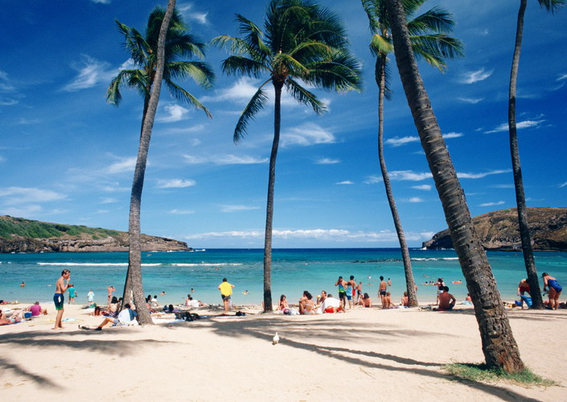
Module
The weather
10
M10U2
The weather is fine all year round.

Slide 3
Some places in the US
纽约市
华盛顿特区
西雅图市
新英格兰（地区）
加利福利亚州
阿拉斯加州
德克萨斯州
New York
Washington DC
[si'ætl]
Seattle
New England
California
Alaska
[ə'læskə]
Texas
['teksəs]

Slide 4
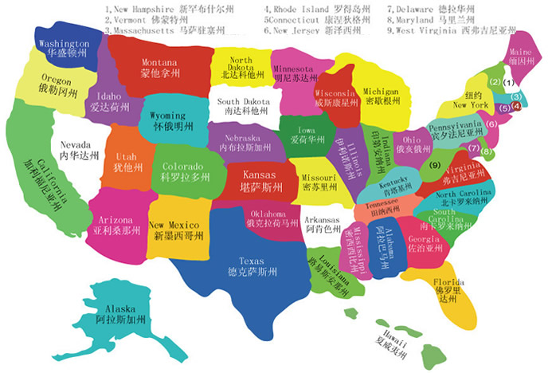
Warming- up
Alaska [ə'læskə]
Seattle[si'ætl]
New England
California
about 3000 miles
Texas['teksəs]

Slide 5
Read Para1& para7
-What's the writer's purpose (目的)of writing this passage?
To tell us the places in the US to see and the best time to go.

Slide 6
Read and complete the table
place | Weather | Best time to visit
New York and Washington DC | Winter:
New England
California
Seattle
Alaska | Summer： Winter
Texas and the southeast
In May or October
Any
time
you
like.
A lot of snow
It gets cooler in September
In September
Fine all year round
All year
Not very cold but it rains a lot
Warm day,
cool night
In summer
Very cold
Very hot and sunny; storms from time to time

Slide 7
Read aloud
The sentences with “so”, “because”,...
1. ...so choose carefully the places to see and the time to go.
2. Bring your camera so you can take photos of the autumn trees.
3. Take your swimming clothes because you might want to go swimming in the sea, even in December.
4. but it rains a lot, so bring an umbrella.
5. So when is the best time to visit US? Any time you like!

Slide 8
Retell
Group-work
You are the guides from the US . Tell the tourists the
places to visit and time to go and things to take.
1.小组合作，分配任务，如每人2段
2.小组合作，可以角色扮演形式呈现课文内容
3. 可补充自己所了解的东西

Slide 9
Retell
Group-work
The US is big country.... so choose ....
place | Weather | Best time to visit | things to take
New York and Washington DC | snow | in May or October
New England | cool | in September | cameras
California | fine | all year round | swimming clothes
Seattle | rain |  | umbrella
Alaska | warm,cool cold | summer | sweater
Texas and the southeast | hot,sunny, storms

Slide 10
4.Complete the sentences
with the correct words' form from the box
brown mile storm sweater umbrella
brown
1 In autumn the leaves turn gold and then ______ .
2 It is about 3,000 ______ from the east coast to the west
coast.
3 You might need a(n) ______ in the evening.
4 Sometimes there are ______ in summer and autumn on
the southeast coast.
5 You will need a(n) ____________ in Seattle because it
rains a lot.
miles
sweater
storms
umbrella

