Slide 1
人教版PEP三年级起点 三年级上册
Unit 5 Let's eat!
Part A
Let’s learn & Let's do
执教教师：周斌 ( Rita )

Slide 2
猜一猜：
What's in the fridge(冰箱)?

Slide 3
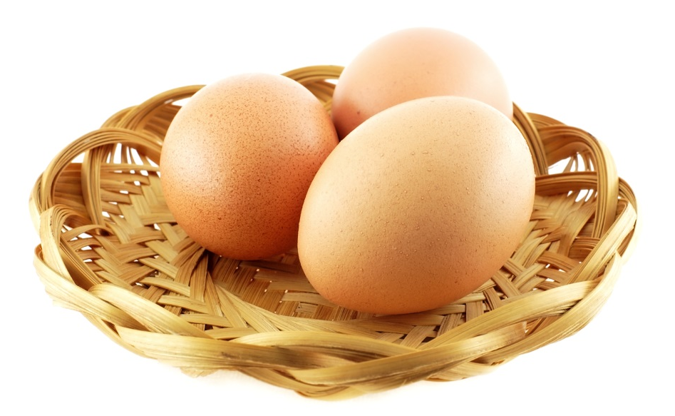
What's in the fridge(冰箱)?
egg
蛋

Slide 4
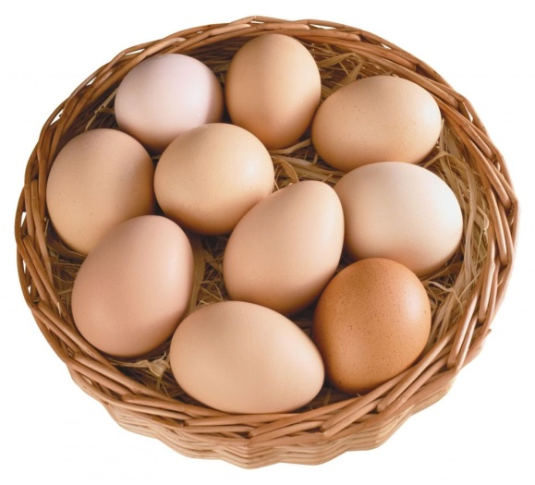
an egg
three eggs
some eggs
Have some eggs!

Slide 5
What's in the fridge(冰箱)?
juice
果汁

Slide 6
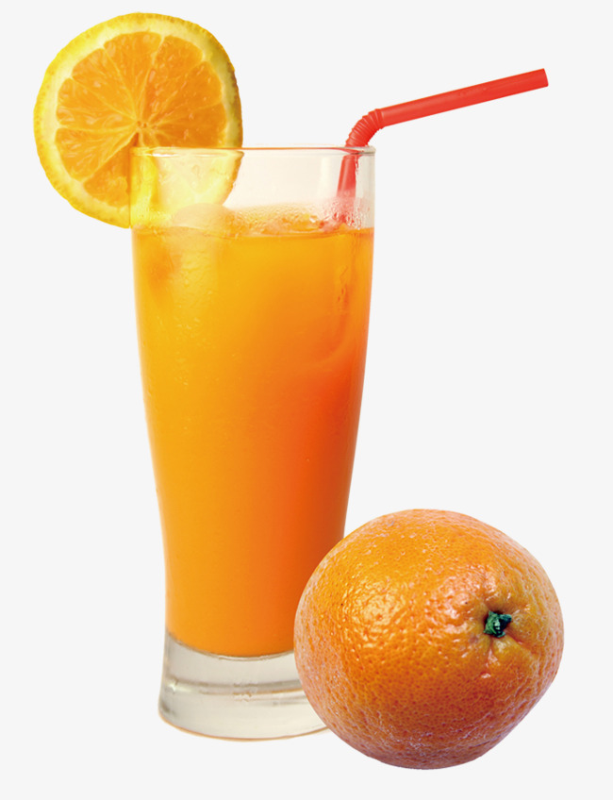
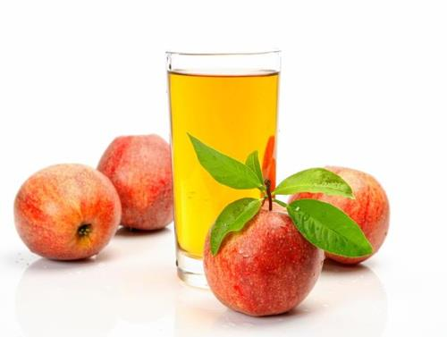
Have some juice!
orange juice
apple juice

Slide 7
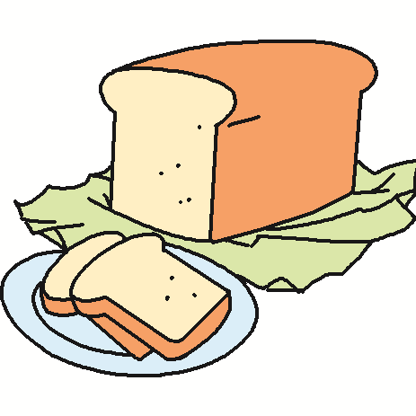
What's in the fridge(冰箱)?
bread
面包
Eat some bread!

Slide 8
What's in the fridge(冰箱)?
milk
牛奶
Drink some milk!

Slide 9
Match.
juice
egg
bread
milk

Slide 10
What is missing?

Slide 11
What is missing?

Slide 12
What is missing?

Slide 13
What is missing?

Slide 14
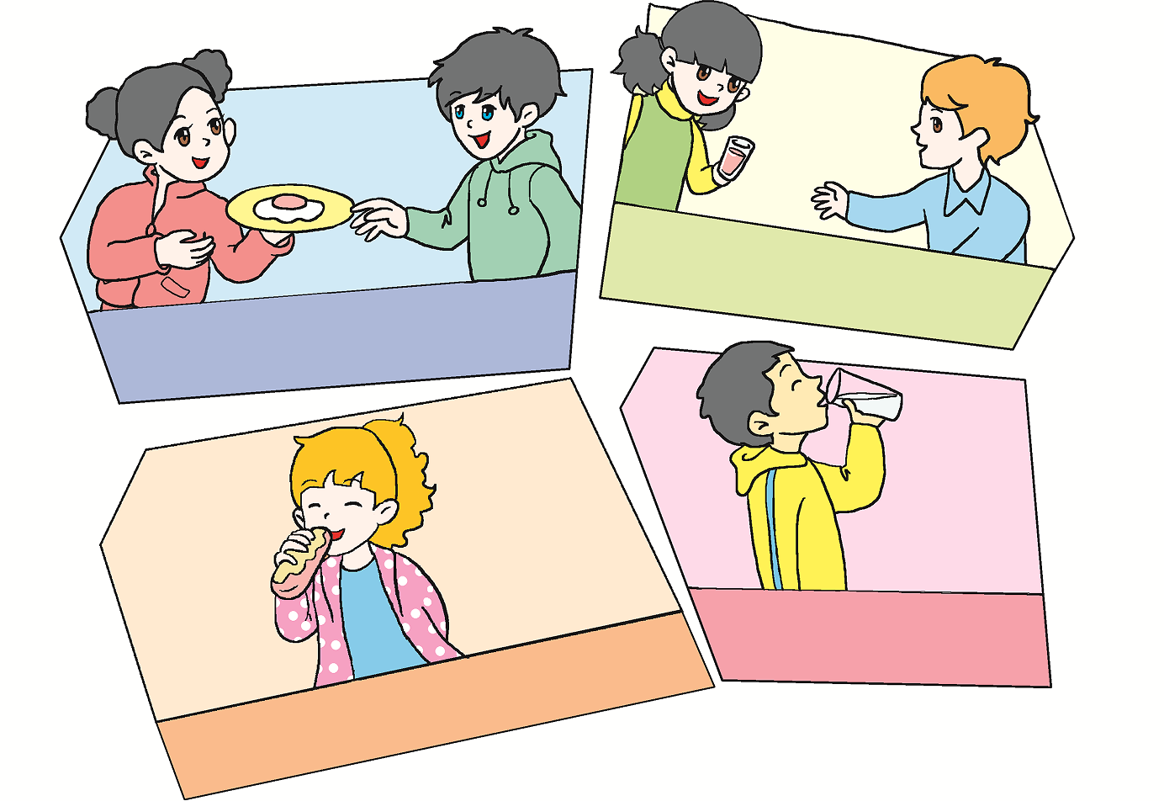
Let's do

Slide 15
Have some juice.
Have some eggs.
Drink some milk.
Eat some bread.

Slide 16
I say you do (我说你做)
Have some eggs.
Have some juice.
Eat some bread.
Drink some milk.

Slide 17
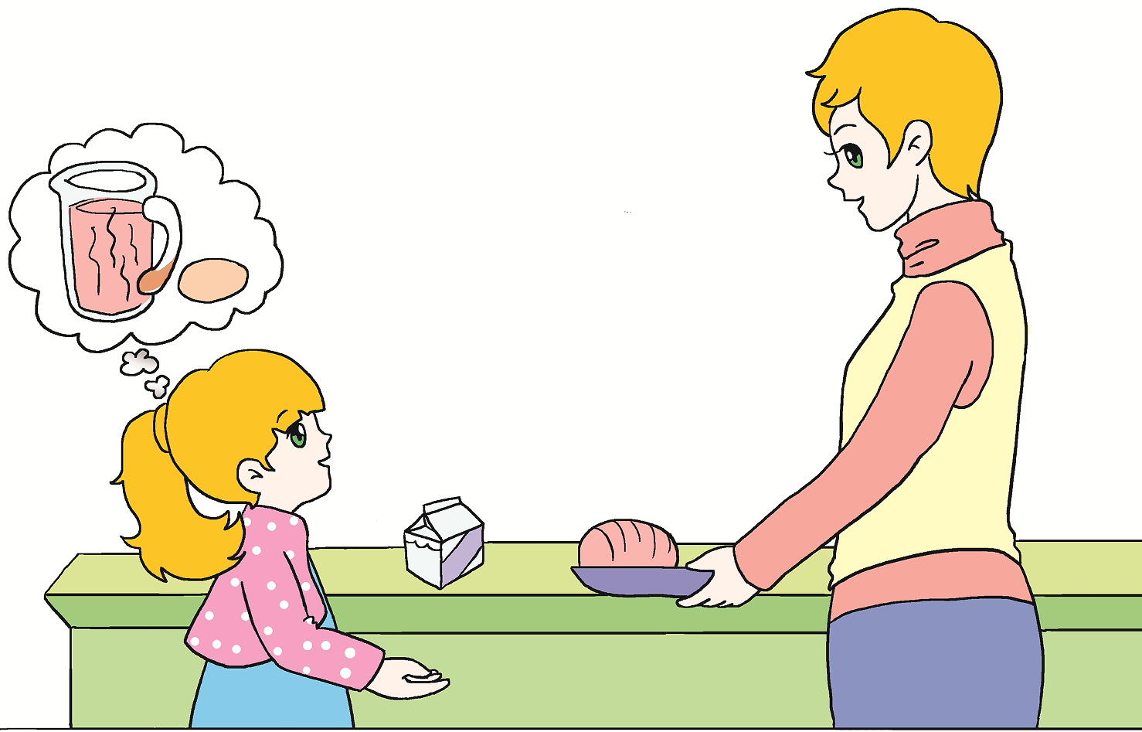
Let’s learn
Have some bread.
juice
状元成才路
状元成才路
状元成才路
状元成才路
状元成才路
状元成才路
状元成才路
状元成才路
状元成才路
状元成才路
egg
状元成才路
状元成才路
状元成才路
状元成才路
状元成才路
状元成才路
状元成才路
状元成才路
状元成才路
状元成才路
状元成才路
状元成才路
状元成才路
状元成才路
状元成才路
状元成才路
状元成才路
状元成才路
状元成才路
状元成才路
状元成才路
状元成才路
milk
状元成才路
bread
状元成才路
状元成才路
状元成才路
状元成才路
状元成才路
状元成才路
状元成才路
状元成才路
状元成才路
状元成才路
状元成才路
状元成才路
状元成才路
状元成才路
状元成才路
状元成才路
状元成才路
状元成才路
状元成才路
状元成才路
状元成才路
状元成才路
Mum, I’m hungry!
状元成才路

Slide 18
Play roles
跟小组内的同伴一起分享你手中的食物! 用I’m hungry. Oh, have some…互相交换和分享你的食物贴纸。
A：I’m hungry.
B: Have some eggs /...
A: Thank you .

Slide 19
Exercises.
( ) 1.当你想请别人吃面包时，你应该说：
A. Have some bread.
B. Drink some bread.
A
( ) 2.当别人请你吃鸡蛋时，你应该说：
A. Have some eggs .
B. Thank you .
B

Slide 20
Summary
Have some bread.
egg
juice
milk
bread
I’m hungry!

Slide 21
Homework
1、抄写今天学的单词四遍。
2、完成APP作业。

Slide 22
录课学校：
弯塘路小学教育集团文华校区
2018年12月6日

