Slide 1
Unit 3
My school calendar
Read and write
梧州市大塘小学 张杰银

Slide 2
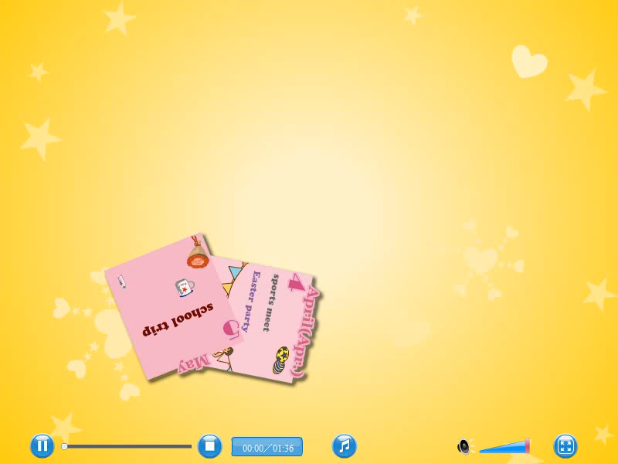
Sing a song

Slide 3
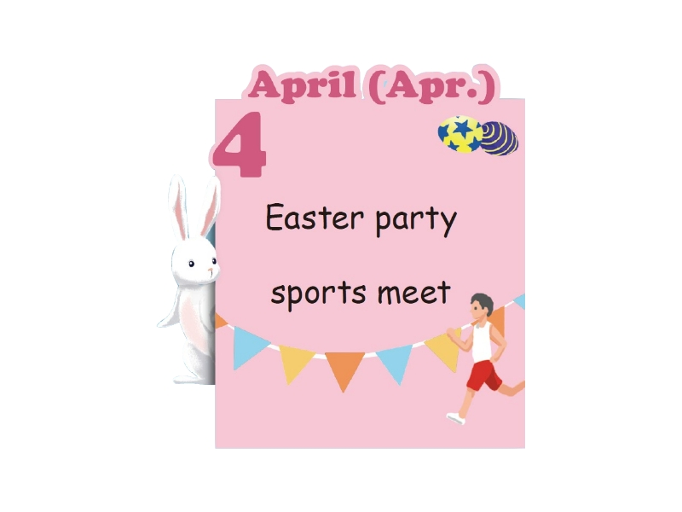
When is Easter ?
It’s in April .

Slide 4


The Easter Holiday is coming !
Our friends will have an Easter party !
Now, let’s have a look!
Let’s go !

Slide 5



Invitation
邀请函
What’s it about ?

Slide 6

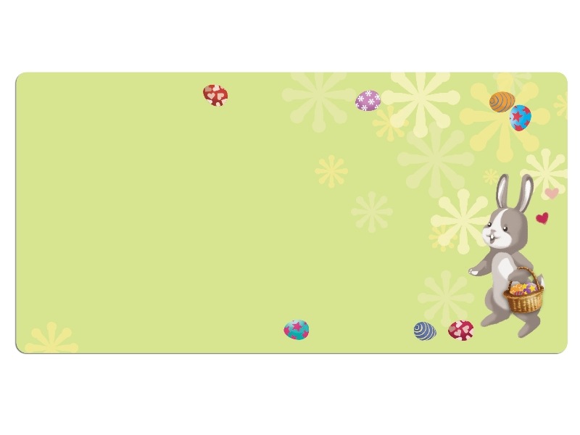
Listen and answer
Easter Party
WHEN: April 12th, 7p.m.
WHY: Easter Holiday
WHERE: Wu Yifan’s home
WHAT: We will play many games. We will roll
Easter eggs. We will look for eggs.
We will eat chocolate eggs.
You will meet the Easter Bunny！
RSVP：Will you come to the party? Please send me an
email at robin@helpsu.cn by March 23rd.

Slide 7

Listen ,read and answer:
1.When is the party ?
2.Why do they have an Easter party?
WHEN: April 12th, 7p.m.
WHY: Easter
WHERE: Wu Yifan’s home
WHAT: We will play many games. We will roll
Easter eggs. We will look for eggs.
We will eat chocolate eggs.
You will meet the Easter Bunny！
RSVP：Will you come to the party? Please send me an
email at robin@helpsu.cn by March 23rd.
holiday
（假期）

Slide 8
Read and answer:
1.Where is the party held? （在哪里举办）
2.What will they do at the party ?（他们将会做什么？）
WHEN: April 12th, 7p.m.
WHY: Easter Holiday
WHERE: Wu Yifan’s home
WHAT: We will play many games. We will roll
Easter eggs. We will look for eggs.
We will eat chocolate eggs.
You will meet the Easter Bunny！
RSVP：Will you come to the party? Please send me an
email at robin@helpsu.cn by March 23rd.

Slide 9
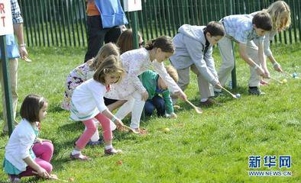
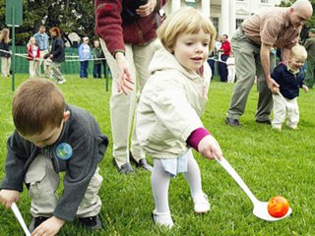
What will you do ?
We will play many games（游戏） .
We will roll Easter eggs.
（滚动）

Slide 10
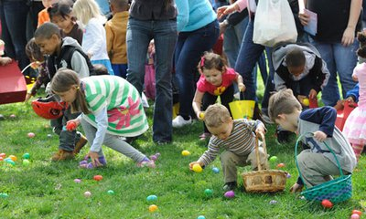
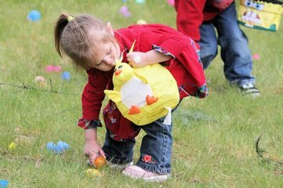
What will you do ?
We will look for eggs .
（寻找）

Slide 11
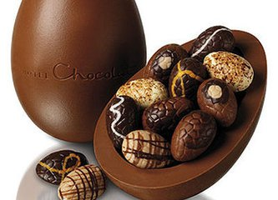
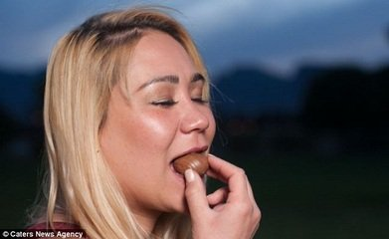

What will you do ?
We will eat chocolate eggs .
（巧克力）

Slide 12
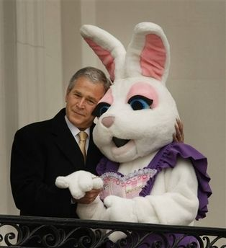
What will we do ?
You will meet the Easter Bunny !
（见到）
（兔子）

Slide 13
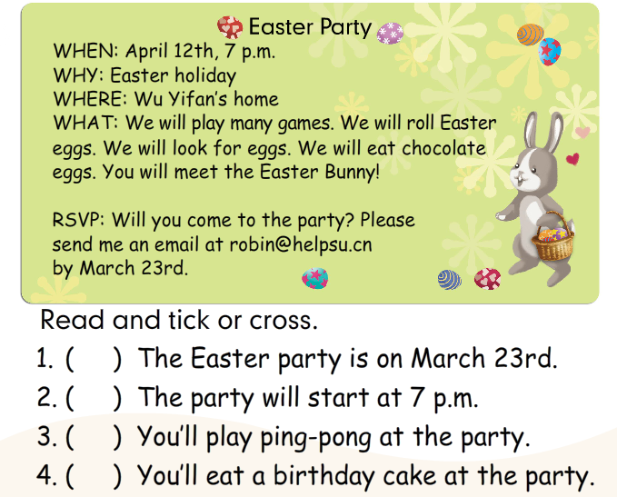
Read and tick or cross .
Check and give us your reasons.
在……之前
×
√
×
×

Slide 14
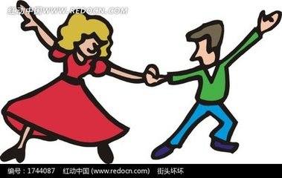
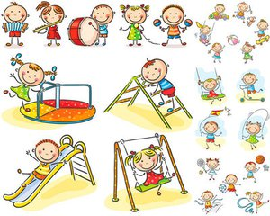
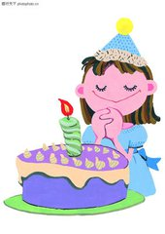

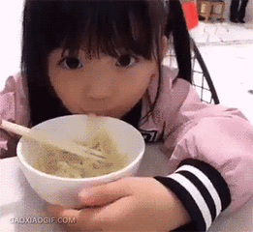
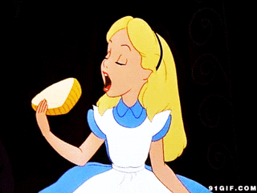
Try to discuss
What will you do if you have a birthday party ?
I will__________
dance
play games
I will__________
I will__________
make a wish
sing the birthday song
eat noodles
eat a birthday cake

Slide 15

Try to write
What will you do if you have a birthday party? Write three sentences.
dance
play games
make a wish
sing the birthday song
eat noodles/a birthday cake
1.______________
2.______________
3.______________
I will dance.
I will make a wish.
I will eat noodles.

Slide 16
Try to write
What will you do if you have a birthday party? Write three sentences.
dance
play games
make a wish
sing the birthday song
eat noodles/a birthday cake
1.______________
2.______________
3.______________

Slide 17

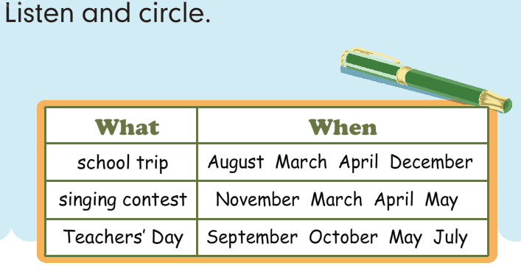
Let’s check

Slide 18
Listen again and answer the questions.
1. What will the students do in May?
___________________________
2. What will they do in December?
___________________________
They will visit a farm.
They will have a party.

Slide 19
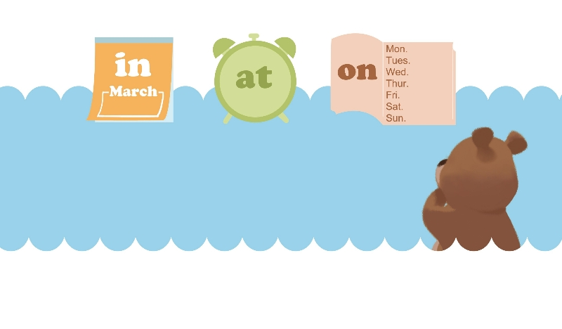
Let’s wrap it up
Fill in the blanks.
in
1. We will have an English party ____February.
2. I get up ____ 7 o’clock every day.
3. What do you have _____ Tuesdays?
at
on

Slide 20

in后面常与年、月、季节连用；
at后面常与具体的时刻连用；
on后面常跟具体哪一天、星期几、节日；

Slide 21
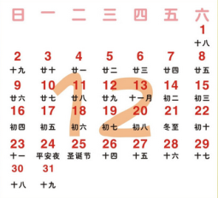
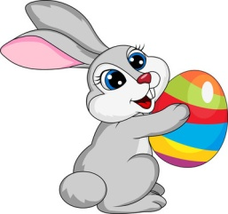
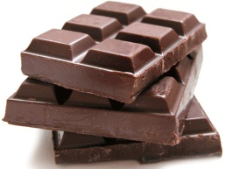

1、看图连线。
(1) chocolate A.
(2) bunny B.
(3) December C.
(4) October D.

Slide 22
2、为下列短语选择合适的中文意思。
(1) in November A. 国庆节
(2) look for B. 暑假
(3) National Day C. 最喜爱的季节
(4) The Great Wall D. 寻找
(5) favourite season E. 在十一月
(6) summer vacation F. 长城

Slide 23
3、选择合适的介词补全句子。
on; in; at
(1) What do you usually do _______the weekend?
(2) I will have a maths test _______ May.
(3) He usually goes to bed_______ 9 o’clock.
(4) My brother often goes swimming _______ the river.
(5) Let’s go to the party _______ Monday.
on
in
at
in
on

Slide 24
Summary
今天，我们通过学习知道：
in后面常与年、月、季节连用；
at后面常与具体的时刻连用；
on后面常跟具体哪一天、星期几、节日

Slide 25
Homework
1.跟读书P29两次。
2.用所学句型“I will … / We will…”说一说你将在周末要做的事情。
3.熟记“in , on , at”的用法。

