Slide 1

Unit 5 Whose dog is it？
A L et’s talk
大塘小学 冯雯

Slide 2
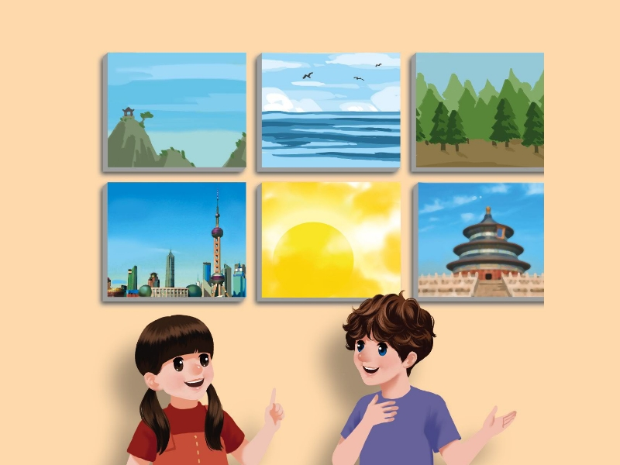


Slide 3
Art show

Slide 4
Are these all ours？

Slide 5
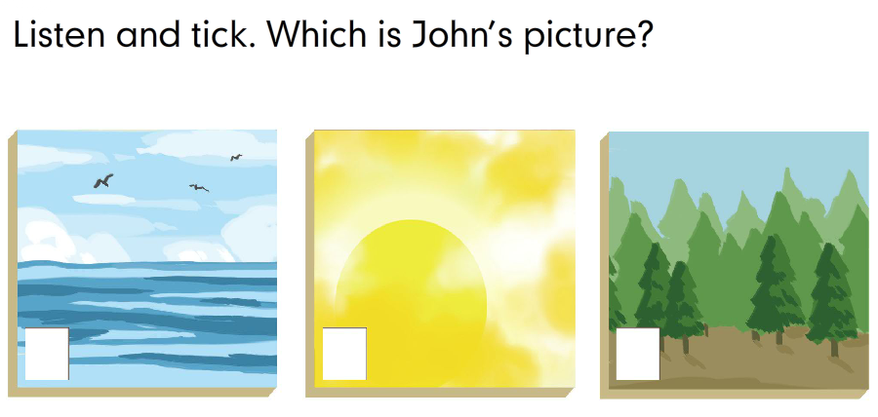
Let’s try
√

Slide 6
Whose is it？
It’s Mike’s.

Slide 7
Whose is it？

Slide 8
Let’s talk
点击图片进行课文朗读

Slide 9
Let’s talk
Chen Jie: The yellow picture is mine. Are these all ours?
Mike: Yes , they are.
Chen Jie: Wow! That picture of Beijing is beautiful.
Whose is it?
Mike: It’s Zhang Peng’s.
Chen Jie: Look! There is a picture of Shanghai, too.
Mike: It’s Yifan’s.
Chen Jie: Oh, yes! It’s his.

Slide 10
Look！The yellow picture
Whose is it？
It’s Chen Jie’s.
The yellow picture is mine.

Slide 11
Look！That picture of BeiJing
Whose is it？
It’s Zhang Peng’s.

Slide 12
Look！That picture of Shanghai
Whose is it？
It’s Yifan’s.
It’s his.

Slide 13

Let's read:
tips:
1.模仿录音，有感情朗读。
2.注意语音、语调和停顿。

Slide 14

Role-Play

Slide 15


"Follow the dog"
加速游戏
快速读出下面的句子。
The yellow picture is mine.
Are these all ours？Yes，they are.
Whose is it？ It’s Zhang Peng’s.
That picture of Beijing is beautiful.
There is a picture of Shanghai，too.

Slide 16
Let’s fill the blank according to the talk.
Chen Jie: The yellow picture is . Are these ?
Mike: Yes , they are.
Chen Jie: Wow! That picture of Beijing is beautiful.
is it?
Mike: It’s .
Chen Jie: Look! There is Shanghai, too.
Mike: It’s Yifan’s.
Chen Jie: Oh, yes! It’s .
mine
all
ours
Whose
Zhang Peng’s
a picture of
his

Slide 17

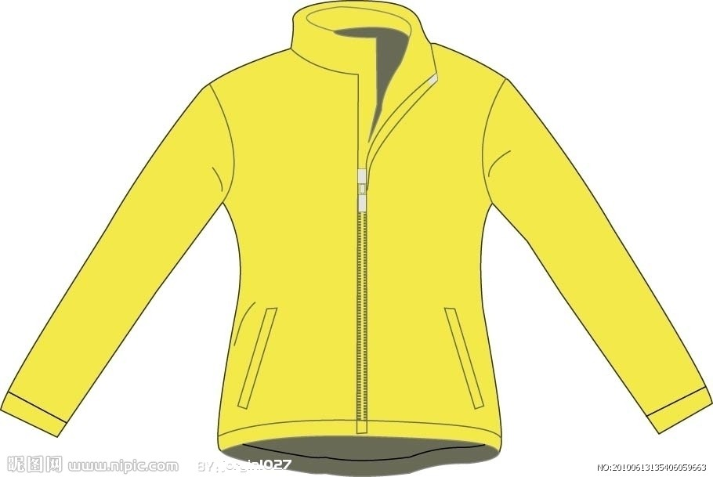

Whose？

Slide 18
Group Work : 创编对话
A: Is this ... yours？
B：No，it isn’t.
A: Whose is it？.
B：It’s … ’s. It’s his/hers.

Slide 19

Homework
1.背诵Let’s talk.
2.创编对话：
A: Is this ... yours？
B：No，it isn’t.
A: Whose is it？.
B：It’s … ’s. It’s his/hers.

