Slide 1
Unit 5 Whose dog is it？
A L et’s learn
大塘小学 冯雯

Slide 2
Sharp eyes
thin
fat
short
big
tall
cute
small
long

Slide 3
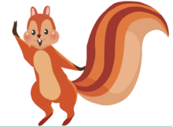
Hello!
Hi!
Where are they going today?

Slide 4
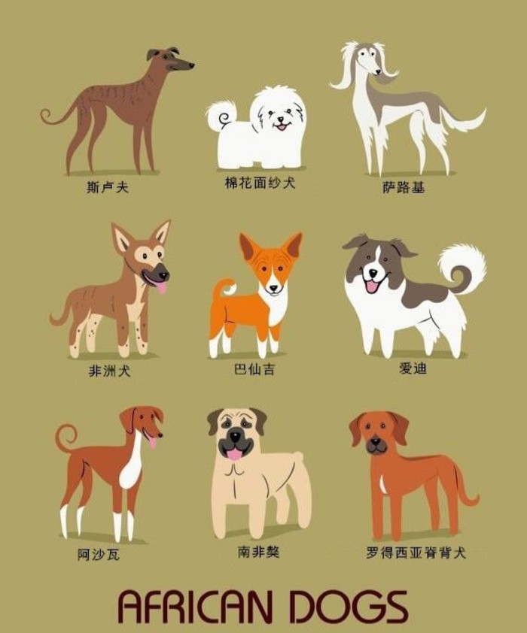
Dog Show
They are watching the dog show!

Slide 5
Whose?

Slide 6
Whose dog is it?

Slide 7
Whose dog is it?
It’s Zoom’s.

Slide 8
Whose dog is it?
It’s Zoom’s.
your dog yours
Look！That’s my dog!
Yes！It’s your dog! The dog is yours!

Slide 9
Whose dog is it?
It’s ChenJie’s.

Slide 10
Whose dog is it?
It’s ChenJie’s.
her dog hers
It’s her dog!
The dog is hers!

Slide 11
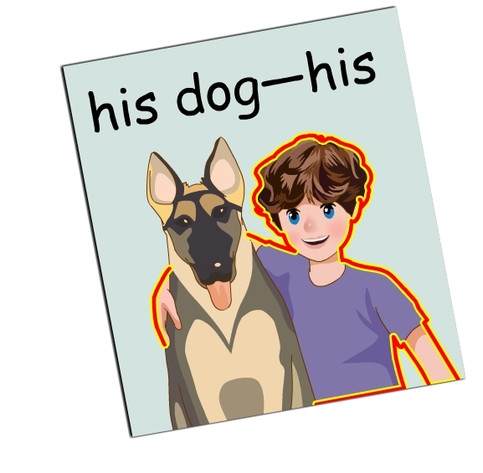
Whose dog is it?
It’s Mike’s.
his dog his
It’s his dog!
The dog is his!

Slide 12
Whose dog is it?
our dog ours
their dog theirs
It’s our dog!
The dog is ours!
It’s their dog!
The dog is theirs!

Slide 13
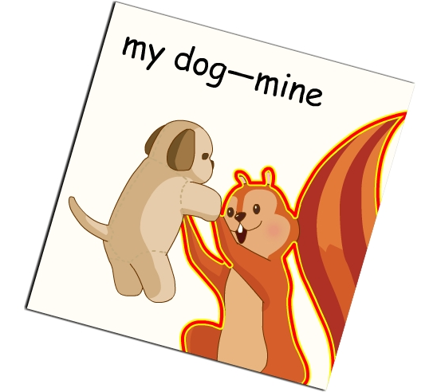
Whose dog is it?
It’s my dog!
The dog is mine!
my dog mine

Slide 14
It’s your dog!
The dog is yours!
It’s her dog!
The dog is hers!
your dog yours
her dog hers

Slide 15
It’s his dog!
The dog is his!
It’s our dog!
The dog is ours!
It’s their dog!
The dog is theirs!
his dog his
our dog ours
their dog theirs

Slide 16
It’s my dog!
The dog is mine!
my dog mine

Slide 19
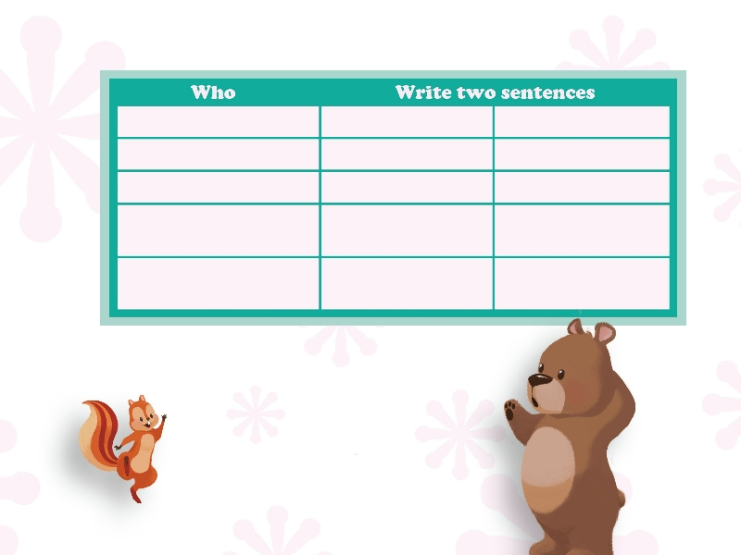
Amy
It’s her book.
The book is hers.
John
It’s his book.
The book is his.
John and Amy
It’s their book.
The book is theirs.
（your name）
It’s my book.
The book is mine.
（you and your partner）
It’s our book.
The book is ours.
Whose book is that？
It’s Amy’s book.
Ah！The book is hers.

Slide 20
Amy
It’s her book.
The book is hers.
John
It’s his book.
The book is his.
John and Amy
It’s their book.
The book is theirs.
（your name）
It’s my book.
The book is mine.
（you and your partner）
It’s our book.
The book is ours.
Find the rules（找规律）
her
his
their
my
our
your
hers
his
theirs
mine
ours
yours
＋ 物品
不加 物品

Slide 21
Practice
一、单项选择。
1.—Is the dog Zoom’s?
— Yes, it’s ________.
A. his B. him C. he
2.—Whose books are these?
—They are ___________ .
A. my B. mine C. me
3.— ___________ is it?
—It’s Zhang Peng’s.
A. How B. Whose C. What
A
B
B

Slide 22
二、根据句意，填上合适的物主代词。
hers
1.That is Amy’s book. It’s .
2.They’re Mike’s and Amy’s dogs. They are
.
3.— Are these pictures all _____ ?
— No, they are not. My pictures are over
there.
theirs
yours

Slide 23
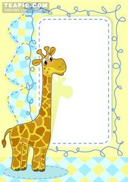
Homework
1.利用his-his、her-hers、my-mine、their-theirs、our-ours、your-yours分别造句.
2.熟读并背诵书P47-48.

