Slide 1
Unit 5 Whose dog is it？
B L et’s talk
大塘小学 冯雯

Slide 3
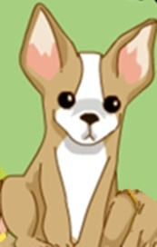
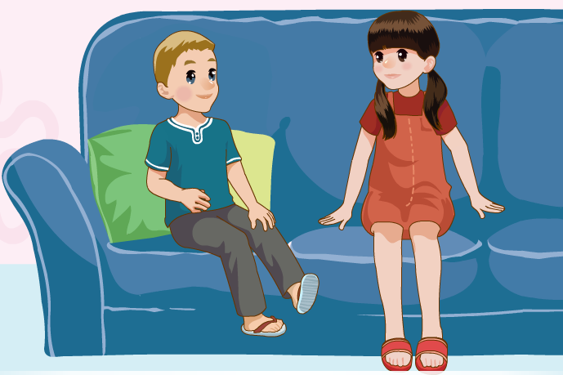
Today，Sam is at ChenJie’s home.
Guess，what are talking about？

Slide 4
Where is Fido？
Is he in the living room?
Is he in the kitten?
Is he in the bedroom?

Slide 5
Let’s try
√

Slide 6
Let’s try
Does Sam play with Fido?
No, he doesn’t.
√

Slide 7
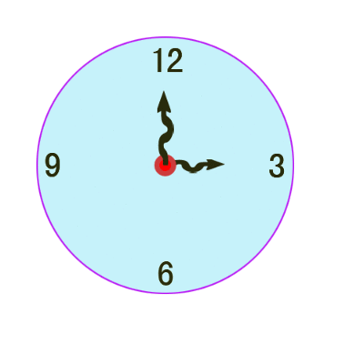
After a while…

Slide 8
Where is Fido ？
now
What is he doing?
Is Fido sleeping in the living room？

Slide 9
Where is Fido ？
now
What is he doing?
Is Fido sitting in the bedroom？

Slide 10
Where is Fido ？
now
What is he doing?
Is Fido drinking water in the kitten？

Slide 11
Let’s talk

Slide 12
Where is Fido ？
now
Fido is in the kitten.
What is he doing?
Fido is eating in the kitten.

Slide 13
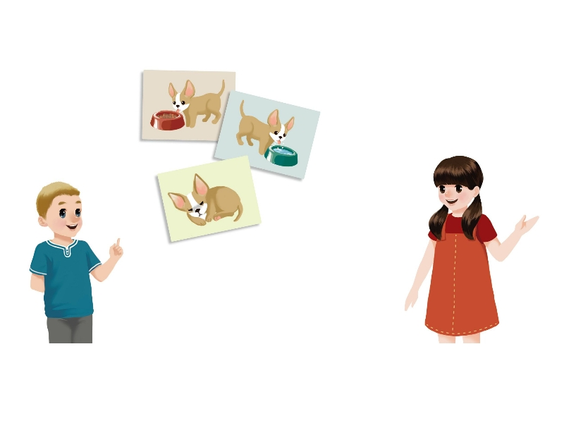
Let’s talk
Guess，what will Sam do with Fido？

Slide 14
Let’s talk

Slide 15
Let’s talk
Guess，what will Sam do with Fido？
Can I play with him now ?
Can I take him to the park?
Sam will play with Fido in the park .
He will play with Fido in the park .

Slide 16
Let's read:
tips:
1.模仿录音，有感情朗读。
2.注意语音、语调和停顿。

Slide 17
Role-Play

Slide 18
Sam is at Chen Jie’s home.
Sam: Where is Fido now?
Chen Jie: He’s in the kitchen.
Sam: Is he drinking water？
Chen Jie: No, he isn’t. He’s eating.
Sam: Can I play with him now?
Chen Jie: Yes. Can you take him to the park？
Sam: Of course! Fido, come here!
Fido: Woof, woof!

Slide 19
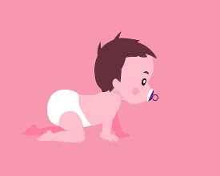
Look and say
Is the ＋动词ing？ Yes，it is./No,it isn’t.
Is the baby climbing？
Yes, it is.

Slide 20
Look and say
Is the ＋动词ing？ Yes，it is./No,it isn’t.
Is the panda climbing？
No, it isn’t.

Slide 21
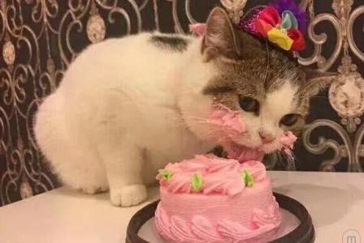
Look and say
Is the ＋动词ing？ Yes，it is./No,it isn’t.
Is the cat drinking？
No, it isn’t.

Slide 22
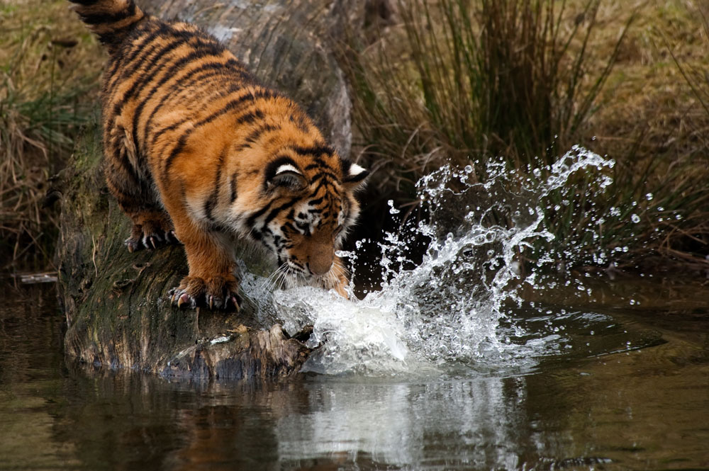
Look and say
Is the ＋动词ing？ Yes，it is./No,it isn’t.
Is the tiger drinking？
Yes, it is.

Slide 23
Look and say
Are the ＋动词ing？
Yes，they are. / No, they aren’t.
Are the rabbits jumping？
Yes, they are.

Slide 24
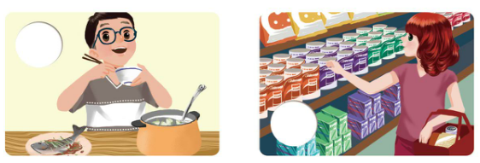
Let’s check
Listen and number.
3
2
4
1

Slide 25
Listen again and choose the right answers.
1.What is Amy doing？
A. She is shopping.
B. She is eating lunch.
2.Whose bike is it?
A. It is his.
B. It is hers.

Slide 26
3.What is the cat doing？
A. It is climbing.
B. It is sleeping.
4.What is Wu Yifan doing now?
A. He is playing.
B. He is eating.

Slide 27
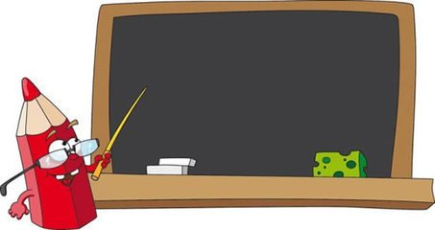
Homework
1.背诵Let’s talk.
2.造句：Is … ＋ 动词ing？
Yes，it is./No,it isn’t.
Are … ＋ 动词ing?
Yes ,they are./ No, they aren’t..

