Slide 1
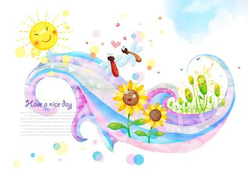
Unit 5 Whose dog is it？
B Read and write
大塘小学 冯雯

Slide 2
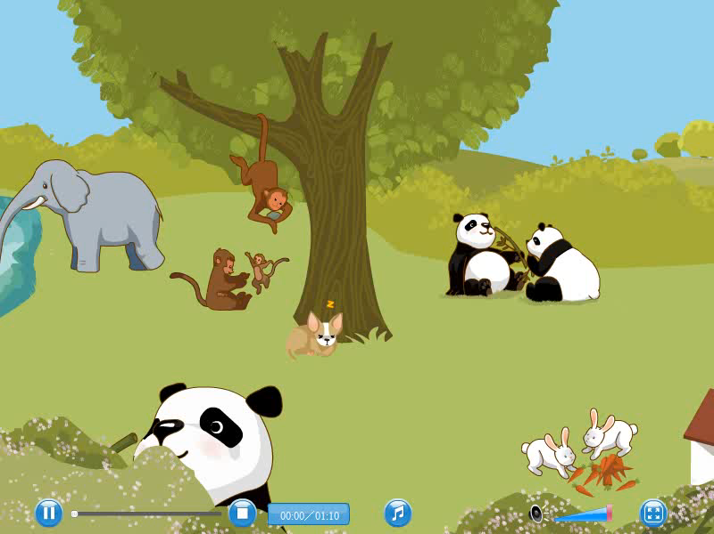

Slide 3
Please read.
dancing
looking
eating
walking
climbing
flying
running
swimming

Slide 4
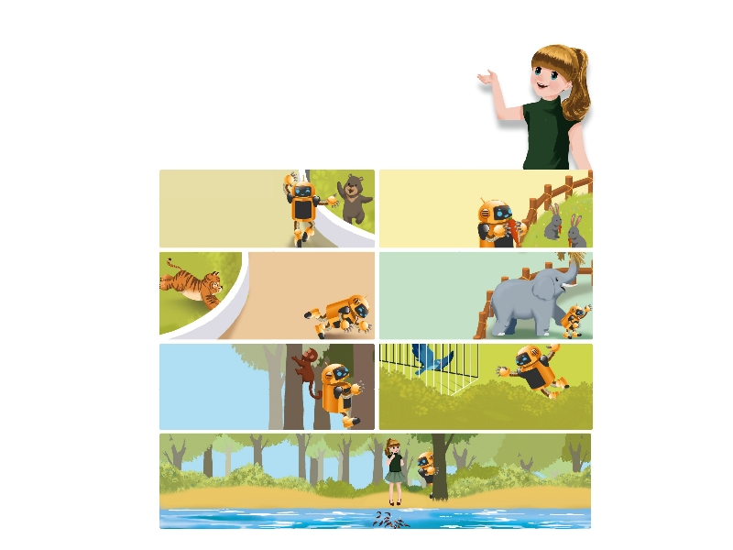
Look! Sarah and Robin are at the zoo.
Robin is excited（激动）！

Slide 5
Question1：
How many animals can Robin see at the zoo？

Slide 6


Slide 7
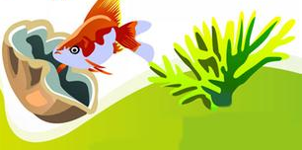
Question1：
How many animals can Robin see at the zoo？
a bear
rabbits
a tiger
an elephant
a monkey
a bird
a fish

Slide 8
Question2：
What are the animals doing？

Slide 9
Question2：
What are the animals doing？
What is the bear doing？
What is Robin doing？
The bear is dancing.
Robin is dancing like a bear .

Slide 10
Question2：
What are the animals doing？
What are the rabbits doing？
What is Robin doing？
Robin is eating like a rabbit .
The rabbits are eating.

Slide 11
Question2：
What are the animals doing？
What is Robin doing？
What is the tiger doing？
The tiger is running.
Robin is running like a tiger .

Slide 12
Question2：
What are the animals doing？
What is the elephant doing？
What is Robin doing？
The elephant is walking.
Robin is walking like an elephant .

Slide 13
Question2：
What are the animals doing？
What is Robin doing？
What is the monkey doing？
Robin is climbing like a monkey .
The monkey is climbing.

Slide 14
Question2：
What are the animals doing？
What is Robin doing？
What is the bird doing？
The bird is flying.
Robin is flying like a bird .

Slide 15
Question3：
Is Robin swimming like a fish？
No！
How do you know？
No！No！I don’t want to be a fish！

Slide 16

Let's read:
tips:
1.模仿录音，有感情朗读。
2.注意语音、语调和停顿。

Slide 17

Role-Play

Slide 18
Question4：
Answer the questions.
1.Where are Sarah and Robin?
They are at .
2.What are the animals doing in the story?
The bear is .
The rabbits are .
The tiger is .
The elephant is .
the zoo
dancing
eating
running
walking

Slide 19
Question5：
Let’s write
Look！This is a zoo. The is .
The is .
The are .
The are .
They are so cute.

Slide 20
Let’s wrap it up
Complete the sentences.
his
his
her
hers
my
mine
their
theirs
our
ours
your
yours
1.Amy: Whose English book is that?
John: It’s Miss White’s book.
It’s .
Amy: Whose storybook is this?
John: It’s Mr. Zhang’s .It’s _______.
hers
his

Slide 21
2.Wu Yifan: Where is my pen?
I can’t find it.
Sarah: Here’s one.
Is this pen?
Wu Yifan: Yes, it’s ______ .
Thank you.
your
mine

Slide 22
3.Grandpa: Whose rabbits are these?
Robin: These are Yifan’s.
Grandpa: Oh, these are rabbits.
Robin: Look! The rabbits are eating
carrots now.
his
theirs

Slide 23
4.Mike: Mum, my dog is so cute.
I love him so much.
Mum: My dear, it’s not only dog.
It’s also mine.
Mike: Yes, Mum. He’s dog.
your
ours

Slide 24
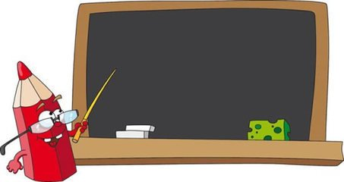
Homework
1.熟读read and write。
2.学会用 ：称谓＋is ＋ 动词ing 或者
称谓＋are ＋ 动词ing来描述正在发生
的动作。

