Slide 1
Unit 5 Whose dog is it？
B L et’s learn
大塘小学 冯雯

Slide 3
What’s his name？
Whose dog is it？
His name is Fido.
It’s ChenJie’s.

Slide 4
Where is Fido？
Fido is sleeping on ChenJie’s leg.
sleeping

Slide 5
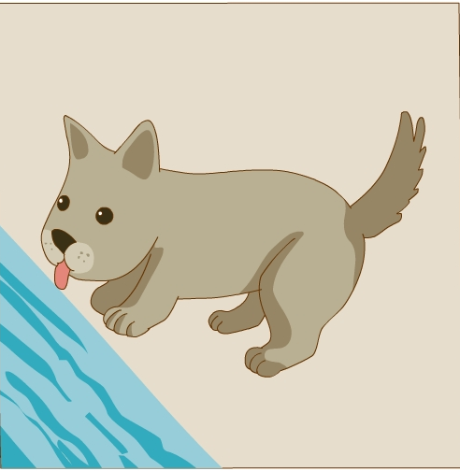
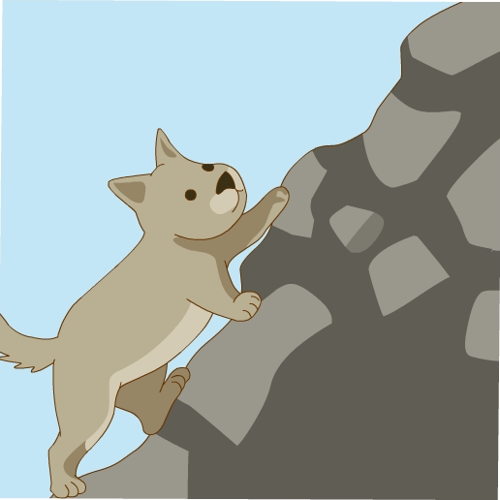
tired
累的

Slide 6
climbing
drinking
eating
Fido is climbing.
He is drinking.
He is seating.

Slide 7
There also are some rabbits.

Slide 8
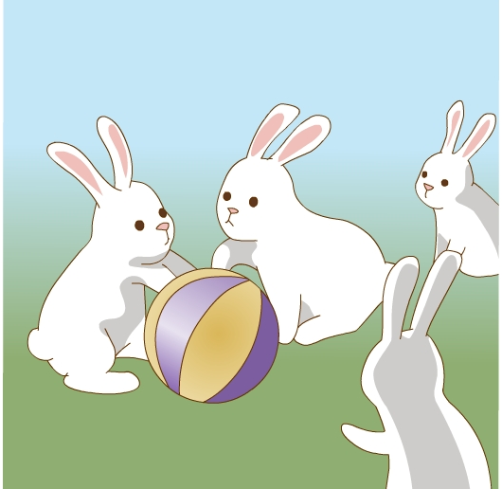
They are jumping.
They are playing.
jumping
playing
sleeping
They are sleeping.

Slide 10
Oh，Fido is sleeping.
Yes. He is so cute.
No. They’re playing with each other.
Are these rabbits eating？

Slide 12
Please read again.
climbing
jumping
eating
drinking
playing
sleeping

Slide 13
Please read again.
reading
listening
taking
cleaning
dancing
running

Slide 14
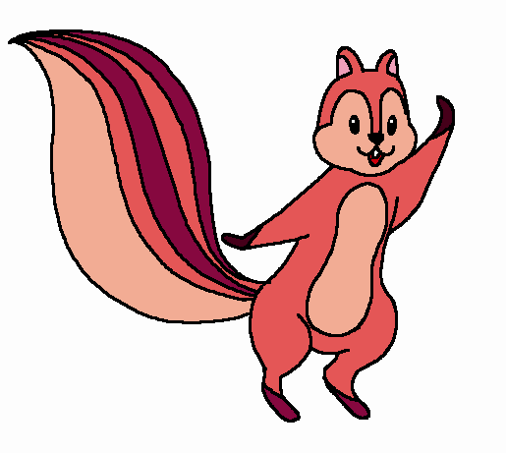
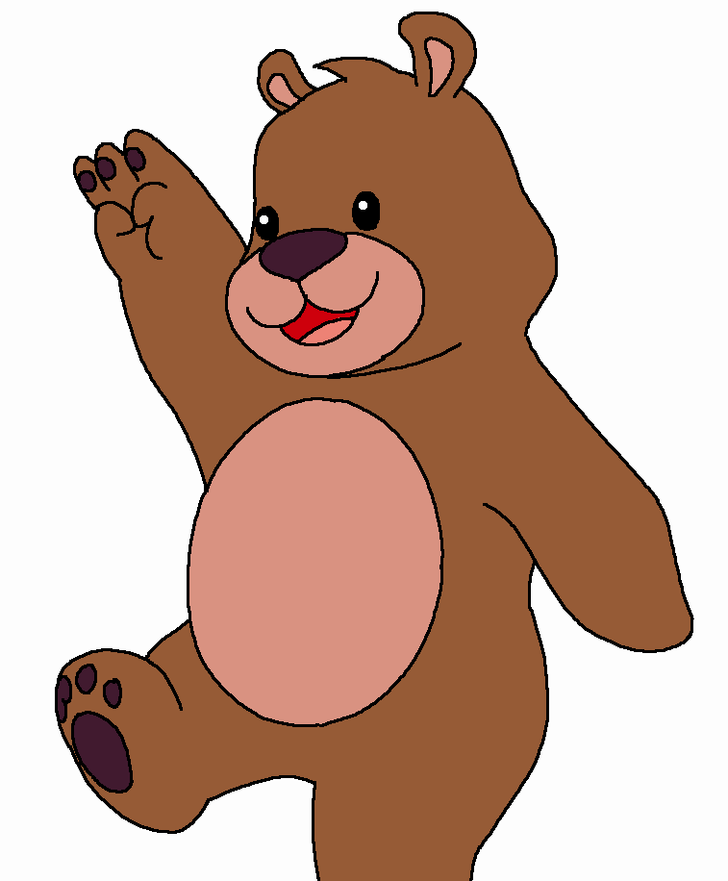
Let’s play
at school
is sleeping
Mike
Mike
is sleeping
at school
Chen Jie
with my
father
is climbing
is running
Oliver
under
the tree
is reading
is listening
to music
Wu Yifan
is jumping
in the park
John
is eating
in the
living room
Zhang Peng
is playing

Slide 15
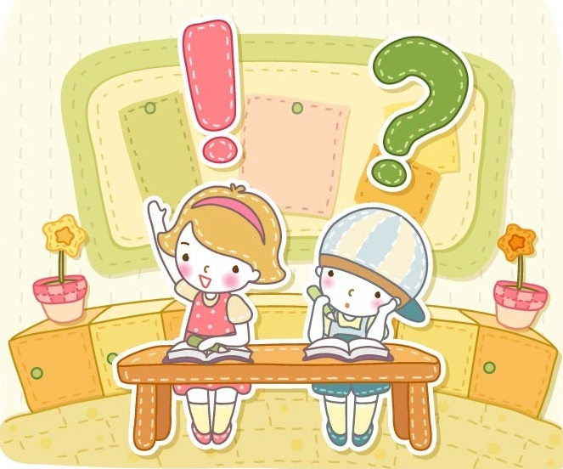
think
你还能仿照上面的方式造出句子吗？

Slide 16
Practice
一、中英互译。
1. a picture of…
2. 在厨房里
3. 喝水
4. listen to music
5. each other
一幅……的画
in the kitchen
drink water
听音乐
相互

Slide 17
二、单项选择。
C
1. Oliver _________ in the park now.
A. climb B. climbs C. is climbing
2. ______ these dogs sleeping?
A. Are B. Is C. Do
3. They’re playing ______ each other.
A. to B. with C. and
A
B

Slide 18
Homework
1.利用climbing、eating、playing、jumping、drinking、sleeping分别造句.
2.熟读并背诵书53

