Slide 1
Unit 5 Whose dog is it？
A Let’s spell
大塘小学 冯雯

Slide 2
Let’s chant

Slide 3
Let’s chant
I think I can sing.
I think I can sing.
I think I can sing a song.
I think I can sing.
I think I can sing.
A song that is not too long.

Slide 4
ng
nk
sing
song
think
long
I think I can sing.
I think I can sing.
I think I can sing a song.
I think I can sing.
I think I can sing.
A song that is not too long.

Slide 5
long
sing
ring
young
think
ink
trunk
pink

Slide 6
ng
nk
sing
song
think
long
ring
ink
trunk
young
pink
ng
/ ŋ /
nk
/ ŋk/

Slide 7
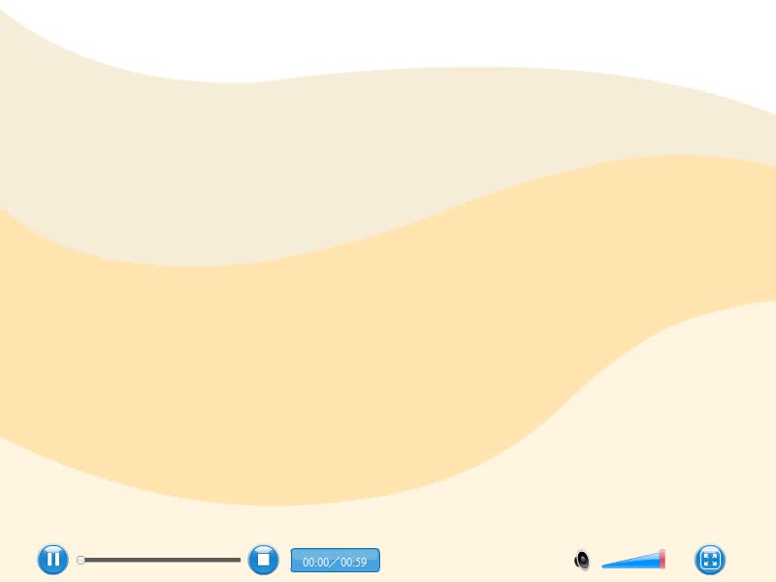

Slide 8
Read, write and listen.
trunk
song
ring
think
sing
thing
drink
pink
thank
morning
long
bank

Slide 9
-ng
-nk
song
ring
sing
trunk
think
drink
thing
morning
pink
thank
bank
long

Slide 10
Look and Say

Slide 11
ng
/ ŋ /
morning
king
thing
strong
jumping
singing
drinking
swimming

Slide 12
nk
/ ŋk /
monkey
thank
drink
bank
sink
link
tank
hank

Slide 13
Play a game
Bingo or Uh-oh
听到含有ng的单词说Bingo！
听到含有nk的单词说Uh-oh！

Slide 14
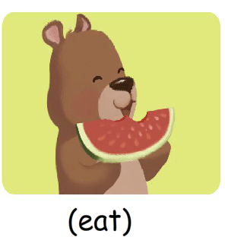
Look！Zoom is eating .

Slide 15
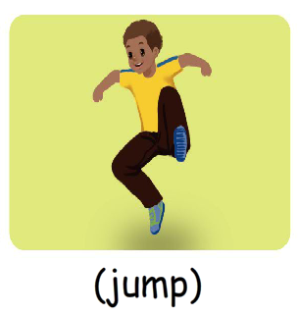
Look and write(P50)
Zoom is eating .
John is jumping .

Slide 16
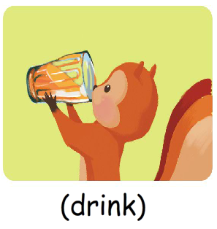
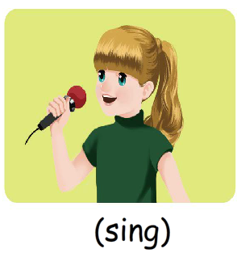
Look and write.
Zip is drinking.
Sarah is singing.

Slide 17
判断划线部分的读音是（ √ ）否（ × ）
1. long sing （ ）
√
2. English thing （ ）
×
√
×
3. think bank （ ）
4. pink know （ ）
√
×
5. ink drink （ ）
6. young thank （ ）

Slide 18
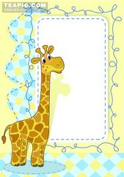
Homework
1.利用singing、eating、jumping、drinking分别造句.
2.熟读书50单词，并掌握ng、nk的发音。

